Slide 1

School of Computer Engineering
Presentation for TY Mini Project (Review 1)
Personalization of Information
Students Name:
Aditi Pandey (SCET TY 081)
Kaustubh Patil(SCET TY 059)
Sanskar Sharma(SCET TY 090)
Guide:
Mrs. Mayura Kulkarni

Slide 2
Index
Introduction
Literature survey
Problem Statement and Objectives
Proposed Block Diagram and it explanation
Methodology
References

Slide 3
Introduction
With the ever-increasing amount of information present on internet, search which caters our needs are often time consuming to get and many a times lead to inefficient and irrelevant results.
A given search query itself can have multiple of contexts and hence finding the exact result that we want in our first go is often difficult.
This inefficiency often leads in time wastage and sometimes even causes distraction and irritation.
Hence, arises the need of personalization.
Personalization of Information is the task of enhancing one’s service experience modified and recommended on the basis of their daily routine, demographics and interests.

Slide 4
Lit Survey
Sr No | Title of Paper | Publication | Year of Pub.
1. | Behaviour-Based Personalization in Web Search | ACM | 2016
2. | Mining User’s Browsing History to Personalize Web Search | IEEE | 2018
3. | Creative Computing for Personalised Meta-Search Engine Based on Semantic Web | IEEE | 2015
4 | Web Usage Classification and Clustering Approach for Web Search Personalization | ACM | 2015
5. | User Profiling Based Recommendation System For E-Learning | IEEE | 2019
6. | Web Page Personalization and Link Prediction Using Generalized Inverted Index and Flame Clustering | IEEE | 2016
7. | User Profile Creation Based On Navigation Pattern for Modeling User Behaviour With Personalised Search | IEEE | 2013
8. | Summarizing Local Context to Personalize Global Web Search | ACM | 2006
9 | Efficient Ranking based on Web Page Importance and Personalized Search | IEEE | 2015
10 | Probabilistic Models for Personalizing Web Search | ACM | 2012

Slide 5
Lit Survey
Sr No. | Title of Paper | Publication | Year of Pub.
11. | A Novel Approach to Personalize Web Search through User Profiling and Query Reformulation | IEEE | 2014
12. | A Novel Approach for Ontology Focused Inter-Domain Personalized Search based on Semantic Set Expansion | IEEE | 2019
13. | Improving Web Page Access Prediction using Web Usage Mining and Web Content Mining | IEEE | 2019
14. | An Optimization Framework for Weighting Implicit Relevance Labels for Personalized Web Search | ACM | 2015
15. | Personalization of Web Search Results Based on User Profiling | IEEE | 2008
16. | Enhanced memory based collaborative filtering based on user similarity for recommender systems | IJRTE | 2019
17. | A Deep Architecture for Content-based Recommendations Exploiting Recurrent Neural Networks | ACM | 2017
18. | Deep Content-Collaborative Recommender System | IEEE | 2018
19. | Analyzing Aggregated Semantics-enabled User Modeling on Google+ and Twitter for Personalized Link Recommendations | ACM | 2016
20. | Implicitly Learning a User Interest Profile for Personalization of Web Search using Collaborative Filtering | IEEE | 2014

Slide 6
Lit Survey
Sr No | Author | Title of Paper | Publication | Year Pub. | Methodology | Limitation | Future Scope
1. | Fei Cai, Shuaiqiang Wang, Maarten de Rijke | Behaviour-Based Personalization in Web Search [1] | ACM | 2016 | This paper uses the click rates and dwell times to extract user interests and estimate document relevance to a query with Bayesian Probabilistic Matrix Factorization | It assumes that the users and query are uniformly distributed. It only uses the last query for document reranking. | It plans to explore more relevant features to improve search personalization.

Slide 7
Lit Survey
Sr No | Author | Title of Paper | Publication | Year Pub. | Methodology | Limitation | Future Scope
2. | Vandik Zaveri, Isha Bandi, Jimit Dholakia, Prof. Smita Sankhe | Mining User’s Browsing History to Personalize Web Search [2] | IEEE | 2018 | This paper the user browsing history is used to create cluster of similar documents using Word2Vec and Latent Semantic Indexing which are then used for SERP. It even has a feedback mechanism. | It considers limited features for clustering and also scraps a smaller number of SERP while giving results. | It aims at using more powerful multi-layered deep learning model for semantic analysis.

Slide 8
Lit Survey
Sr No | Author | Title of Paper | Publication | Year Pub. | Methodology | Limitation | Future Scope
3. | Yury Ustinovskiy, Gleb Gusev, Pavel Serdyukov | An Optimization Framework for Weighting Implicit Relevance Labels for Personalized Web Search [3] | ACM | 2015 | The proposed paper uses optimized Mean Reciprocal Rank as the weights of query-doc for the decision tree algorithm for search results | The method uses already extracted dataset for training and hence web mining part not explored | In future it aims at working with more complex ML models such as Neural Networks.

Slide 9
Lit Survey
Sr. No. | Author | Title of Paper | Publication | Year of Pub. | Methodology | Limitation | Future Scope
4. | Mercy Paul Selvan, A.Chandra Shekar, Deepak R Babu, A. Krishna Teja | Efficient Ranking based on Web Page Importance and Personalized Search [4] | IEEE | 2015 | The paper proposes the use of user-feedback for personalization accompanied by Markov Model for searching relevant documents and modified PageRank for ranking them | The paper does not exploit the use and features of web user profile | It aims at developing new Markov algorithms and combining cloud and multithreading power

Slide 10
Lit Survey
Sr. No. | Author | Title of Paper | Publication | Year of Pub. | Methodology | Limitation | Future Scope
5. | Shipra Narang, Nikita Taneja | Deep Content-Collaborative Recommender System [5] | IEEE | 2018 | The paper uses the Naïve Bayes Bag-of-Words Model for score prediction on the basis of user web search log and Pearson correlation to group similar users | Long documents have poor semantic scoring. | It aims at using social profile data for recommendations

Slide 11
Lit Survey
Sr. No. | Author | Title of Paper | Publication | Year of Pub. | Methodology | Limitation | Future Scope
6. | Alessandro Suglia, Claudio Greco, Cataldo Musto, Marco de Gemmis, Pasquale Lops | A Deep Architecture for Content-based Recommendations Exploiting Recurrent Neural Networks [6] | ACM | 2017 | The paper proposes generalized recommendation system which uses AMAR architecture LSTM-RNN model for designing user-document likelihood | As it is generalized its results for real time application such as web search is not known | It aims at working more on optimization, architecture and additional features and try working on CNN and RNN with GRU

Slide 12
Problem statement
Build a personalized web search system with user profiling and a suitable model
Objectives to be achieved
Build a personalized user profile by web data extraction
Develop a system that will understand the context of search query.
Develop algorithm for searching relevant documents and rank in order of preference
Provide better search results and recommendations
Reduce the time required to produce personalized result

Slide 13
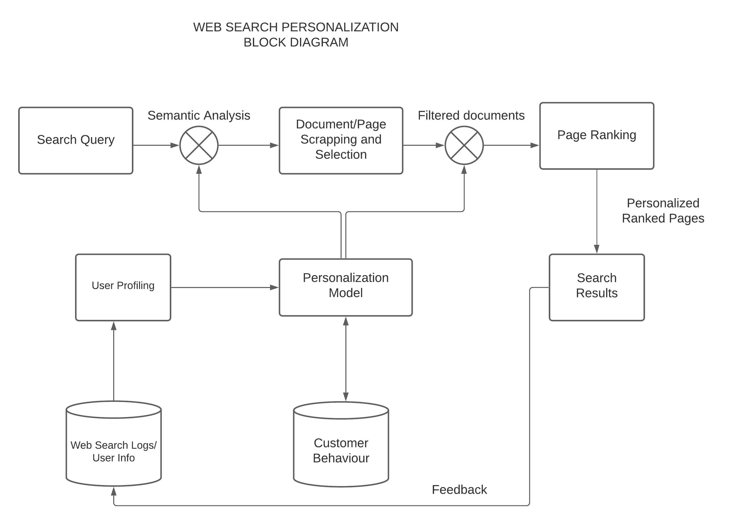
Proposed Block System

Slide 14
The proposed block diagram consists of 5 modules:
User Profiling
Personalization Model
Search Query Analysis
Document filtering and selection
Page Ranking
User Profiling: This part contains extracting useful customer information from his web search logs or by explicit feedback which will act as knowledge base for our personalization model.
Personalization Model: The user profile created is then used to build a model that will govern the search query-result pipeline making it more personalized and relevant

Slide 15
Search Query Analysis: This part or module is used for analysing the semantic context and the intent of the given search query to direct the results in correct path
Document filtering and Selection : This part consists of scrapping the webpages and filtering out the pages that has more similarity ad correlation with the given query
Page Ranking : The final module consists of finally ranking the filtered documents/ webpages obtained, such that the user gets more relevant searches as per interest at the start itself
All the above three modules/parts are always directed by our personalization model trying to predict best possibilities and outcomes at that given stage as per our user’s choice

Slide 16
Methodology
Pipeline Structure
Information Retrieval and Ranking
Re-Ranking the retrieved documents (links/website/items online) according to the user profile.

Slide 17
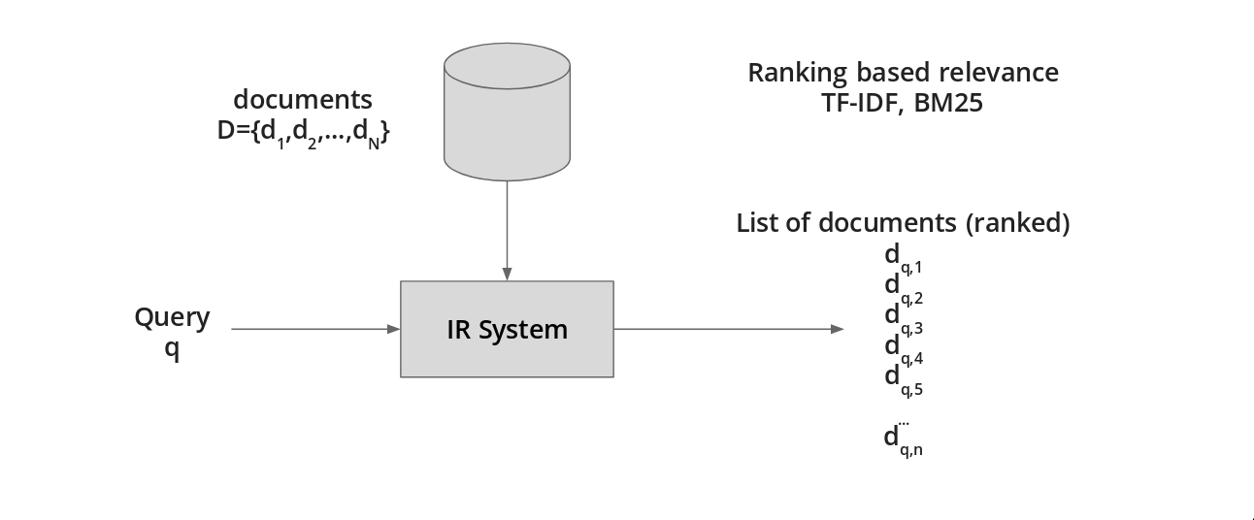
INFORMATION RETRIVAL (IR)
In the common search process, for a given query, executed over a collection of documents, the Information Retrieval (IR) system will return a list of documents ranked by their score.
This score is usually calculated using algorithm such as TF-IDF or BM25.

Slide 18
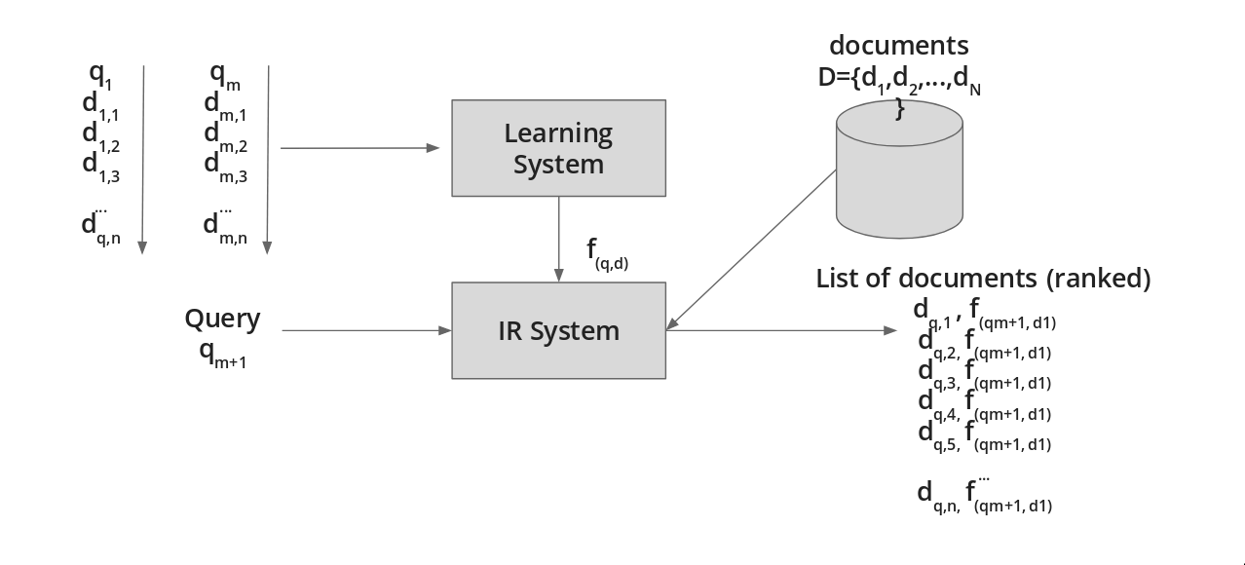
INFORMATION RETRIVAL (IR)
The ranking represents the relative relevance of the document with respect to the query.
In Learning to Rank, there is a ranking function, that is responsible of assigning the score value. This function is “learn in the training phase”, where is provided with a collection of queries, documents and target scores. As example, we can see how this work in the next image.

Slide 19



ListNet Approach
The major question with the listwise approach is how to define a function that can represent the difference between the generated ranking list and the one given as target.
To provide an answer to this question, the authors of ListNet propose to use a probabilistic method, considering for this two models, the permutation probability and the top one probability.
The objective of the learning step can be formalized as the minimization of the total losses with respect to the training data (is the loss function)
collection of scores for a collection of documents
the generated scores based on the list of feature vectors x(i) used to train the model.

Slide 20
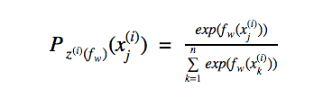
The ListNet algorithm
The previous theory has been put in place in the ListNet algorithm, based on the top one probability, with a Neural Network as a model and Gradient Descendant as optimization, the authors are able to optimize the listwide loss function.
In ListNet, the ranking function, based on the Neural Network model w is denoted as fw. Given a feature vector xj(i), fw(xj(i))will assign an score for it.
If we take the exponential function as , we can rewrite the top one probability of document dj(i)as:
top one probability of document dj

Slide 21
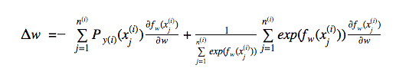
The learning algorithm for ListNet can be described as:
Input: training data (pairs of document, features and target scores)
Parameter: number of iterations T and learning rate η
Initialize parameter ω (weights)
for t = 1 to T do
for i = 1 to m do
Input x(i) of query q(i) to Neural Network and compute score list z(i)(fω) with current ω
Compute gradient 𝛥ω
Update ω = ω − η × 𝛥ω
end for
end for
Output Neural Network model ω
Gradient descendant for ListNet
Time complexity of ListNet is of order O(m*n).

Slide 22
Re-Ranking documents as per Personalization
Research in progress
Bayesian Personalized Ranking. Last interesting “old-fashioned
Recurrent Neural Network (RNN) based autoencoder architecture of GRU4Rec can be considered as “deep learning approach” for sequence based personalization.
A Simple Convolutional Generative Network for Next Item personalization (NextItNet)
Next Item Recommendation with Self-Attention (AttRec) uses self-attention to model short term user intent and relationships among items.
Adding external memory as in Memory Augmented Transformer Networks (MATN) also seems to be a promising approach.
Sequential recurrent neural network with attention.(Spotify)
Another interesting direction is to model patterns by graph neural networks such as HyperRec or by a temporal attentive sequential personalization model (TASER).

Slide 23
References
[1] Fei Cai, Shuaiqiang Wang, Maarten de Rijke. Behavior-Based Personalization in Web Search. In Published online 0 Month 2016 in Wiley Online Library (wileyonlinelibrary.com). February 8, 2016.
[2] Vandik Zaveri, Isha Bandi, Jimit Dholakia, Prof. Smita Sankhe. Mining User’s Browsing History to Personalize Web Search . In Proceedings of the 2nd International Conference on Inventive Communication and Computational Technologies (ICICCT 2018)
[3] Yury Ustinovskiy, Gleb Gusev, Pavel Serdyukov. An Optimization Framework for Weighting Implicit Relevance Labels for Personalized Web Search, International World Wide Web Conference Committee (IW3C2), , Florence, Italy, May 18–22, 2015.
[4] Mercy Paul Selvan, A.Chandra Shekar, Deepak R Babu, A. Krishna Teja. 2015. Efficient Ranking based on Web Page Importance and Personalized Search . In 2015 International Conference on Communications and Signal Processing (ICCSP), Melmaruvathur, India, 2-4 April 2015.
[5] Shipra Narang, Nikita Taneja. 2018. Deep Content-Collaborative Recommender System (DCCRS). In 2018 International Conference on Advances in Computing, Communication Control and Networking (ICACCCN), Greater Noida (UP), India, India, 12-13 Oct. 2018
[6] Alessandro Suglia, Claudio Greco, Cataldo Musto, Marco de Gemmis, Pasquale Lops, and Giovanni Semeraro. 2017. A Deep Architecture for Content-based Recommendations Exploiting Recurrent Neural Networks. In Proceedings of UMAP ’17, Bratislava, Slovakia, July 09-12, 2017, 10 pages.

Slide 24
Thank You!!
Any questions.

