Slide 1


CE251: PROGRAMMING IN JAVA
July – November 2020-21
Java Packages: Putting Classes Together
Prof. Rima Patel
Assistant Professor
Devang Patel Institute of Advance Technology and Research

Slide 2

Introduction
The main feature of OOP is its ability to support the reuse of code:
  Extending the classes (via inheritance)
  Extending interfaces
The features in basic form limited to reusing the classes within a program.
Java Packages

Slide 3
What if we need to use classes from other programs without physically copying them into the program under development ?
In Java, this is achieved by using what is known as “packages”, a concept similar to “class libraries” in other languages.
Java Packages

Slide 4
A java package is a group of similar types of classes, interfaces and sub-packages.
Package in java can be categorized in two form, built-in package and user-defined package.
Java Packages

Slide 5
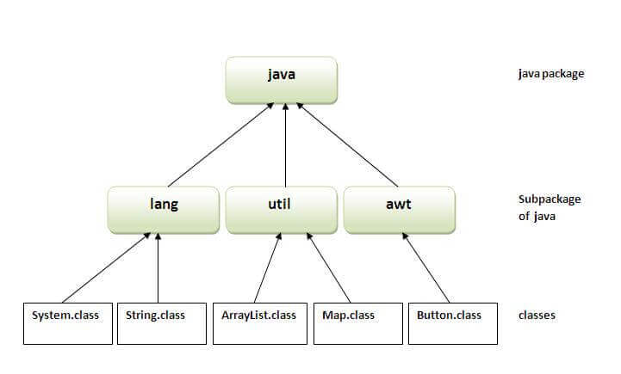
Java Packages

Slide 6
Advantage of Java Package
1) Java package is used to categorize the classes and interfaces so that they can be easily maintained.
2) Java package provides access protection.
3) Java package removes naming collision.
Java Packages

Slide 7
What packages are contains?
Java Packages

Slide 8
Packages
Packages are Java’s way of grouping a number of related classes and/or interfaces together into a single unit. That means, packages act as “containers” for classes.
Java Packages

Slide 9
What are the benefits of organising classes into packages ?
  The classes contained in the packages of other programs/applications can be reused.
  In packages classes can be unique compared with classes in other packages. That two classes in two different packages can have the same name. If there is a naming clash, then classes can be accessed with their fully qualified name.
  Classes in packages can be hidden if we don’t want other packages to access them.
  Packages also provide a way for separating “design” from coding.
Java Packages

Slide 10
What is the real time use of packages?
Every project divided into different set of modules
Every modules is nothing but a package statement
Java Packages

Slide 11
Java Predefine/foundation Packages
Java provides a large number of classes grouped into different packages based on their functionality.
The 14 predefined Java packages are:
  java.lang
    Contains classes for primitive types, strings, math functions, threads, and exception
  java.util
    Contains classes such as vectors, hash tables, date etc.
  java.io
    Stream classes for I/O
  java.awt
    Classes for implementing GUI – windows, buttons, menus etc.
  java.net
    Classes for networking
  java.applet
    Classes for creating and implementing applets
Java Packages

Slide 12
Where you can find all those packages?
Java Packages

Slide 13

Java Packages

Slide 14
Example
//save as Simple.java
package mypack;
public class Simple{
public static void main(String args[]){
System.out.println("Welcome to package");
}
}
Java Packages

Slide 15
How to run java package program
You need to use fully qualified name e.g. mypack.Simple etc to run the class.
To Compile: javac -d . Simple.java
To Run: java mypack.Simple
Java Packages

Slide 16
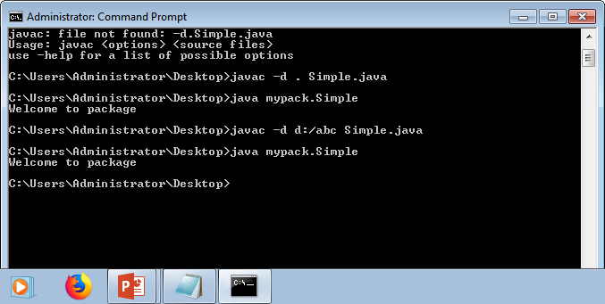
Java Packages

Slide 17
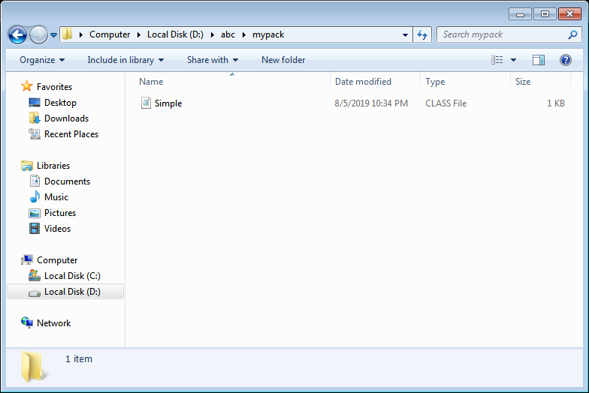
Java Packages

Slide 18
Using System Packages
The packages are organised in a hierarchical structure. For example, a package named “java” contains the package “awt”, which in turn contains various classes required for implementing GUI (graphical user interface).
java
lang
“java” Package containing
“lang”, “awt”,.. packages;
Can also contain classes.
awt
Graphics
awt Package containing
classes
Font
Classes containing
methods
Image
…

Slide 19
How to access package from another package?
There are three ways to access the package from outside the package.
1)import package.*;
2)import package.classname;
3)fully qualified name.
Java Packages

Slide 20
Accessing Classes from Packages
There are two ways of accessing the classes stored in packages:
  Using fully qualified class name
    java.lang.Math.sqrt(x);
  Import package and use class name directly.
    import java.lang.Math
    Math.sqrt(x);
Selected or all classes in packages can be imported:
Implicit in all programs: import java.lang.*;
package statement(s) must appear first
import package.class;
import package.*;
Java Packages

Slide 21
1) Using packagename.*
If you use package.* then all the classes and interfaces of this package will be accessible but not subpackages.
The import keyword is used to make the classes and interface of another package accessible to the current package.
Java Packages

Slide 22
Example
//save by A.java
package pack;
public class A{
public void msg(){System.out.println("Hello");}
}
//save by B.java
package mypack;
import pack.*;
class B{
public static void main(String args[]){
A obj = new A();
obj.msg();
}
}
Java Packages

Slide 23
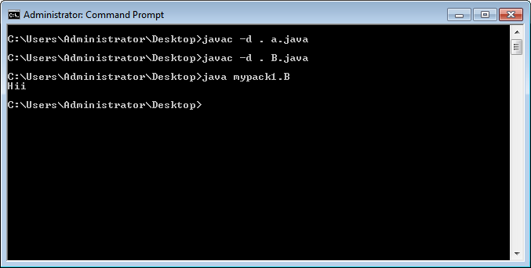
Java Packages

Slide 24
Using packagename.classname
If you import package.classname then only declared class of this package will be accessible
Java Packages

Slide 25
Example
//save by A.java
package pack;
public class A{
public void msg(){System.out.println("Hello");}
}
//save by B.java
package mypack;
import pack.A;
class B{
public static void main(String args[]){
A obj = new A();
obj.msg();
}
}
Java Packages

Slide 26
Using fully qualified name
If you use fully qualified name then only declared class of this package will be accessible. Now there is no need to import. But you need to use fully qualified name every time when you are accessing the class or interface.
It is generally used when two packages have same class name e.g. java.util and java.sql packages contain Date class.
Java Packages

Slide 27
Example
//save by A.java
package pack;
public class A{
public void msg(){System.out.println("Hello");}
}
//save by B.java
package mypack;
import pack.*;
class B{
public static void main(String args[]){
pack.A obj = new pack.A();
obj.msg();
}
}
Java Packages

Slide 28
User defined Packages
Java Packages

Slide 29
What is the naming convention to declare package?
Java Packages

Slide 30
Package names are written in all lower case to avoid conflict with the names of classes or interfaces. Companies use their reversed Internet domain name to begin their package names—for example, com.example.mypackage for a package named mypackage created by a programmer
Java Packages

Slide 31
Example
package in.ac.charusat.ce.java;
class MyPackage
{ public static void main(String[] args)
{
System.out.println("Hello World!");
}
}
class B
{
}
class C
{
}
Java Packages

Slide 32
Creating Packages
Java supports a keyword called “package” for creating user-defined packages.
The package statement must be the first statement in a Java source file (except comments and white spaces) followed by one or more classes.
Package name is “myPackage” and classes are considered as part of this package; The code is saved in a file called “ClassA.java” and located in a directory called “myPackage”.
  package myPackage;
  public class ClassA {
    // class body
  }
  class ClassB {
  // class body
  }
Java Packages

Slide 33
How to compile it?
Java Packages

Slide 34
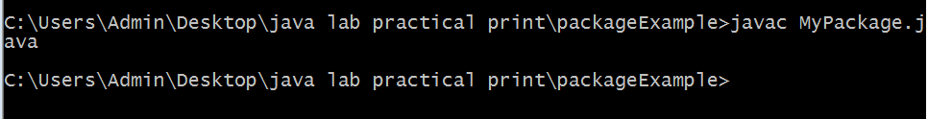
javac MyPackage.java
Java Packages

Slide 35
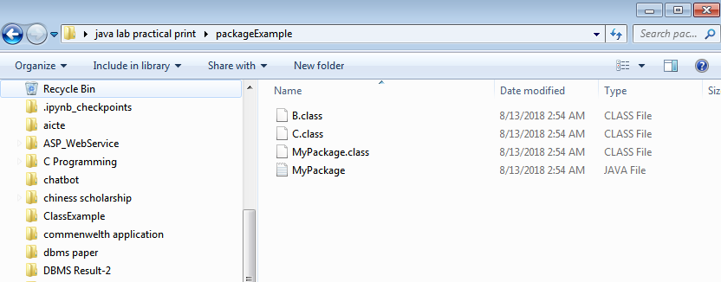
How many classes will be generated?
Java Packages

Slide 36
Compilation command
javac –d . MyPackage.java
-d → create directory structure
. → place the folders structure in current directory
Java Packages

Slide 37
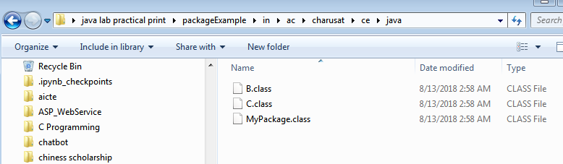
Check the directory structure after compilation
Java Packages

Slide 38
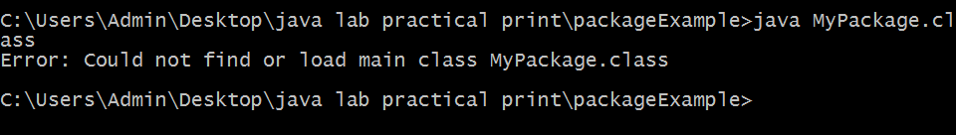
How to execute the application?
Java Packages

Slide 39
How to execute the application?
Execute java application with fully qualified name
java in.ac.charusat.ce.java.MyPackage
Java Packages

Slide 40
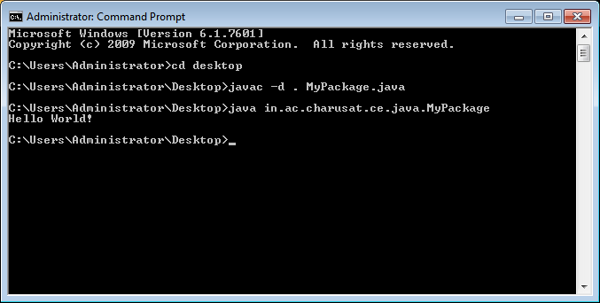
Java Packages

Slide 41
How to create two packages and use one package class inside another package?
Java Packages

Slide 42
Example
package in.ac.charusat.state; class Charusat { void gujaratState() { System.out.println("Charusat at Gujarat"); } }
package com.google.requiredinfo; class Google { public static void main(String[] args) { Charusat c = new Charusat(); c.gujaratState(); } }
Java Packages

Slide 43
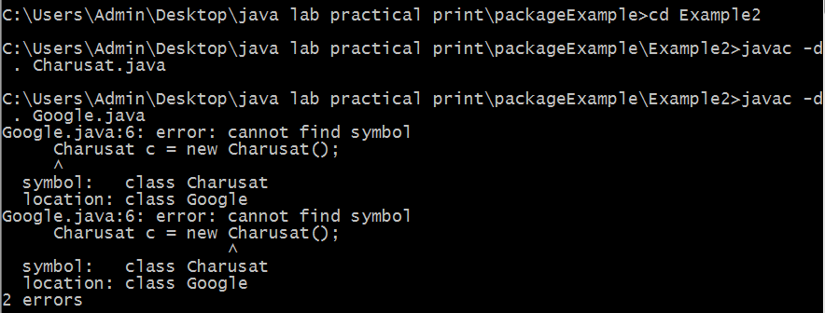
Compile the application
Java Packages

Slide 44
There are 2 errors
1. Whenever we are using other package classes, we must import the package first of all.
Java Packages

Slide 45
(1)
package com.google.requiredinfo; import in.ac.charusat.state.Charusat; class Google { public static void main(String[] args) { Charusat c = new Charusat(); c.gujaratState(); } }
package com.google.requiredinfo; import in.ac.charusat.state.*; class Google { public static void main(String[] args) { Charusat c = new Charusat(); c.gujaratState(); } }
Java Packages

Slide 46
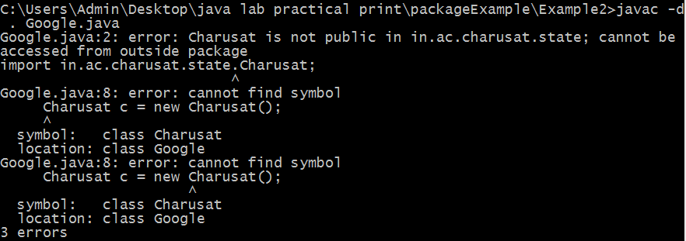
Will it compile or not?
Java Packages

Slide 47
Error -2
Class is not public
Method is not public
package in.ac.charusat.state; public class Charusat { public void gujaratState() { System.out.println("Charusat at Gujarat"); } }
Java Packages

Slide 48
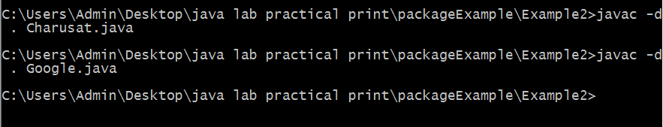
execute it?
Java Packages

Slide 49
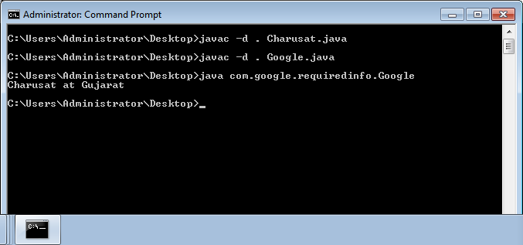
Java Packages

Slide 50
Homework
Try the same example with protected modifier and compare with default modifier.
Java Packages

Slide 51
Example-2 Creating Sub Packages
Classes in one ore more source files can be part of the same packages.
As packages in Java are organised hierarchically, sub-packages can be created as follows:
  package myPackage.Math
  package myPackage.secondPakage.thirdPackage
Store “thirdPackage” in a subdirectory named “myPackage\secondPackage”. Store “secondPackage” and “Math” class in a subdirectory “myPackage”.
Java Packages

Slide 52
Accessing a Package
As indicated earlier, classes in packages can be accessed using a fully qualified name or using a short-cut as long as we import a corresponding package.
The general form of importing package is:
  import package1[.package2][…].classname
  Example:
    import myPackage.ClassA;
    import myPackage.secondPackage.ClassB;
  All classes/packages from higher-level package can be imported as follows:
    import myPackage.*;
Java Packages

Slide 53
Do this exercise- Using a Package
Let us store the code listing below in a file named “ClassA.java” within subdirectory named “myPackage” within the current directory (say “abc”).
  package myPackage;
  public class ClassA {
  // class body
  public void display()
  {
  System.out.println("Hello, I am ClassA");
  }
  }
  class ClassB {
  // class body
}
Java Packages

Slide 54
Using a Package
Within the current directory (“abc”) store the following code in a file named “ClassX.java”
  import myPackage.ClassA;
  public class ClassX
  {
  public static void main(String args[])
  {
  ClassA objA = new ClassA();
  objA.display();
  }
  }
Java Packages

Slide 55
Compiling and Running
When ClassX.java is compiled, the compiler compiles it and places .class file in current directly. If .class of ClassA in subdirectory “myPackage” is not found, it comples ClassA also.
Note: It does not include code of ClassA into ClassX
When the program ClassX is run, java loader looks for ClassA.class file in a package called “myPackage” and loads it.
Java Packages

Slide 56
Using a Package
Let us store the code listing below in a file named “ClassA.java” within subdirectory named “secondPackage” within the current directory (say “abc”).
  package secondPackage;
  public class ClassC {
  // class body
  public void display()
  {
  System.out.println("Hello, I am ClassC");
  }
  }
Java Packages

Slide 57
Using a Package
Within the current directory (“abc”) store the following code in a file named “ClassY.java”
  import myPackage.ClassA;
  import secondPackage.ClassC;
  public class ClassY
  {
  public static void main(String args[])
  {
  ClassA objA = new ClassA();
  ClassC objC = new ClassC();
  objA.display();
  objC.display();
  }
  }
Java Packages

Slide 58
Output
  Hello, I am ClassA
  Hello, I am ClassC
Java Packages

Slide 59
Protection and Packages
All classes (or interfaces) accessible to all others in the same package.
Class declared public in one package is accessible within another. Non-public class is not
Members of a class are accessible from a difference class, as long as they are not private
protected members of a class in a package are accessible to subclasses in a different class
Java Packages

Slide 60
Visibility - Revisited
Public keyword applied to a class, makes it available/visible everywhere. Applied to a method or variable, completely visible.
Private fields or methods for a class only visible within that class. Private members are not visible within subclasses, and are not inherited.
Protected members of a class are visible within the class, subclasses and also within all classes that are in the same package as that class.
Java Packages

Slide 61
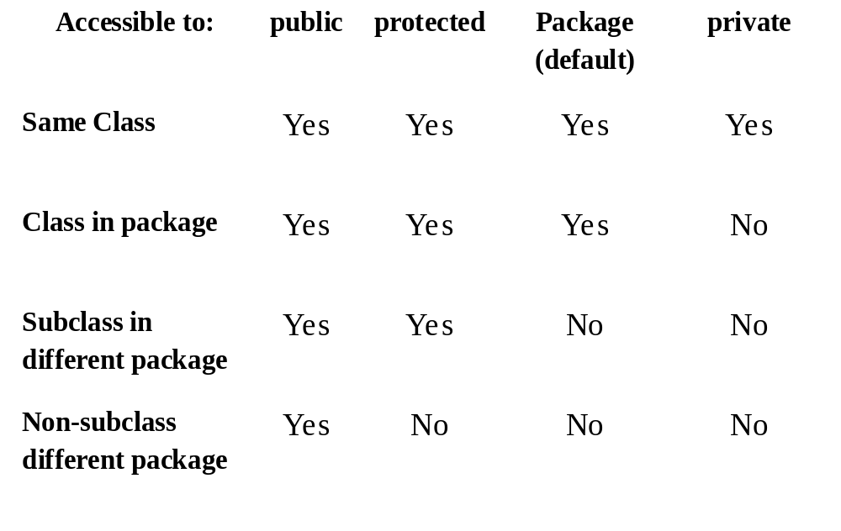
Visibility Modifiers
Java Packages

Slide 62
1) Private
The private access modifier is accessible only within the class.
Java Packages

Slide 63
class A{
private int data=40;
private void msg(){System.out.println("Hello java");}
}
public class Simple{
public static void main(String args[]){
A obj=new A();
System.out.println(obj.data);//Compile Time Error
obj.msg();//Compile Time Error
}
}
Role of Private Constructor
If you make any class constructor private, you cannot create the instance of that class from outside the class. For example:
class A{
private A(){}//private constructor
void msg(){System.out.println("Hello java");}
}
public class Simple{
public static void main(String args[]){
A obj=new A();//Compile Time Error
}
}
Java Packages

Slide 64
2) Default
If you don't use any modifier, it is treated as default by default.
The default modifier is accessible only within package.
It cannot be accessed from outside the package. It provides more accessibility than private.
But, it is more restrictive than protected, and public.
Java Packages

Slide 65
//save by A.java
package pack;
class A{
void msg(){System.out.println("Hello");}
}
//save by B.java
package mypack;
import pack.*;
class B{
public static void main(String args[]){
A obj = new A();//Compile Time Error
obj.msg();//Compile Time Error
}
}
the scope of class A and its method msg() is default so it cannot be accessed from outside the package.
Java Packages

Slide 66
3) Protected
The protected access modifier is accessible within package and outside the package but through inheritance only.
The protected access modifier can be applied on the data member, method and constructor. It can't be applied on the class.
It provides more accessibility than the default modifier.
Java Packages

Slide 67
//save by A.java
package pack;
public class A{
protected void msg(){System.out.println("Hello");}
}
//save by B.java
package mypack;
import pack.*;
class B extends A{
public static void main(String args[]){
B obj = new B();
obj.msg();
}
}
Java Packages

Slide 68
4) Public
The public access modifier is accessible everywhere. It has the widest scope among all other modifiers.
Java Packages

Slide 69
//save by A.java
package pack;
public class A{
public void msg(){System.out.println("Hello");}
}
//save by B.java
package mypack;
import pack.*;
class B{
public static void main(String args[]){
A obj = new A();
obj.msg();
}
}
Java Packages

Slide 70
Adding a Class to a Package
Consider an existing package that contains a class called “Teacher”:
This class is stored in “Teacher.java” file within a directory called “pack1”.
How do we add new public class called “Student” to this package.
package pack1;
public class Teacher
{
// class body
}
Java Packages

Slide 71
Adding a Class to a Package
Define the public class “Student” and place the package statement before the class definition as follows:
Store this in “Student.java” file under the directory “pack1”.
When the “Student.java” file is compiled, the class file will be created and stored in the directory “pack1”. Now, the package “pack1” will contain both the classes “Teacher” and “Student”.
package pack1;
public class Student
{
// class body
}
package pack1;
class Teacher
class Student
Java Packages

Slide 72
Packages and Name Clashing
When packages are developed by different organizations, it is possible that multiple packages will have classes with the same name, leading to name clashing.
We can import and use these packages like:
  import pack1.*;
  import pack2.*;
  Student student1; // Generates compilation error
package pack1;
package pack2;
class Teacher
class Student
class Student
class Courses
Java Packages

Slide 73
Handling Name Clashing
In Java, name classing is resolved by accessing classes with the same name in multiple packages by their fully qualified name.
Example:
  import pack1.*;
  import pack2.*;
  pack1.Student student1;
  pack2.Student student2;
  Teacher teacher1;
  Courses course1;
Java Packages

Slide 74
Extending a Class from Package
A new class called “Professor” can be created by extending the “Teacher” class defined the package “pack1” as follows:
import pack1.Teacher;
public class Professor extends Teacher
{
// body of Professor class
// It is able to inherit public and protected members,
// but not private or default members of Teacher class.
}
Java Packages

Slide 75
Summary
Packages allow grouping of related classes into a single united.
Packages are organised in hierarchical structure.
Packages handle name classing issues.
Packages can be accessed or inherited without actual copy of code to each program.
Java Packages

Slide 76
Any Question???

