Slide 1
Packages

Slide 2
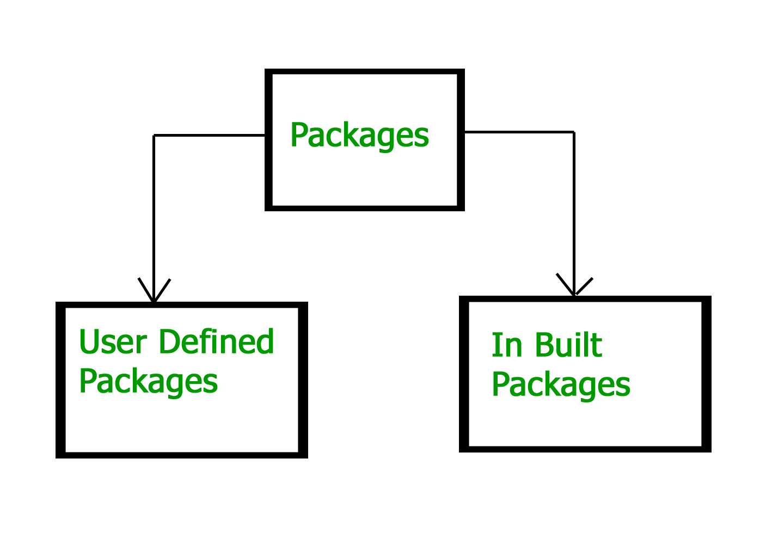
Package :-
A package as the name suggests is a pack(group) of classes, interfaces and other packages. In java we use packages to organize our classes and interfaces.
Types of Packages :

Slide 3
Built in Packages :-
These packages consist of a large number of classes which are a part of Java API.Some of the commonly used built-in packages are:
1) java.lang: Contains language support classes(e.g classed which defines primitive data types, math operations). This package is automatically imported.
2) java.io: Contains classed for supporting input / output operations.
3) java.util: Contains utility classes which implement data structures like Linked List, Dictionary and support ; for Date / Time operations.
4) java.applet: Contains classes for creating Applets.
5) java.awt: Contain classes for implementing the components for graphical user interfaces (like button , ;menus etc).
6) java.net: Contain classes for supporting networking operations.
import java.util.Scanner
Here:
→ java is a top level package
→ util is a sub package
→ and Scanner is a class which is present in the sub package util.

Slide 4
User-defined packages :-
The package we create is called user-defined package with the help of keyword “package” .
Syntax:-
package nameOfPackage;
Example :-
MyPackageClass.java
package mypack;
class MyPackageClass {
public static void main(String[] args) {
System.out.println("This is my package!");
}
}

Slide 5
How to access package from another package?
There are three ways to access the package from outside the package.
import package.*;
import package.classname;
fully qualified name.

Slide 6
Example :-
A.class
case 1 :-
case 2:-
case 3:-
package pack;
public class A{
public void msg(){
System.out.println("Hello");
}
}
package mypack;
import pack.*;
class B{
public static void main(String args[]){
A obj = new A();
obj.msg();
}
}
package mypack;
import pack.A;
class B{
public static void main(String args[]){
A obj = new A();
obj.msg();
}
}
package mypack;
class B{
public static void main(String args[]){
pack.A obj = new pack.A();//using fully qualified name
obj.msg();
}
}

Slide 7
Sub-packages :-
A package inside another package is known as sub package. For example If I create a package inside mypack package then that will be called sub package.
Lets say I have created another package inside mypack and the sub package name is mysubpack . So if I create a class in this subpackage it should have this package declaration in the beginning:
package mypack .mysubpack ;

Slide 8
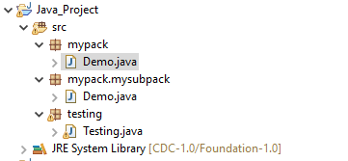
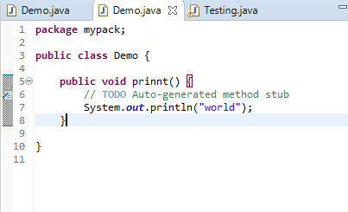
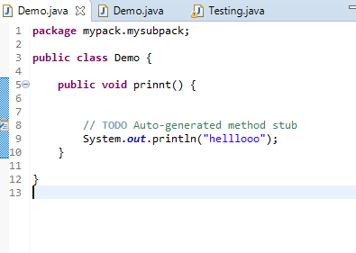
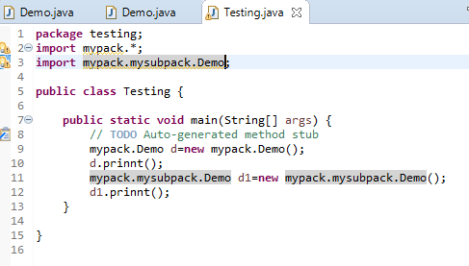
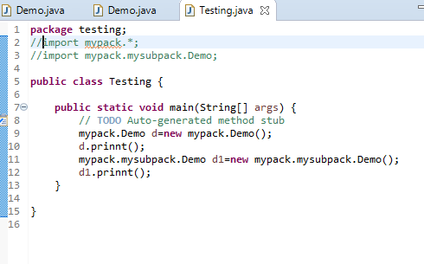
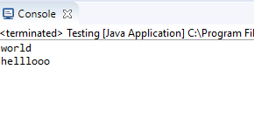

Slide 9
Advantages of using a package :-
These are the reasons why you should use packages in Java:
Reusability: While developing a project in java, we often feel that there are few things that we are writing again and again in our code. Using packages, you can create such things in form of classes inside a package and whenever you need to perform that same task, just import that package and use the class.
Better Organization: Again, in large java projects where we have several hundreds of classes, it is always required to group the similar types of classes in a meaningful package name so that you can organize your project better and when you need something you can quickly locate it and use it, which improves the efficiency.
Name Conflicts: We can define two classes with the same name in different packages so to avoid name collision, we can use packages

Slide 10
Important points:
Every class is part of some package.
If no package is specified, the classes in the file goes into a special unnamed package (the same unnamed package for all files).
All classes/interfaces in a file are part of the same package. Multiple files can specify the same package name.
If package name is specified, the file must be in a subdirectory called name (i.e., the directory name must match the package name).
We can access public classes in another (named) package using: package-name.class-name

Slide 11
Sometimes class name conflict may occur. For example: Lets say we have two packages abcpackage and xyzpackage and both the packages have a class with the same name, let it be JavaExample.java. Now suppose a class import both these packages like this:
import abcpackage.*;
import xyzpackage.*;
This will throw compilation error. To avoid such errors you need to use the fully qualified name method that I have shown above. For example
abcpackage.JavaExample obj = new abcpackage.JavaExample();
xyzpackage.JavaExample obj2 = new xyzpackage.JavaExample();
This way you can avoid the import package statements and avoid that name conflict error.

Slide 12
If we create a class inside a package while importing another package then the package declaration should be the first statement, followed by package import. For example:
package abcpackage;
import xyzpackage.*;
A class can have only one package declaration but it can have more than one package import statements. For example:
package abcpackage; //This should be one
import xyzpackage;
import anotherpackage;
import anything;

Slide 13
The wild card import like package.* should be used carefully when working with subpackages. For example: Lets say: we have a package abc and inside that package we have another package xyz, now xyz is a subpackage.
classes inside abc are: Example1, Example 2, Example 3
classes inside xyz are: Demo1, Demo2
So if I import the package abc using wildcard like this:
import abc.*;
Then it will only import classes Example1, Example2 and Example3 but it will not import the classes of sub package.
To import the classes of subpackage you need to import like this:
import abc.xyz.*;
This will import Demo1 and Demo2 but it will not import the Example1, Example2 and Example3.
So to import all the classes present in package and subpackage, we need to use two import statements like this:
import abc.*;
import abc.xyz.*;

Slide 14
Thank You

