Slide 1
HR Data analysis
By – Aditi s

Slide 2
Description
A dataset containing information about a company’s employees was provided from Kaggle. My task was to analyse the data and provide insights on the following questions:
What is the average salary of employees by department?
Which department has the highest number of employees?
What is the distribution of gender in the company?
Is there a correlation between years of experience and salary?
Which department has the highest average salary?

Slide 3
After downloading the dataset from Kaggle, the data was analysed and cleaned for further visualization. Datatypes of all columns was checked and changed where needed. After that columns which were non-relevant were removed. The insights for the provided questions are given in the following slides.

Slide 4
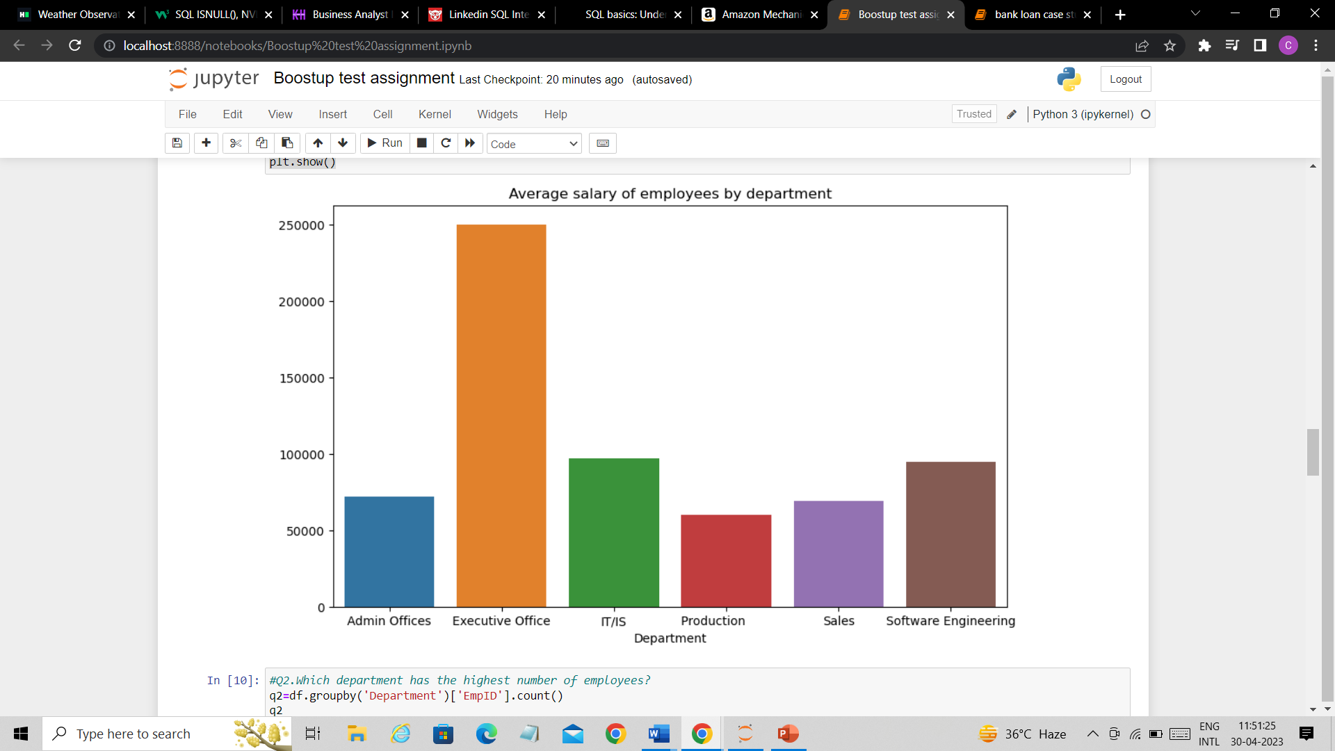
What is the average salary of employees by department?
Department | Average Salary
Admin Offices | 71791.88
Executive Office | 250000.00
IT/IS | 97064.64
Production | 59953.54
Sales | 69061.25
Software Engineering | 94989.45

Slide 5
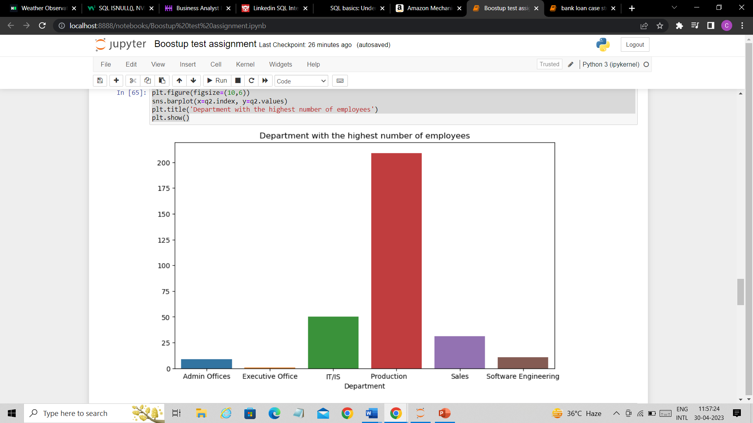
Which department has the highest number of employees?
We can clearly see from this figure that ‘Production’ is the department with the highest number of employees with employee count of 209.

Slide 6
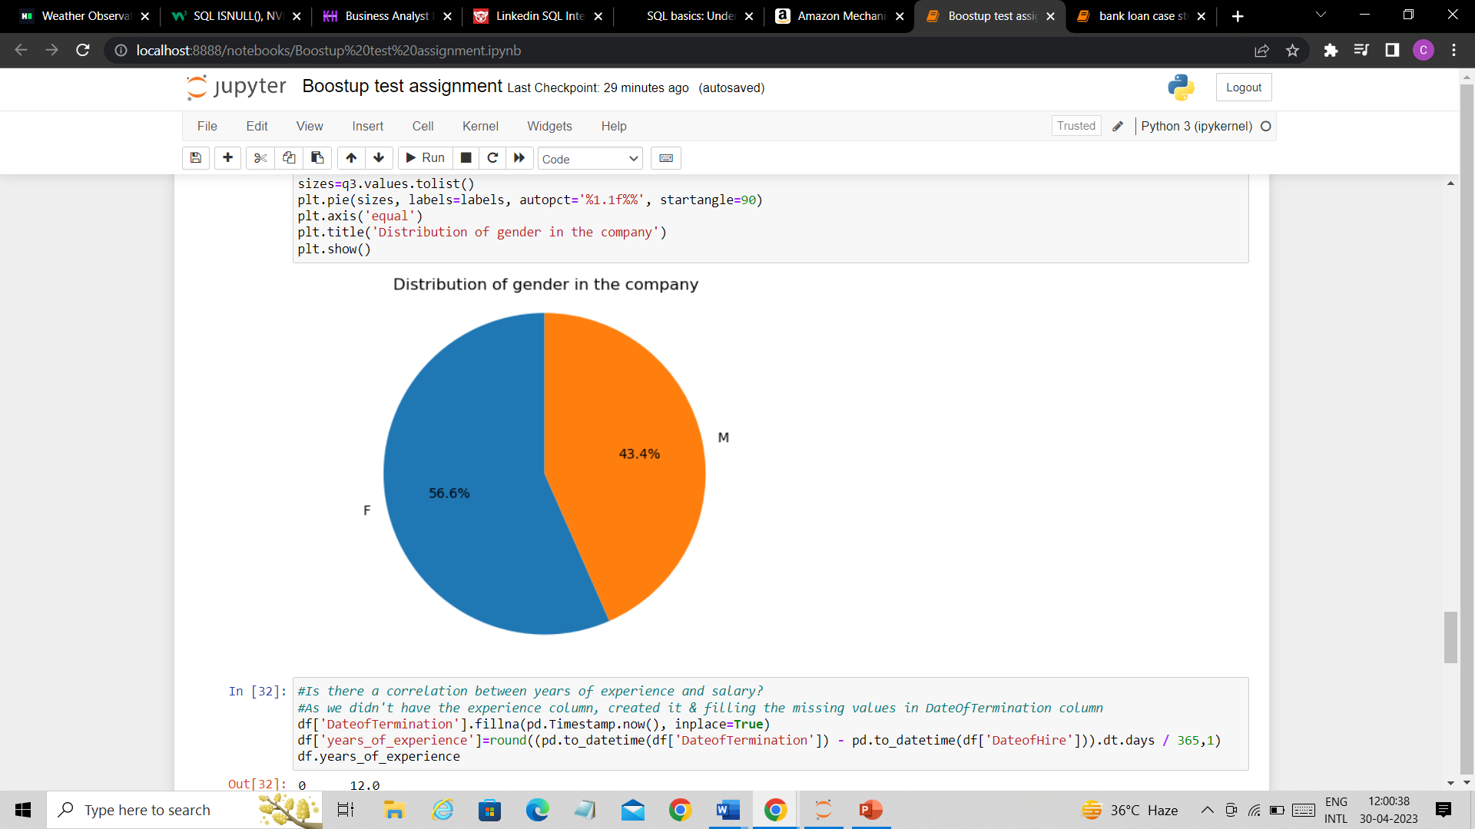
What is the distribution of gender in the company?
The company has higher percentage of women as compared to men.

Slide 7
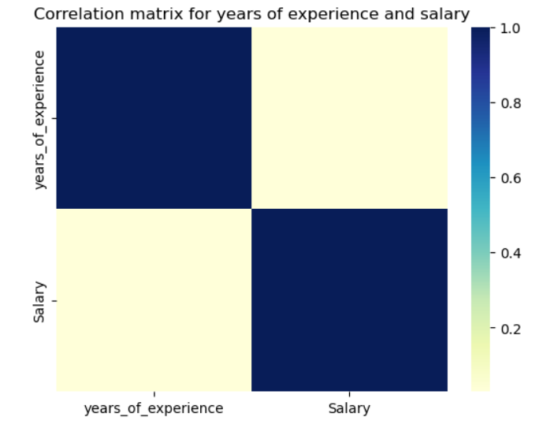
Is there a correlation between years of experience and salary?
The correlation between years of experience and salary is 0.0266

Slide 8
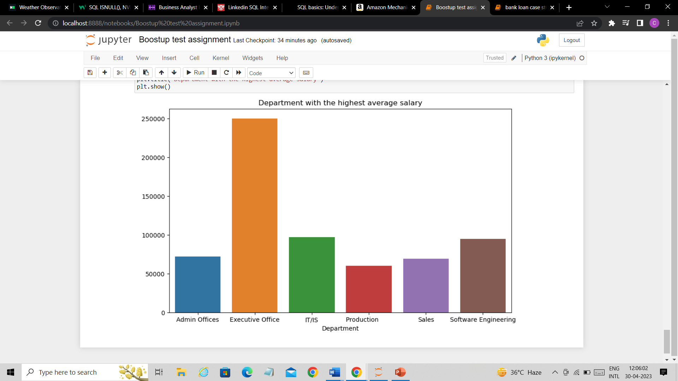
Which department has the highest average salary?
Executive Office is the department with highest average salary with the average of 250000.00

