Slide 1

TEAM - ENIGMA
AUTOMATIC QUESTION GENERATOR
TEAM MEMBERS:
-NITHISH KUMAR (RA1911003010217)
-ADITI MITTAL (RA1911003010226)
-ANWEASHA SAHA (RA1911003010235)
-VIJAY R. (RA1911003010239)

Slide 2
PROBLEM STATEMENT
While exam-style questions are a fundamental educational tool serving a variety of purposes, manual construction of questions is a complex process that requires training, experience, and resources.
This, in turn, hinders and slows down the use of educational activities (e.g. providing practice questions) and new advances that require a large pool of questions.
To reduce the expenses associated with manual construction of questions and to satisfy the need for a continuous supply of new questions, automatic question generation (AQG) techniques were introduced.

Slide 3
OBJECTIVE WITH TECHNICAL DEPTH
Automatic generation of questions and evaluating their answers is a highly challenging task in natural language processing and educational technology.
This project focuses on generating subjective questions and also an evaluation system is suggested for assessing the answers.
For generating the questionnaires, key-phrases are extracted from the course curriculum (syllabus). Next, based on the key-phrases, different types of subjective questions are generated.

Slide 4
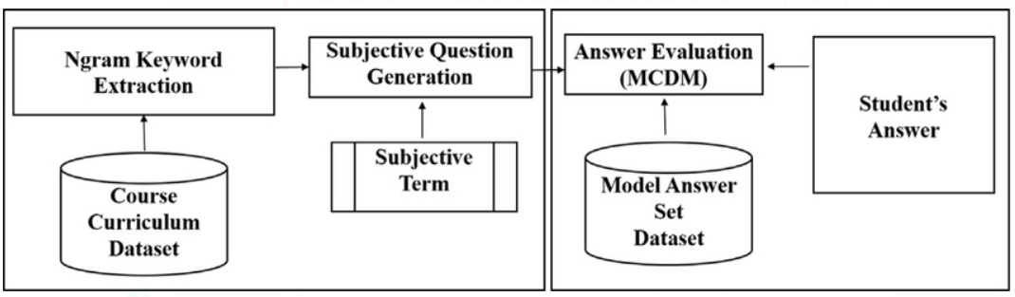
OBJECTIVE WITH TECHNICAL DEPTH
Finally, the evaluation of student’s responses is achieved using a multi-criteria-decision-making approach. It uses a set of model answers taken from different textbooks and subject experts to evaluate the answers.
Multiple measures are used to assess the answers by comparing them with this model set. The results of the profound system reveal that the automated appraisal process can reduce the manual effort of the human.

Slide 5
BENEFITS OF AQG
AQG can reduce the cost (in terms of both money and effort) of question construction which, in turn, enables educators to spend more time on other important instructional activities.
In addition to resource saving, having a large number of good-quality questions enables the enrichment of the teaching process with additional activities such as adaptive testing , which aims to adapt learning to student knowledge and needs, as well as drill and practice exercises.
Finally, being able to automatically control question characteristics, such as question difficulty and cognitive level, can inform the construction of good quality tests with particular requirements.

Slide 6
BENEFITS OF AQG
Although the focus of this review is education, the applications of question generation (QG) are not limited to education and assessment.
Questions are also generated for other purposes, such as validation of knowledge bases, development of conversational agents, and development of question answering or machine reading comprehension systems, where questions are used for training and testing.

Slide 7
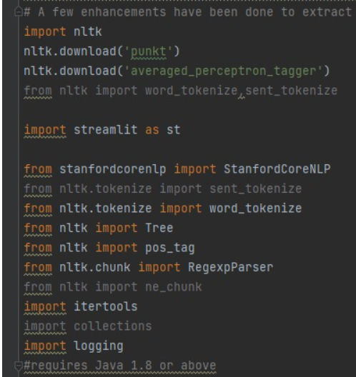
CODE

Slide 8

OUTPUT

Slide 9
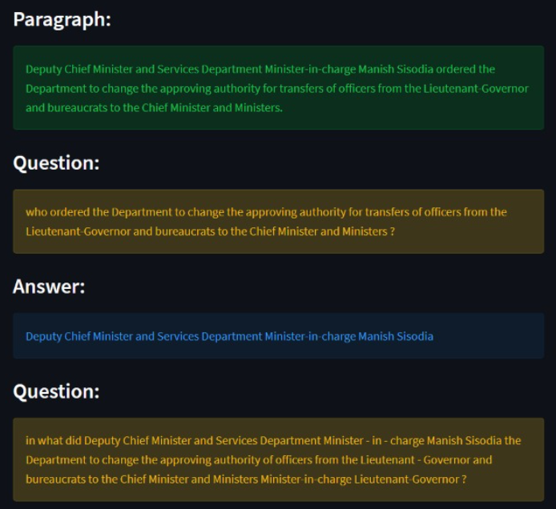
OUTPUT

Slide 10
THANK YOU!

