Slide 1

Switzerland Virtual Internship, Power Bi -By Forage

Slide 2
Task 1 Call Centre Trends (Descriptive Analysis): Tools/Technologies Used: Excel, Power BI
Created a report for PwC Virtual Job Simulation (Telecom company).
This Power BI project aims to analyse a comprehensive call centre dataset with features including Call ID, Agent, Date, Time, Topic, answered calls, Resolved, Speed of Answer), Average Talk Duration, and Satisfaction Rating. The goal is to setting KPIs and gain valuable insights into call centre performance, customer satisfaction, and emerging trends.

Slide 3
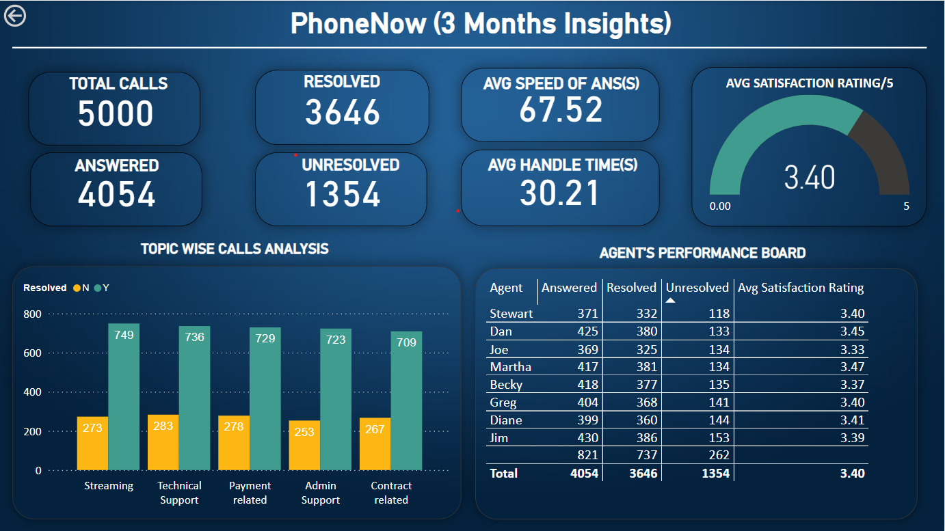

Slide 4
Task 2 Customer Retention (Time Series Analysis): Tools/Technologies Used: Excel, Power BI
This analysis was aimed at helping a telecom organization understand their customer behaviour and how best to serve them through a Customer Retention Analysis using various key performance indicators (KPIs) and important visuals to draw insights to make recommendations to help the telecom organization take the right decisions.
Provided relevant strategies to overcome customers at risk.

Slide 5
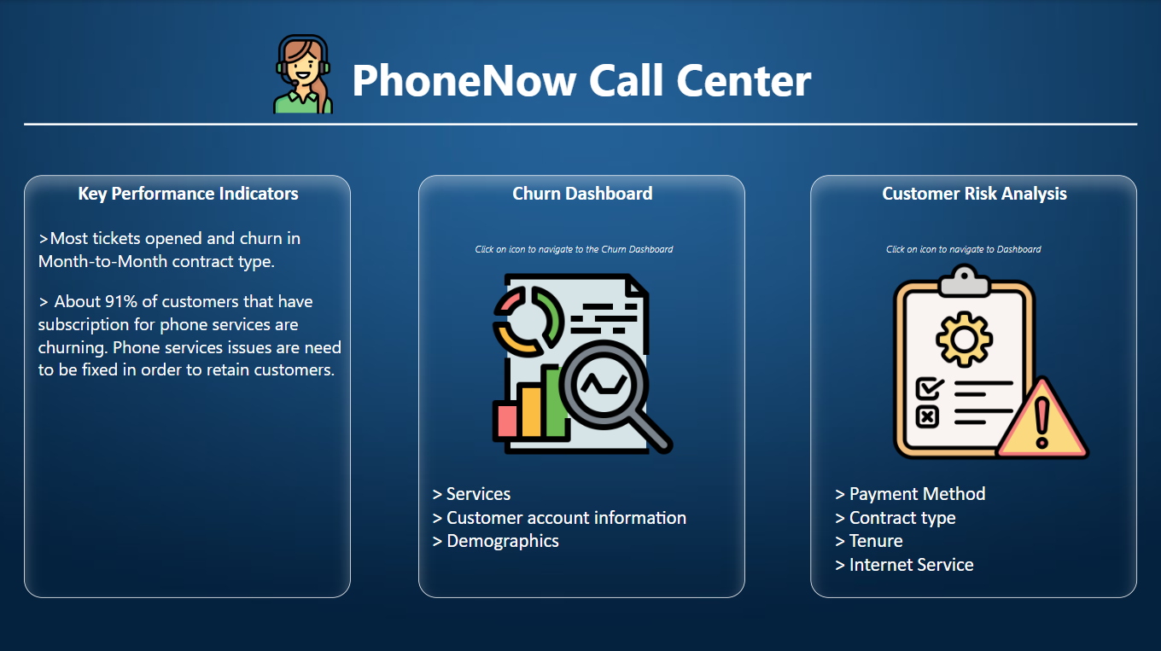

Slide 6
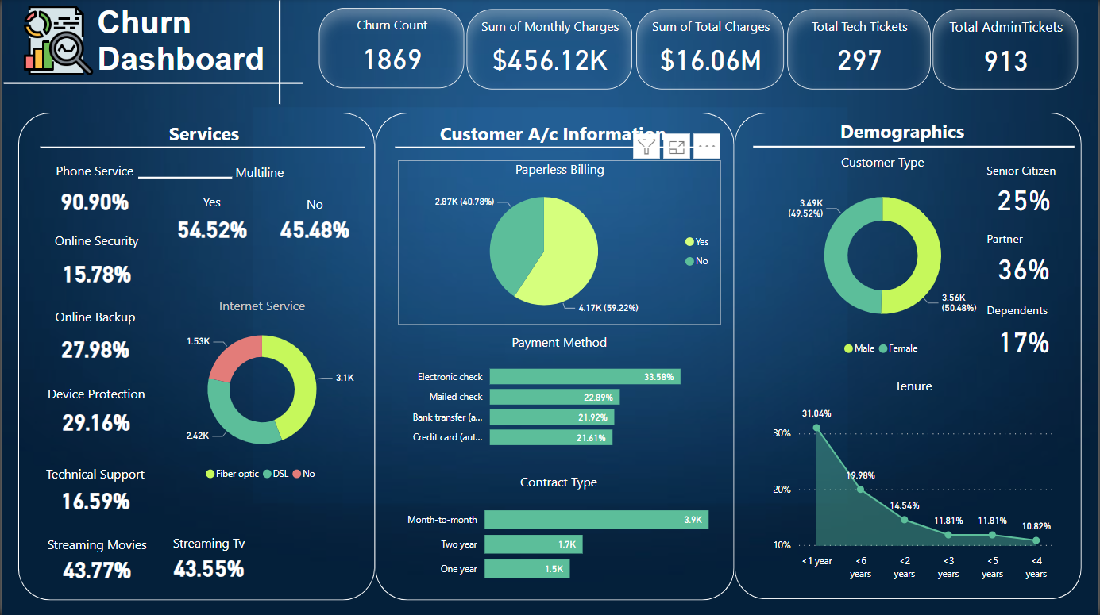

Slide 7
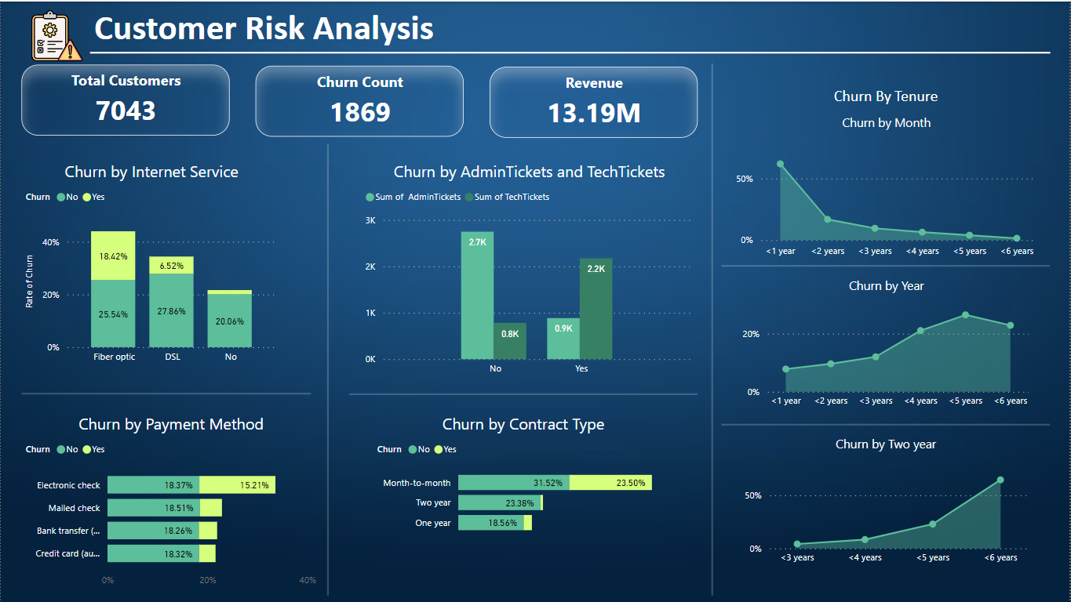

Slide 8
Task 3 Diversity & Inclusion (Prescriptive Analysis): Tools/Technologies Used: SQL, Power BI
This part of the project enabled me to calculate various measures. Created a dashboard that aims at showcasing the diversification , performance and hiring rate at various levels in an organization . It is made as a part of my final task in PWC virtual internship.
Developed and optimized report for HR Team to balance the workforce based on gender using various DAX formulas and found that the average performance ratings for female and male employees were very similar (2.42 for females and 2.41 for males) suggests that there may be gender equality in terms of performance within the organization.

Slide 9
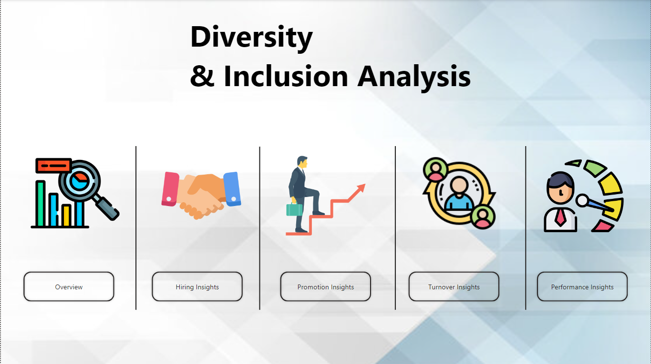

Slide 10
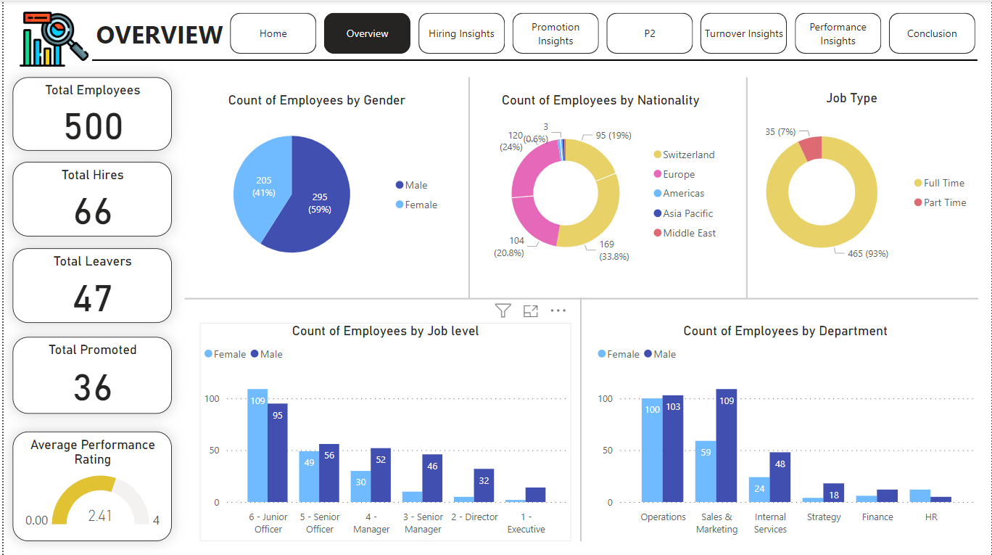

Slide 11
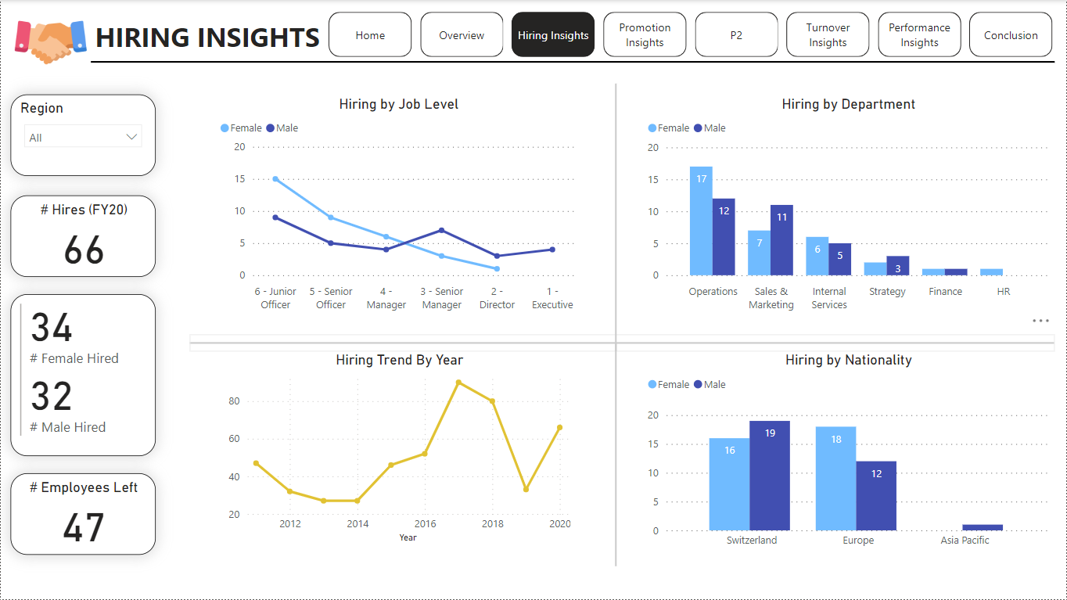

Slide 12
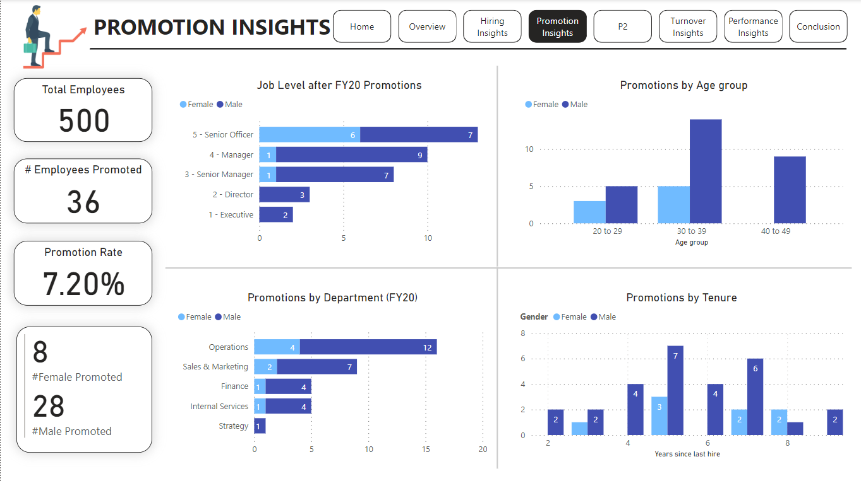

Slide 13
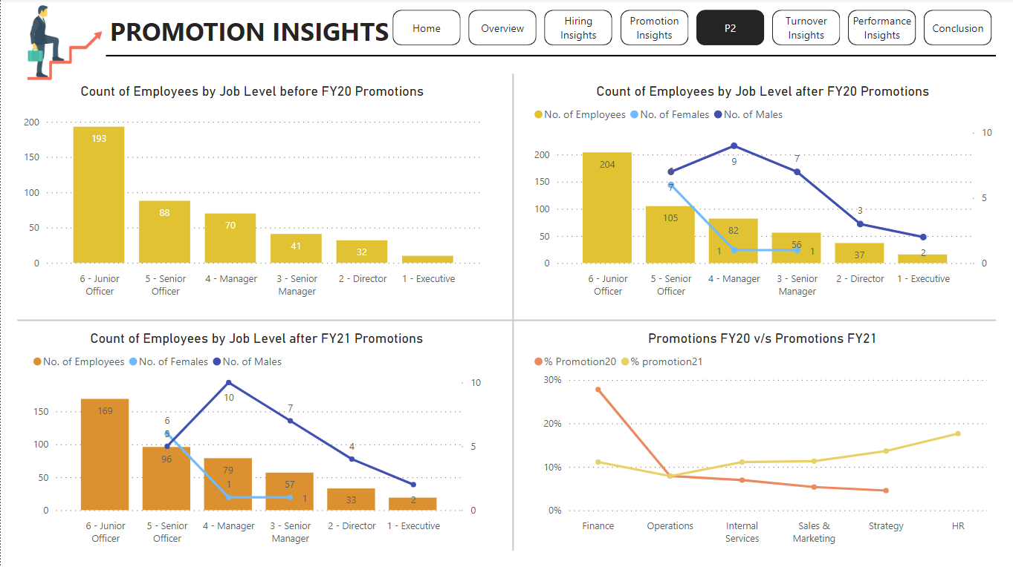

Slide 14
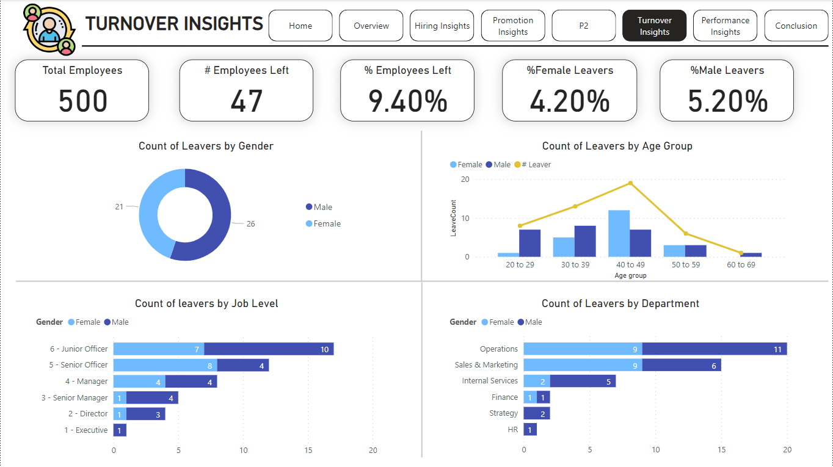

Slide 15
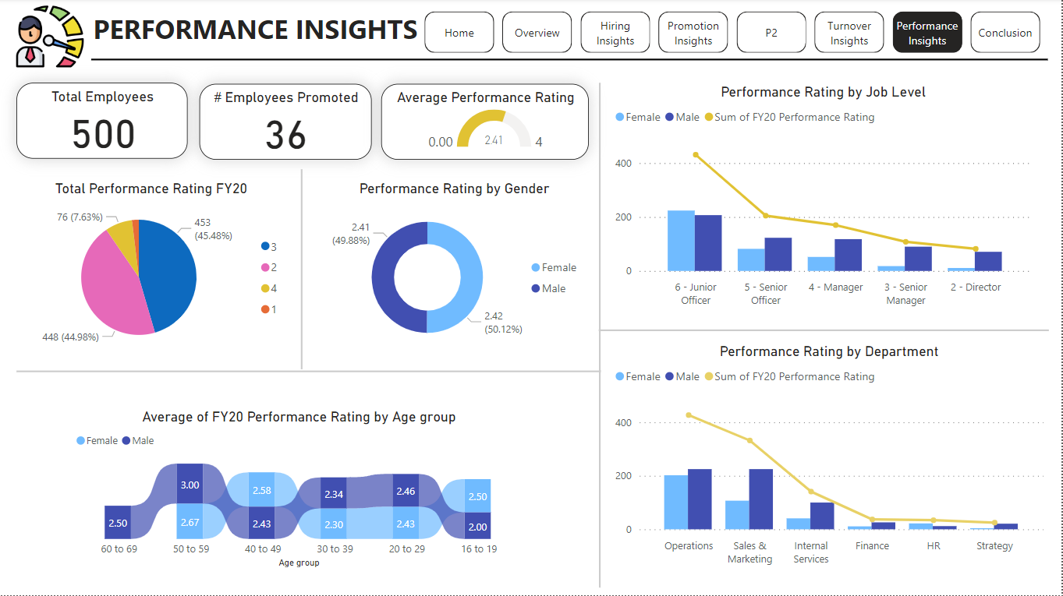

Slide 16
