Slide 1
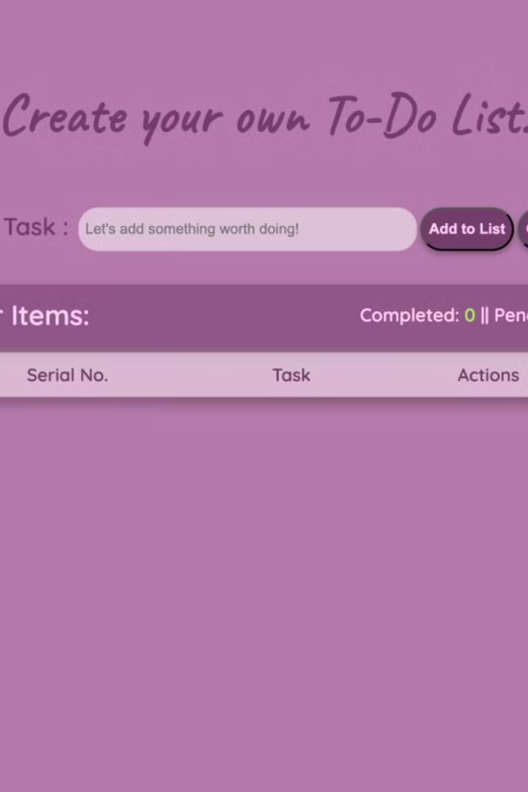

Project Todo List: HTML, CSS, and JS
This presentation will guide you through creating a functional and visually appealing To-Do List application using HTML, CSS, and JavaScript.
by Aditi Singh

Slide 2

Introduction to Project Management
1
Organization and Structure
2
Time Management
Effective time management helps meet deadlines and allocate resources effectively.
Project management ensures tasks are organized, prioritized, and efficiently completed.
3
Collaboration and Communication
Streamlined communication and teamwork are crucial for successful project outcomes.

Slide 3
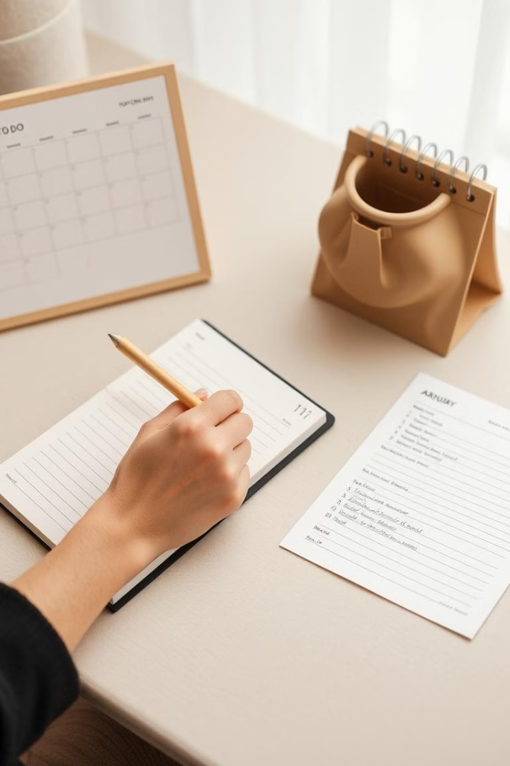
Planning and Organizing Tasks
1
Identify Tasks
Break down the project into smaller, manageable tasks.
2
Prioritize Tasks
Organize tasks by urgency and importance.
3
Estimate Time
Assign realistic timeframes for completing each task.

Slide 4
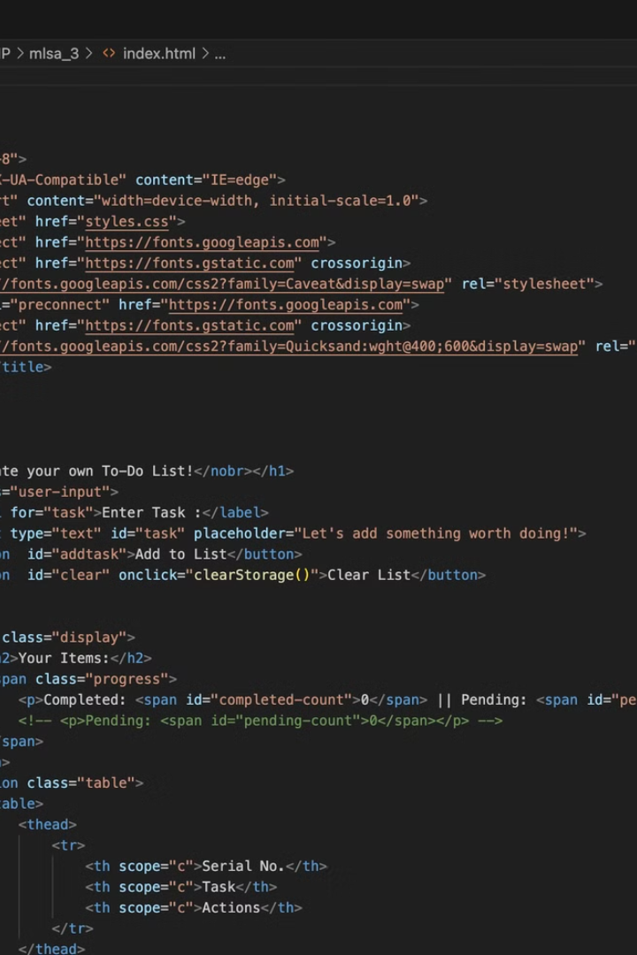
Implementing a Todo List with HTML
HTML Structure
Input Field
Create the basic structure of the to-do list using HTML elements.
Use an input field to allow users to add new tasks.
List Elements
Implement an unordered list (UL) to display the tasks.

Slide 5
Styling the Todo List with CSS
Typography
Color Scheme
Layout
Choose a clear and readable font for the to-do list items.
Select colors that are visually appealing and easy on the eyes.
Organize the to-do list elements using CSS properties like flexbox or grid.

Slide 6
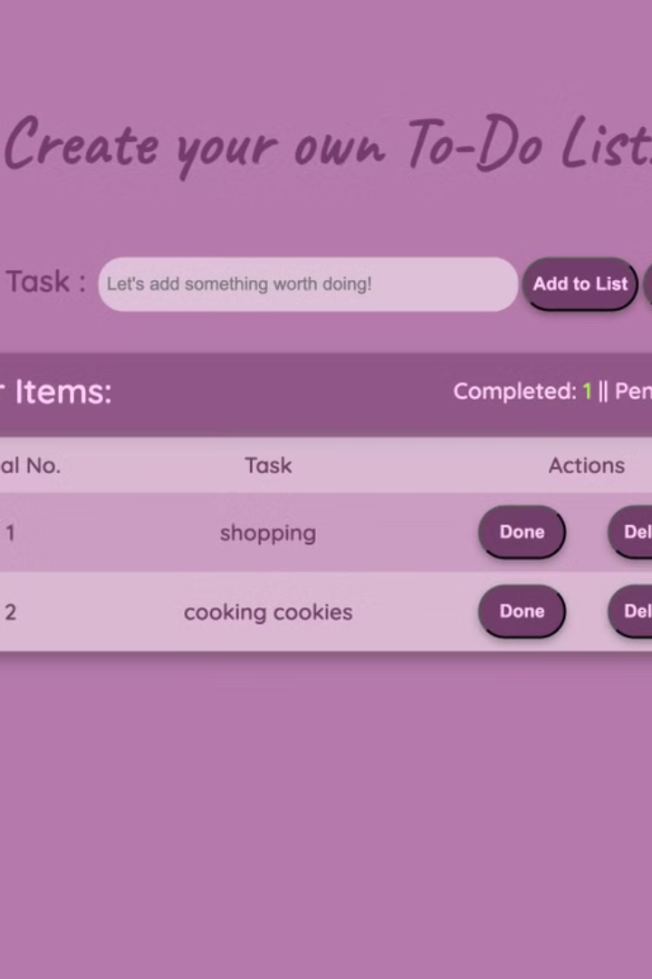



Adding Dynamic Functionality with JavaScript
Add Tasks
Implement JavaScript to capture new tasks from the input field.
Mark Complete
Enable users to mark tasks as completed using checkboxes.
Delete Tasks
Add functionality to remove completed or unwanted tasks from the list.

Slide 7
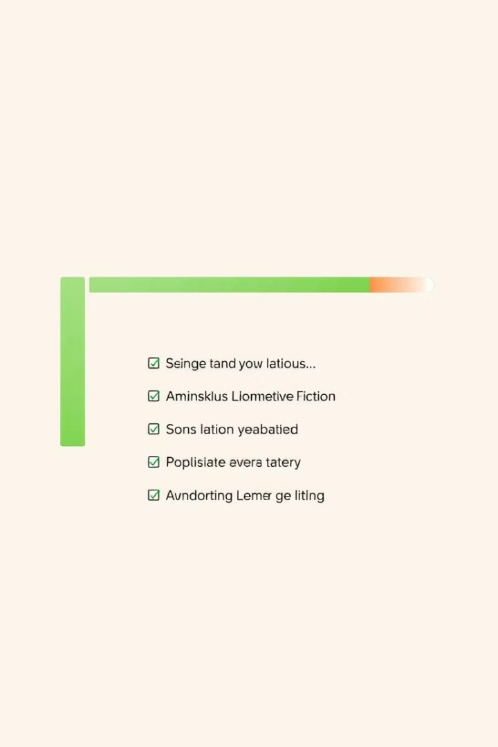
Tracking Project Progress and Completion
Task
Status
Completion Date
Design the UI
Completed
2023-10-26
Implement HTML Structure
Completed
2023-10-27
Add CSS Styling
In Progress
2023-10-28

Slide 8
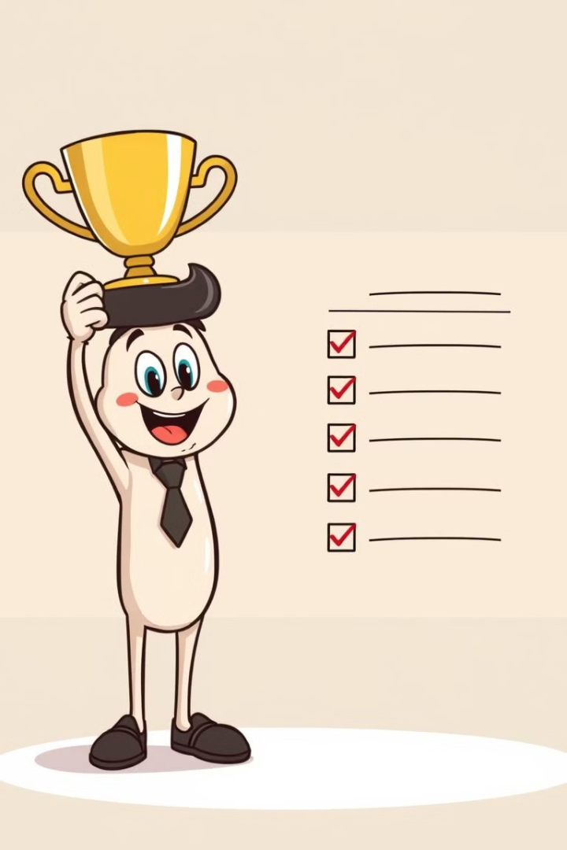



Conclusion and Next Steps
Review and Refine
Test the to-do list thoroughly and make any necessary adjustments.
Deploy the Application
Publish the to-do list app to a website or platform for use.
Future Enhancements
Consider adding advanced features like task reminders or local storage.

