Slide 1
12/17/21, 1:47 PM
3rd_year_project
In [ ]:
import pandas as pd
#!pip install nsepy
from nsepy import get_history
from datetime import date
import numpy as np
import pandas as pd
import matplotlib.pyplot as plt
%matplotlib notebook
from datetime import datetime
import matplotlib.transforms as transforms
In [45]:
%%javascript
IPython.OutputArea.auto_scroll_threshold = 9999;
In [46]:
import pandas as pd
#!pip install nsepy
from nsepy import get_history
from datetime import date
import numpy as np
import matplotlib.transforms as transforms
In [47]:
import matplotlib.pyplot as plt
%matplotlib notebook
In [48]:
symbol_index = ['NIFTY SMLCAP 100','NIFTY SMLCAP 250','NIFTY SMLCAP 50','NIFTY MIDCAP 1 symbol_stock = ['SBIN', 'RELIANCE', 'HDFCBANK', 'INFY', 'KOTAKBANK','TCS', 'LT', 'HIND
In [49]:
print("Pre-available Indices:\n\n", symbol_index) print("\nPre-available Stocks:\n\n", symbol_stock)
Pre-available Indices:
['NIFTY SMLCAP 100', 'NIFTY SMLCAP 250', 'NIFTY SMLCAP 50', 'NIFTY MIDCAP 150', 'NIFTY 50', 'NIFTY BANK', 'NIFTY NEXT 50', 'NIFTY FMCG']
Pre-available Stocks:
['SBIN', 'RELIANCE', 'HDFCBANK', 'INFY', 'KOTAKBANK', 'TCS', 'LT', 'HINDUNILVR', 'ITC']
In [28]:
inp = int(input("Press: \t 1 for Indices \t 2 for Stocks : ")) sym = ''
if inp == 1:
sym += input("Enter the symbol name : ")
if sym not in symbol_index:
symbol_index.append(symbol)
elif inp == 2:
sym += input("Enter the symbol name : ")
if sym not in symbol_stock:
symbol_stock.append(symbol)

Slide 2
12/17/21, 1:47 PM
else:
print("\nInvalid Input")
Press: 1 for Indices 2 for Stocks : 1 Enter the symbol name : NIFTY 50
3rd_year_project
In [29]:
data1 = []
data1 = pd.DataFrame(data1)
start, end = input("Enter space separated START & END dates in the format %YY,%MM,%DD : syear, smonth, sday = map(int, start.split(','))
eyear, emonth, eday = map(int, end.split(','))
Enter space separated START & END dates in the format %YY,%MM,%DD : 2018,1,1 2021,12,17
In [30]:
df = ''
nf = ''
data1 = []
data1 = pd.DataFrame(data1)
if inp == 1:
for x in symbol_index:
data = get_history(symbol=x, start=date(2018,7,1), end=date(2021,12,16), index
data = pd.DataFrame(data) data['Index_Name'] = x
data1 = pd.concat([data1,data]) print(x)
# Save the Data
data1.to_csv('data.csv', index=True)
df = pd.read_csv(r'data.csv', index_col = 0, parse_dates = True) nf = df[(df['Index_Name']==sym)]
if inp == 2:
for x in symbol_stock:
data = get_history(symbol=x, start=date(syear,smonth,sday), end=date(eyear,emon data = pd.DataFrame(data)
data1 = pd.concat([data1,data]) print(x)
# Save the Data
data1.to_csv('data.csv', index=True)
df = pd.read_csv(r'data.csv', index_col = 0, parse_dates = True) nf = df[(df['Symbol']==sym)]
NIFTY | SMLCAP | 100
NIFTY | SMLCAP | 250
NIFTY | SMLCAP | 50
NIFTY | MIDCAP | 150
NIFTY | 50
NIFTY | BANK
NIFTY | NEXT 50
NIFTY | FMCG
In [31]:
def data_resampling(nf, period):
#df = pd.read_clipboard(parse_dates=['Date'], index_col=['Date'])
logic = {'Open'
'High'
'Low'
: 'first',
: 'max',
: 'min',
'Close' : 'last',
'Volume': 'sum'}
dfw = nf.resample(period).apply(logic)
# set the index to the beginning of the time_period

Slide 3
12/17/21, 1:47 PM
3rd_year_project
dfw.index = dfw.index - pd.tseries.frequencies.to_offset("6D")
return dfw
In [32]:
def plot(dfw):
fig, ax = plt.subplots(figsize=(10,5)) dfw['Close'].tail().plot(ax = ax)
ax.set_ylabel("Price")
if inp == 1:
ax.set_title(nf['Index_Name'][0]+' '+period[p]+' analysis')
if inp == 2:
ax.set_title(nf['Symbol'][0]+' ' +period[p]+' analysis')
#S3-------------------
ax.hlines(y=dfw['S3'][-1], xmin=dfw.index[0], xmax=dfw.index[-1], colors='black', l trans = transforms.blended_transform_factory(
ax.get_yticklabels()[0].get_transform(), ax.transData)
ax.text(0,dfw['S3'][-1], "{:.0f}".format(dfw['S3'][-1]), color="black", fontweight= ha="right", va="center")
#R3-------------------
ax.hlines(y=dfw['R3'][-1], xmin=dfw.index[0], xmax=dfw.index[-1], colors='black', l
trans = transforms.blended_transform_factory(
ax.get_yticklabels()[0].get_transform(), ax.transData)
ax.text(0,dfw['R3'][-1], "{:.0f}".format(dfw['R3'][-1]), color="black", fontweight= ha="right", va="center")
#S4-------------------
ax.hlines(y=dfw['S4'][-1], xmin=dfw.index[0], xmax=dfw.index[-1], colors='red', lin trans = transforms.blended_transform_factory(
ax.get_yticklabels()[0].get_transform(), ax.transData)
ax.text(0,dfw['S4'][-1], "{:.0f}".format(dfw['S4'][-1]), color="red", fontweight= ' ha="right", va="center")
#S5-------------------
ax.hlines(y=dfw['S5'][-1], xmin=dfw.index[0], xmax=dfw.index[-1], colors='red', lin
trans = transforms.blended_transform_factory(
ax.get_yticklabels()[0].get_transform(), ax.transData)
ax.text(0,dfw['S5'][-1], "{:.0f}".format(dfw['S5'][-1]), color="red", fontweight= ' ha="right", va="center")
#S6-------------------
ax.hlines(y=dfw['S6'][-1], xmin=dfw.index[0], xmax=dfw.index[-1], colors='red', lin trans = transforms.blended_transform_factory(
ax.get_yticklabels()[0].get_transform(), ax.transData)
ax.text(0,dfw['S6'][-1], "{:.0f}".format(dfw['S6'][-1]), color="red", fontweight= ' ha="right", va="center")
#R4-------------------
ax.hlines(y=dfw['R4'][-1], xmin=dfw.index[0], xmax=dfw.index[-1], colors='green', l trans = transforms.blended_transform_factory(
ax.get_yticklabels()[0].get_transform(), ax.transData)
ax.text(0,dfw['R4'][-1], "{:.0f}".format(dfw['R4'][-1]), color="green", fontweight=
ha="right", va="center")
#R5-------------------
ax.hlines(y=dfw['R5'][-1], xmin=dfw.index[0], xmax=dfw.index[-1], colors='green', l trans = transforms.blended_transform_factory(
ax.get_yticklabels()[0].get_transform(), ax.transData)
ax.text(0,dfw['R5'][-1], "{:.0f}".format(dfw['R5'][-1]), color="green", fontweight= ha="right", va="center")
#R6-------------------
ax.hlines(y=dfw['R6'][-1], xmin=dfw.index[0], xmax=dfw.index[-1], colors='green', l trans = transforms.blended_transform_factory(
ax.get_yticklabels()[0].get_transform(), ax.transData)

Slide 4
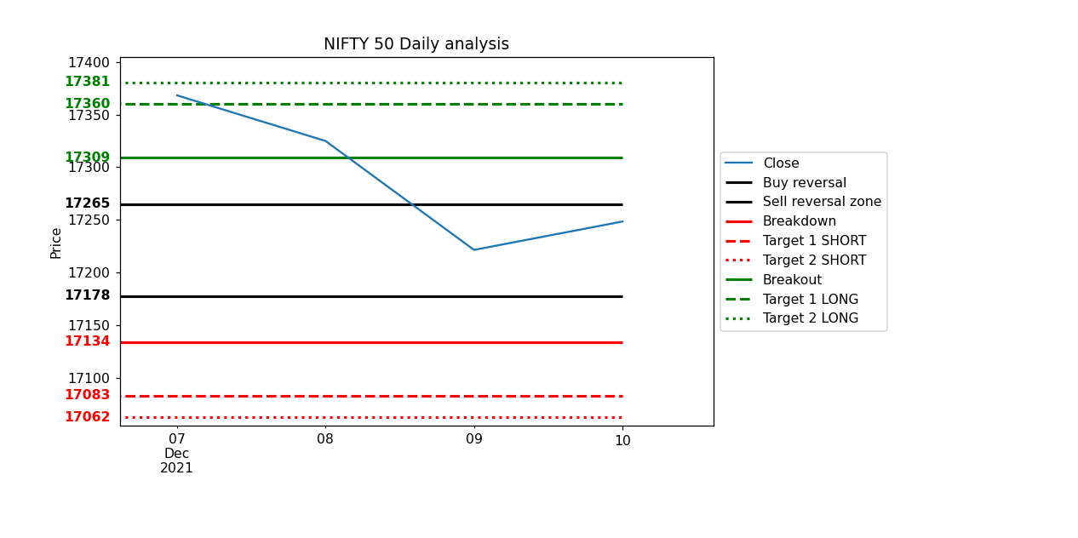
12/17/21, 1:47 PM
3rd_year_project
ax.text(0,dfw['R6'][-1], "{:.0f}".format(dfw['R6'][-1]), color="green", fontweight= ha="right", va="center")
box = ax.get_position()
ax.set_position([box.x0, box.y0, box.width * 0.8, box.height]) ax.legend(loc='center left', bbox_to_anchor=(1, 0.5))
# plt.tight_layout(
plt.show()
In [51]:
resampled_data = ''
period = {'D':'Daily', 'W':'Weekly', 'M':'Monthly', 'Q':'Quarterly', 'Y':'Yearly'}
print("Periods", period)
choice = {1:'VIEW ALL Period Analyses', 2:'View Single Period Analysis'} print('Choose',choice)
c = int(input())
if c == 2:
p = input('Choose the period : ')
if p in period:
resampled_data = levels(data_resampling(nf, p))
plot(resampled_data)
if c == 1:
for p in period:
resampled_data = levels(data_resampling(nf, p))
plot(resampled_data)
Periods {'D': 'Daily', 'W': 'Weekly', 'M': 'Monthly', 'Q': 'Quarterly', 'Y': 'Yearly'} Choose {1: 'VIEW ALL Period Analyses', 2: 'View Single Period Analysis'}
1

Slide 5
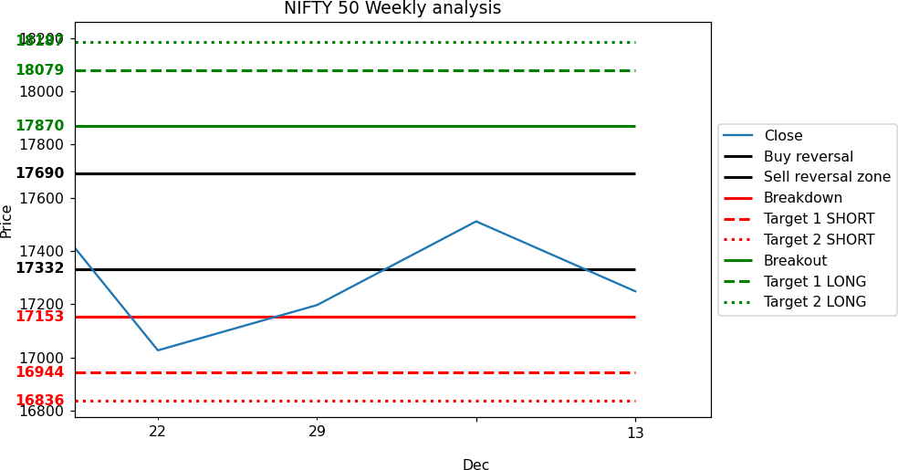
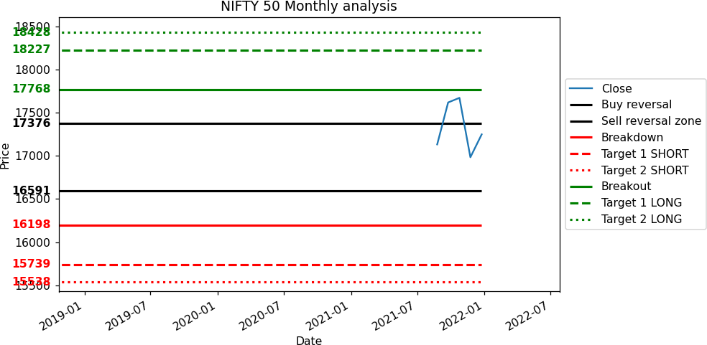
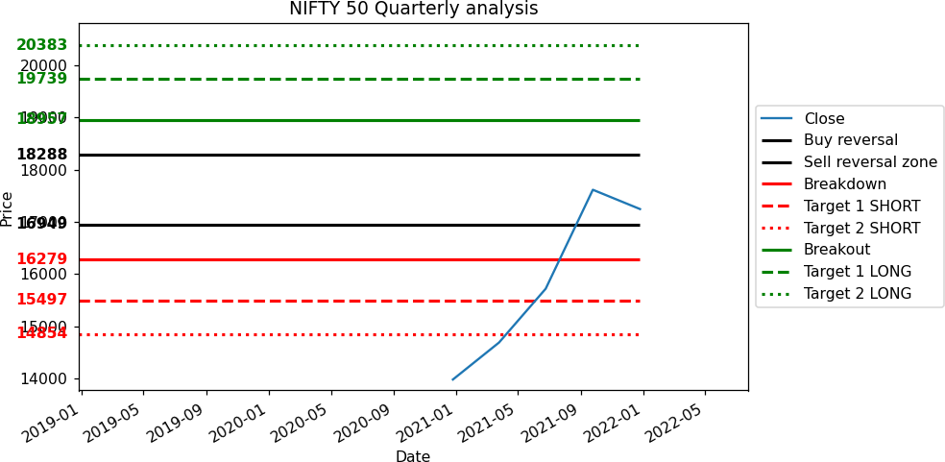
12/17/21, 1:47 PM
3rd_year_project

Slide 6
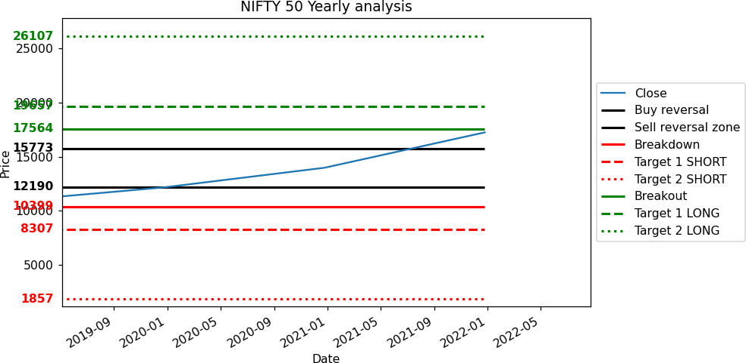
12/17/21, 1:47 PM
3rd_year_project
In [41]:
%matplotlib notebook

