Slide 1
Secure Data Hiding in Images using Steganography
CAPSTONE PROJECT
Presented By: Aditri
Student Name :
ADITRI B RAY
College Name & Department :
MS RAMAIAH INSTITUTE OF TECHNOLOY(MSRIT)
CSE(CORE)
BANGALORE

Slide 2
OUTLINE
Problem Statement
Technology used
Wow factor
End users
Result
Conclusion
Git-hub Link
Future scope

Slide 3
Problem Statement
With the rise of digital communication, securing sensitive data has become crucial.
Traditional encryption methods are effective but often raise suspicion.
Steganography provides a means to hide information within images in a way that is undetectable to the human eye, ensuring covert data transmission.
However, existing steganography solutions lack user-friendly interfaces, strong password protection, and web-based accessibility.
This project addresses these issues by developing a secure, intuitive, and efficient image steganography tool.

Slide 4
Technology used
Frontend: HTML, CSS (Dark/Light theme), JavaScript.
Backend: Python (Flask)
Data Handling: Pillow (PIL) for image processing
Security: AES encryption for password-protected encoding
Storage: File-based system (can be extended to cloud storage)

Slide 5
Wow factors
✨ Interactive UI with Dark Mode & Theme Toggle
✨ Real-time Image Preview for selected images before encoding/decoding
✨ Password-Protected Encoding & Decoding for enhanced security
✨ Expanding Magic Smiley Animation in UI for an engaging experience
✨ Potential for Future AI-based Steganalysis Detection Countermeasures

Slide 6
End users
👨‍💻 Cybersecurity Professionals – Securely transmit sensitive data 📧 Journalists & Activists – Share confidential information under censorship 🔐 Privacy Enthusiasts – Hide personal notes or data in images 🎨 Digital Artists – Conceal copyright information or easter eggs in art 🏢 Corporations – Secure internal communication without suspicion

Slide 7
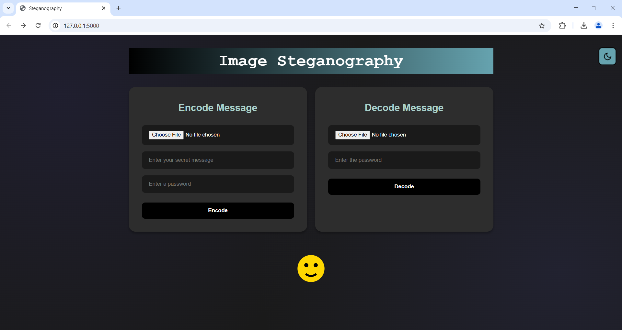
Results
LIGHT/DARK THEME:

Slide 8
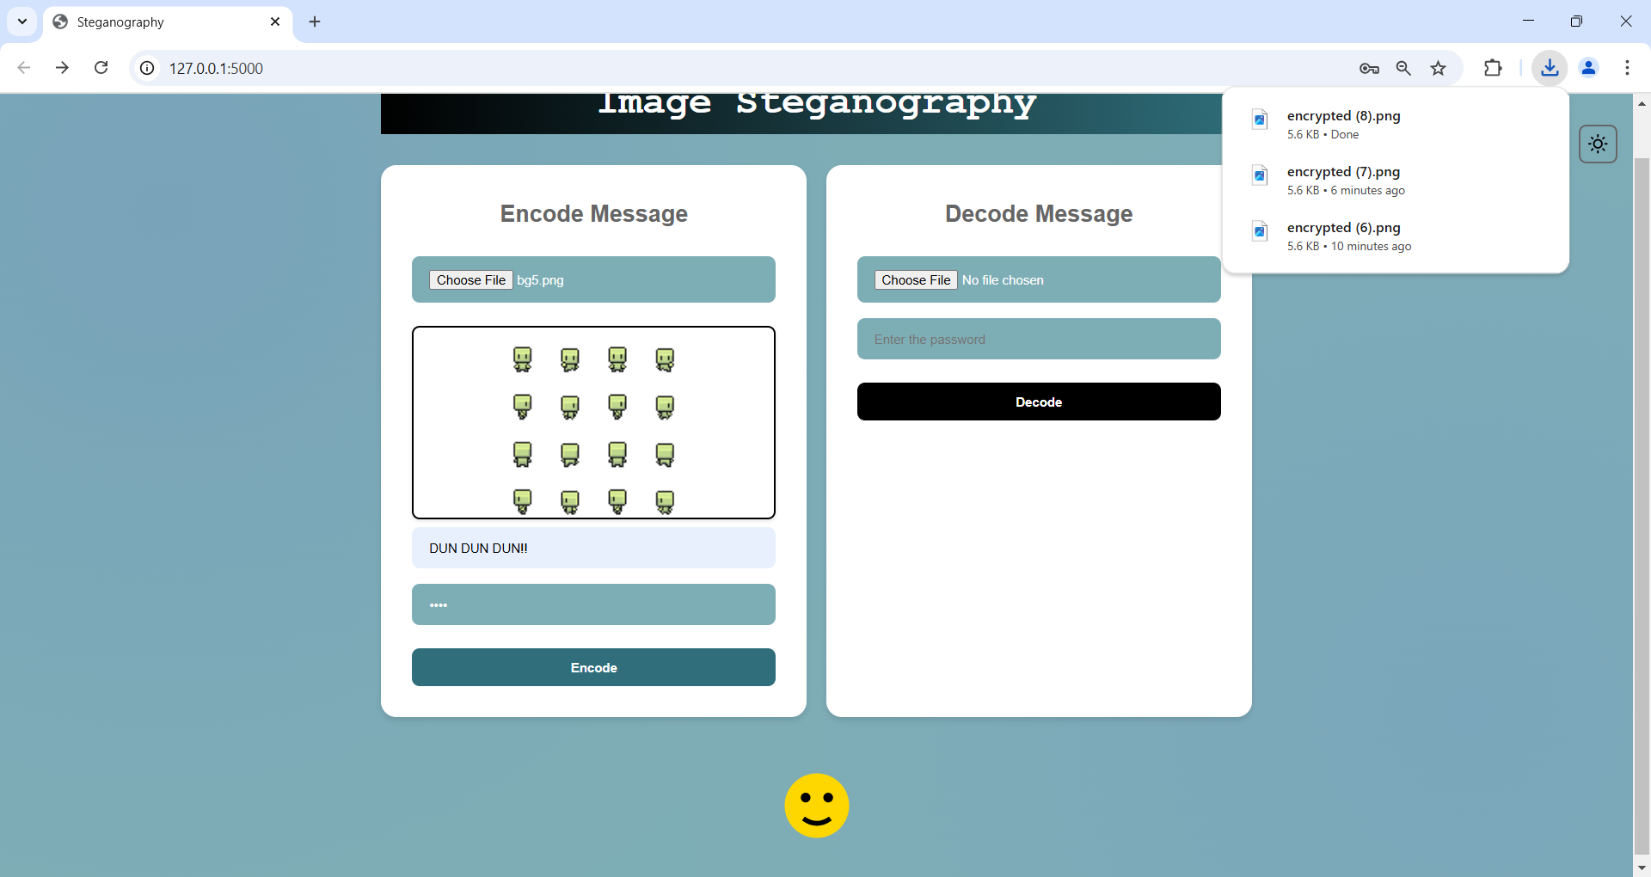
ENCODE:

Slide 9
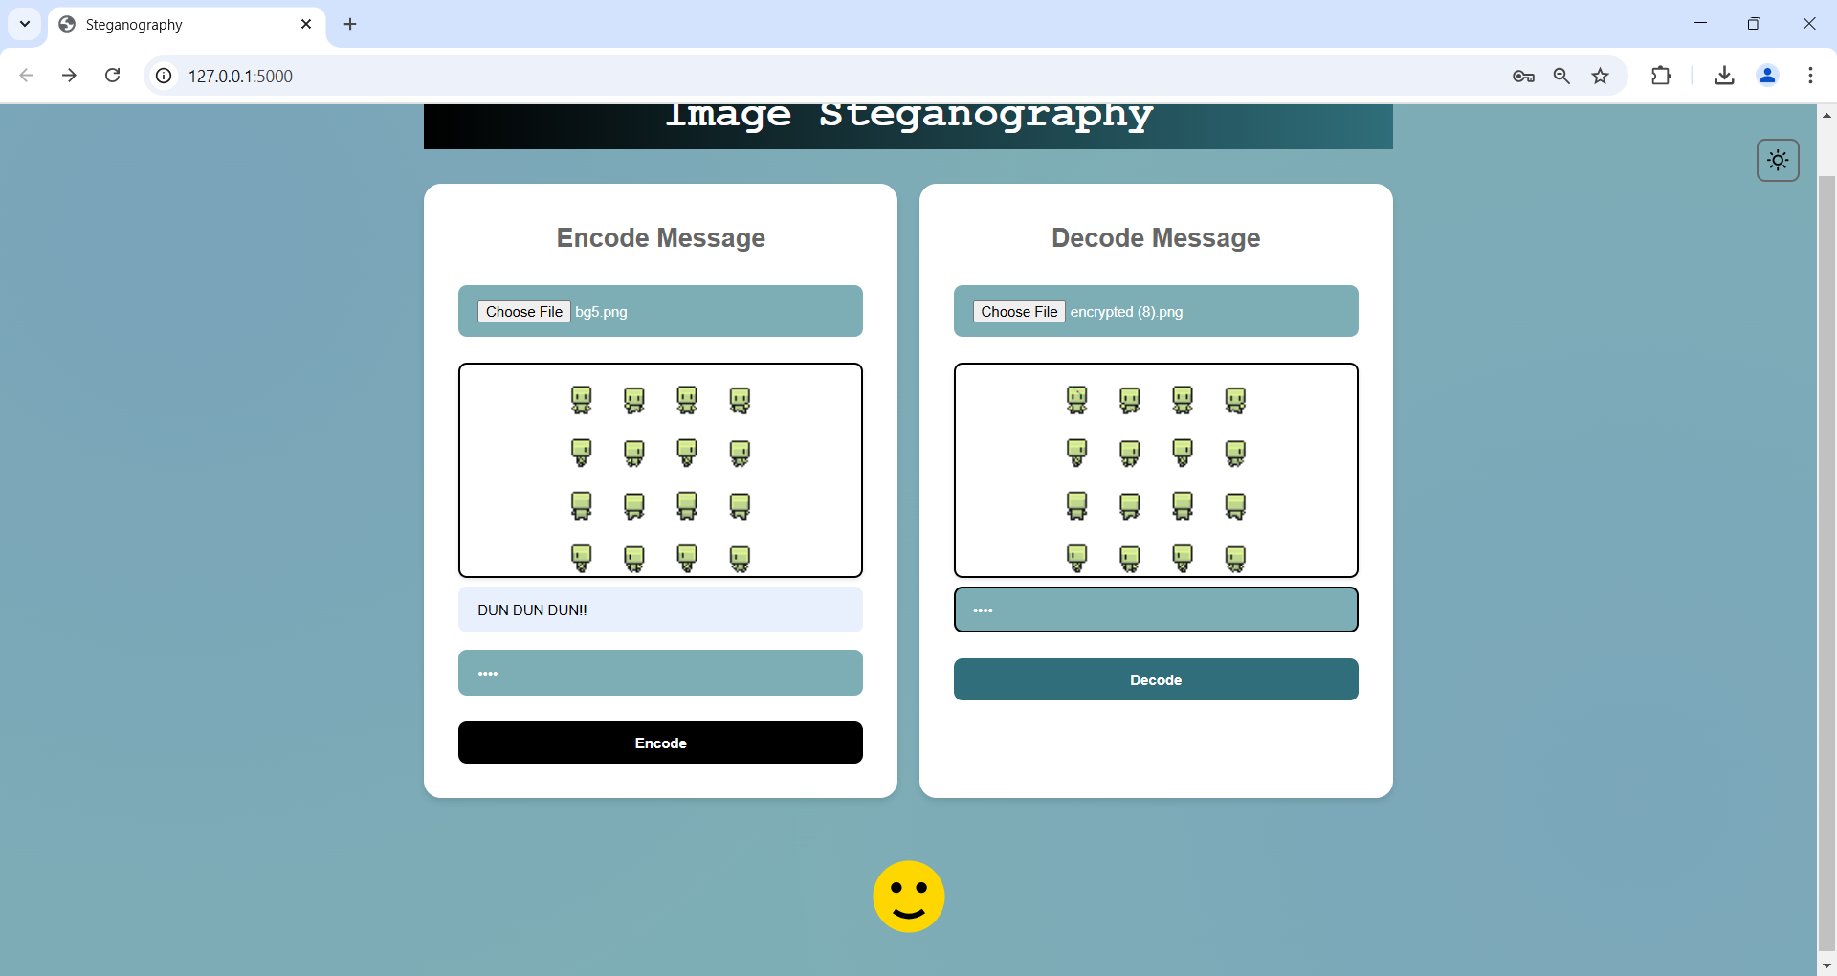
DECODE:

Slide 10

OUTPUT:

Slide 11
Conclusion
This project provides a modern, intuitive, and secure solution for digital steganography.
By combining image processing, encryption, and a user-friendly UI, it enhances data security while remaining accessible.
With future improvements like cloud storage, AI-driven security enhancements, and mobile integration, it can become a mainstream solution for private communication.

Slide 12
GitHub Link
https://github.com/AditriRay/Steganography

Slide 13
Future scope(optional)
Implement more advanced encryption techniques like AES with steganography.
Support larger file types beyond images (e.g., audio, video).
Mobile & Cloud Integration: Develop a mobile app with steganography-based messaging.
Enable cloud storage for encoded images for remote access.
AI-Powered Steganography: Use machine learning to adaptively hide messages in different image regions.
Detect and counter steganalysis techniques that try to crack hidden messages.

Slide 14
Concept:
A cryptic website where players solve a hidden puzzle by uncovering secret messages embedded in images.
Players upload images they find throughout the game, and the system decodes hidden clues.
Some images might require passwords (found through riddles in previous levels).
Completing a challenge unlocks new encrypted messages or levels.
Aesthetic: A dark, cyberpunk-themed interface with glowing text and glitch effects.
Multi-player Mode: Players can hide messages inside images and challenge friends to decrypt them.

Slide 15
THANK YOU!

