Slide 1

MACHINE LEARNING INTERNSHIP PROJECT · SUMMER 2026
Employee Attrition Prediction System
Developed by Aditya Verma · B.Tech CSE (AI & ML)
United College of Engineering & Research, Prayagraj · AKTU, Lucknow
Internship at IIHMF, MNNIT Prayagraj

Slide 2

INTRODUCTION
Problem Statement
What is Employee Attrition?
The voluntary or involuntary departure of employees from an organization — a costly challenge impacting productivity and morale.
Why Predict It?
Replacement costs can exceed 1.5× annual salary
Disrupts team dynamics and project continuity
ML enables proactive, data-driven retention strategies
HR analytics transforms reactive hiring into predictive workforce planning

Slide 3
OBJECTIVES & DATASET
Project Goals & Data Source
Project Objectives
IBM HR Analytics Dataset
Predict employee attrition using supervised ML models
1,470
35
Employee records
Features
Compare Logistic Regression, Random Forest, and XGBoost
Binary
Deploy a real-time prediction system via Streamlit
Target: Attrition (Yes/No)

Slide 4
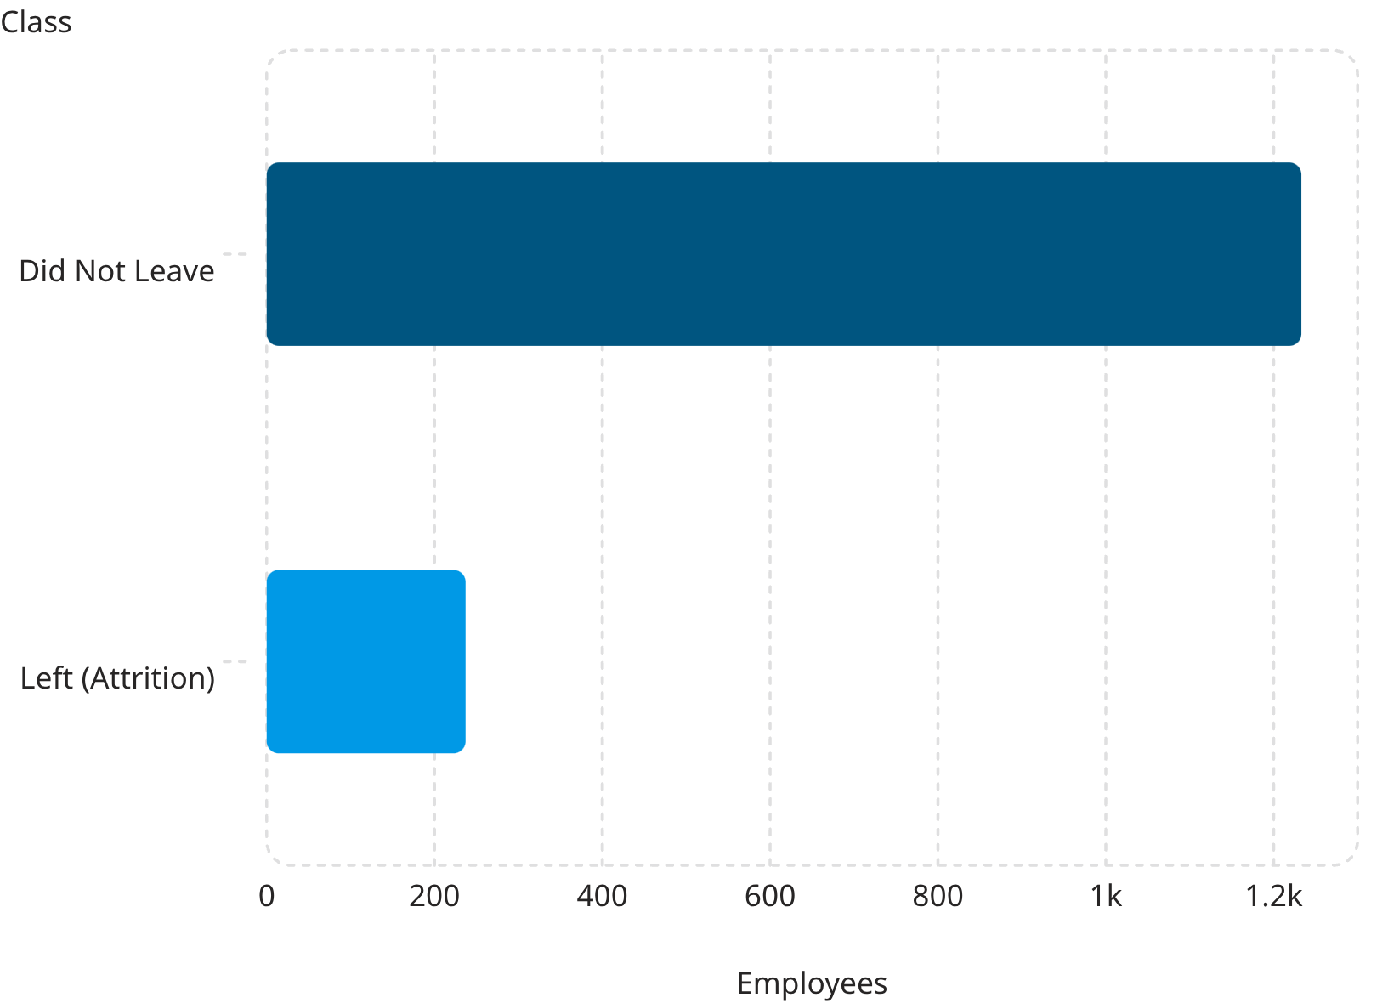
EXPLORATORY DATA ANALYSIS
Understanding the Data
Key Observations
Class Imbalance: ~16% attrition rate — minority class requires careful handling
Correlation Analysis: Overtime, Job Satisfaction, and Years at Company were top predictors
Categorical Features: Department, Job Role, and Business Travel showed meaningful distribution patterns
No Missing Values in the original dataset — clean and well-structured

Slide 5

DATA PREPROCESSING
Preparing the Data for Modeling
Drop Columns
One-Hot Encode
Standard Scale
Train-Test Split
A clean, consistent preprocessing pipeline ensures all three models are trained on identical, well-structured input data — enabling fair and reproducible comparison.

Slide 6

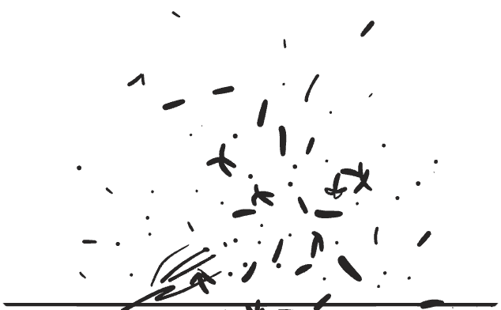


MACHINE LEARNING MODELS
Three Models, One Dataset
Logistic Regression
Random Forest
XGBoost
Linear probabilistic classifier. Interpretable, efficient, and well-suited for binary classification tasks.
Ensemble of decision trees. Robust to overfitting, handles non-linear relationships naturally.
Gradient boosting framework. High predictive power with regularization to control model complexity.
All three models were trained and evaluated on the same preprocessed dataset for a fair, apples-to-apples comparison.

Slide 7

MODEL EVALUATION
Performance Comparison
Model
Accuracy
Precision
Recall
F1-Score
Logistic Regression ✅
86.05%
61.54%
34.04%
43.84%
Random Forest
83.33%
41.67%
10.64%
16.95%
XGBoost
86.05%
65.00%
27.66%
38.81%
Logistic Regression selected as the final model — it achieved the best overall balance across Accuracy, Precision, Recall, F1-Score, and ROC-AUC, with the added benefit of interpretability for HR stakeholders.

Slide 8

DEPLOYMENT
Streamlit Web Application
Application Features
Employee Information Form
Real-Time Prediction
Instant attrition risk output powered by the Logistic Regression model
Input fields for age, department, job satisfaction, overtime, and more
Confidence Score
HR Decision Support
Displays prediction probability to support informed HR decisions
Practical tool for workforce planning and retention strategy

Slide 9
RESULTS & FUTURE SCOPE
What We Built & What's Next
✅ Project Results
🔭 Future Scope
End-to-end ML pipeline from raw data to deployed model
SMOTE
Hyperparameter Tuning
Interactive Streamlit web application for real-time prediction
Address class imbalance
Optimize model performance
Logistic Regression model achieving 86.05% accuracy
Cross-Validation
SHAP Explainability
Improve generalization
Interpret feature importance
Cloud Deployment
Scale for production use

Slide 10
CONCLUSION
Summary
1
2
Problem Addressed
Best Model Selected
Built an ML system to predict employee attrition using the IBM HR Analytics dataset
Logistic Regression achieved 86.05% accuracy with the best balance across all evaluation metrics
3
4
Real-World Deployment
Scalable Foundation
Delivered an interactive Streamlit application enabling real-time, explainable HR predictions
Established a reproducible pipeline ready for SMOTE, SHAP, and cloud deployment
Thank You
Questions?
Aditya Verma · B.Tech CSE (AI & ML) · IIHMF, MNNIT Prayagraj · Summer 2026

