Slide 1
Spreadsheet Project:
IT Ticket Analysis
Aditya Thakur
22/01/2025

Slide 2

Objectives
Identify Areas for Improvement: Pinpoint specific processes or systems that frequently lead to ticket submissions, allowing for targeted enhancements.
Understand Market Trends: Analyze ticket trends to better anticipate user needs and align IT services with business objectives.
Enhance Resource Allocation: Use insights from ticket analysis to optimize staffing and resource distribution, ensuring timely responses to user issues.
Introduction
Did you know that over 70% of IT support tickets can be resolved with proper analysis and proactive measures? In today’s fast-paced digital landscape, understanding the dynamics of IT support is crucial for enhancing efficiency and customer satisfaction.
This project focuses on analyzing IT ticket data to uncover patterns and trends that can significantly impact service delivery and operational efficiency. By leveraging data analytics, we aim to transform the way IT departments manage support requests.

Slide 3
DATA OVERVIEW
IT Tickets Analysis - Dataset Summary
Content:
Total Records: 97,499 tickets
Sheets Analyzed:
Tickets
IT Agents
Key Attributes in Tickets Sheet:
Ticket ID
Date
Employee ID
Agent ID
Request Category
Issue Type
Severity
Priority
Resolution Time (Days)
Satisfaction Rate
Key Attributes in IT Agents Sheet:
Agent ID
Full Name
Email
Year of Birth
Month of Birth
Day of Birth
Dataset Objective:
To analyze IT ticket resolution efficiency, agent performance, and system effectiveness.
Visual: A table with dataset structure or a mockup of the columns.

Slide 4
Slide 2: Key Insights and Metrics
Title: Initial Insights and Trends
Content:
Ticket Trends:
Average daily ticket volume: 267 tickets/day
Peak request category: "System" issues
Agent Performance:
Highest tickets handled by a single agent: 2,027
Average resolution time: 4.55 days
Satisfaction Metrics:
Overall average satisfaction rate: 4.1/5
Agents with lowest ratings identified for training.
Visual Suggestions:
A bar chart comparing resolution times by category.
A pie chart showing distribution of request categories.
Footer Note: "Data accuracy ensured through validation and cleaning procedures."

Slide 5
Methodology
Data Cleaning
Duplicates Removal: Identified and eliminated duplicate ticket entries to ensure data integrity.
Handling Missing Values:
Imputed missing values using mean/mode where applicable.
Removed incomplete records that could skew analysis.
Data Enrichment
Categorization: Assigned categories to tickets based on keywords for more accurate analysis.
Time Stamping: Converted ticket submission times into a standardized format for time-based analysis.
Types of Analysis Conducted
Statistical Analysis: Calculated averages, medians, and frequencies to understand ticket distribution.
Trend Analysis: Analyzed ticket volume over time to identify peak periods and recurring issues.
Tools and Functions Used
Excel Functions:
Pivot Tables: For summarizing and analyzing ticket data effectively.
VLOOKUP: To merge additional data sources for enriched insights.
Charts and Graphs: Visual representations of trends and distributions for easier interpretation.

Slide 6
Analysis and Insights
System category has received a total of 39002 tickets which is the maximum among all categories.
The least amount of tickets has been received from Hardware category which is 9733.
It is crucial to understand distribution of ticket categories so that we can decide that which category need more improvement

Slide 7
Analysis and Insights
Maximum no of tickets were held by agent id 48 which is 2027 tickets.
Minimum no of tickets were held by agent id 13 which is 1856 tickets.
Understanding of ticket distribution among IT agents is necessary to measure the performance of IT agents.

Slide 8
Analysis and Insights
The above pivot table shows the count of tickets for each issue type.
Count of tickets raised for IT error were 24278.
Count of tickets raised for IT request is 73220.
Understanding of ticket distribution among issue types is crucial to know that for which issue types , more tickets are raised.

Slide 9
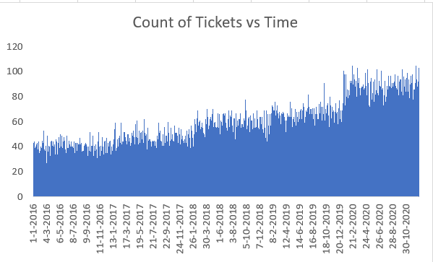
Analysis and Insights
The above graph shows that volume of tickets have gradually increased from 2016 to 2020.
Maximum no of tickets raised on any day were 105 on 16 Feb 2020 and 20 Feb 2020.
Minimum no of tickets raised on any day were 17 on 17 Nov 2016.

Slide 10
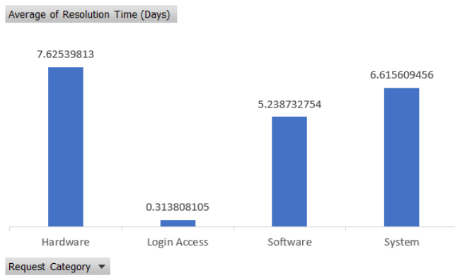
Analysis and Insights
Tickets raised from Hardware category takes the most to resolve.
Ticket raised from Login Access category gets resolved in just 0.3 days.
Understanding of resolution time of different request category is necessary to understand which request category is taking more time to get resolved.

Slide 11
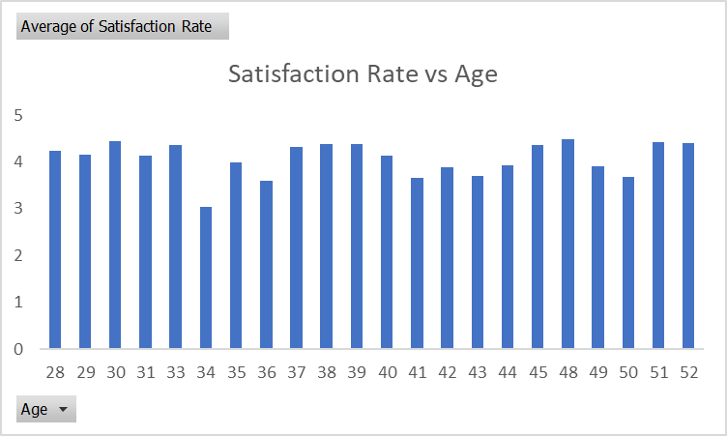
Analysis and Insights
Consistently High Satisfaction (Ages 28-38): The satisfaction rate remains relatively stable and high in the age range of 28-38.
Slight Dip in Mid-Age Group (Ages 39-43): There is a noticeable dip in satisfaction levels around ages 39-43.
Satisfaction Rebounds (Ages 44-52): The satisfaction rate recovers and stays consistent towards the upper age bracket (44-52).

Slide 12
Analysis and Insights
Steady Improvement: The satisfaction rate has consistently increased year over year from 2016 to 2020.
Significant Jump: The most noticeable rise in satisfaction occurred between 2016 and 2017.
Peak in 2020: 2020 recorded the highest satisfaction rate, suggesting successful efforts to boost employee morale.

Slide 13
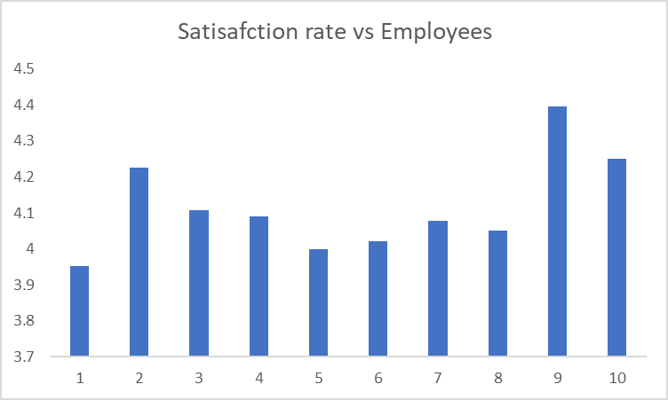
Analysis and Insights
The data has a total of 2000 employees, but we are only analysing performance of 10 employees.
The peak satisfaction rate is given by the employee no 9 which is close to 4.4.
The lowest satisfaction rate is given by no. 1 which is close to 3.9.
The satisfaction rate of the whole data ranges from 3.9 to 4.5.

Slide 14
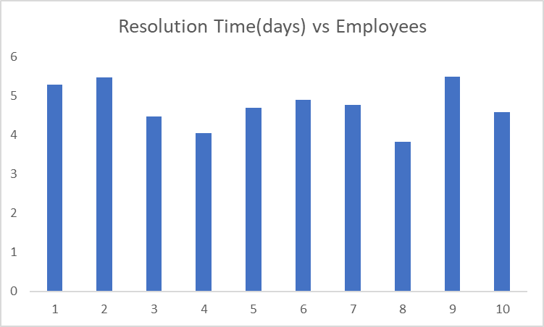
Analysis and Insights
Issues of employee no. 4 got resolved on just less than 4 days on an average.
While for Id no. 2 and 9 , it took more than 5 days.

Slide 15
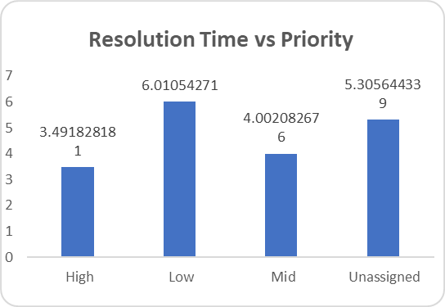
Analysis and Insights
This graph shows the resolution time of different priorities.
Unassigned priority tickets are taking less time to resolve than low priority tickets.
High Priority tickets get resolved in just 3.49 days.
It is crucial to understand that whether tickets are being resolved according to priorities or not.

Slide 16
Analysis and Insights
System-related requests dominate the ticket count with 39,002 tickets.
Login Access issues are the second highest, with 29,193 tickets.
Software requests are substantial but lower than System and Login Access.
Hardware requests are the least frequent, with only 9,733 tickets.

Slide 17
Analysis and Insights
Most tickets (25,071) are resolved within 0 days.
Resolution times of 1 to 7 days also show a high ticket count, with a gradual decline.
Resolution times beyond 10 days are minimal.
Resolution efficiency decreases as time increases.

Slide 18
Analysis and Insights
Normal severity tickets are the most common, with 88,656 tickets.
Major severity tickets are relatively few, with only 4,836.
Minor, Unclassified, and Urgent tickets have very low counts, with only 2,258 Minor, 356 Unclassified, and 1,392 Urgent tickets.

Slide 19
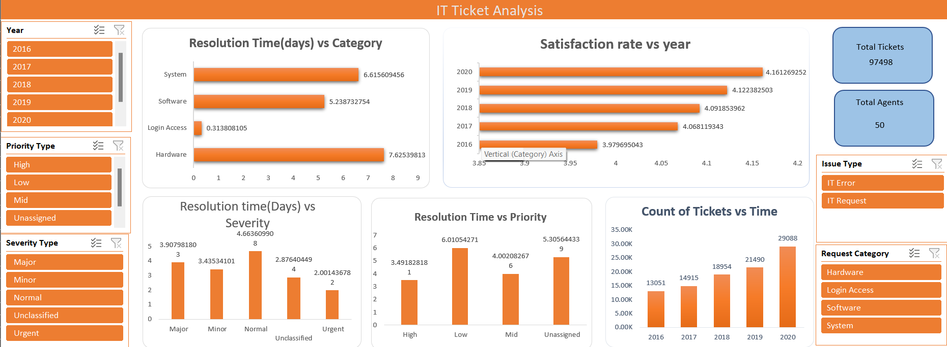
Dashboard and Visualizations

Slide 20
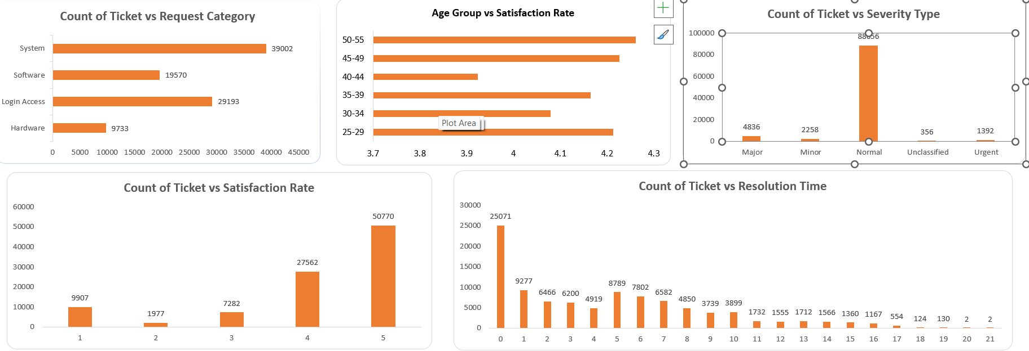
Dashboard and Visualizations

Slide 21
Conclusion
In this analysis, we have uncovered key insights regarding the performance of the IT support team. We observed a increasing trend in ticket volume and identified areas where agent performance can be optimized, particularly through training programs for agents with lower satisfaction scores and longer resolution times.
Recommendations:
Prioritize targeted training for underperforming agents.
Upgrade software tools to reduce resolution times and improve user experience.
By addressing these areas, the IT support team will not only improve operational efficiency but also enhance the overall satisfaction of employees, driving better long-term performance.

Slide 22
Conclusion
Implications
Strategic Recommendations:
Upgrading ticket management software system is another good alternative.
Slow resolution times that are caused by inefficiencies in the current system can be improved by upgrading the system.
Software upgrades can be expensive (licensing, implementation, training on new software).
New software might automate certain tasks, track issues better, and improve the overall efficiency of ticket handling.
Summary of Key Findings
Another option might be to improve training programs.
We should focus on agents with high resolution times and low satisfaction scores.
We found an insight in the analytics section(9th slide) that agents 19,22,25,28,3,22, 7 have resolution time>=5 days and satisfaction rate<=4.
If their performance is due to a lack of training then improving training could be a cost-effective solution.
Better-trained agents can resolve tickets faster and more accurately, improving satisfaction scores and lowering resolution times.
Implications
Strategic Recommendations:
Hiring more agents can be one option.
The current agent-to-ticket ratio is approx 1912 tickets per agent over four years from 2016-2020.
It seems that the resolution time is high due to agent overload, so hiring more agents can be the solution.
Hiring more agents incurs salary costs, benefits, and overhead expenses.
This could reduce the workload for existing agents, leading to faster ticket resolution times and more satisfaction rate as resolution time has increased.

