Slide 1
Department of Electronics and Communication Engineering, VNIT Nagpur
Mini Project Submission
For
ECL423: Image Analysis and Computer Vision
(Academic Year: 2023-24)

Slide 2
Mini Project Title : MA-Net: A Multi-Scale Attention Network for Liver and Tumor Segmentation
Janhavi Ghuge (BT20ECE041)
Aditya Kakade (BT20ECE050)
Kumar Mridul (BT20ECE060)
Humaiz Qazi (BT20ECE079)
Topic Based on the Research Paper:
MA-Net: A Multi-Scale Attention Network for Liver and Tumor Segmentation

Slide 3
Contents…
Introduction
Motivation
Existing Solution
Proposed Solution
Methodology
Results
Conclusion
References

Slide 4
Introduction
Liver cancer ranks among the leading causes of cancer-related mortality worldwide, underscoring the urgent need for accurate diagnostic tools and treatment strategies.
Manual segmentation of liver and tumor lesions from medical scans remains the primary method for diagnosis, yet it is fraught with challenges that hinder efficiency and accuracy.
Traditionally, radiologists perform this segmentation manually. This process is not only time-consuming but also relies heavily on the expertise of the individual radiologist, potentially introducing inconsistencies.
Deep learning techniques, particularly Convolutional Neural Networks (CNNs), have demonstrated remarkable success in various image analysis tasks, including medical image segmentation.

Slide 5
Introduction
Challenges in Medical Image Analysis: Medical images present unique challenges, such as poor contrast, heterogeneous lesion characteristics, and intricate anatomical structures, necessitating tailored segmentation methods for accurate analysis.
Role of U-Net and its Limitations: U-Net, a popular architecture for medical image segmentation, has significantly advanced the field but may struggle to capture complex spatial and channel-wise relationships critical for precise segmentation.
Introducing MA-Net: In response to these challenges, we propose MA-Net, a novel Multi-Scale Attention Network tailored specifically for liver and tumor segmentation. By integrating self-attention mechanisms, MA-Net aims to enhance feature representation and improve segmentation accuracy, thereby addressing the limitations of existing methods.

Slide 6
Motivation
Manual segmentation inefficiencies: Radiologists spend significant time manually identifying liver and tumor regions, delaying treatment.
Subjectivity and expertise reliance: Manual segmentation results vary based on radiologist expertise, impacting diagnostic accuracy.
Advancements in imaging technology: Automated segmentation methods are needed to handle the growing volume of high-resolution medical images.

Slide 7
Motivation
Potential for improved outcomes: Automated segmentation can streamline workflows, leading to faster diagnoses and better treatment decisions.
Challenges in medical image analysis: Medical images present unique difficulties like low contrast and variable lesion characteristics.
Necessity for advanced computational techniques: Traditional methods may not suffice, requiring the development of sophisticated algorithms like deep learning.

Slide 8
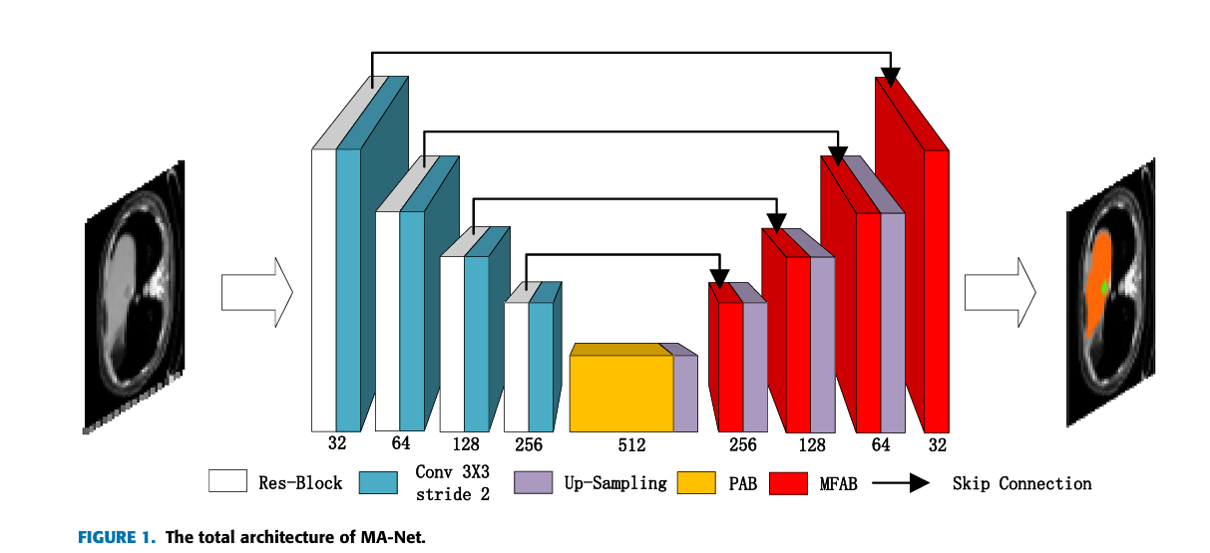

Slide 9
Existing Solutions and its Limitations
Fully Convolutional Networks (FCN) have achieved success in image segmentation.
U-Net with skip connections is a popular architecture for medical image segmentation.
Existing skip connections cannot capture spatial and channel-wise relationships between pixels.
Dilated convolutions and pooling used in some methods cannot capture these relationships globally and may lose details.

Slide 10
Proposed Solution
A novel Multi-scale Attention-Net (MA-Net) architecture for liver and tumor segmentation is proposed.
MA-Net uses self-attention mechanism to capture spatial and channel-wise dependencies of feature maps.
Position-wise Attention Block (PAB) captures spatial dependencies between pixels globally.
Multi-scale Fusion Attention Block (MFAB) captures channel dependencies between any feature maps, fusing high-level and low-level features.
MA-Net aims to obtain richer multi-scale semantic information and improve segmentation performance.

Slide 11
Methodology Used in the Research Paper:
The research paper introduces a novel network named Multi-scale Attention Net (MA-Net) for liver and tumor segmentation, incorporating self-attention mechanisms for adaptive integration of local features with global dependencies.
The methodology includes the design of two key blocks: Position-wise Attention Block (PAB) for spatial feature interdependencies and Multi-scale Fusion Attention Block (MFAB) for channel dependencies between feature maps
The proposed method utilizes an improved encoder-decoder architecture of U-Net, consisting of Res-blocks, Position-wise Attention Block, and Multi-scale Fusion Attention Block for liver and tumor segmentation

Slide 12
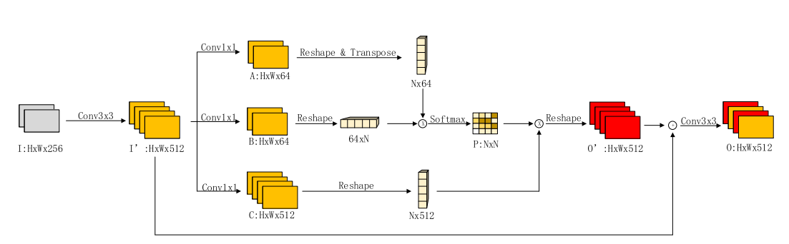
Methodology Used in the Research Paper:
Fig.: The Position-wise Attention Block (PAB). The input image is HxWx256 and output is HxWx512. The attention feature map is obtained by Softmax function.

Slide 13
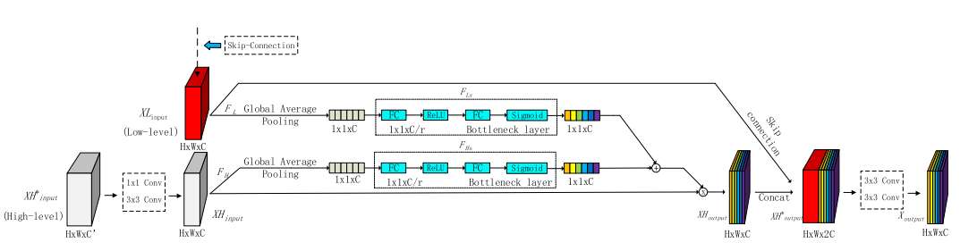
Methodology Used in the Research Paper:
Fig.: The Multi-scale Fusion Attention Block (MFAB). We use two SE-Blocks to capture Low-level and High-level feature map respectively. The final channel attention feature map is obtained via a Concat connection.

Slide 14
Methodology Used in the Research Paper:
The study combines self-attention mechanisms, multi-scale semantic information, and a new loss function to enhance segmentation accuracy on the 2017 LiTS dataset .
The Res-block in the methodology comprises convolutional layers, Group Normalization (GN), and residual connections for extracting high-dimensional feature information.

Slide 15
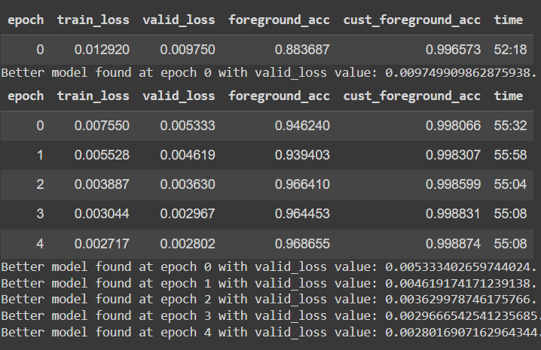
Results :

Slide 16
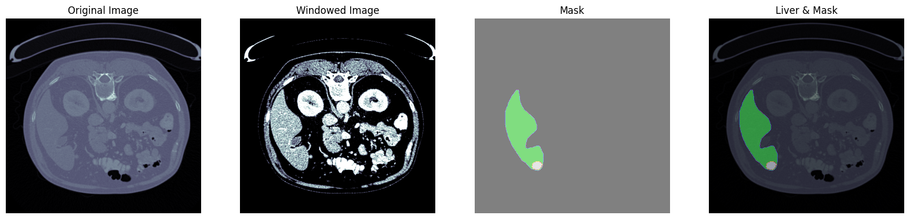

Slide 17
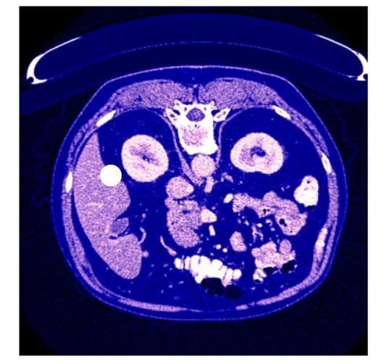
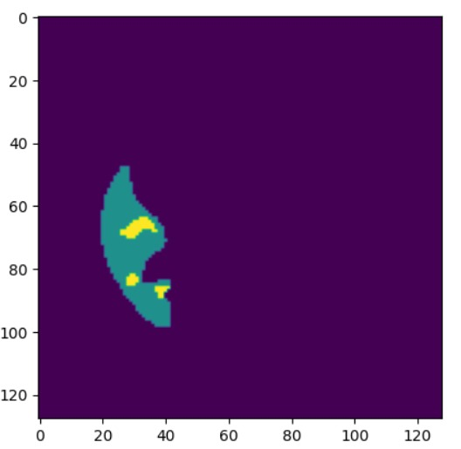
Example of liver and tumor segmentation result :
Input Image :
Output Image :
The green region denotes the liver and the yellow region denotes the tumor.

Slide 18
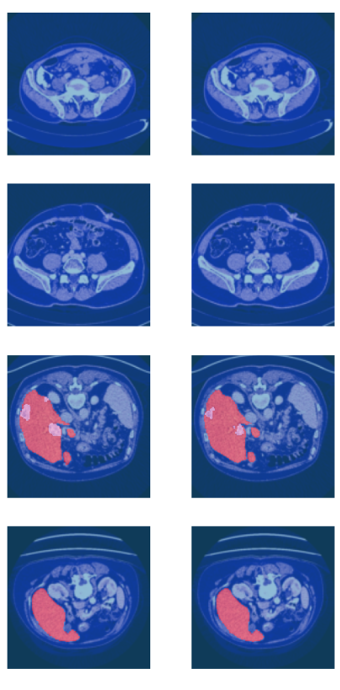
Target
Predictions

Slide 19
Conclusion
This research presented the Multi-scale Attention Net (MA-Net), a novel architecture for liver and tumor segmentation in medical images. MA-Net addresses limitations of existing methods by incorporating a self-attention mechanism. This mechanism allows the network to capture crucial relationships between pixels, both spatially (how they relate to neighbors) and across channels (how features connect).Experiments on the LiTS 2017 dataset demonstrated significant improvement over existing methods, achieving Dice scores of 0.960 ± 0.003 for liver and 0.749 ± 0.008 for tumors.While our method shows considerable potential, future studies will explore its applicability to other medical imaging tasks and consider incorporating 3D information from CT images to further enhance segmentation accuracy. Overall, MA-Net represents a significant step forward in medical image analysis, with the potential for continued development and advancement in the field.

Slide 20
References :
T. Fan, G. Wang, Y. Li, and H. Wang, "MA-Net: A Multi-Scale Attention Network for Liver and Tumor Segmentation," IEEE Access, vol. 8, pp. 155732-155743, 2020.
J. Ferlay, H.-R. Shin, F. Bray, D. Forman, C. Mathers, and D. M. Parkin, ‘‘Estimates of worldwide burden of cancer in 2008: GLOBOCAN 2008,’’ Int. J. Cancer, vol. 127, no. 12, pp. 2893–2917, Dec. 2010.
R. Lu, P. Marziliano, and C. Hua Thng, ‘‘Liver tumor volume estimation by semi-automatic segmentation method,’’ in Proc. IEEE Eng. Med. Biol. 27th Annu. Conf., Jan. 2006, pp. 3296–3299.
J. Long, E. Shelhamer, and T. Darrell, ‘‘Fully convolutional networks for semantic segmentation,’’ in Proc. IEEE Conf. Comput. Vis. Pattern Recognit. (CVPR), Jun. 2015, pp. 3431–3440.
O. Ronneberger, P. Fischer, and T. Brox, ‘‘U-Net: Convolutional networks for biomedical image segmentation,’’ in Proc. Int. Conf. Med. Image Comput. Comput.-Assist. Intervent. Cham, Switzerland: Springer, 2015, pp. 234–241

