Slide 1
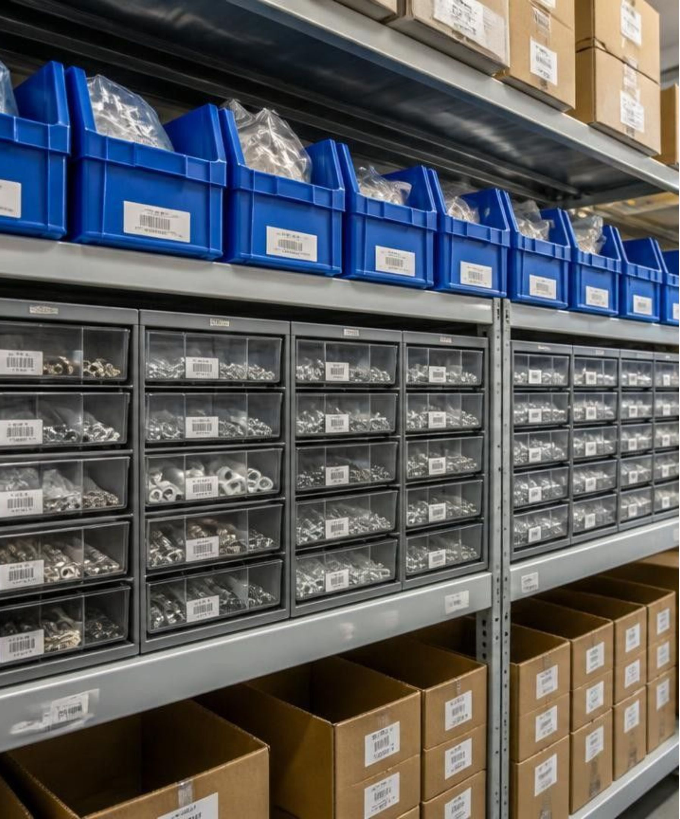
STOCKROOM
Inventory Tracking System
Academic Review · 3rd Semester Project
Frontend Software Engineering Demonstration
Notes:
Introduce Stockroom as a 3rd semester project designed to replace chaotic manual tracking with a clean, centralized inventory dashboard.

Slide 2

CURRENT BOTTLENECKS
PROBLEM STATEMENT
1
Spreadsheet fragmentation
Unlinked files make stock tracking difficult to maintain and synchronize.
2
Overlooked stock thresholds
Low-stock items and depleted SKUs go unnoticed until shortages happen.
3
Lack of unified visibility
A centralized web interface is needed to make stock levels effortless to monitor.
ZERO VISIBILITY
when spreadsheets fall out of sync
Notes:
Highlight the core problems: spreadsheet fragmentation, missed low-stock items, and the immediate need for a centralized dashboard.

Slide 3





PROJECT SCOPE
CORE OBJECTIVES
Clean Web Interface
Multi-Attribute Tracking
Low-Stock Alerts
Complete CRUD Tools
Responsive UI
Automatically identify and highlight low-quantity inventory for reorder.
Ensure smooth layouts across desktop and mobile terminal viewports.
Build an intuitive, responsive management interface for daily operations.
Track precise item quantity, SKU identifiers, and stockroom shelf locations.
Provide full search, category filtering, add, edit, and deletion capabilities.
Notes:
Present the five core objectives established for the semester build: clean interface, granular SKU tracking, automated low-stock detection, full CRUD, and responsiveness.

Slide 4
ENGINEERING FOUNDATION
TECHNOLOGY STACK
HTML5
CSS3
JavaScript (ES6+)
Structure & Forms
Styling & Responsiveness
Application Logic
Page structure and forms.
Application logic and DOM events.
Responsive design and UI styling.
5 CORE TOOLS
LocalStorage API
Git & GitHub
Client Persistence
Version Control & Collaboration
Demo persistence and session management.
Version control and project repository.
Clean vanilla web stack delivering dependable offline-ready capability
100% Client-Side Architecture · Zero External Dependencies
Notes:
Review the technology decisions: vanilla HTML5/CSS3/JavaScript ES6+, LocalStorage for browser persistence, and Git/GitHub for version control.

Slide 5
CAPABILITIES
Sign In & Account Creation — Simple user authentication and active session management.
Interactive Central Dashboard — Single-pane operational overview showing all inventory records.
Inventory Metrics — Instant summaries for total distinct items and aggregate unit counts.
Automatic Low-Stock Indicator — Real-time visual flagging when items fall under threshold levels.
Location & Shelf Tracking — Distinct counts of designated stockroom bays, shelves, and zones.
Full Inventory CRUD Operations — Add, modify, and delete item details with immediate data updates.
Real-Time Search & Filters — Instant keyword matching by SKU or name with status filtering.
SYSTEM FEATURES
A cohesive suite designed for day-to-day stockroom operations and visibility.
7 MODULES
Integrated from authentication to reporting
Notes:
Walk through the seven key system features: authentication, dashboard, metrics, low-stock warnings, location counts, CRUD operations, and filtering.

Slide 6
EXECUTION LIFECYCLE
SYSTEM FLOW
How operator interactions propagate through client-side state and browser persistence.
End-to-end client transaction path
1
2
3
4
Authenticate
Navigate
Mutate
Persist & Render
Sign In / Register
Load Dashboard
CRUD Action
Save LocalStorage
User submits credentials
Reads initial inventory list
Add, edit, or delete items
Serializes updated JSON array
Session Set
View Stock Table
Form Validation
Refresh Interface
Validates active session
Inspects items and quantities
Validates SKU and counts
Re-renders table and indicators
Notes:
Trace the pipeline step by step: authentication, dashboard display, CRUD input trigger, serialization into LocalStorage, and automatic UI re-rendering.

Slide 7
CODEBASE ARCHITECTURE
6 FILES
PROJECT STRUCTURE
Modular, lightweight repository designed for rapid onboarding and evaluation
File / Artifact | Role | Functionality & Scope
index.html | Authentication View | User sign-in and account registration forms.
home.html | Dashboard View | Inventory ledger, metrics cards, modal forms, and search.
auth.js | Auth Controller | Credential validation, session persistence, and logout flow.
inventory.js | Inventory Engine | CRUD operations, search filters, low-stock checks, and storage sync.
style.css | Presentation | Responsive grid layouts, design tokens, and state styling.
README.md | Documentation | Setup guide, project walkthrough, and workflow instructions.
Strict separation of concerns across presentation, client-side logic, and persistent storage layers.
Notes:
Break down the clean repository structure: HTML views, JavaScript controllers, styles, and documentation.

Slide 8
ASSESSMENT & ROADMAP
READY FOR REVIEW
CONCLUSION & FUTURE SCOPE
Project Links
1
Delivered Prototype
2
Backend & Database
GitHub Repository: Add your repository URL
LinkedIn Article: Add your published article URL
Practical inventory-tracking prototype; demonstrates frontend development and Git workflow.
Backend/database development.
3
Role-Based Access
4
Scanning & Deployment
Role-based access.
Barcode scanning, audit history and cloud deployment.
Thank you — open for questions and feedback.
Academic Review Complete · 3rd Semester Project
Notes:
Conclude with the practical inventory-tracking prototype, its frontend development and Git workflow, then outline future scope: backend/database, role-based access, barcode scanning, audit history and cloud deployment. Direct the panel to the repository.

