Slide 1

Chat Application Project: Structure, Database, UI, and Responsiveness
This presentation covers the chat app's architecture, database design, user interface, and responsiveness. We'll explore multithreading for smooth message handling and discuss key technologies like Python, JAVA and PostgreSQL.

Slide 2
Project Structure: Modular Design
Backend
Frontend
Handles server logic and database operations using Java.
Chat interface built with React or Angular for smooth user interaction.
API Layer
Modules
Stockserver for secure communication between frontend and backend.
Client server for User authentication, messaging, and group chat functionality as separate units.

Slide 3
Project Structure: Multithreading Implementation
1
Thread Pool
2
Message Queue
Enables concurrent handling of multiple user messages efficiently.
Manages incoming messages orderly before processing.
3
Thread Safety
4
Client Port
Server Port to prevent data conflicts and race conditions
A Client Server for multithreading operations within multiple users.

Slide 4
Database Design: Data Relationships
Relationships
Optimizations
One-to-many: Users to Messages (users send multiple messages)
Indexes on foreign keys for faster queries
Many-to-many: Users and Groups via Group_Members
JAVA chosen for reliability and concurrency

Slide 5
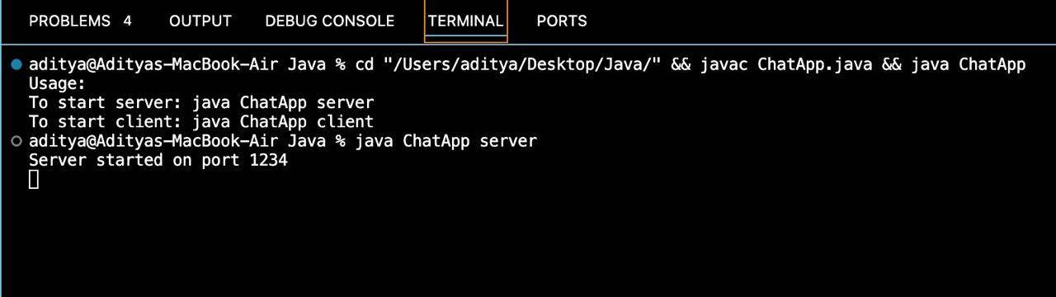
Database Connectivity: API Endpoints
To start server
Use;- java ChatApp server
To start client :
Use :- java ChatApp client
Server starts on Port 1234,
Which we created using private Socket.

Slide 6
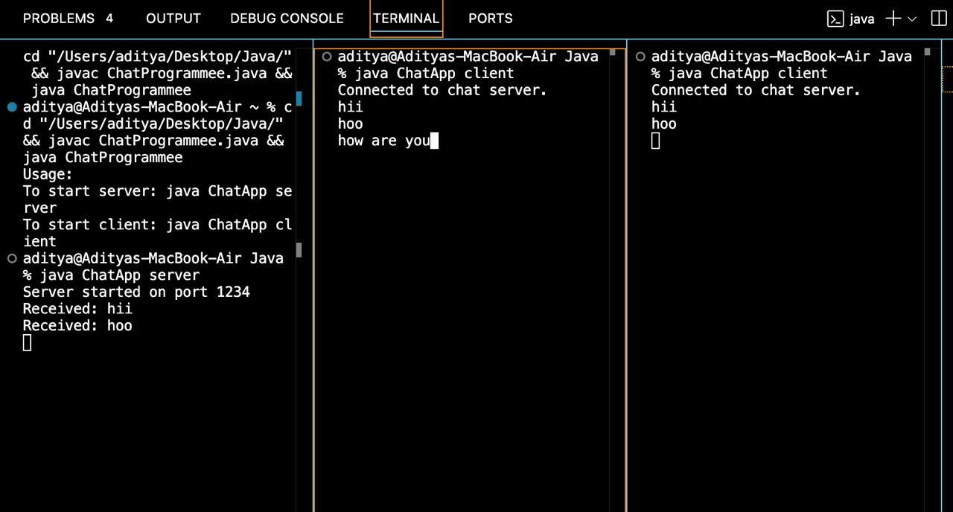
User Interface: Key Components
Chat Window
User List
Displays real-time message streams smoothly.
Multiple user at a same time within a Chat Panel .
Input Field
Group Chat Panel
Area for composing and sending messages easily.
Lists user’s groups and quick access to chats.

Slide 7
User Interface: Design Principles
Clean & Intuitive
Real-time Updates
Simple navigation between chats and groups.
Multiple user on same panel.
Instant message display for active conversations.
Messages encrypted within client servers

Slide 8
Aesthetics and Styling
Color Palette
Typography
Visual Cues
Modern, with light and dark theme options.
Consistent fonts for clarity and readability.
Icons enhance usability and guide user actions.

Slide 9

Conclusion: Key Takeaways
Responsive Design
User-Friendly Interface
Supports diverse devices and platforms seamlessly.
Robust Database
Modular Structure
Efficient data storage with relational integrity.
Engaging experience with real-time responsiveness.
Promotes maintainability and scalability.

