Slide 1
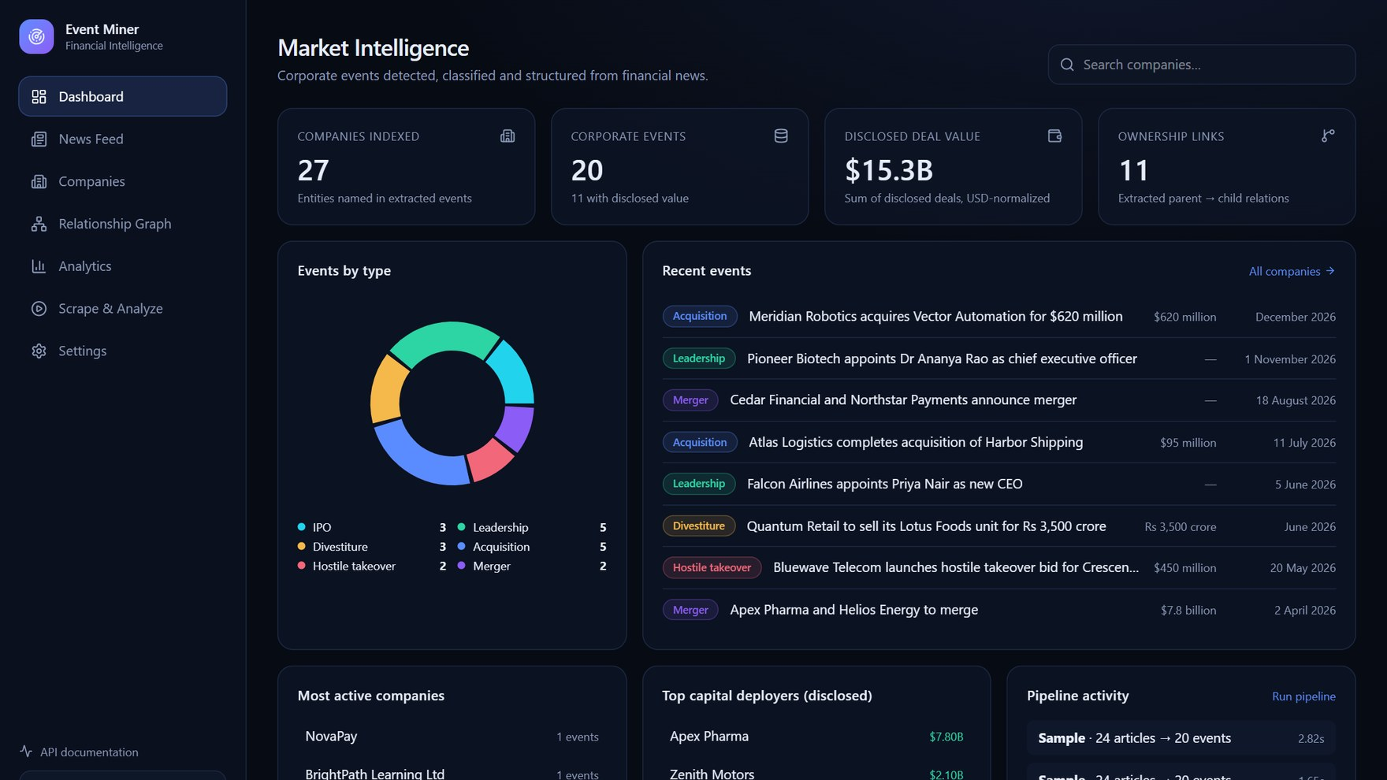
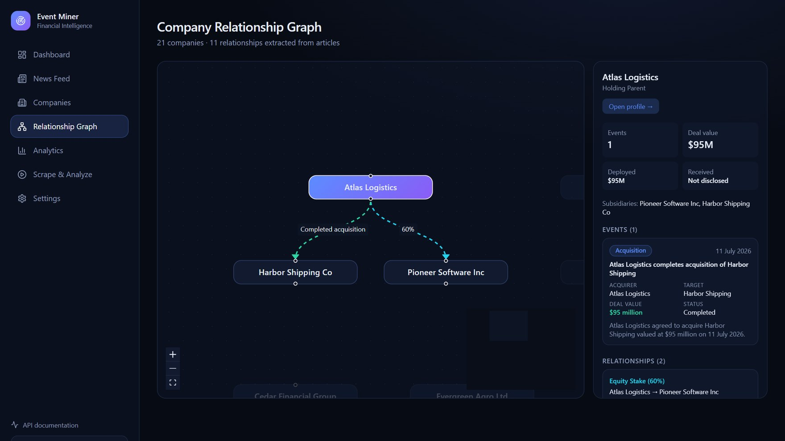
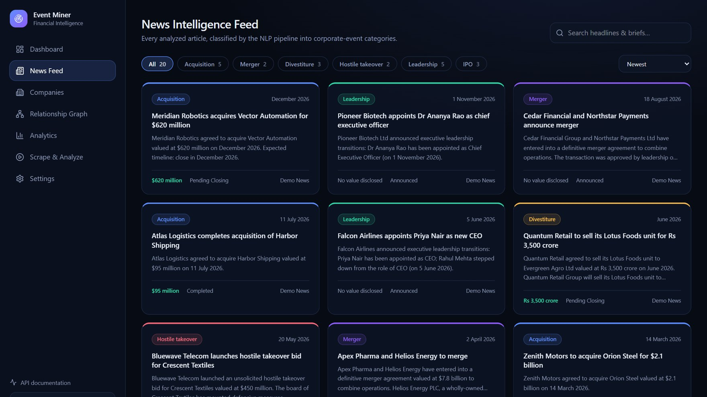
PROJECT PRESENTATION
Corporate
Event Miner
An AI-Powered Corporate Event Detection and Intelligent News Feed System
TEAM MEMBERS
INSTITUTION
Aditya Varshney
Aditya Agarwal
Jawagar K.R
VIT-AP University
PROJECT GUIDE
Prof. Gundimeda
Venugopal
Notes:
Introduce the project and the team. Corporate Event Miner turns unstructured financial news into structured corporate intelligence.

Slide 2




PROBLEM & MOTIVATION
Financial news is hard to use
Scattered Sources
Unstructured Noise
Manual Bottleneck
Hidden Relationships
Financial news is distributed across many fragmented platforms.
Key corporate announcements are buried in unrelated updates.
Extracting values, dates and entities by hand is slow.
Isolated articles hide parent-subsidiary structures.
Result: valuable corporate events are hard to find, compare and connect.
Notes:
Financial news is large, fast, and unstructured. Four core pain points motivate the project.

Slide 3




PROPOSED SOLUTION & OBJECTIVES
From raw news to structured intelligence
1. Collect
›
2. Classify
›
3. Extract
›
4. Build Graph
›
5. Present
Crawl 5 financial news sources
TF-IDF + logistic regression
Parties, values, dates, people
Ownership & deal links
REST API + React dashboard
IMPLEMENTED EVENT CATEGORIES
Acquisition
Merger
Divestiture
Hostile Takeover
Executive Change
IPO
No Event
Notes:
Our solution is a five-stage pipeline from raw feeds to an interactive dashboard, detecting seven categories.

Slide 4





SYSTEM ARCHITECTURE
Frontend → REST API → Services → Pipeline
React Frontend
FastAPI REST API
Service Layer
Original Pipeline
Storage
→
→
→
→
TypeScript · Vite
Tailwind · Recharts
React Flow
Pydantic validation
OpenAPI docs
Background jobs
Companies
Financials · Graph
NLP · Scraping
crawler · classifier
extractor
company_tree
SQLite (WAL)
JSON / CSV outputs
Trained model
Reuse, don’t rewrite: the original scraping & NLP modules run unchanged behind the API.
Notes:
The original Flask dashboard was modernised into a frontend/backend architecture. The original scraping and NLP modules are reused unchanged and wrapped in services.

Slide 5
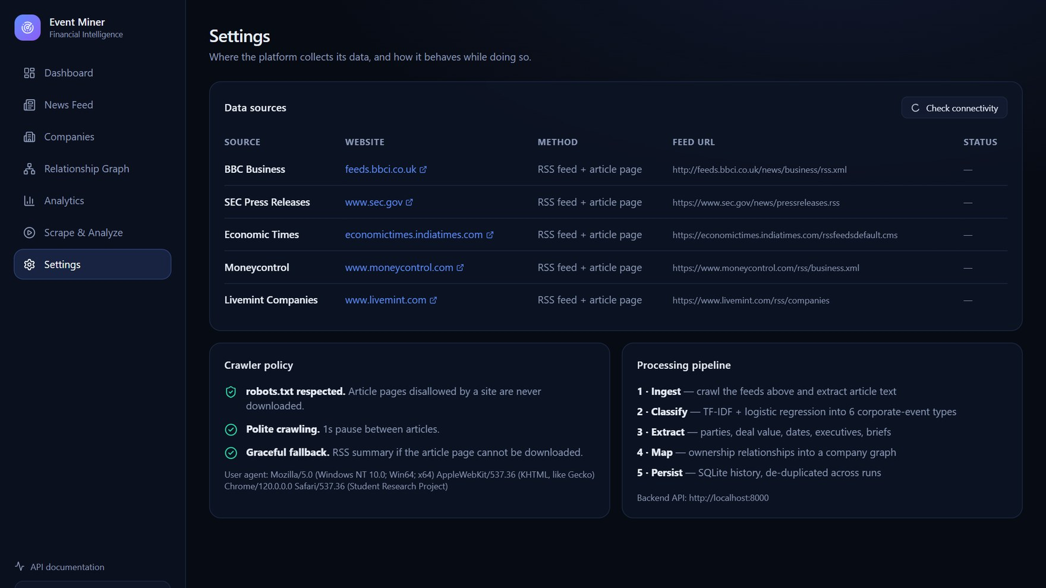
DATA COLLECTION
Where the data comes from
BBC Business
feeds.bbci.co.uk
SEC Press Releases
sec.gov
Economic Times
economictimes.indiatimes.com
Moneycontrol
moneycontrol.com
Livemint Companies
livemint.com
robots.txt respected
1 s pause between articles
Falls back to the RSS summary
Settings page with a live connectivity check
Notes:
Five public RSS sources are crawled. The crawler respects robots.txt and pauses between articles. The Settings page shows this live.

Slide 6


TECHNOLOGY STACK
Built with proven tools
Backend
Frontend
Visualisation
FastAPI, Uvicorn, Pydantic. REST endpoints with OpenAPI docs.
React, TypeScript, Vite, Tailwind CSS, TanStack Query.
Recharts for charts, React Flow for the relationship graph.
NLP Classification
Extraction & Ingestion
Data & Graphs
scikit-learn: TF-IDF vectors and logistic regression.
Regex rules, feedparser, requests, BeautifulSoup.
SQLite, NetworkX directed graphs, JSON / CSV, joblib.
Notes:
The stack combines a Python NLP backend with a modern React frontend.

Slide 7
NLP CLASSIFICATION & EXTRACTION
Two stages turn text into records
1 Machine-learning classification
2 Rule-based extraction
1
Receive cleaned article text
Input headline
“Zenith Motors to acquire Orion Steel for $2.1 billion”
2
Vectorise into TF-IDF features
{
"event_type": "ACQUISITION",
"acquirer": "Zenith Motors",
"target": "Orion Steel",
"deal_value": "$2.1 billion",
"status": "Announced",
"confidence": 0.91
}
3
Predict category with logistic regression
4
Apply heuristic overrides for edge cases (e.g. hostile bids, earnings news)
Notes:
Classification uses TF-IDF and logistic regression with heuristic overrides. Extraction uses regular-expression rules. The example output is real output from the pipeline.

Slide 8
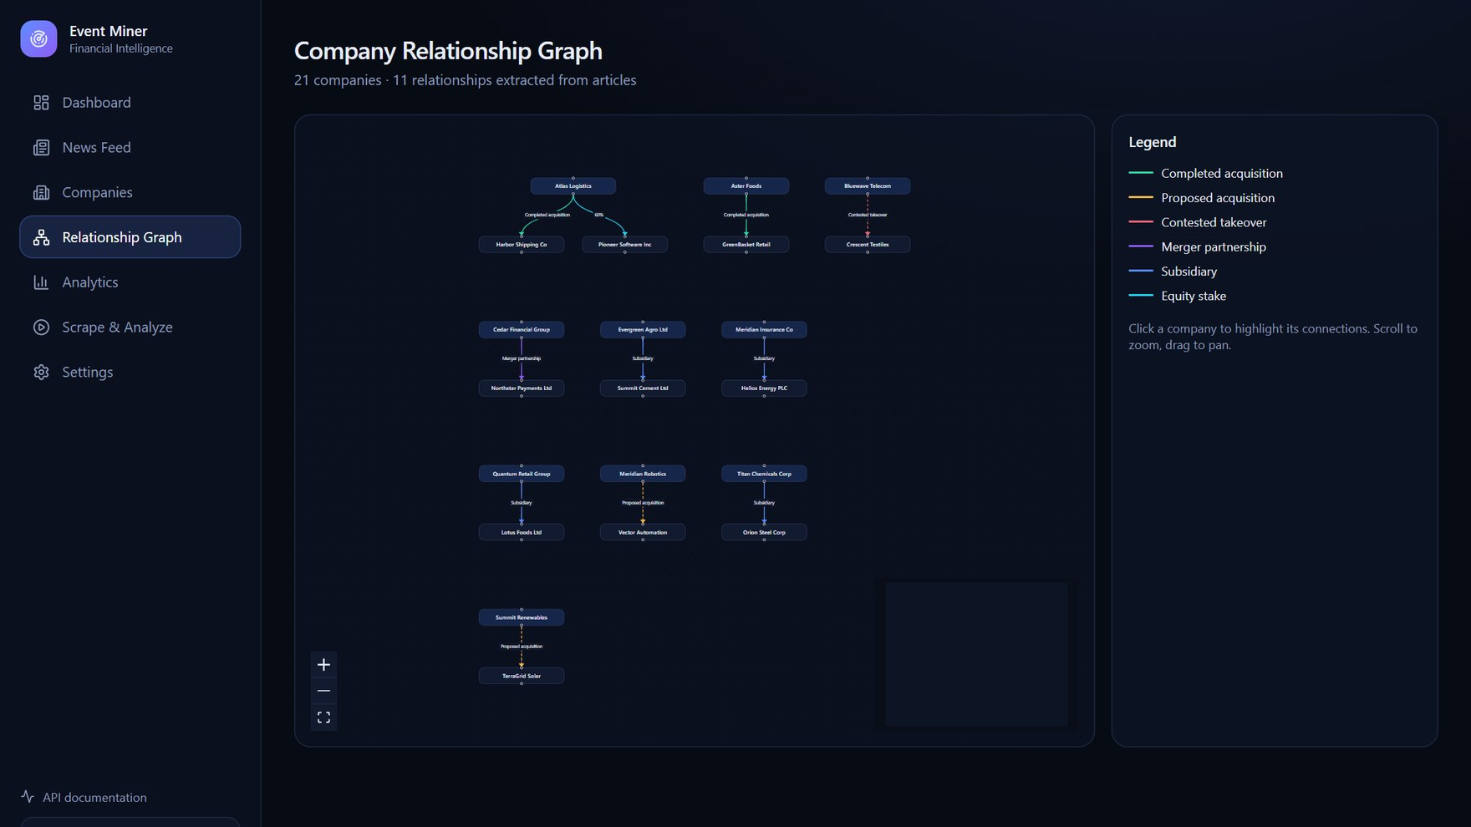
CORPORATE RELATIONSHIP GRAPH
Ownership and deals as a network
Companies map to nodes; relationships form directed edges
Parent companies are linked to evidenced subsidiaries
Proposed, contested and completed deals are kept apart
RELATIONSHIP TYPES
Completed acquisition
Proposed acquisition
Contested takeover
Merger partnership
Relationship graph built from extracted articles
Equity stake
Notes:
Companies are nodes and relationships are directed edges. The graph distinguishes completed acquisitions from proposed or contested ones, so no ownership is invented.

Slide 9
LIVE APPLICATION · DASHBOARD
Market intelligence at a glance
27
companies indexed
20
corporate events
$15.3B
disclosed deal value
11
ownership links
Every figure is derived from stored data and served by the REST API.
Notes:
The dashboard summarises everything indexed: companies, events, disclosed deal value and ownership links, plus recent events and pipeline activity.

Slide 10
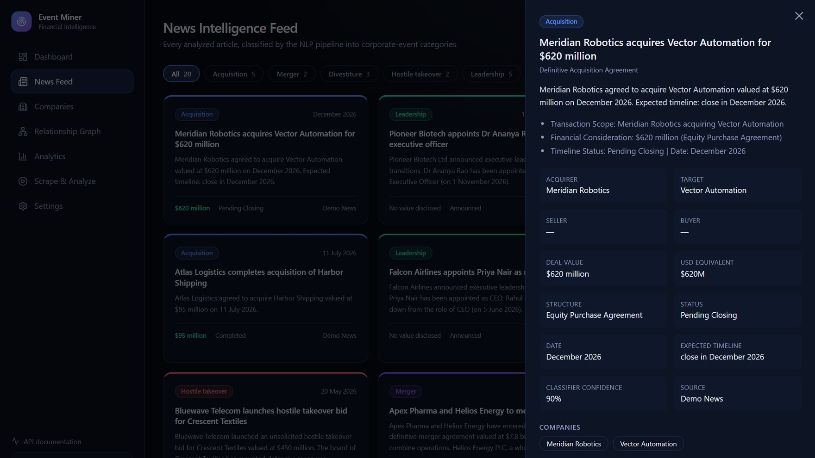
LIVE APPLICATION · NEWS FEED
Every article, classified and structured
Category cards
Article dossier
Filter by event type, search headlines, sort by date, value or confidence.
Brief, highlights, parties, deal terms, confidence and the source article.
Notes:
The news feed shows every classified article as a colour-coded card. Filter by category, search, sort, and open a dossier with the full extracted detail.

Slide 11
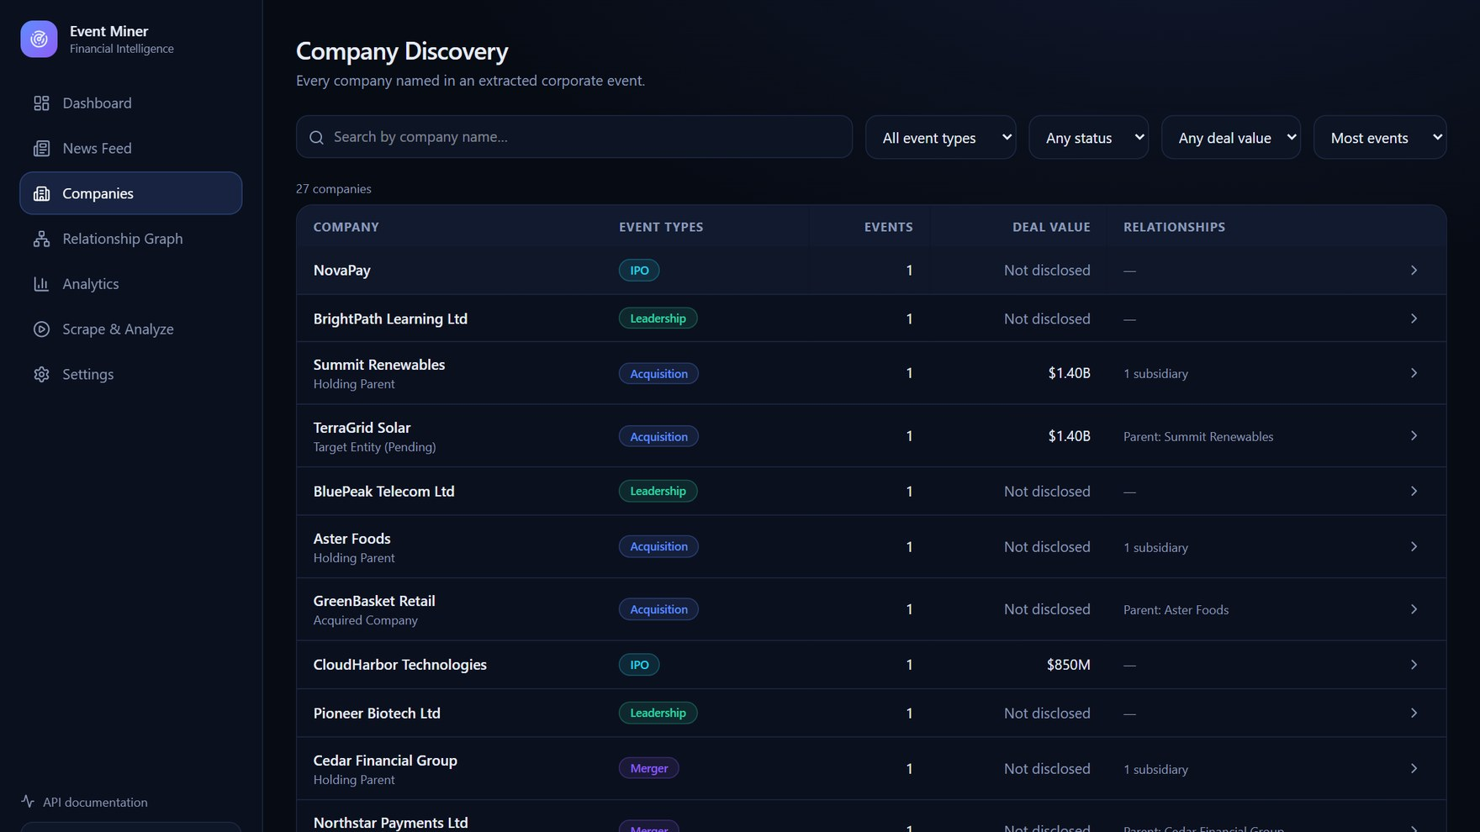
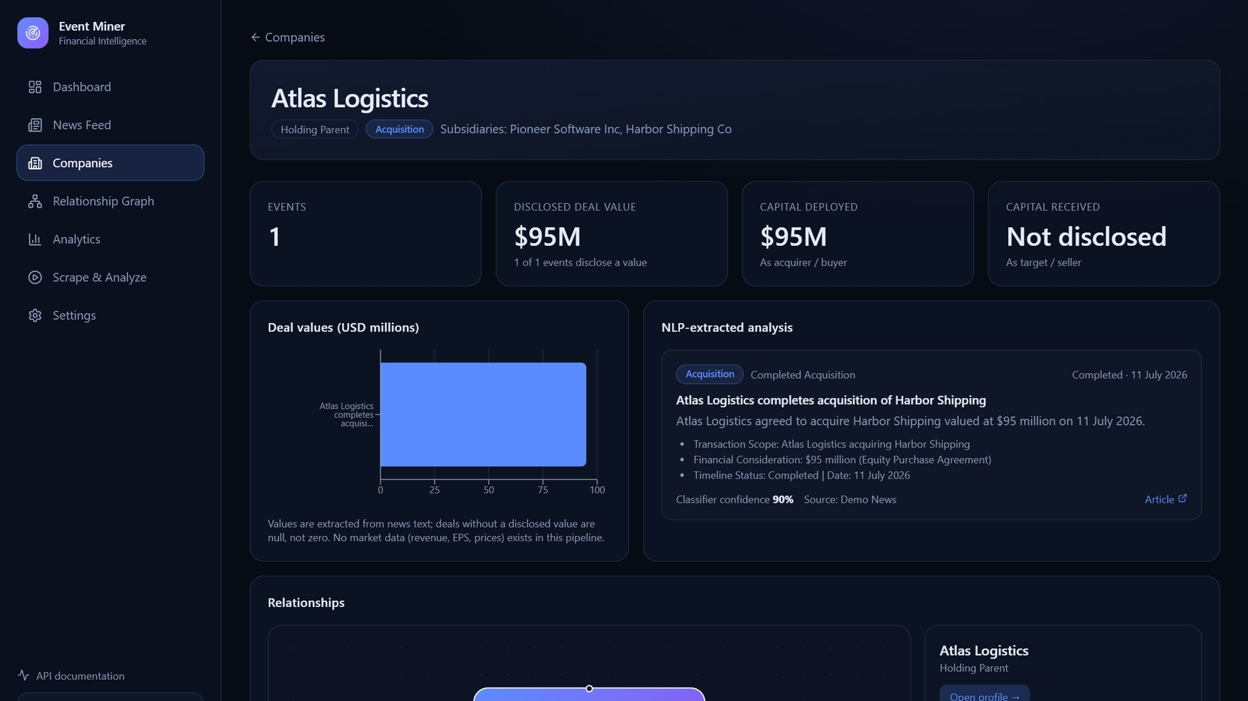
LIVE APPLICATION · COMPANIES
Discovery and company profiles
Company discovery
Company profile
Search by name; filter by event type, status and deal value.
Deal chart, NLP-extracted analysis and the company’s relationship graph.
Notes:
Companies are discovered from the extracted events. Each profile combines financials from disclosed deal values, NLP analysis and relationships.

Slide 12
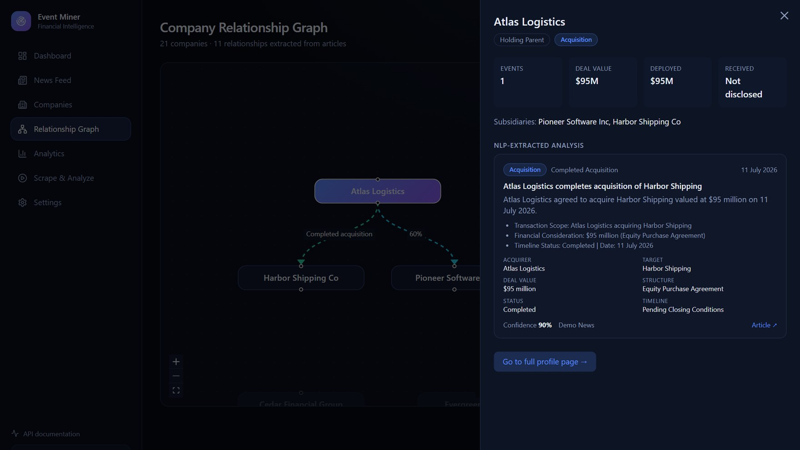
LIVE APPLICATION · INTERACTIVE GRAPH
Click a company, get the full picture
Select a node
Open profile
Zoom, highlight connections; see acquirer, target, deal value and status.
Slide-over with stats, NLP analysis, confidence and source link.
Notes:
Clicking a company zooms to it, highlights its connections and shows acquirer, target and deal value. Open profile slides in the full analysis without leaving the graph.

Slide 13
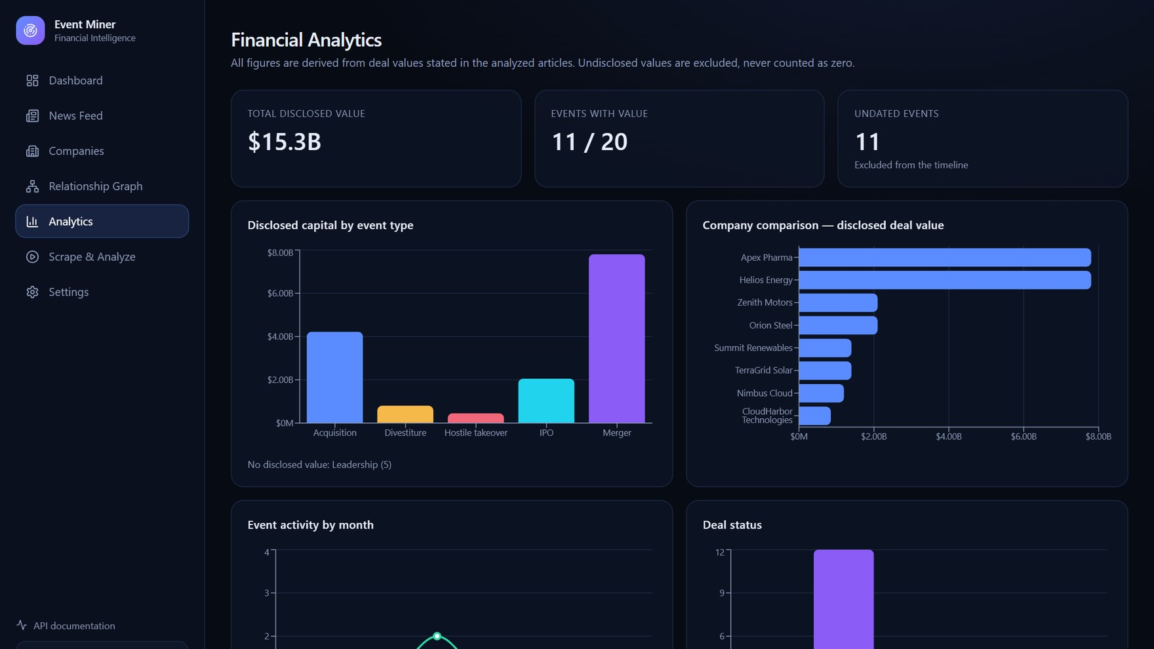
LIVE APPLICATION · ANALYTICS
Financial analytics from extracted deals
Disclosed capital by event type
Company comparison by deal value
Event activity by month
Deal status breakdown
Classifier hold-out performance
Honest data. Undisclosed values are excluded, never counted as zero.
Notes:
Analytics are derived only from deal values stated in the articles. Undisclosed values are excluded and never shown as zero.

Slide 14
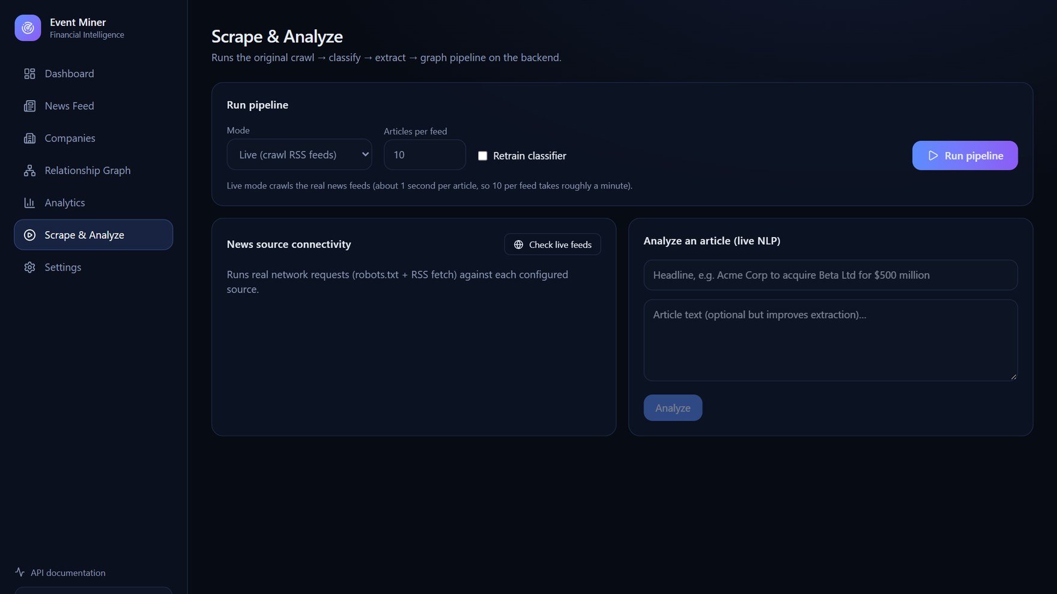
LIVE APPLICATION · SCRAPE & ANALYZE
Run the pipeline in the background
1
Article Ingestion
2
Classification
3
Event Extraction
4
Relationship Mapping
5
Output Generation
6
Database Persistence
Live or offline mode
Runs on the server, so you can navigate away
Live stage tracker and logs
Notes:
Pipeline runs are non-blocking background jobs. You can leave the page and return later; it reattaches to the running job with live logs.

Slide 15
REST API
One API behind the whole interface
GET
/api/v1/companies
GET
/api/v1/companies/{id}/financials
Search & filter companies
Deal values & capital
GET
/api/v1/companies/{id}/analysis
GET
/api/v1/relationships
NLP analysis per event
Full company graph
GET
/api/v1/events
GET
/api/v1/analytics/overview
Classified news feed
Dashboard metrics
POST
/api/v1/analysis/text
POST
/api/v1/scraping/run
Live NLP on any headline
Start a background job
Pydantic validation · consistent error format · CORS · Swagger UI at /docs
Notes:
Every feature is exposed through a REST API with validation, consistent errors and OpenAPI documentation at /docs.

Slide 16
TESTING & EVALUATION
What we measured
7 / 7
12 / 12
280
100%
original pipeline tests pass
REST API tests pass
labeled examples (70 hold-out)
hold-out accuracy
WHAT THE RESULTS TELL US
End-to-end live run: 5 feeds, 49 articles crawled, 3 flagged as events
Hold-out accuracy comes from a small curated set, so it is optimistic
Live headlines expose false positives; a larger real labeled set is needed
Notes:
All automated tests pass. The classifier scores perfectly on a small curated hold-out, which is likely optimistic. A live run showed that real feeds yield few, noisy events.

Slide 17


LIMITATIONS & FUTURE WORK
Where we go next
Current limitations
Future work
Classifier is loose on live headlines, so some false positives appear
Event data only: no market prices, revenue or EPS
Dates are free text; some events stay undated
Rule-based extraction needs human validation
Train on a larger real labeled dataset
Transformer-based entity recognition
Add market-data APIs for company financials
Scheduled crawling, de-duplication and deployment
Notes:
Be upfront about limitations, then show the roadmap.

Slide 18
PROJECT SUMMARY
Bridging raw financial news and structured corporate intelligence
Ingestion
Classification
Extraction
Visualisation
THANK YOU
Aditya Varshney | Aditya Agarwal | Jawagar K.R
Guide: Prof. Gundimeda Venugopal · VIT-AP University
Demo video: youtu.be/azqXibAGV-w
Code: github.com/Aditya-Agarwal86/Finance
Notes:
Close with the summary, thank the audience, point to the demo video and repository.

