Slide 1
SMA-powered Non-Magnetic Actuator Project Report
Course: APL434 - Smart Materials and Structures
Instructor: Prof. Sushma Santapuri
Aditya Agrawal – 2021AM10198
Swapnil Kashyap – 2021AM10782

Slide 2
Actuator Subsystems
Heat Transfer Model
Phase Transformation Model
Dynamics Model
Kinematics Model
Constitutive Model

Slide 3

Heat Transfer Model

Slide 4



Phase Transformation Model
Reverse Transformation(Martensite to Austenite):
Forward Transformation(Austenite to Martensite):

Slide 5


Dynamics Model
The stroke (△x) is given by:
The actuator force produced (F_{m}):

Slide 6



Kinematics Model

Slide 7

Constitutive Model

Slide 8
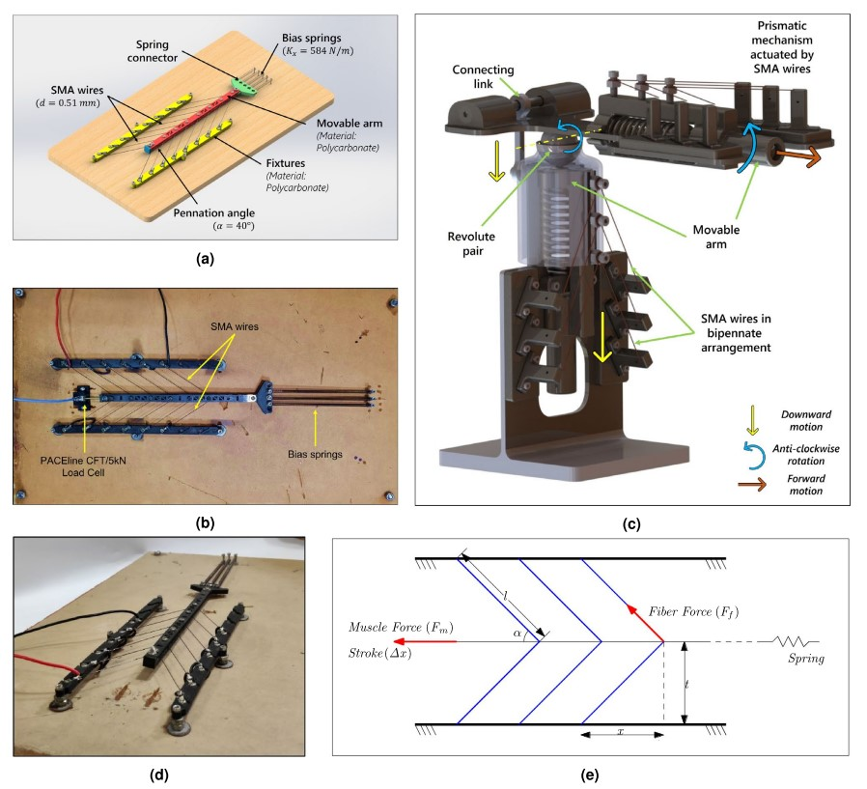
Visual Representation of the model
Adapted from Kanhaiya et. al., 2022

Slide 9
Goals Achieved
Completed the literature review of the main paper.
Analyzed the key differences between the experimental results and the model predictions.
Interpreted all the graphs produced in the paper using the Liang and Rogers Model.
Understood the intricacies involved in the derivation of the governing equations and reflected on the effects of key assumptions made in the model.
Prepared a sequential flow chart of the governing equations required to simulate the model on MATLAB.
Prepared the code for the entire model.

Slide 10
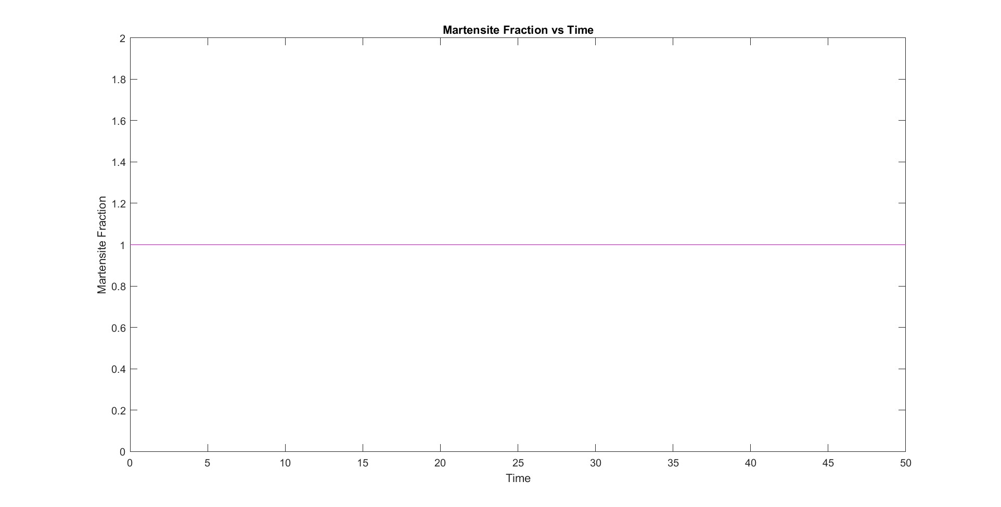
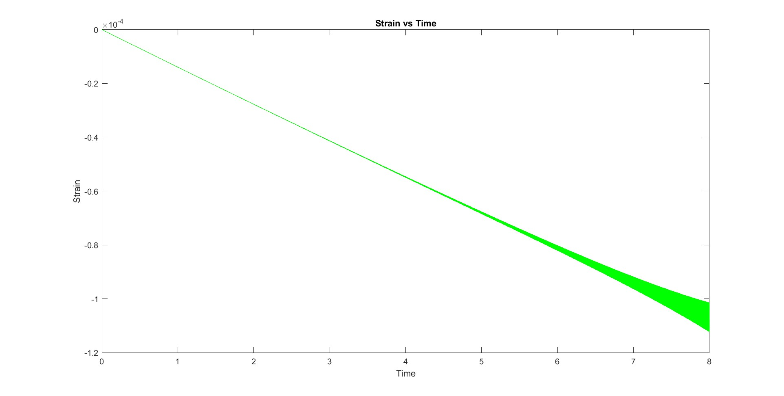
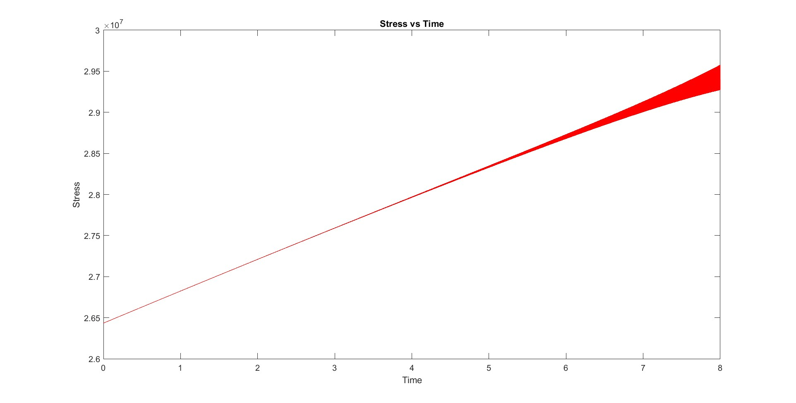
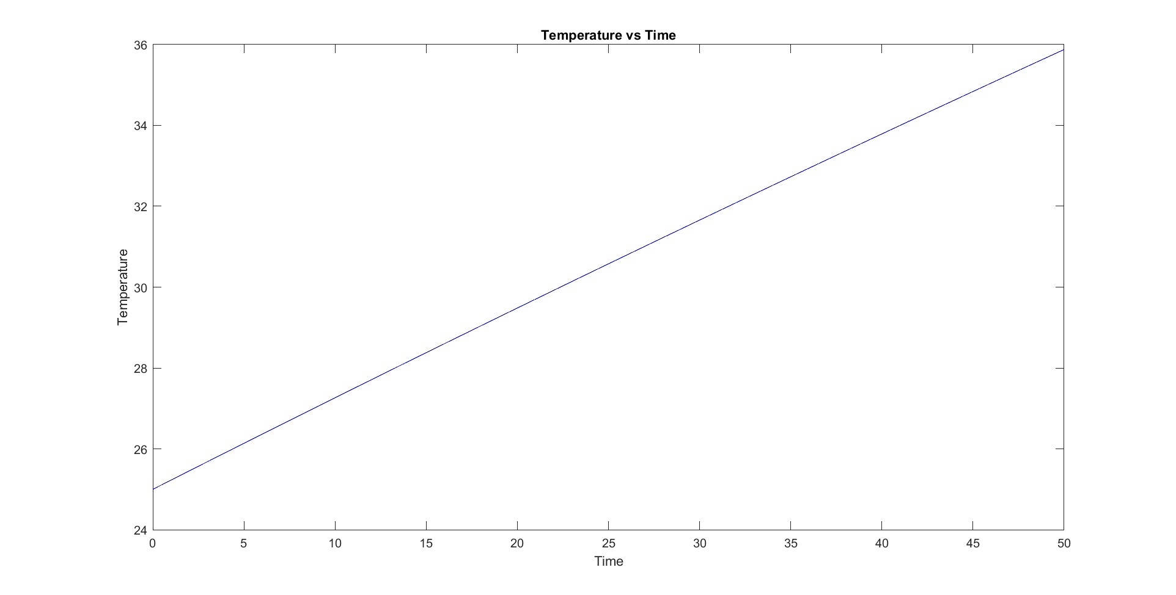
Results

Slide 11
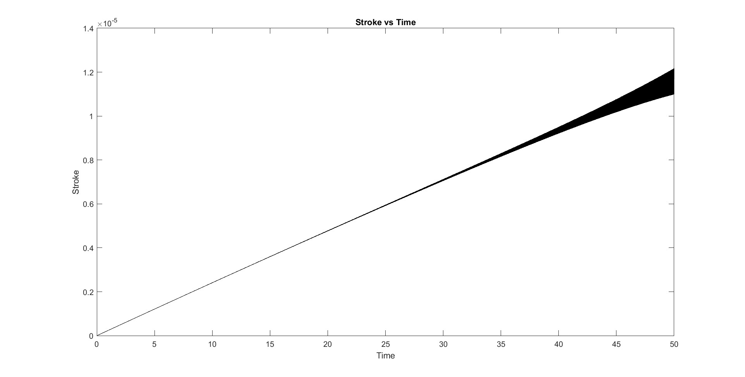
Results
The stroke of the actuator increases as heating prolongs.
These are results only for the heating phase.
Once the transformation begins, there are huge oscillations in the state variables.
The oscillations were too intense and didn’t give any significant practical meaning.
There may be many reasons for this. The primary reason being the non-linear nature of the highly coupled set of model equations.

Slide 12
Scopes for Improvement
We can try to apply the Brinson’s model instead of Liang and Rogers for better accuracy.
The changing cross sectional area and length of the wires could be incorporated in the model.
The time stepping scheme used could be changed to a better one.
After correction of the outputs, a Simulink model can be created for better understanding of the model’s driving equations.

Slide 13
References
Kanhaiya Lal Chaurasiya, A. Sri Harsha, Yashaswi Sinha, and Bishakh Bhattacharya. Design and development of non-magnetic hierarchical actuator powered by shape memory alloy based bipennate muscle. Scientific Reports, 12(1):10758, 2022.

Slide 14
Thank You

