Slide 1

Cricket Simulator OS Project
24114005 24114028
24114088 24114050
24114006

Slide 2

Objective
To build a deadlock-free, multi-threaded simulator where cricket entities interact without crashing the system state.
The OS to Cricket Mapping:
The CPU / Critical Section: The Cricket Pitch.
Processes/Threads: Players (Bowlers, Batsmen, Fielders) and Umpire.
The Ready Queue: The Pavilion (Batsmen waiting to bat).
System Interrupts: Wide, No ball, and "Ball in Air" events.

Slide 3

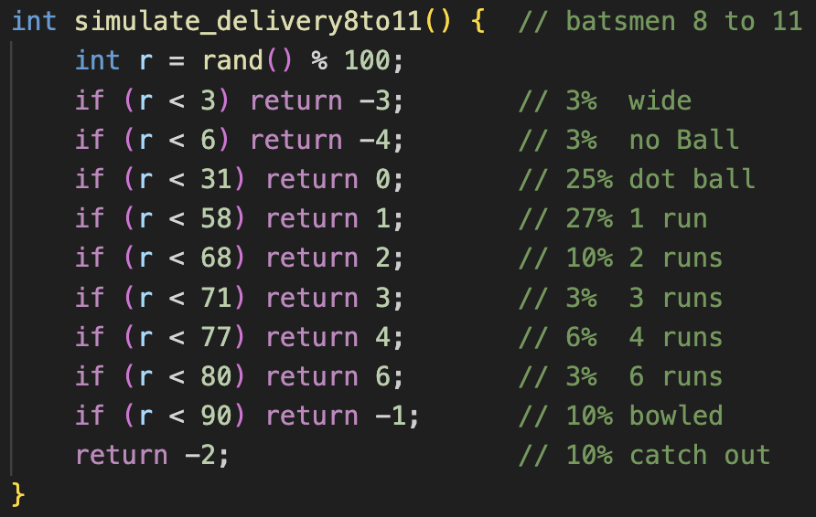
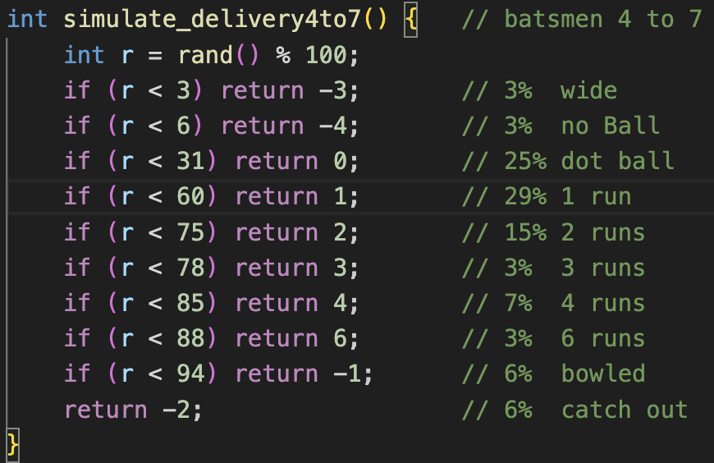
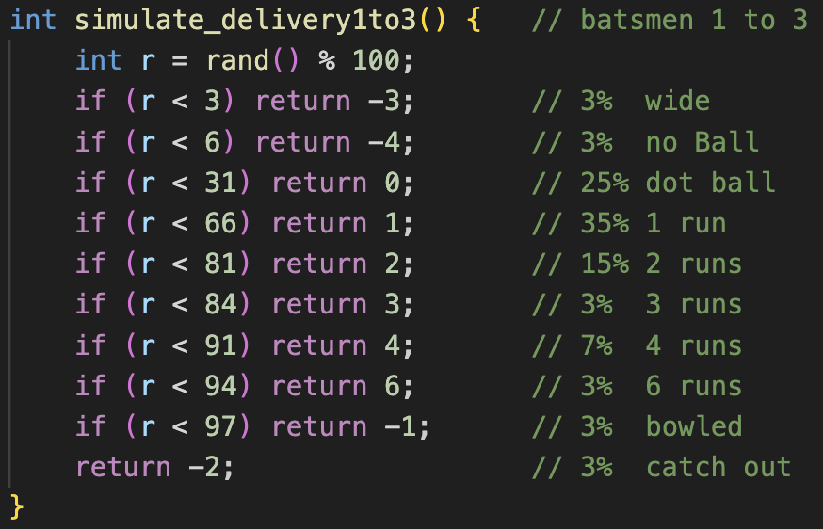

Assumptions
T20 Constraints: Simulation strictly adheres to max 20 overs (120 balls) and 10 wickets per innings. If 10 wickets fall before 20 overs complete, immediately termination of all active threads and simulation ends.
Stratified Probability Distribution: To enforce burst time predictions, batsman threads divided into three tiers (Top, Middle, Tail). Each tier executes a specific simulate_delivery function with weighted probabilities, ensuring tail-enders statistically consume less CPU time.
Extras (Wides & No-Balls): Wide (3%) and no balls (3%) treated as system interrupts. Extra run added to total, but ball deemed "illegal”.

Slide 4
Thread architecture
Producers (Bowlers): 6 threads. They "produce" deliveries and write them to the shared pitch state.
Consumers (Batsmen): 11 threads. They "consume" deliveries from the pitch to produce runs or get dismissed.
Waiters (Fielders): 10 threads. Sleeping background processes that wake up only on a specific hardware interrupt (ball_in_air).
Kernel Daemon (Third Umpire): Runs asynchronously in the background monitoring system matrices for deadlocks.

Slide 5
Process Synchronization
pitch_mutex: Enforces mutual exclusion on the Critical Section. Ensures only one ball is bowled and played at a time.
score_mutex: Prevents dirty reads/writes to the global scoreboard.
crease_sem (Semaphore): Counting semaphore initialized to 2. Restricts the pavilion queue, ensuring exactly two Batsman threads hold the active Striker/Non-Striker slots.
Strict Handshake Protocol: Uses pthread_cond_wait and pthread_cond_broadcast to force a strict sequential handshake between the active Bowler and Striker, preventing ghost deliveries or partial overs.

Slide 6
CPU Scheduling Strategies
Round Robin (RR): Controls the Bowlers.
Time Quantum: Exactly 6 legal deliveries (1 over).
Enforced using an array to handle the T20 maximum over limits (4 overs for top bowlers, 3 for the rest).
Shortest Job First (SJF): Controls the Batsman arrival order at the crease_sem.
Predicted Burst Time: Estimated balls faced. Tail-enders (low burst) are prioritized to enter the crease first.

Slide 7

SJF: Prediction vs Actual Execution
The OS Concept: Schedulers cannot predict the exact future, they rely on estimates.
Our Implementation: Sort threads into the semaphore queue based on SJF predictions. Execution at the crease is Non-Preemptive and utilizes the probability distributions to simulate realistic, weighted OS execution variance.
Result: A tail-ender might survive 20 balls (exceeding prediction), or a top-order batsman might get out ball 1 (falling short).

Slide 8
Deadlock detection and recovery
The Deadlock (Circular Wait): A circular wait deadlock (where both batsmen run to the same end) does not happen on boundaries or dot balls. It only occurs on running plays (1, 2, or 3 runs) with a probability we assumed to be 7%.
The Detector: The Umpire thread monitors the Allocation and Request Wait-For matrices.
The Recovery (Process Termination): Upon detecting a deadlock, the Umpire Kernel randomly selects one Batsman thread as the victim, terminates it (Run Out), and clears the system state to resume execution.

Slide 9
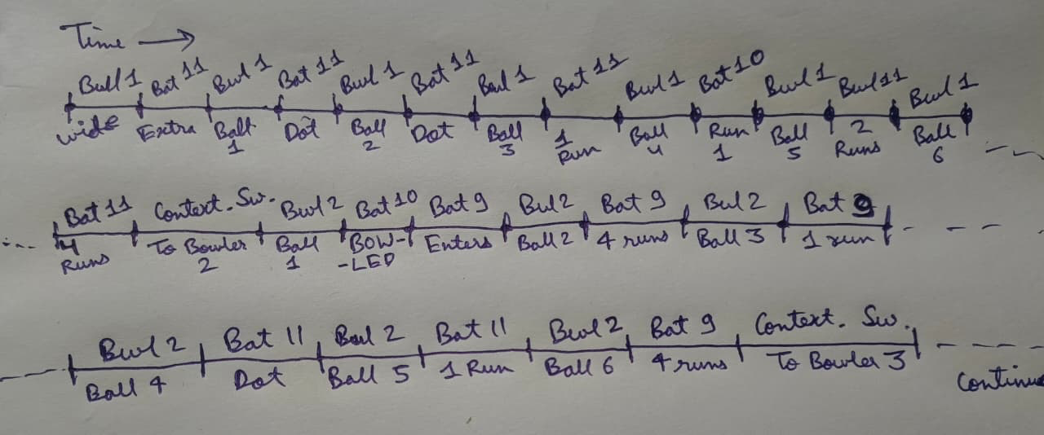
Thread execution (Gantt chart)

Slide 10
Wait Time Analysis
FCFS: Threads arrive and acquire the crease_sem sequentially (1, 2, 3...). This causes a severe Convoy Effect, where the Middle Order waits extensively in the pavilion queue.
SJF (Predicted vs. Actual Execution): The scheduler sorts the Ready Queue, prioritizing tail-enders (lowest predicted burst times).
The Reality: Execution is Non-Preemptive. Stratified probabilities guarantee tail-enders face fewer balls, though random OS variance still allows for unexpected long or short bursts.
The Result: Because tail-ender threads empirically acquire and release the crease_sem rapidly, SJF drastically reduces the wait time for Middle Order threads (preventing the FCFS convoy effect).

Slide 11
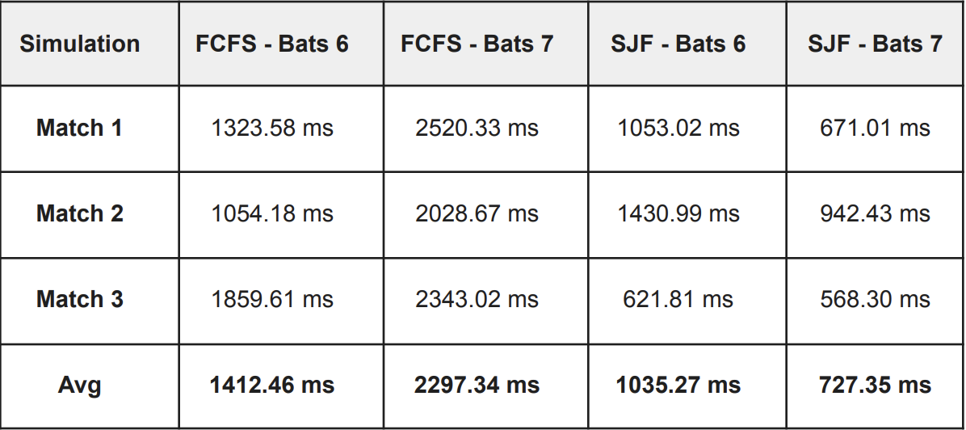
Wait Time Analysis - SFJ vs FCFS

