Slide 1
KEYDIFF: Key Similarity-Based KV Cache Eviction for Long-Context LLM Inference in Resource-Constrained Environments
Aditya Pratap Singh Bhadoria (24114005)
Deokar Parth Rajesh (24114032)
Fundamentals of AI/ML (CSC-351)

Slide 2






Context & Challenge
The Context
The Bottleneck
The Dilemma
Large Language Models utilize a Key-Value (KV) cache during autoregressive generation to store states from previously processed tokens, bypassing redundant calculations.
As the context window expands, the memory footprint required to store these historical tokens scales linearly, creating a severe hardware limitation for edge devices.
Enforcing a strict memory ceiling requires deleting older tokens. However, naive deletion (like discarding chronological data) often destroys critical contextual information.

Slide 3
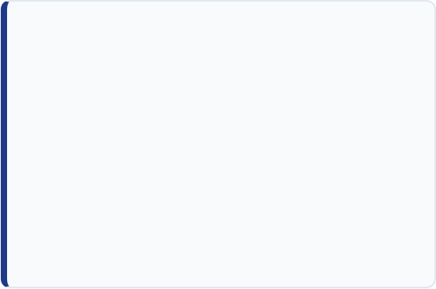


Proposed Methodology
Instead of computing expensive full-attention scores, KEYDIFF evaluates the angular distinctiveness of the cached vectors to filter out redundant information.
CLUSTER CENTROID
Centroid Calculation: Compute the mean vector of all currently stored key features to locate the semantic center of the cache.
EVICTION SCORE
Divergence Scoring: Measure the cosine similarity of each individual token against this calculated centroid.
Identify Redundancy: Tokens that are highly similar to the centroid contain repetitive data. Outliers (dissimilar tokens) represent highly specific, vital context.
Action: Retain the distinct outliers and safely evict the tightly clustered, redundant tokens to satisfy memory constraints.

Slide 4
Implementation and Experiment
Implementation table:
Experiment Setup table:
Component | Used
Language | Python
Library | NumPy
Similarity | Cosine similarity
Cache policies | Full, Recent-token, KEYDIFF
Cache structure | Custom KV cache
Parameter | Value
Prompt length | 256 tokens
Key dimension | 48
Cache budget | 64
Block size | 16
Number of trials | 100
Random seed | 20260823
Evaluation:
A synthetic needle-in-a-haystack retrieval test was used.
One distinctive key containing the answer was inserted among correlated distractor keys. After eviction, a query was used to check whether the correct information was still present.

Slide 5
Results & Conclusion
Method | Cache Size | Needle Retention | Accuracy | Runtime
Full Cache | 256 | 100% | 100% | 0.272 ms
Recent-token | 64 | 0% | 0% | 0.308 ms
KEYDIFF | 64 | 100% | 100% | 1.026 ms
Observations & Conclusion:
KEYDIFF reduced the cache from 256 to 64 tokens, representing a massive 75% reduction in total cache size constraint.
Despite the severe memory bottleneck, KEYDIFF successfully retained the needle in all 100 trials, yielding a 100% retrieval accuracy in this simulation.
The standard Recent-token (sliding window) eviction completely failed to retain the crucial early context.
KEYDIFF required slightly more computation time (1.026 ms) due to the underlying cosine similarity math, providing an acceptable trade-off for perfect retention.

