Slide 1
Automated Chemical Mixer
By Aditya Bodhi,
Ghananshu Desale
and Vinayak Renukdas

Slide 2
Content
Introduction
Problem statements
Goal
Block diagram
Components
Schematic
Programming
PCB design and fabrication
Mixer structure
Mixing container
Testing & calibration
Working principle
Conclusion

Slide 3
Introduction
In agriculture and small-scale industries, the mixing of liquid chemicals is a common but manual and error-prone task.
There is a growing need for a compact, automated solution that can dispense and mix liquids efficiently, especially in rural or low-tech environments.
This project presents a microcontroller-based chemical mixer that aims to simplify and automate the process of dispensing and mixing two liquids with user-defined volumes and timing.
The system is designed to be cost-effective, modular, and easy to operate, making it ideal for small-scale applications.

Slide 4
Problem statement
Farmers often mix chemicals like UAN, 2,4-D, glyphosate, and pesticides with water manually, using open containers and without precise measurement.
These chemicals are toxic, can cause skin burns, respiratory issues, and environmental harm if mishandled.
Manual mixing leads to inaccurate dosing, wastage, and health risks.
There is a need for a low-cost, semi-automated system to safely and reliably mix agricultural chemicals with water.

Slide 5
Goal
To design and develop a low-cost, automated chemical mixing system that:
Dispenses two different liquids accurately using submersible pumps
Allows the user to control and customize volumes and mixing time through a keypad
Uses a DC motor for mixing with adjustable duration
Provides a user-friendly interface using an LCD for display and feedback
Operates reliably for agricultural and small-scale applications without the need for high precision

Slide 6
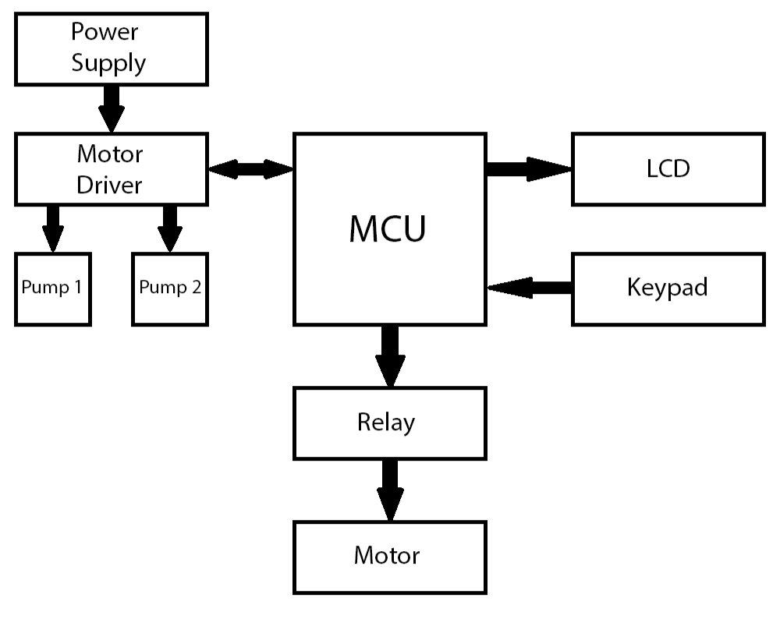
Block Diagram

Slide 7
Components
Power supply : A 12V DC adapter is used to power the overall system. The L298N motor driver module is used to derive a regulated 5V output, which powers the ESP32 microcontroller and other 5V components.
Control : The system is controlled by an ESP32-WROOM-32 microcontroller. It manages all operations including pump control, user input handling, display updates, and mixing logic.
Pumps : Two R385 submersible pumps are used to draw liquids from separate containers and dispense them into a central mixing chamber. These pumps are driven and controlled through the L298N motor driver.
Mixer : A 12V DC geared motor (100 RPM) is used to stir the liquids after dispensing. The motor is controlled via a 5V single-channel relay, enabling on/off control based on the selected mixing duration.
Display : A 16x2 I2C LCD module is used to display user menus, selected volumes, mixing time input, and a live countdown during the mixing process.
User input : User input is provided through a 4x4 matrix keypad. It is used to navigate menus, select volume levels for each liquid, and set the mixing time. A PCF8574 I/O expander is used to minimize GPIO usage on the ESP32.

Slide 8
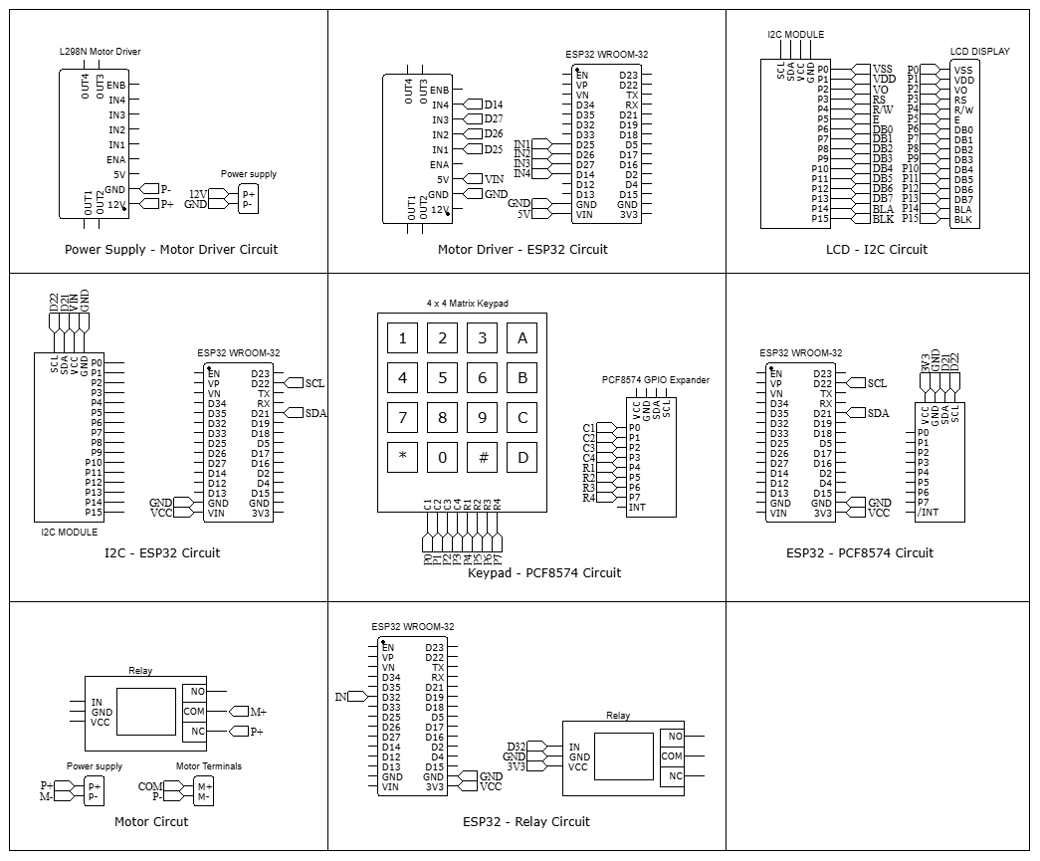
Schematic

Slide 9
Programming
Libraries:
Wire.h - For I2C communication between ESP32 and peripherals
PCF8574.h - Handles keypad input via I/O expander over I2C
LiquidCrystal_I2C.h - Controls the 16x2 LCD display using I2C interface
Functions:
Setup() - Initializes LCD, keypad, I/O pins, and displays welcome screen
loop() - Main flow: volume selection → dispensing → mixing time → countdown
showWelcomeScreen() - Displays startup greeting on LCD
selectVolume(message) - Lets user select volume for Liquid A/B using keypad navigation (A/B/*)
dispenseLiquids() - Triggers pumps to dispense both liquids sequentially
pumpLiquid(volume, p1, p2) - Converts selected volume to pump runtime, displays live dispensing progress
getMixingTime() - Takes mixing time input in minutes and seconds with validation
startMixingCountdown() -Activates relay-controlled mixer motor and runs live countdown on LCD
getNumericInput() - Captures multi-digit numerical input from keypad
getKey() - Scans keypad rows and columns using PCF8574 to detect key presses

Slide 10
PCB Design & Fabrication
The system was developed on a custom double-layer PCB to ensure compact form factor and seamless integration of all components.
The layout was designed using EasyEDA, with careful attention to power routing and signal integrity.
Major components include the ESP32, L298N motor drivers, relay module, PCF8574 I/O expander, and female headers to mount the all these components.
Screw terminals and male headers were incorporated for modular assembly and ease of maintenance.
The Gerber files were generated and sent to Robu.in for fabrication.
The PCB is fabricated on FR-4 material, with a thickness of 1.6 mm and dimensions of 157.48 mm × 147.32 mm.
Track widths used in the design are 1.5 mm, 1.00 mm, and 0.254 mm based on current requirements and spacing constraints.

Slide 11
Mixer Structure
The structure was built using a three-shelf plastic table as the base frame.
Two plastic bottles are mounted on the top shelf, serving as containers for separate chemicals.
The second shelf houses both submersible pumps and the mixing motor, with the motor shaft facing downward.
Silicone rubber tubes connect each container to its corresponding pump for fluid transfer.
The PCB is mounted on an angled acrylic sheet fixed to the top shelf for better visibility and access.
All wiring is routed through the hollow legs of the table to maintain a clean and organized layout.
A 12V DC power jack is installed on the acrylic mount, allowing easy connection via a standard 12V adapter.

Slide 12
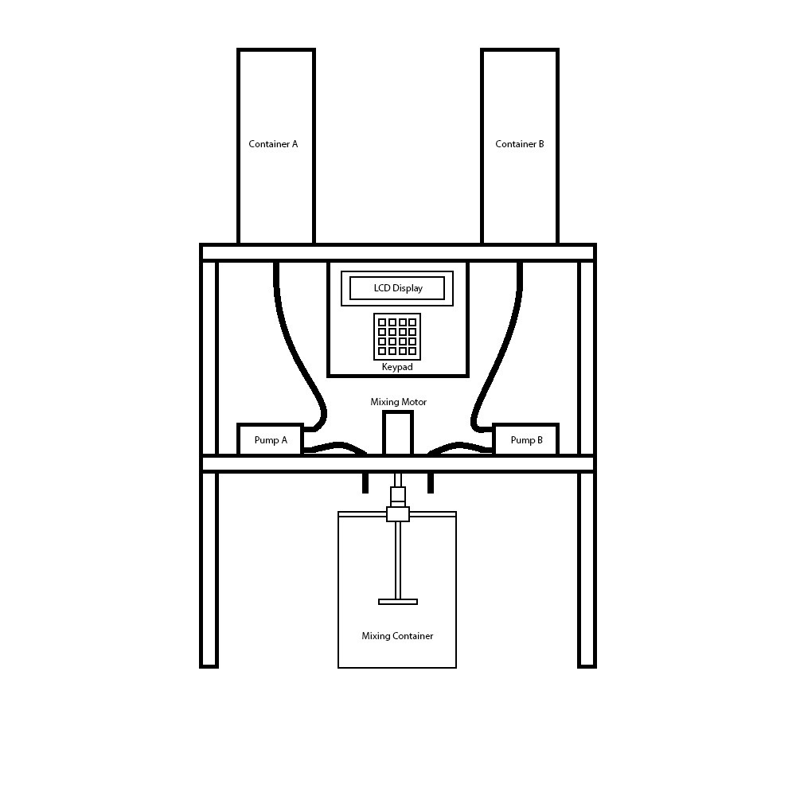
Mixer Structure

Slide 13
Mixing Container
A custom mixing container was designed specifically for the chemical mixer.
An acrylic strip is mounted on top of the container, holding a ball bearing at its center.
A 4-inch M6 bolt passes vertically through the bearing and is secured underneath with a nut.
A stirring blade is attached to the lower end of the bolt inside the container.
The shaft of the mixing motor is connected to a socket wrench with limited vertical movement.
To engage the mixer:
Lift the socket wrench, align the container so that the bolt head sits below it,
Release the wrench to let it lock onto the bolt head automatically.
When the motor is activated, the socket wrench rotates the bolt, stirring the contents efficiently.

Slide 14
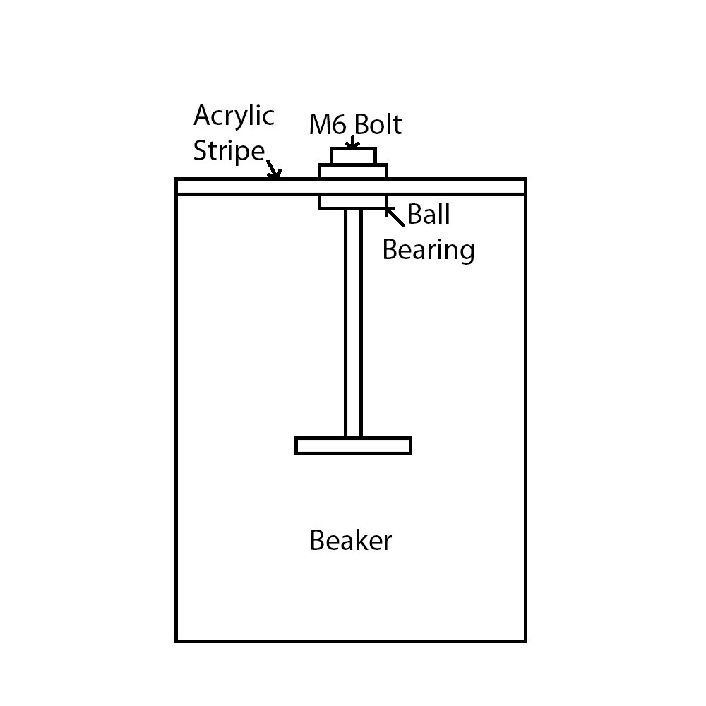
Mixing Container

Slide 15
Texting & Calibration
To ensure accurate dispensing, extensive calibration of the pump motors was conducted.
The project uses a time-based dispensing method, so precise timing was crucial.
Flow sensors were not used, making it necessary to determine run-time manually.
Each pump was tested individually using a stopwatch and a measuring container.
The goal was to establish a relationship between motor run-time (ms) and liquid volume (mL).
Tests were conducted for volumes ranging from 50 mL to 500 mL, in 50 mL intervals.
Each test was repeated 2–3 times to ensure accuracy and consistency.
Results showed that the flow rate is not linear—the time required per 50 mL increases at higher volumes.
The correlation between volume and time was non-linear, requiring a custom timing table.

Slide 16
Working Principle
On system startup, the LCD displays: “Welcome Chemical Mixer”.
The user is prompted to select the volume for Container A.
Volume options (50 mL, 100 mL, etc.) are navigated using ‘A’ (up) and ‘B’ (down) keys.
Pressing ‘*’ confirms the selected volume.
The system then prompts for Container B volume using the same method.
After volume selection, the system starts dispensing:
Pump 1 (Container A) runs first.
The LCD shows live dispensing progress in 5 mL increments.
After Pump 1, Pump 2 (Container B) operates similarly.
Once dispensing is complete, the user is prompted to enter mixing time in minutes and seconds.
If the entered time exceeds 30 minutes, an error is shown.
On valid input, the mixing motor is activated, and the LCD displays:
“Mixing” on the top row
A live countdown timer on the bottom row
When the countdown ends, the motor automatically stops, completing the process.

Slide 17
Conclusion
The project successfully demonstrates a functional prototype for automated chemical mixing.
It simplifies the process of liquid dispensing and timed mixing using low-cost components.
While the system does not dispense highly accurate volumes, it is suitable for low-precision applications like agriculture.
Future improvements can include:
Integration of flow sensors for better accuracy
Adding preset modes for common use cases
Enclosure design for portability and protection

Slide 18
Questions

