Slide 1

Apartment maintenance
RNS INSTITUTE OF TECHNOLOGY
BENGALURU - 98
DEPARTMENT OF INFORMATION SCIENCE & ENGINEERING
Presentation on Internship
Aditya C
USN: 1RN18IS007
ENMAZ Engineering Services Pvt. Ltd.
Internal Guide
Mr. Pramoda R
Asst. Prof, Dept of ISE, RNSIT
External Guide
Mr. Akshay D R
CEO, ENMAZ Engineering services

Slide 2
AGENDA
Abstract
About the Company
Introduction
Literature Survey
Requirements
System Design
Detailed Design
Implementation
Testing
Conclusion and Future Enhancements
References
Q & A

Slide 3
ABSTRACT
Apartment maintenance is a tedious and time consuming process which has to be undertaken by all the members of a society
We aim to implement an apartment maintenance app using flutter
An Android App is useful for apartment/society maintenance as everyone has a smartphone and can easily be aware and updated of all the activities happening in their society
Interactions between residents of the society can be made using this app

Slide 4
About the Company
Enmaz has a simple yet robust solution that helps any Industry / Factory digitise their workfloor in no time.
The products offered will help in remote monitoring, controlling and also analysing any machinene parameter or process
Reliable Hardware, Time tested, high quality, designed, developed and manufactured in India. 18 months of replacement warranty.

Slide 5
INTRODUCTION
An apartment maintenance application designed to help apartment residents to be aware and involved in daily maintenance activities in their apartment or society
This project finds itself suitable to the current economy when there are too many apartments and flats in every metro city
Residents can control maintenance activities from their fingertips through their smartphones
Reduces the need of physical meetings and calls

Slide 6
LITERATURE SURVEY
We have referred to 5 reference papers for doing this project and their links are:
Modern App Development with Dart and Flutter
Application Development using Flutter
High Rise Residential Home Management System
Android Based Responsive Approach for Residential Society Maintenance
ADMINISTRATION SYSTEM FOR END TO END LUXURY APARTMENT MANAGEMENT SOFTWARE

Slide 7
Requirements
OS: Windows 8 or above
Visual Studio code
Android Studio version 9
Flutter
Lunancy
Any Web Browser
All flutter extensions and dependencies required for this app

Slide 8
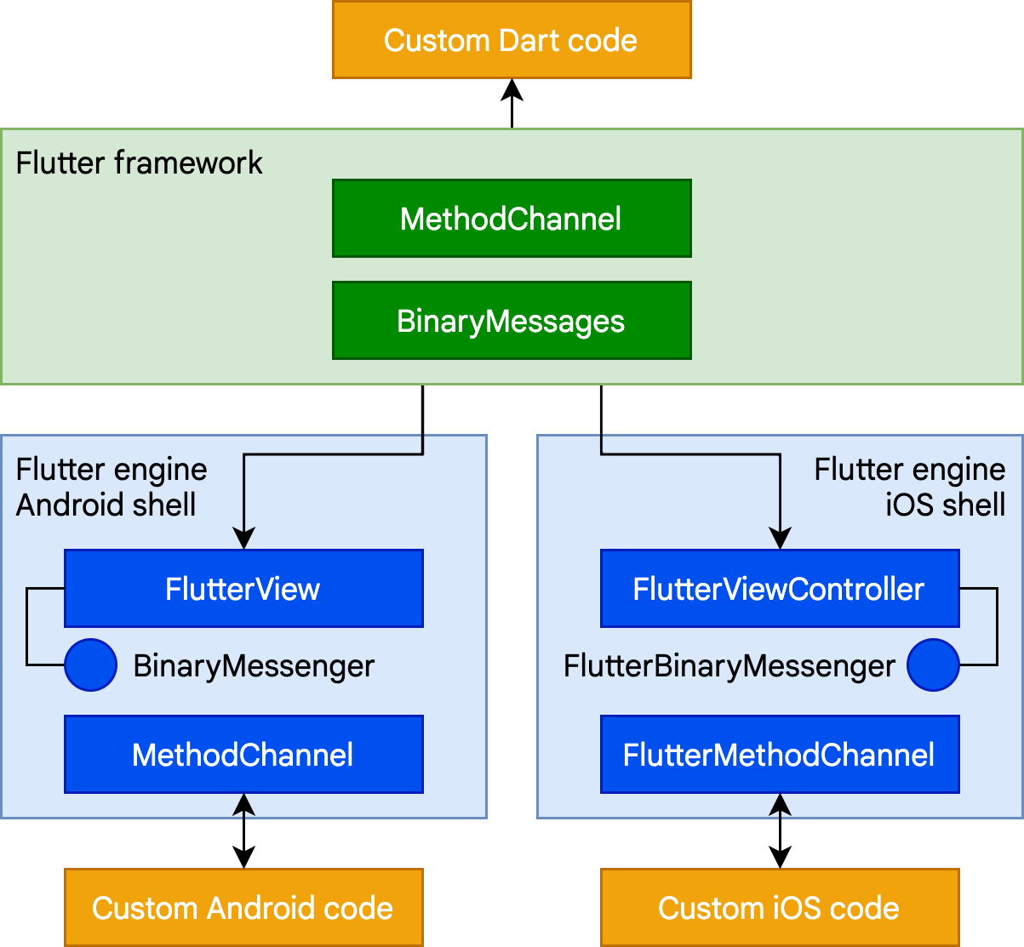
System Design
Flutter application basic design :

Slide 9
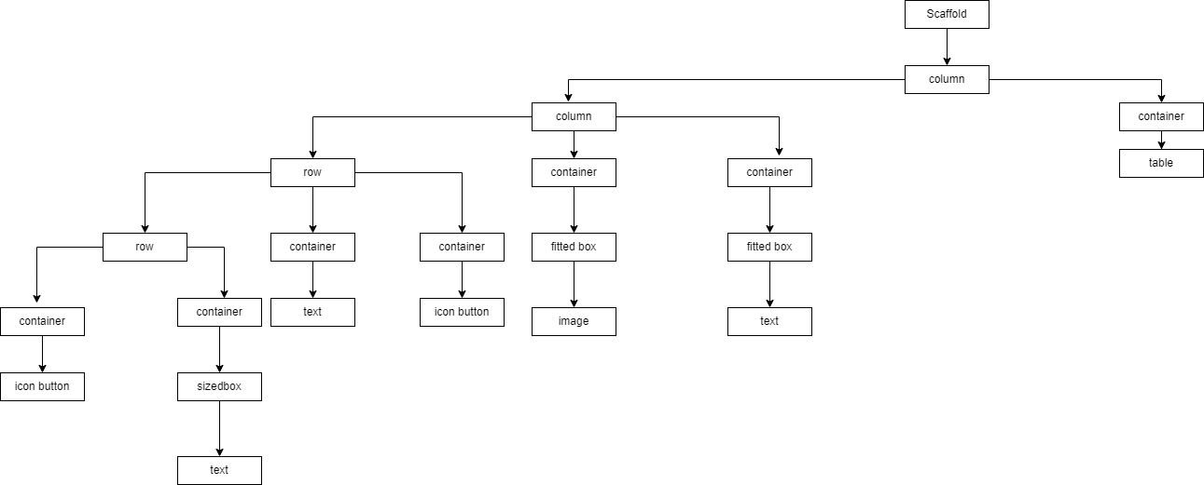
Detailed Design
Design details – Container flow diagram of our flutter App:

Slide 10
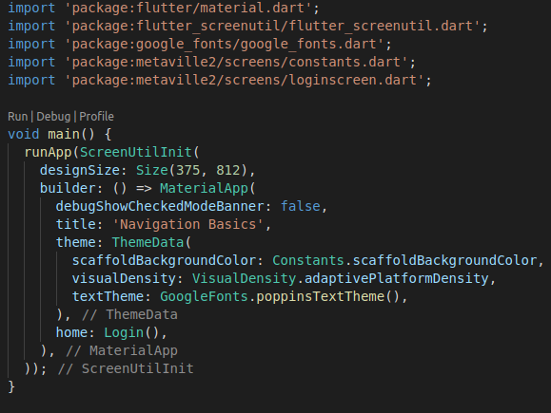
Implementation / Coding
main.dart:

Slide 11
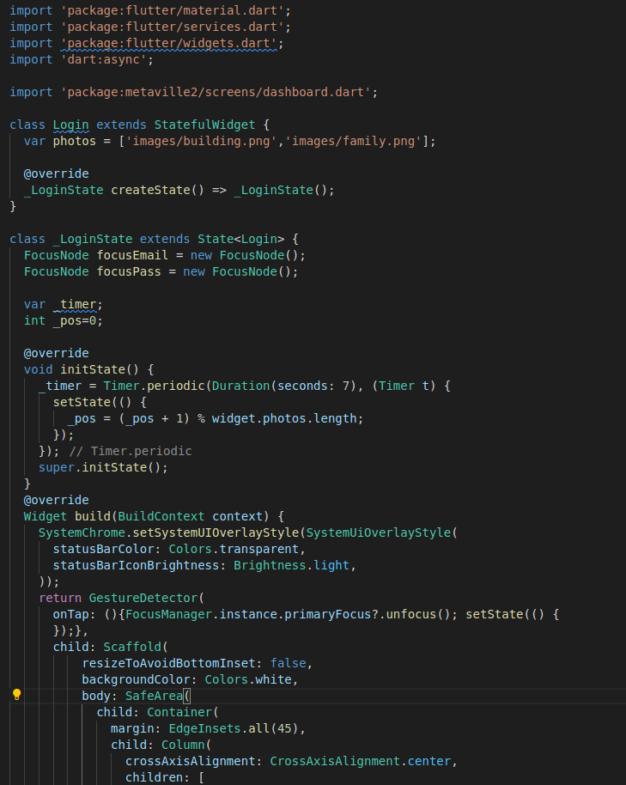
VIII Semester, Department of ISE, RNSIT
2021 - 2022

Slide 12
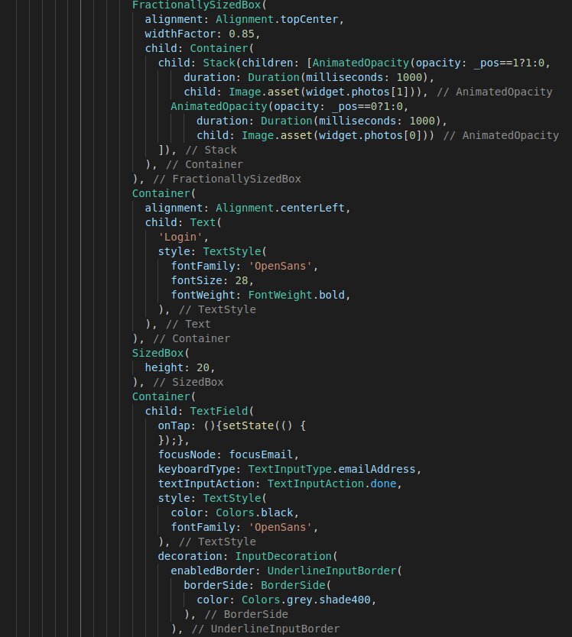
2021 - 2022
VIII Semester, Department of ISE, RNSIT

Slide 13
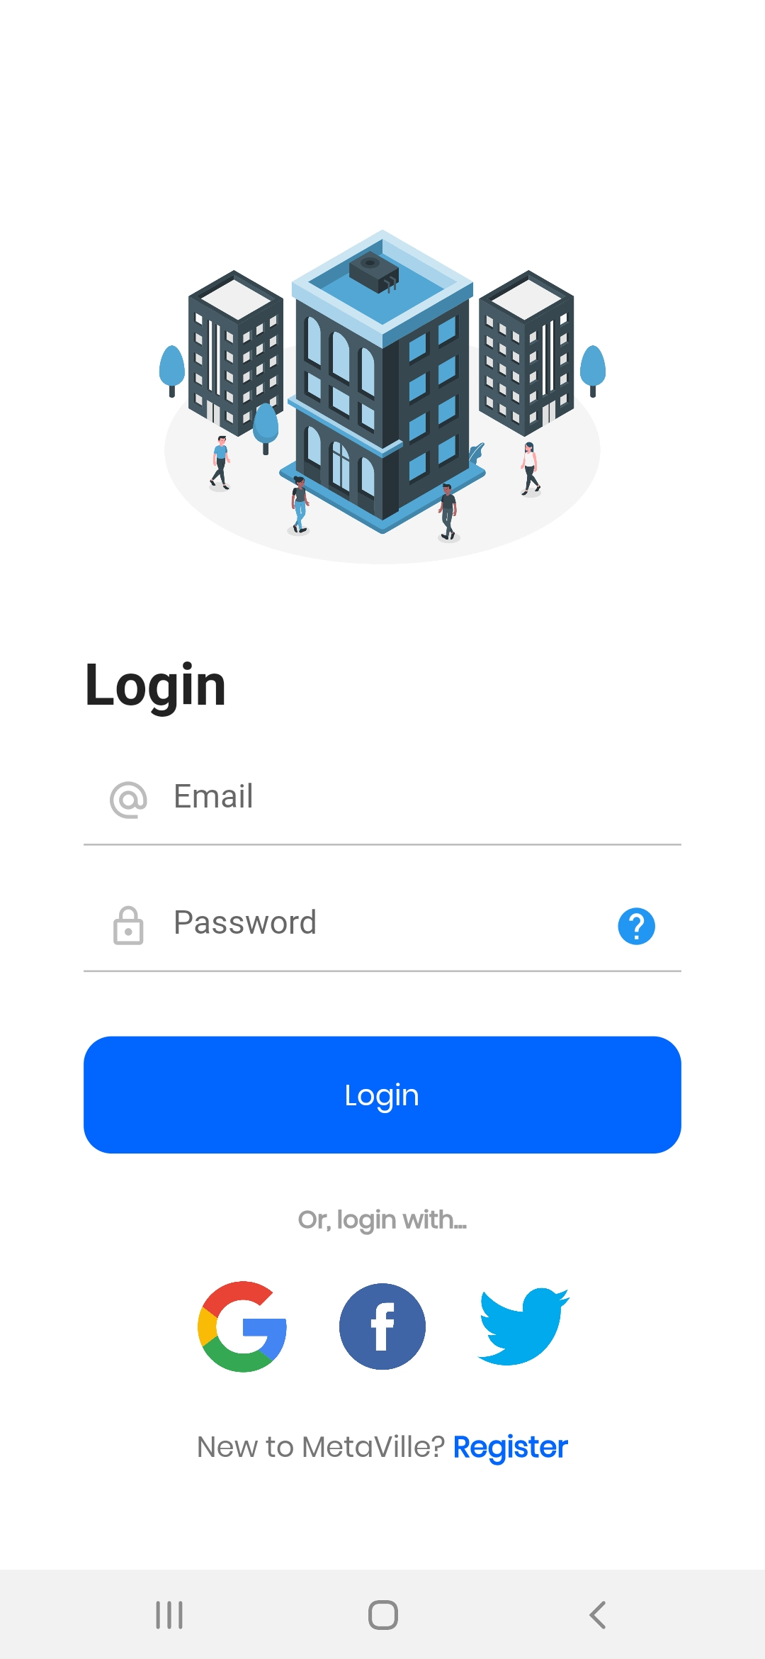
Design

Slide 14
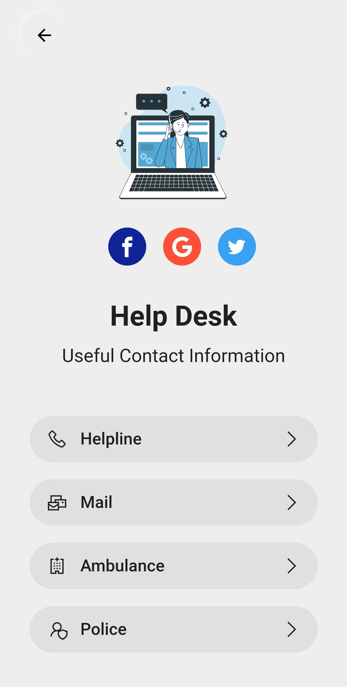
VIII Semester, Department of ISE, RNSIT
2021 - 2022

Slide 15
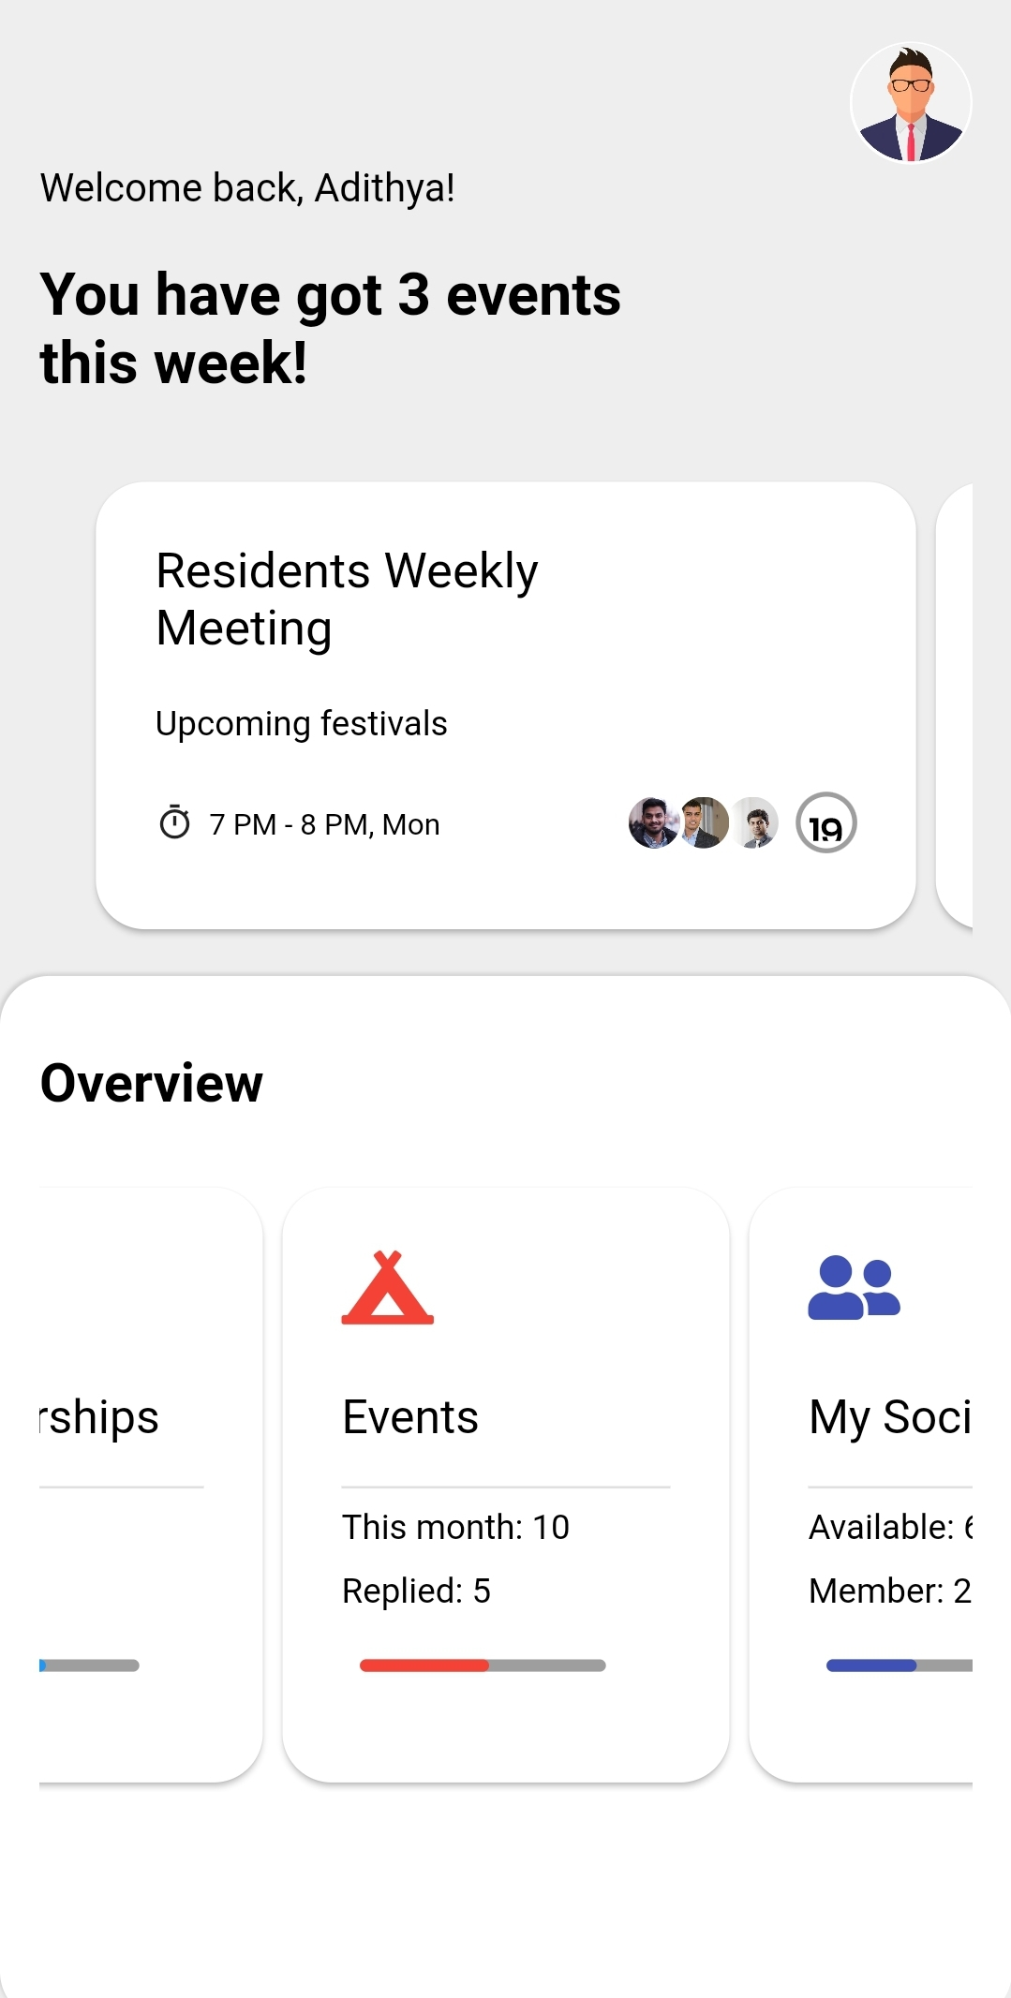
2021 - 2022
VIII Semester, Department of ISE, RNSIT

Slide 16
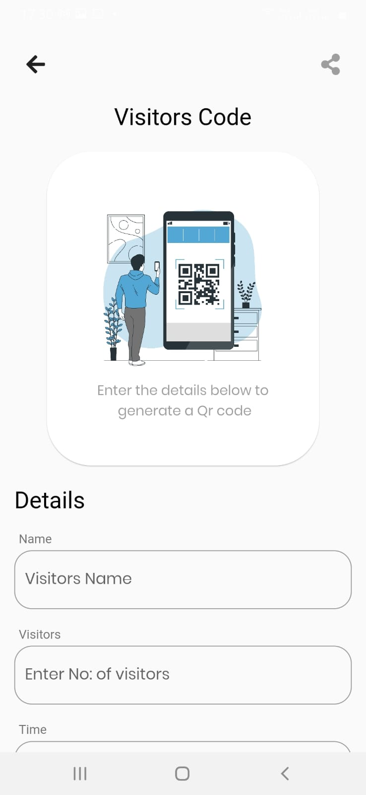
VIII Semester, Department of ISE, RNSIT
2021 - 2022

Slide 17
CONCLUSIONS
easy to use and adaptable project for all users
The UI is simplistic and easy to understand
Residents can use the app to be informed about meetings, activities and infrastructure available in the society premises
Residents can raise complaints and service requests in their flats using this App
Most commonly needed phone numbers of committe members can be found on this app

Slide 18
Future Enhancements
A in-app payments can be included to take all maintenance charges
UPIs or Payment Gateways can be integrated with this app
Whatsapp chat links can be included for quicker messaging
Utility service professionals can be contacted via this app
Inter- apartment communications can be implemented

Slide 19
REFERENCES
Flutter : https://docs.flutter.dev/
https://stackoverflow.com/questions/tagged/flutter
The Dart Programming Language book by Gilad Bracha
https://flutter.dev/community

Slide 20
Question and Answer

Slide 21
THANK YOU

