Slide 1
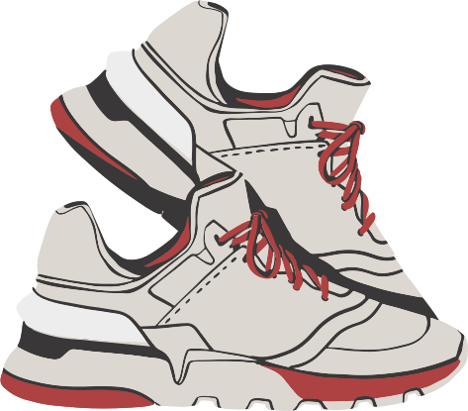
Sneak-Cult
PRESENTED BY:
Aayush Bansal
Aditya Chabba
Akshay Sharma
Ananya Thakur

Slide 2
INTRODUCTION
The Sneaker Website project aims to develop a comprehensive online platform dedicated to sneakers, catering to the needs of sneaker enthusiasts, collectors, and casual buyers alike. The website will serve as a hub for browsing, purchasing, and engaging with the latest sneaker releases, brands, and trends, offering a seamless and immersive shopping experience
Project Overview

Slide 3
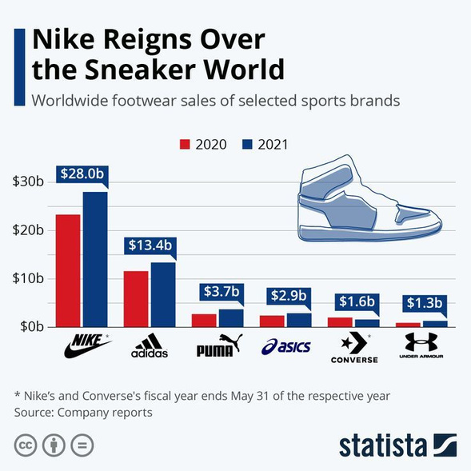
Problem Statement
The challenge lies in providing sneaker enthusiasts with a centralized platform offering exclusive releases, accurate information, seamless shopping experiences, and community engagement, while ensuring authenticity and trust in a fragmented and counterfeit-ridden market.

Slide 4
NEXT PHASE
Key Challenges:
LIMITED ACCESS TO EXCLUSIVE RELEASES
AUTHENTICITY AND TRUST ISSUES
LACK OF COMPREHENSIVE INFORMATION
LIMITED COMMUNITY ENGAGEMENT
FRAGMENTED SHOPPING EXPERIENCE

Slide 5
MOTTO
OBJECTIVE
CURATE EXCLUSIVE SNEAKER RELEASES
PROVIDE ACCURATE AND DETAILED INFORMATION
CREATE A SEAMLESS SHOPPING EXPERIENCE
ENSURE AUTHENTICITY AND TRANSPARENCY

Slide 6
OVERVIEW
KEY FEATURES
Extensive Product Catalog
Advanced Search and Filtering
Product Details and Reviews
User Accounts and Profiles
Community Engagement
Secure Online Shopping
IDEA BRAINSTORM

Slide 7
TECHNOLOGY USED
MERN STACK
MONGO DB
EXPRESS JS
REACT JS
NODE JS

Slide 8
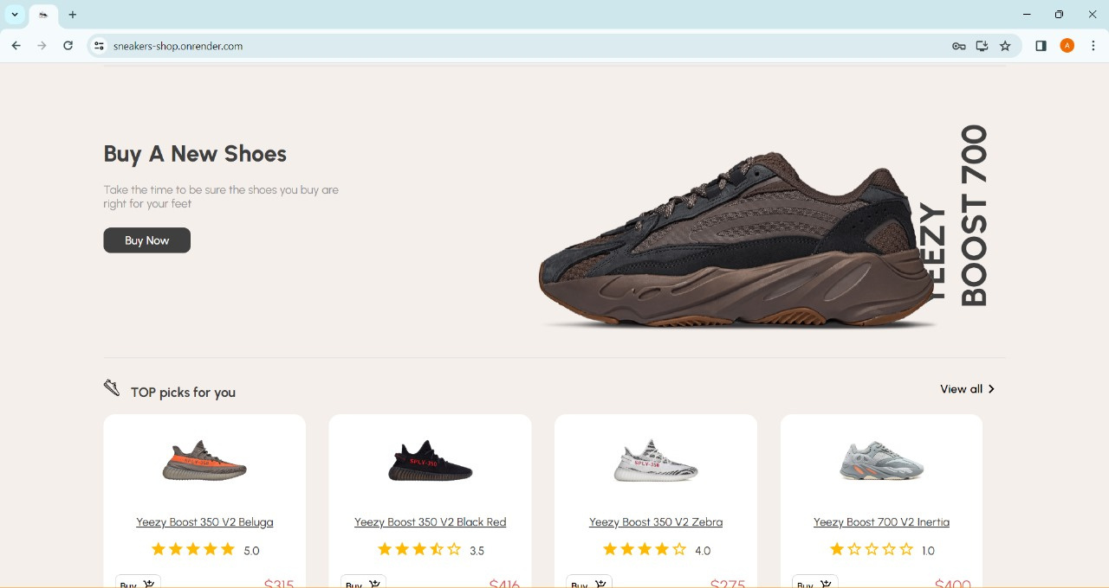

Slide 9
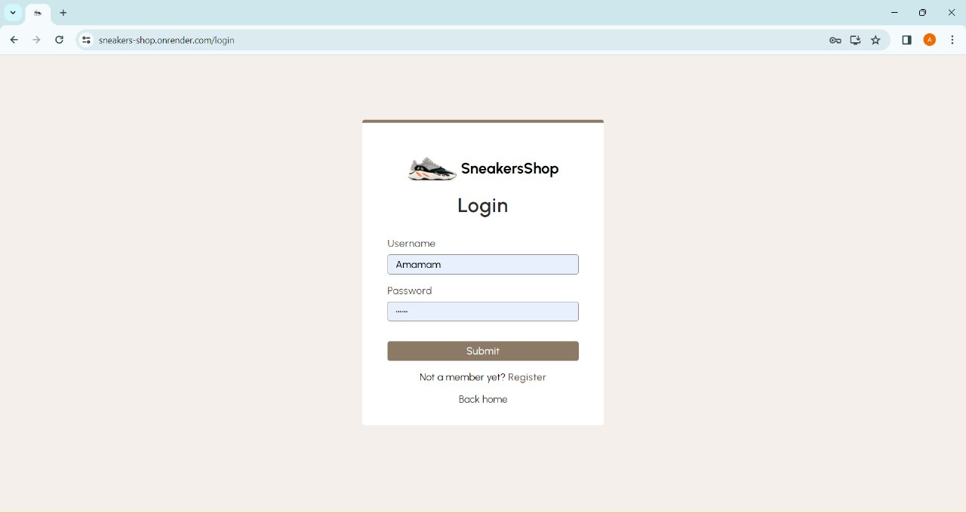

Slide 10
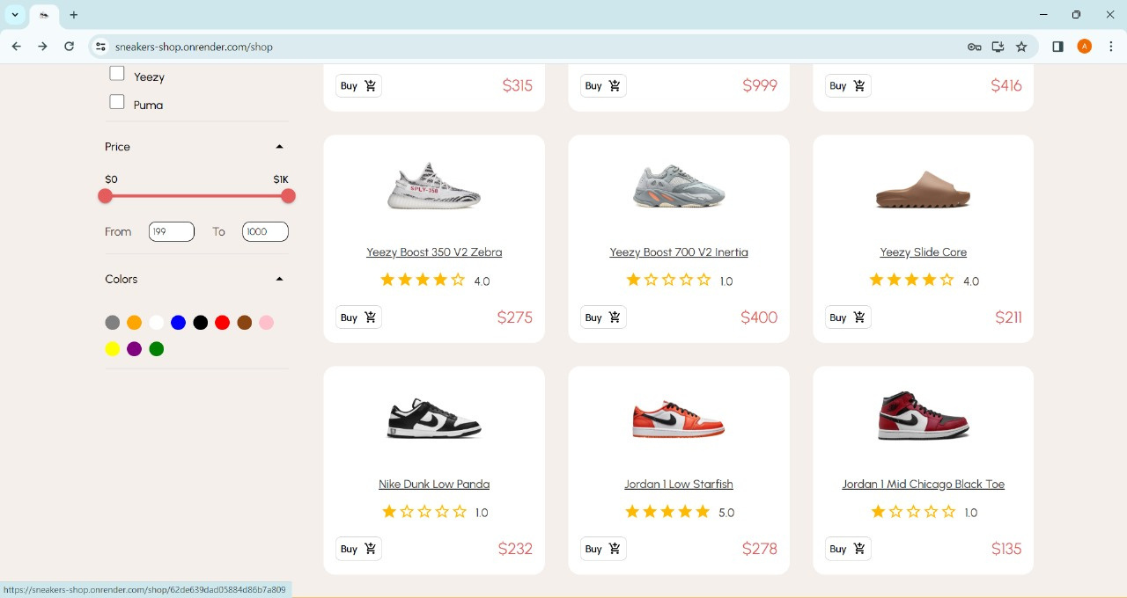

Slide 11
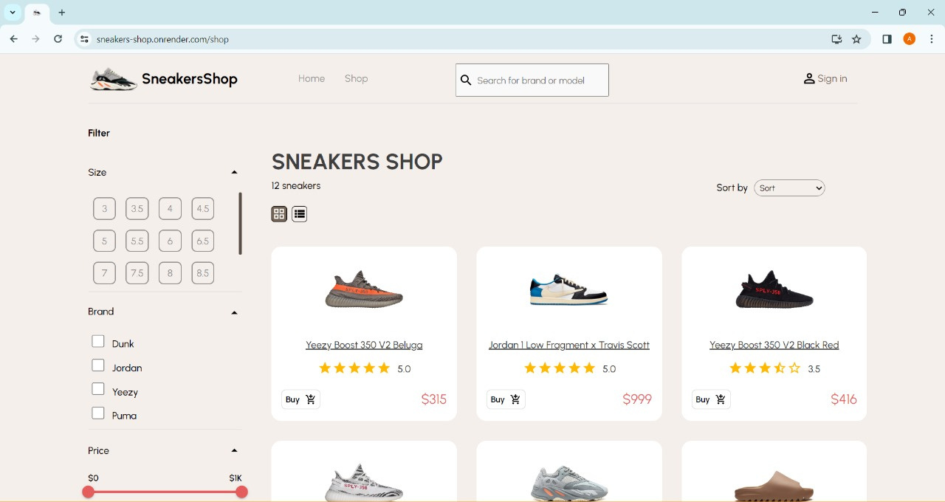

Slide 12
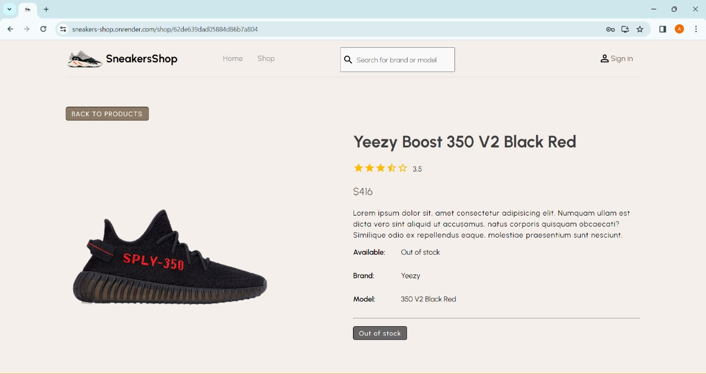

Slide 13
Thank you !

