Slide 1



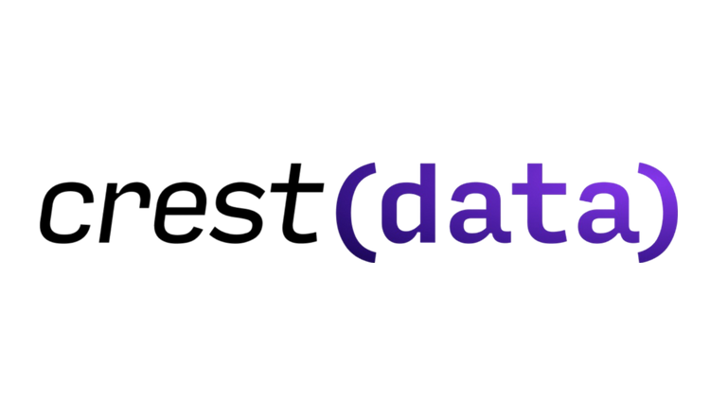

2025
Track :
CREST SECURITY AI-ML
Title :
Securing Systems using ML/AI - Malware Detection
Sponsored By:
Team Name:
NEURAL NOMADS
Members:
Mohit Ginglani (Leader)
Aditya Pandey
Satvik Gaikwad
Vedant Kumar

Slide 2
PROBLEM STATEMENT
We were tasked with building a machine learning model to classify malware into predefined categories using the provided dataset.
The goal was to develop efficient system that can accurately identify the type of malware based on the given data.
The solution will help enhance the detection and prevention mechanisms for real-world cybersecurity systems.

Slide 3

INTRODUCTION
OVERVIEW OF OUR APPROACH
EDA of individual datasets.
Dataset Merging based on common SHA-256.
PCA for dimensionality reduction.
Classical and Quantum Models exploration and comparison.
Running on test.csv for final prediction on the best performing model.

Slide 4


PROPOSED APPROACH
Exploratory Data Analysis (EDA): Helps understand data distribution, detect outliers, handle missing values, and uncover relationships through visualizations and statistics, guiding preprocessing and modeling decisions.
Principal Component Analysis (PCA): Reduces dimensionality by transforming data into a smaller set of uncorrelated components, retaining the most significant variance. We tested models using the top 256, 100, and 50 components from 22,696 features.
Normalization: Ensures features are scaled to a common range, preventing dominance by any single feature. It improves model performance and convergence, especially for gradient-based algorithms.
After Executing Classical, Advanced and QUANTUM ML models we propose the MLP Classifier due to these factors:
Hidden Layers: Two hidden layers with 50 and 25 neurons, respectively. Activation Function: Rectified Linear Unit (ReLU) for non-linearity. Optimization: Adam optimizer for efficient gradient updates. Regularization: L2 regularization (alpha=0.05) to prevent overfitting. Epochs: Trained for 400 iterations to ensure convergence. Random State: Fixed for reproducibility. This architecture allowed the model to balance complexity and efficiency, making it the best choice for malware detection in our study.

Slide 5
WHY OUR SOLUTION ?
We opted for an MLP model to balance performance and computational efficiency, addressing challenges such as large dataset size and resource constraints by optimizing the architecture and using model pruning and quantization.
To improve feature representation, we used different PCA field sizes and incorporated autoencoders and feature selection techniques like RFE. For quantum model limitations, we employed quantum-inspired classical methods and error-mitigation strategies for real quantum hardware.
We chose MLP over traditional models like SVM and logistic regression, as it handles non-linear relationships well and scales with large datasets.
MLP outperforms computationally expensive deep learning models like ConvLSTM and is more efficient for malware classification, offering a robust solution while maintaining accuracy.

Slide 6
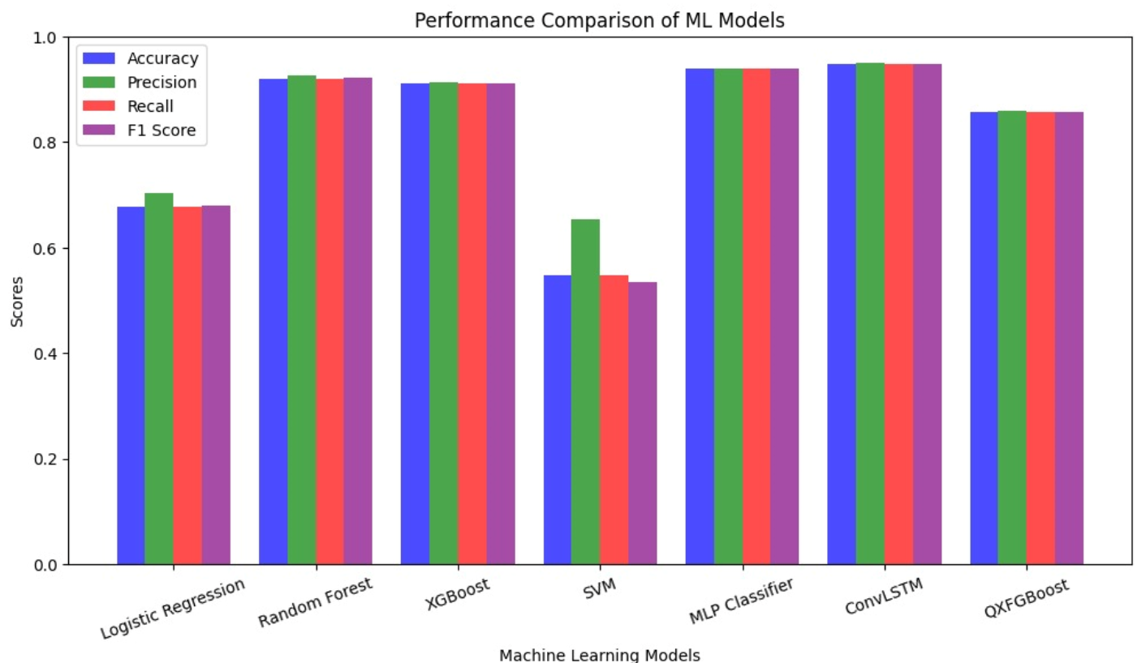
RESULTS
As the final result of our implimentation , the MLP Classifier achieved the best performance. The model's evaluation metrics are as follows:
Accuracy: 0.9390
Precision: 0.9398
Recall: 0.9390
F1-Score: 0.9388.
These results demonstrate the effectiveness of the MLP Classifier in accurately predicting the given dataset.

Slide 7

LIMITATIONS
Computational Constraints – Potentially large dataset requires high computational resources. Thus our model has high resource requirement and multiple frameworks were needed to execute the model. Quantum kernel methods require additional kernel to be installed that slows the training.
Feature Representation Issues – The PCA analysis may not optimally capture malware data patterns, and may lead to loss of important information. Therefore we have used 256, 100 and 50 field PCA for different models respectively.
Quantum Model Limitations – The approach relies on a noise-free quantum simulator; real quantum hardware introduces errors that could degrade performance. Quantum models also do not always outperform classical methods on medium-sized datasets and have not been fully tested in security domain
Limitations of Traditional ML Models – SVM struggles with large datasets due to slow training, logistic regression assumes linear separability, and XGBoost requires extensive hyperparameter tuning to avoid overfitting.
Challenges with Deep Learning (ConvLSTM, CNNs, Transformers) – These models need large labeled datasets are computationally expensive, and may not always outperform simpler models for malware classification.

Slide 8

REFERENCES
Quantum Machine Learning of Bigdata Set Using Randomized Measurements
2024
CFP22CB5-ART: ISBN: 978-1-6654-6084-2: Detection of Attacks using Attention-based Conv-LSTM and Bi-LSTM in Industrial Internet of Things
2022
https://youtu.be/xgA4Dx_7q34?si=oojx58AP2ySo5j6Q
QiSKIT - Global Summer School
2021

