Slide 1



Presented by
Insurance Charges Analysis
Section - 3 (Group - 2)
1
Ajmaeen Abid
ID: 2023-1-60-175
2
Aditya Debnath
ID: 2022-2-60-124
3
Umme Habiba
ID: 2022-1-60-362

Slide 2
Insurance Charges Analysis
Introduction
Dataset (quantity = 2) – insurance medical cost
Model – Linear Regression Model for continuous value.
Dataset Description
Dataset 1: filename `insurance.csv` — rows: 1338, columns: 7
Dataset 2: filename `insurance_uncleaned_realistic.csv` — rows: 1338, columns: 10

Slide 3
Key features
Dataset 1 | Dataset 2
age — numeric (years) | age — numeric (years)
sex — categorical (male/female) | sex — categorical (male/female)
bmi — numeric (body mass index) | bmi — numeric (body mass index)
children — numeric (number of children) | children — numeric (number of children)
smoker — categorical (yes/no) | smoker — categorical (yes/no)
region — categorical (northeast/northwest/southeast/southwest) | region — categorical (northeast/northwest/southeast/southwest)
charges — numeric (insurance charges) — target variable | blood_pressure -- numeric
 | exercise_level – categorical (low/medium/ high)
 | medical_history – categorical (diabetes/ hypertension/none)
 | charges — numeric (insurance charges) — target variable

Slide 4
Data Preprocessing
For Dataset 1 – Drop the duplicate values. No Null found.
For Dataset 2 – Find the null value, missing values are replace by mean, mode. Drop the duplicate values.

Slide 5
Preprocessing summary - Dataset 1 and Dataset 2
 | Dataset 1 | Dataset 2
Initial Rows | 1338
Duplicates removed | 1 | 0
age | 0 | 0
sex | 0 | 0
bmi | 0 | 50
children | 0 | 0
smoker | 0 | 30
region | 0 | 0
exercise_level | none | 540
Charges | 0 | 0
medical_history | none | 259
Blood_pressure | none | 353

Slide 6
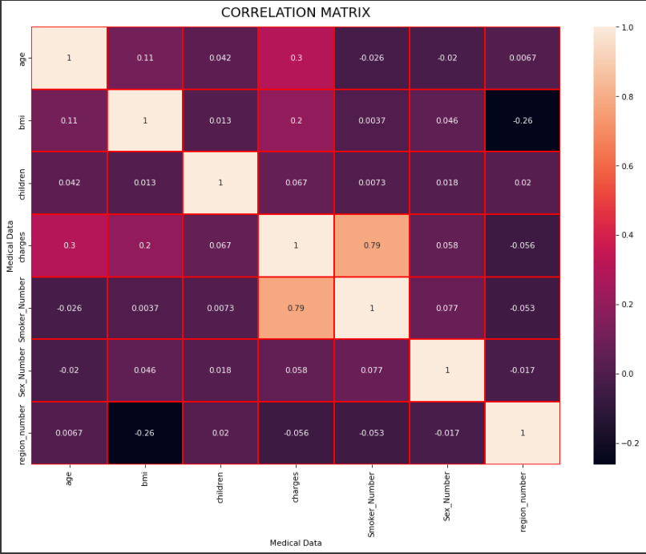
Exploratory Data Analysis (EDA) Correlation matrix - Dataset 1:

Slide 7
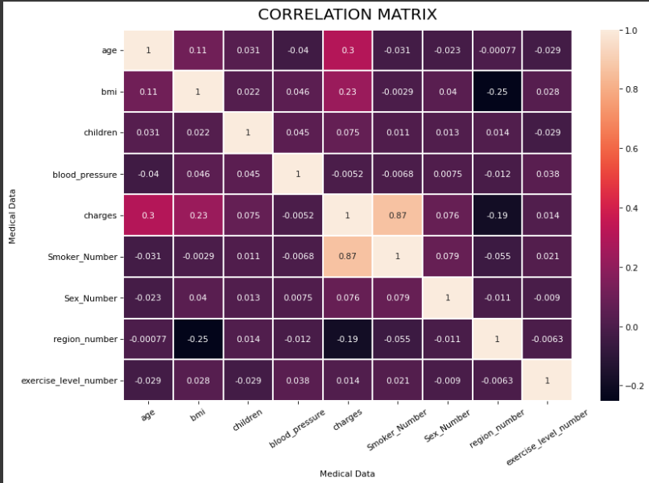
Exploratory Data Analysis (EDA) Correlation matrix - Dataset 2:

Slide 8
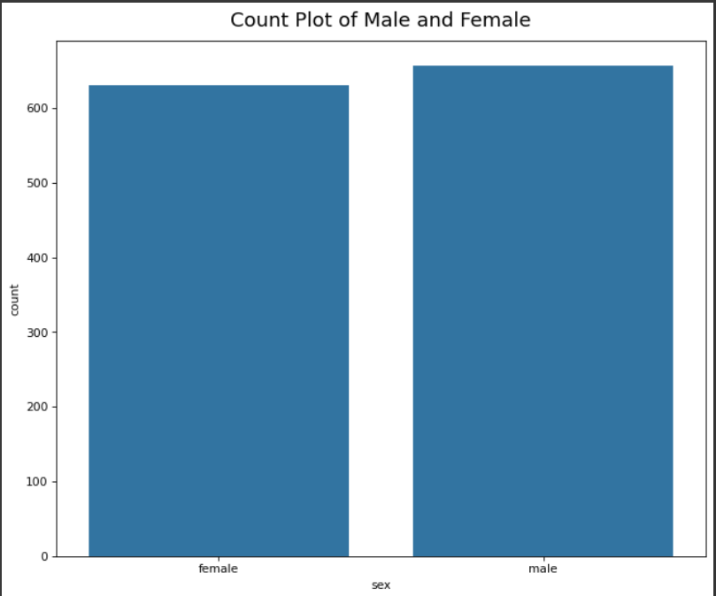
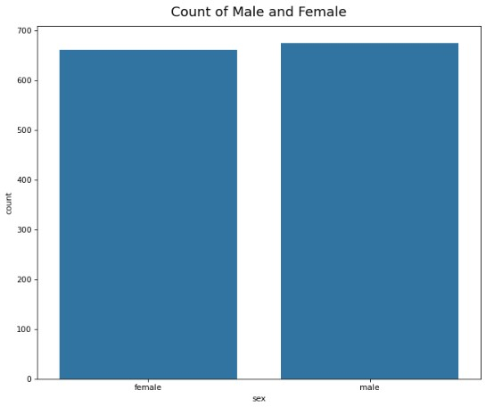
Count Plot of Male and Female - Dataset 1 and Dataset 2:
Dataset 1
Dataset 2

Slide 9
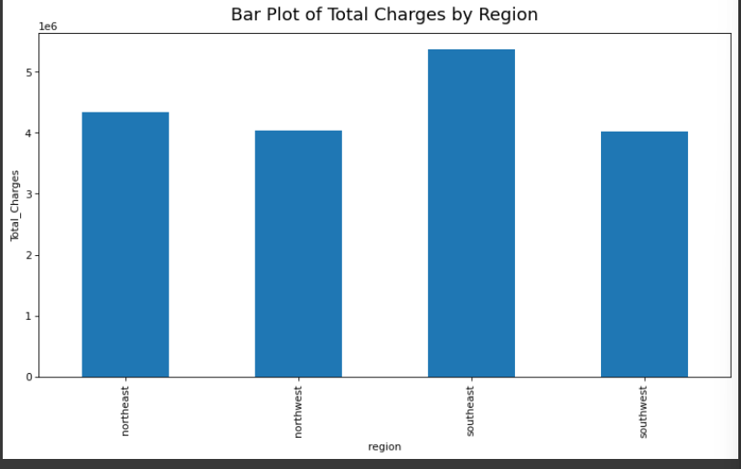
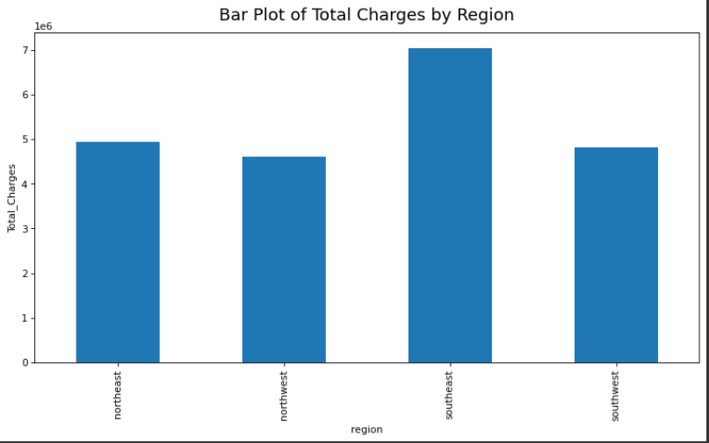
Bar Plot of Total charges by Region – Dataset 1 and Dataset 2:
Dataset 1
Dataset 2

Slide 10
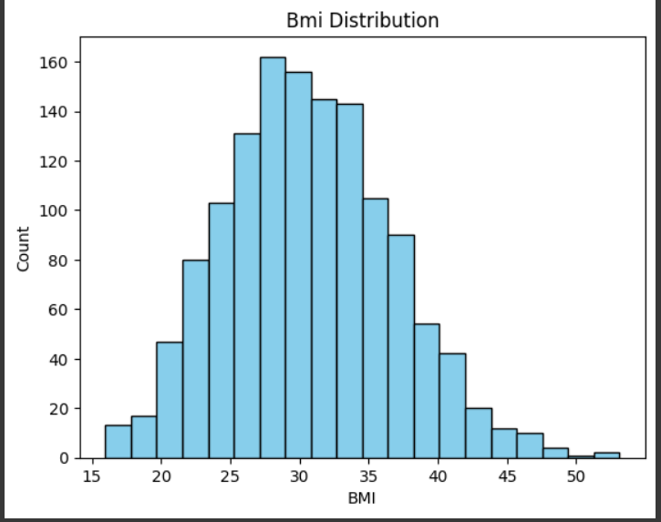
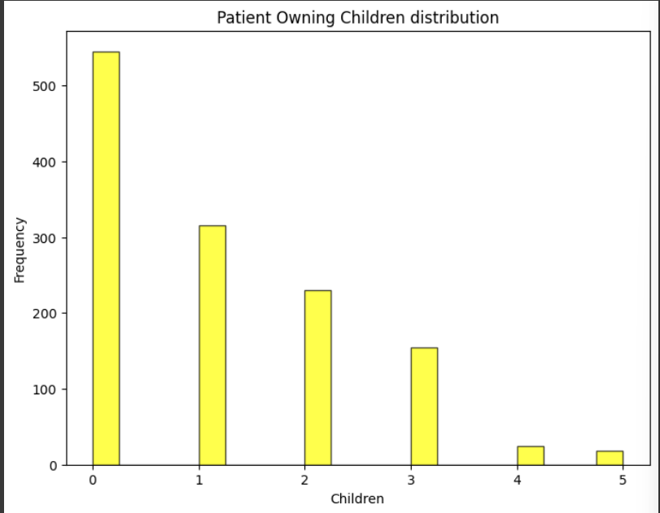
Histogram of bmi distribution – Dataset 1:
Histogram of children distribution of the Patients – Dataset 2:

Slide 11
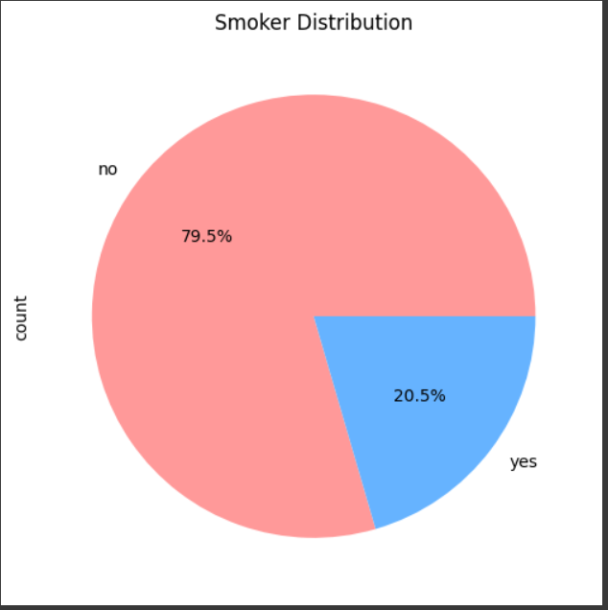
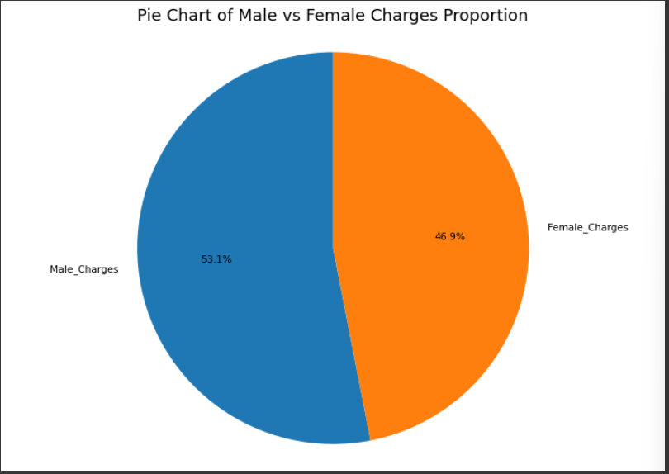
Pie Chart – Dataset 1 and Dataset 2:

Slide 12
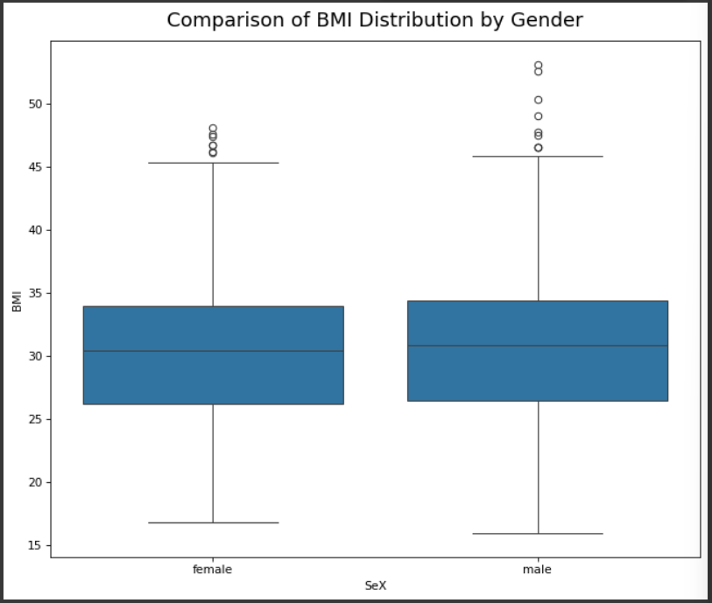
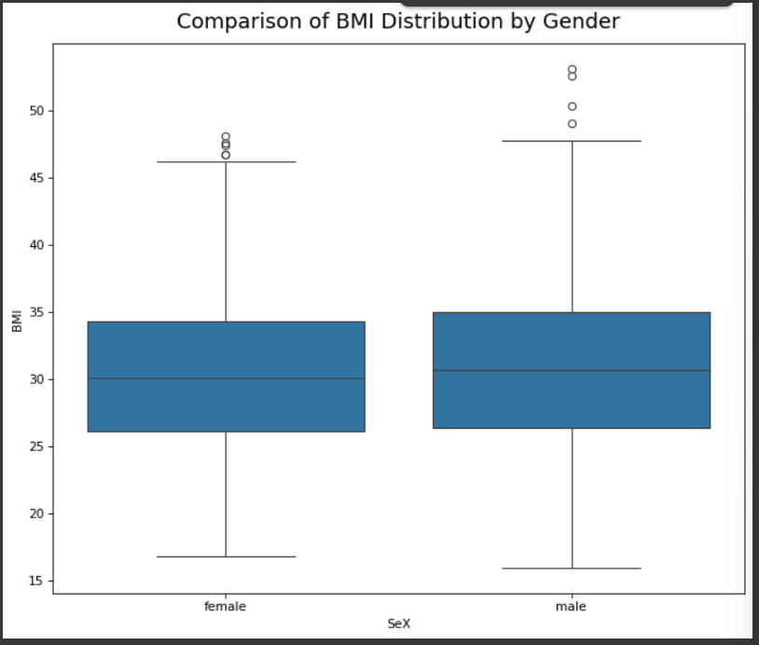
Box Plot of Age Comparison of BMI – Dataset 1 and Dataset 2:
Dataset 1
Dataset 2

Slide 13
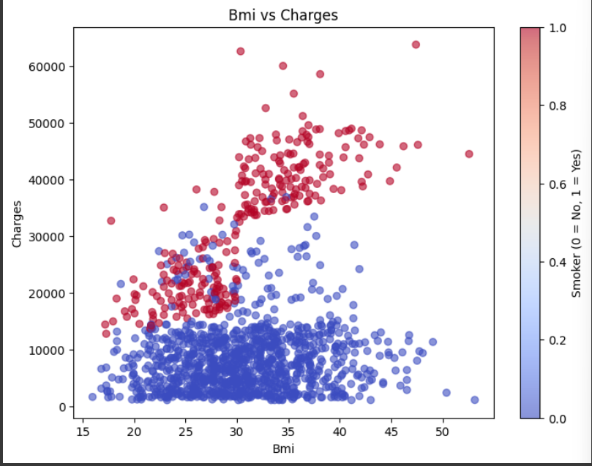
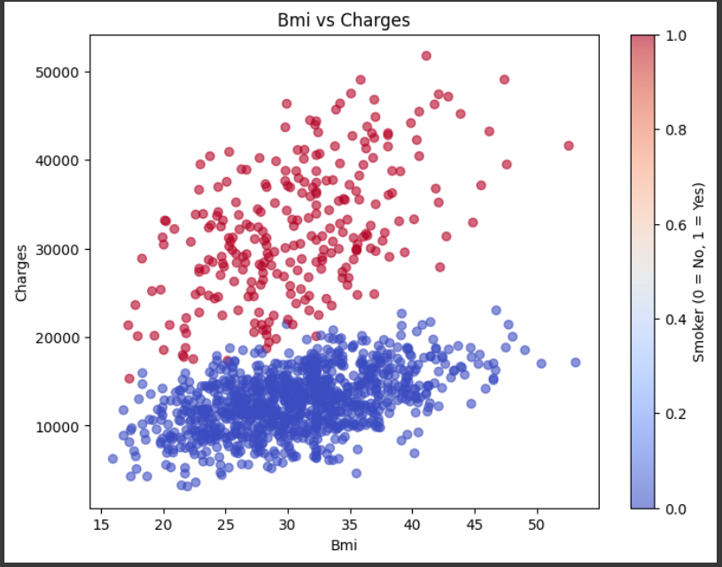
Scatter Plot of BMI VS Charges – Dataset 1 and Dataset 2:
Dataset 1
Dataset 2

Slide 14
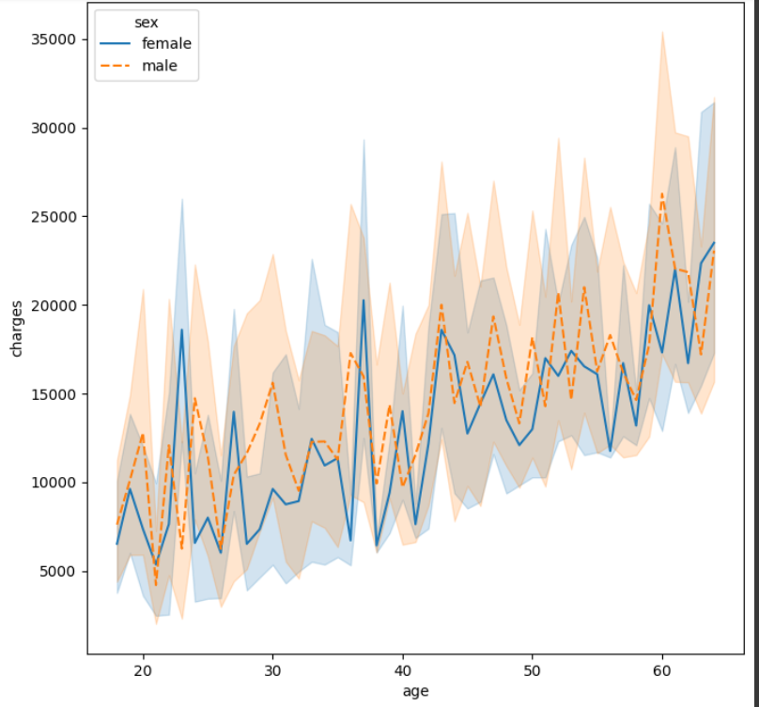
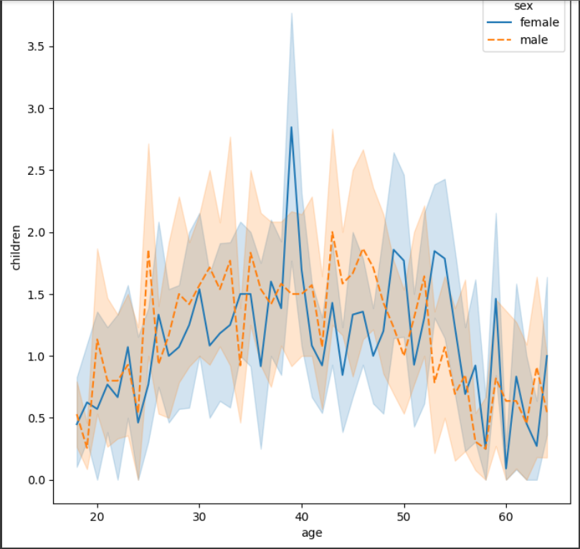
Line Plot Age VS Charges according to gender
– Dataset 1:
Line Plot Age VS Children according to gender
– Dataset 2:

Slide 15
Machine Learning Models
Dataset 1 – Model Performance
Dataset 2 – Model Performance
Metric | Linear Regression | Decision Tree
Mean Target (Medical Cost) | 14272.01 | 14272.0075
MAE | 4181.35 | 2591.6682
MAE as % of Mean Target | 29.29% | 18.16%
MSE | 35604894.07 | 18722739.9352
RMSE | 5966.99 | 4326.9782
RMSE as % of Mean Target | 41.81% | 30.3179%
R² Score | 0.8062 | 0.8981
Metric | Linear Regression | Decision Tree
Mean Target (Medical Cost) | 15836.71 | 15836.71
MAE | 2143.18 | 2066.35
MAE as % of Mean Target | 13.53% | 13.05%
MSE | 7157336.70 | 7066064.17
RMSE | 2675.32 | 2658.21
RMSE as % of Mean Target | 16.89% | 16.79%
R² Score | 0.9006 | 0.9019

Slide 16
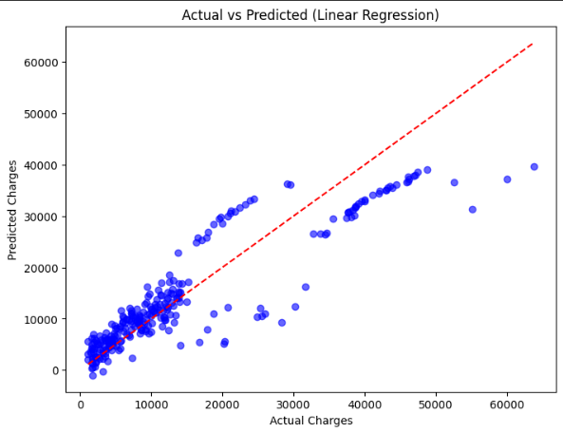
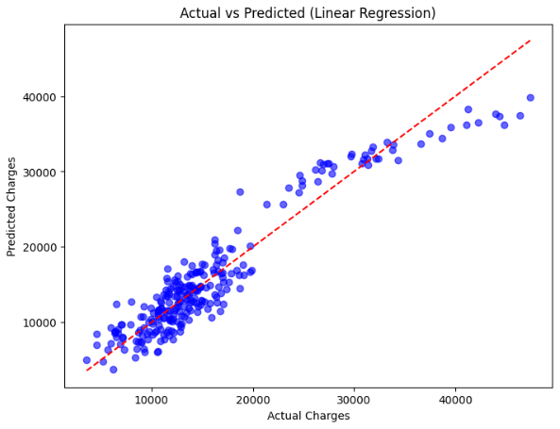
Machine Learning Models
Dataset 1 – Linear Regression
Dataset 2 – Linear Regression

Slide 17

Summary
Both Linear Regression and Decision Tree models work well for predicting medical costs. For Dataset1, Linear Regression reached an R² of about 0.80, while the Decision Tree performed better with an R² of about 0.82, along with lower MAE and RMSE values. For Dataset2, Linear Regression achieved an R² of about 0.90, but again the Decision Tree outperformed it with an R² of about 0.92 and lower errors. This shows that while both models are reliable, the Decision Tree is more accurate and is the better choice for medical cost prediction.
.

