Slide 1

HOSPITAL PERFORMANCE
ANALYTICS DASHBOARD
End-to-End Data Analytics Project
Built with Microsoft Excel · Power Pivot · Pivot Tables · Interactive Dashboard
DATA CLEANING
POWER PIVOT
KPI ANALYSIS
DASHBOARD
27,891 Visits
974 Patients | Avg Age 72

Slide 2



PROJECT OVERVIEW
The Challenge
The Approach
The Outcome
Raw hospital data spread across multiple relational tables with 20,000+ records — unclean, uncategorized, and unananalyzed.
End-to-end Excel analytics: data cleaning → feature engineering → Power Pivot modeling → multi-dimensional pivot analysis → interactive dashboard.
A fully interactive Hospital Performance Dashboard delivering KPIs, demographic insights, and operational metrics for decision-makers.
27,891 Total Encounters
974 Unique Patients
20,000+ Records
2 Relational Tables
Avg Age: 72 yrs

Slide 3






DATA CLEANING & FEATURE ENGINEERING
Standardize
Null Handling
Age Calculation
Age Groups
Length of Stay
Stay Type
Gender: M→Male
Marital: M→Married
IF/IFS functions
ZIP→Unknown
Reason→Not Specified
No data deleted
DATEDIF logic
Alive: age to TODAY()
Deceased: to death date
Child 0-18
Adult 19-40
Middle 41-60
Senior 60+
STOP - START
Same-day = 1 day
Business logic applied
Short: 1-2 days
Medium: 3-7 days
Long: 8+ days
Each transformation was driven by business logic — not just technical cleaning

Slide 4
POWER PIVOT DATA MODEL
PATIENTS TABLE
ENCOUNTERS TABLE
🔑 Id (Primary Key)
patients.Id → encounters.PATIENT
🔑 Id
BIRTHDATE
ONE-TO-MANY
🔗 PATIENT (Foreign Key)
DEATHDATE
START / STOP timestamps
GENDER_CLEAN
LENGTH_OF_STAY
AGE / AGE_GROUP
STAY_TYPE
MARITAL_CLEAN
ENCOUNTERCLASS
RACE / ETHNICITY
PAYER / ORGANIZATION
ADDRESS
REASONDESCRIPTION
Power Pivot enables cross-table analysis like SQL JOINs — without duplicating data or using VLOOKUP

Slide 5







KEY PERFORMANCE INDICATORS
27,891
974
72 yrs
1.24 days
Total Hospital Visits
Unique Patients
Avg Length of Stay
Average Patient Age
77% Senior Visits
99.84% Short Stays
51% / 49% Gender
Adults: 2.31 day LOS
21,632 of 27,891 encounters are patients aged 60+
Almost all visits are 1-2 days — high throughput facility
Near-equal male-female split across all encounters
Highest avg stay — seniors are processed fastest at 1.07 days

Slide 6
MULTI-DIMENSIONAL ANALYSIS
Visits by Age Group
Gender Distribution
Monthly Visit Trend
Avg Length of Stay by Age Group

Slide 7

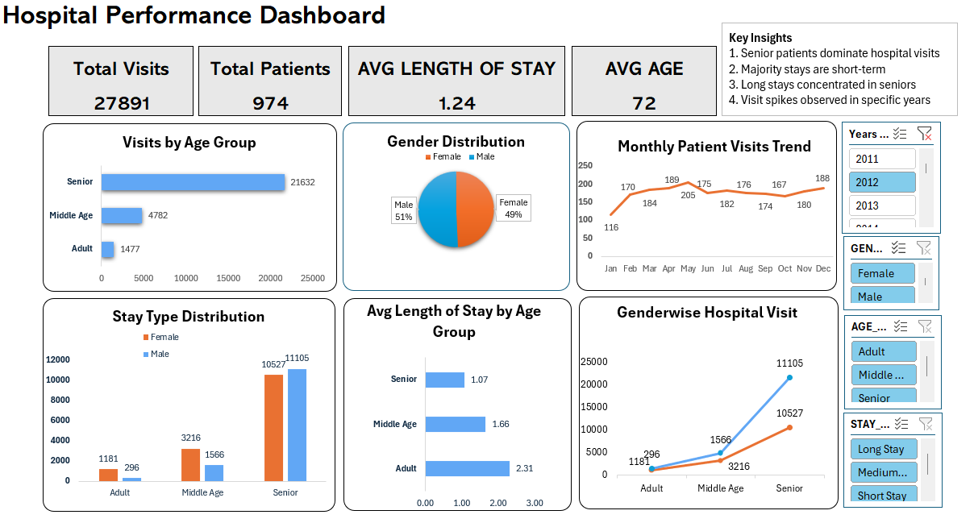



INTERACTIVE DASHBOARD DESIGN
Hospital Performance Dashboard
KPI Cards (Top Row)
4 large-number metric tiles — Total Visits, Patients, Avg LOS, Avg Age — for instant executive summary
Year
6 Chart Suite
Age Group
Bar Chart
Gender Pie
Chart
Gender
Bar, Pie, Column, Line charts — each answering a different business question across demographics & trends
4 Interactive Slicers
Age
Stay Type
Distribution
Monthly Trend
Line Chart
Year · Gender · Age Group · Stay Type — all slicers connected to ALL charts simultaneously for dynamic filtering
Clean Design
Consistent color theme, no gridlines, proper spacing — professional & self-service ready for any stakeholder
All slicers connected to all charts → fully dynamic self-service analytics

Slide 8
KEY INSIGHTS & BUSINESS IMPACT
01
Senior Patients Dominate
02
High Throughput Operations
77%
21,632 of 27,891 encounters are from patients aged 60+. Hospital resources and protocols should be oriented towards geriatric care.
99.84%
Near-complete short-stay pattern signals efficient throughput. This hospital functions as a high-volume outpatient hub rather than long-term care.
of all visits
short stays
03
Age-LOS Inversion
04
Seasonal Visit Patterns
2.31 vs 1.07
Adults stay 2.31 days on average while Seniors — the majority — stay only 1.07 days. Seniors have highly standardized, faster care protocols.
Jan 116 → Mar 205
Clear seasonal demand peaks in March and December. Hospital staffing and resource planning can be optimized using these cyclical patterns.
Adult vs Senior LOS
monthly range

Slide 9





EXCEL SKILLS DEMONSTRATED
Data Cleaning
Feature Engg.
Data Modeling
IF / IFS / IFS functions
Age from DATEDIF + TODAY()
Power Pivot Data Model
XLOOKUP for enrichment
Age Group segmentation
Table relationships
Null value strategies
Length of Stay calc
Cross-table analysis
Categorical standardization
Stay Type categorization
No VLOOKUP duplication
Pivot Analysis
Visualization
Dashboard UX
Multi-dim pivot tables
Bar, Pie, Line, Column
Clean layout design
Calculated fields
Chart formatting & cleanup
Consistent color theme
Cross-dimensional pivots
Slicer interactivity
Self-service slicers
Demographic & trend analysis
KPI card design
Executive KPI summary

Slide 10

WHAT I DELIVERED
THANK YOU
End-to-End Analytics Workflow
Hospital Performance Analytics Dashboard
Relational Data Modeling
"I took raw hospital data, built a relational model, applied business logic throughout cleaning and feature engineering, conducted multi-dimensional analysis, and delivered an interactive Excel dashboard — covering the complete analytics pipeline from raw data to actionable insights."
Business Logic in Every Step
6-Chart Interactive Dashboard
4 Actionable Business Insights
Data Cleaning
Power Pivot
Feature Engineering
Dashboard Design
Business Insights

