Slide 1


SMART INDIA HACKATHON 2025
RAAHI
Problem Statement ID – SIH25002
Problem Statement Title- Smart Tourist Safety Monitoring & Incident Response System using Al, Geo-Fencing, and Blockchain-based Digital ID
Theme- Travel & Tourism
PS Category- Software
Team ID-
Team Name- code crafters

Slide 2
RAAHI - AI-Powered Tourist Safety Ecosystem
Code
Crafters
Proposed Solution
RAAHI is an AI-powered tourist safety ecosystem combining blockchain digital IDs, real-time emergency response, and predictive safety intelligence. It connects tourists, authorities, and emergency services through integrated mobile app and admin dashboards.
Blockchain-based Digital Tourist ID with KYC & itinerary
Tourist Mobile App:
➢ Geo-fencing alerts for high-risk areas
➢ Panic button & live location sharing
➢ Safety Score & AI anomaly detection (route deviation, inactivity, distress)
➢ Multilingual support (10+ Indian languages + English)
Admin/Police Website:
➢ KYC approval/rejection workflow
➢ Real-time SOS alerts and last known location
➢ Heat maps, digital ID verification, incident dashboard
Optional IoT wearables for high-risk zones
Innovation & Uniqueness:
➢Tamper-proof identity via blockchain
➢ Proactive safety with AI + geo-fencing
➢ Integrated app + admin portal for coordinated response

Slide 3
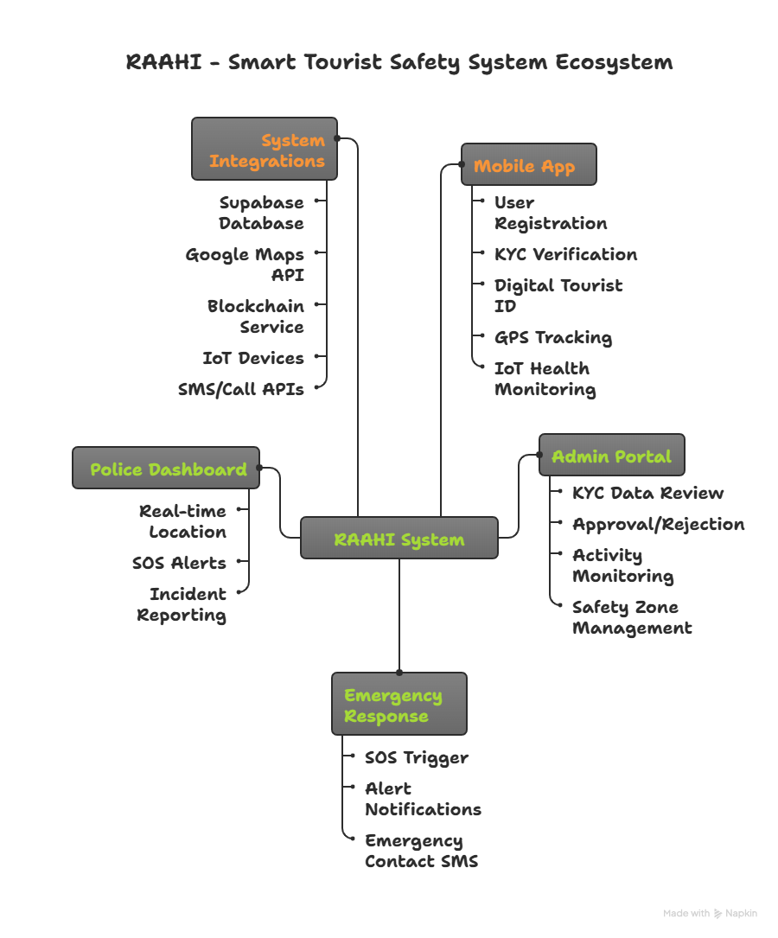
TECHNICAL APPROACH
Code
crafters
Mobile App: Flutter (Dart), Google Maps API, Supabase (backend + storage), IoT integration
Admin Website: React + Context API + Tailwind CSS
Backend: Node.js + Express + Socket.io (real-time alerts) for website, Supabase for mobile app
Database: Supabase PostgreSQL for mobile app, MongoDB for admin website (users, digital IDs, emergency alerts)
Security: JWT Auth, RBAC, blockchain hash for data integrity
Process:
User registers & submits KYC → KYC sent to admin portal → Approval generates blockchain ID → Real-time SOS/location updates → Police/admin dashboard for monitoring

Slide 4
FEASIBILITY AND VIABILITY
Code crafters
Analysis of the feasibility of the idea
➢Technical feasibility proven with working Flutter app + React admin portal
➢Government integration possible via existing emergency services (100, 108, 121)
➢Blockchain implementation using established SHA256 encryption standards
➢Scalable cloud infrastructure (Supabase + MongoDB) can support users.
Potential challenges and risks
➢Internet connectivity in remote tourist locations
➢Government approval for official tourism authority integration
➢User adoption and digital literacy among diverse tourist demographics
➢Data privacy compliance across multiple jurisdictions
➢Initial setup costs for IoT devices and infrastructure
Strategies for overcoming these challenges
➢ Offline mode with data sync when connectivity restored
➢ Pilot program with state tourism boards for gradual rollout
➢ Multi-language support and simple UI for easy adoption
➢ End-to-end encryption and GDPR compliance by design
➢ Freemium model with government partnerships for subsidized IoT devices

Slide 5
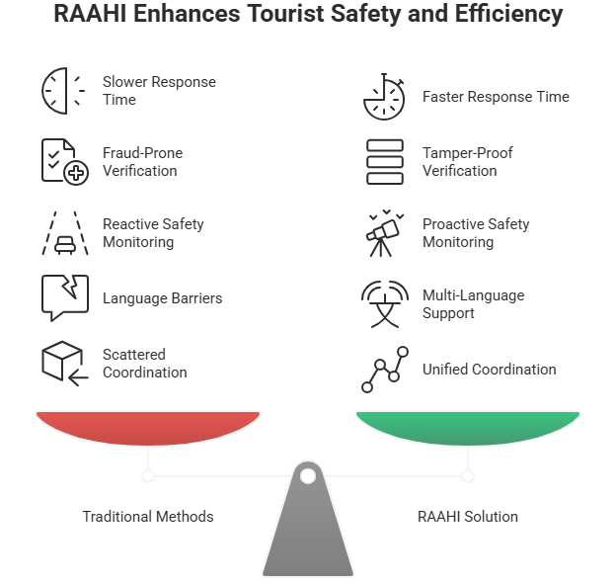
IMPACT AND BENEFITS
Code
crafters
Potential impact on the target audience
➢ 60% faster emergency response through automated alerts and admin dashboard
➢ Enhanced tourist confidence with blockchain-verified digital IDs
➢ Coordinated response between tourists, police, and tourism authorities
➢ Proactive safety for annual tourists in India
"RAAHI is like having a personal bodyguard, family hotline, and GPS guide combined into one smart companion - but powered by AI and blockchain for every tourist in India."
Benefits of the solution
➢ Social: Multi-language safety for diverse tourists, family peace of mind
➢ Economic: Reduced tourism losses, increased visitor confidence and numbers
➢ Technological: AI-powered prevention, blockchain fraud protection, seamless app-admin integration

Slide 6
RESEARCH AND REFERENCES
Code
crafters
➢ Ministry of Tourism, Government of India - Tourist Safety Guidelines (2024)
➢ National Crime Records Bureau - Tourist Incident Reports (2023-24)
➢ IEEE Papers - Blockchain Identity Verification Systems
➢ Google Maps Platform - Emergency Location Services Documentation
➢ Supabase Documentation - Real-time Database Architecture
➢ Flutter Security Guidelines - Cross-platform Development Best Practices
➢ Police Department Studies - Emergency Response Coordination Protocols
➢ Digital India Initiative - Government Blockchain Implementation

