Slide 1

Customer Shopping Behavior Analysis
Uncovering spending patterns, segments, and preferences across 3,900 transactions to guide strategic decisions.

Slide 2
Dataset at a Glance
3,900
18
Purchases
Columns
Transactional records analyzed
Demographics, purchases, behavior
37
$59.76
Missing Values
Avg Purchase
In Review Rating column
Average spend per order
Features include age, gender, location, subscription status, item category, purchase amount, season, discount applied, shipping type, and review rating.

Slide 3


Data Preparation in Python
Clean & Standardize
Imputed missing Review Ratings by category median; renamed columns to snake_case
Feature Engineering
Created age_group and purchase_frequency_days columns
Load to MySQL
Connected Python to MySQL for SQL analysis

Slide 4
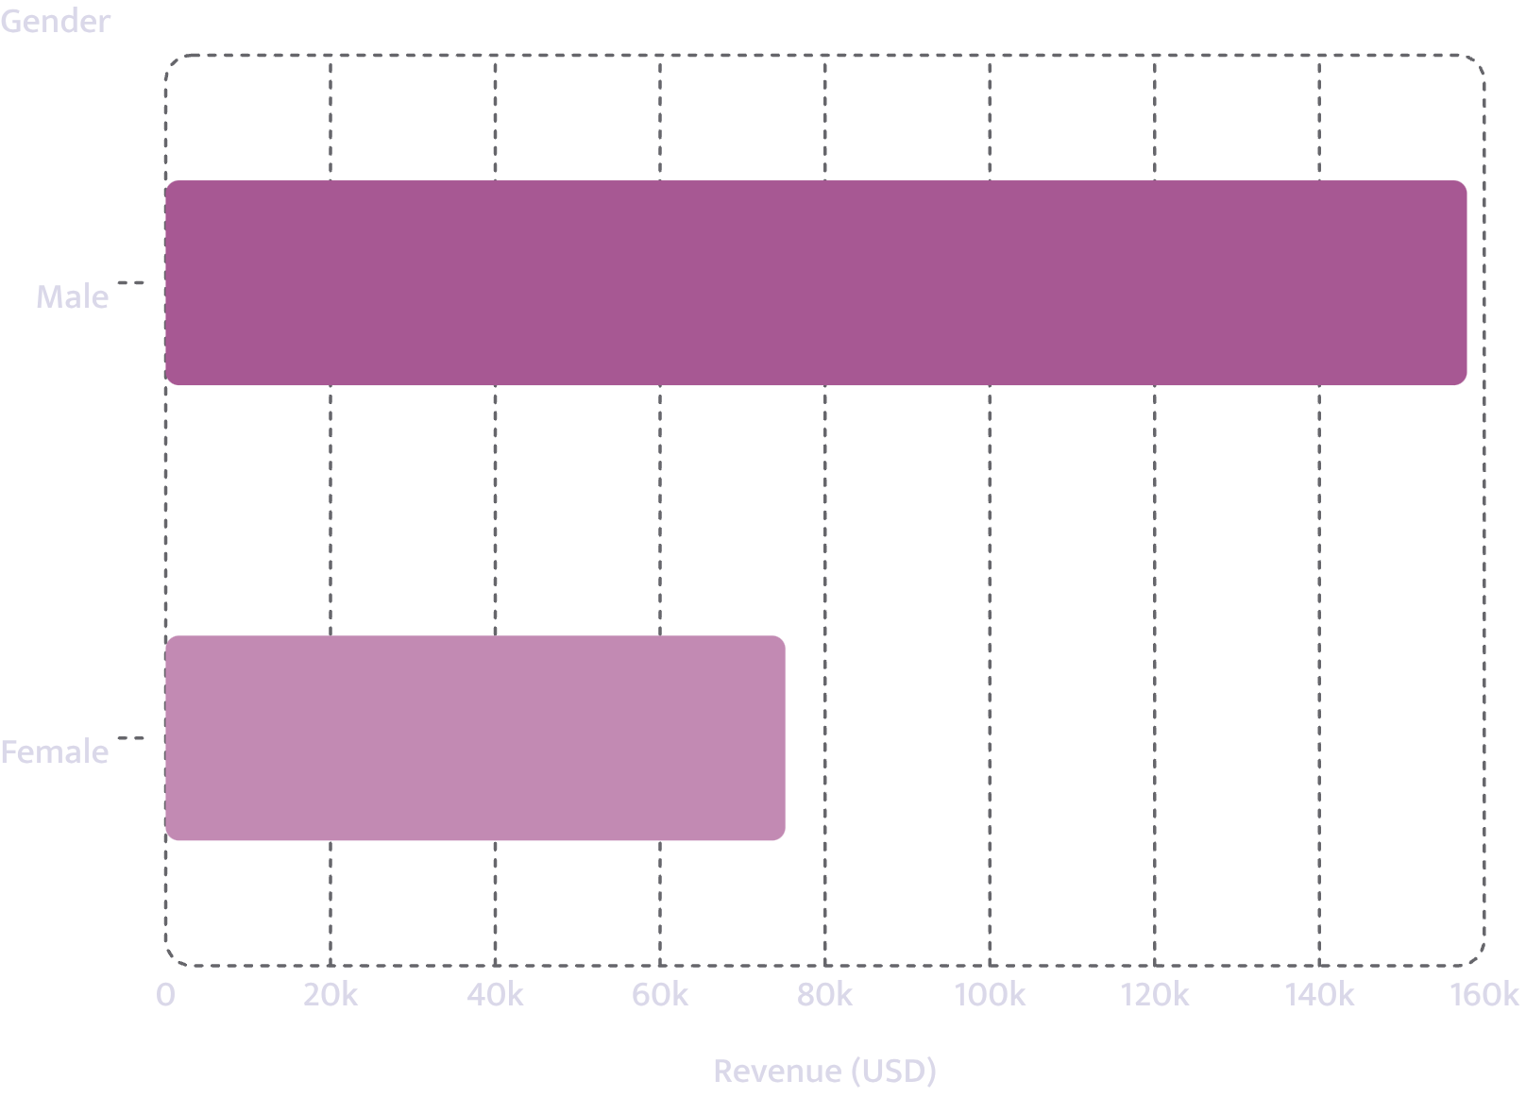
Revenue by Gender
Male customers generate 2× more revenue than female customers.
Male: $157,890 · Female: $75,191

Slide 5
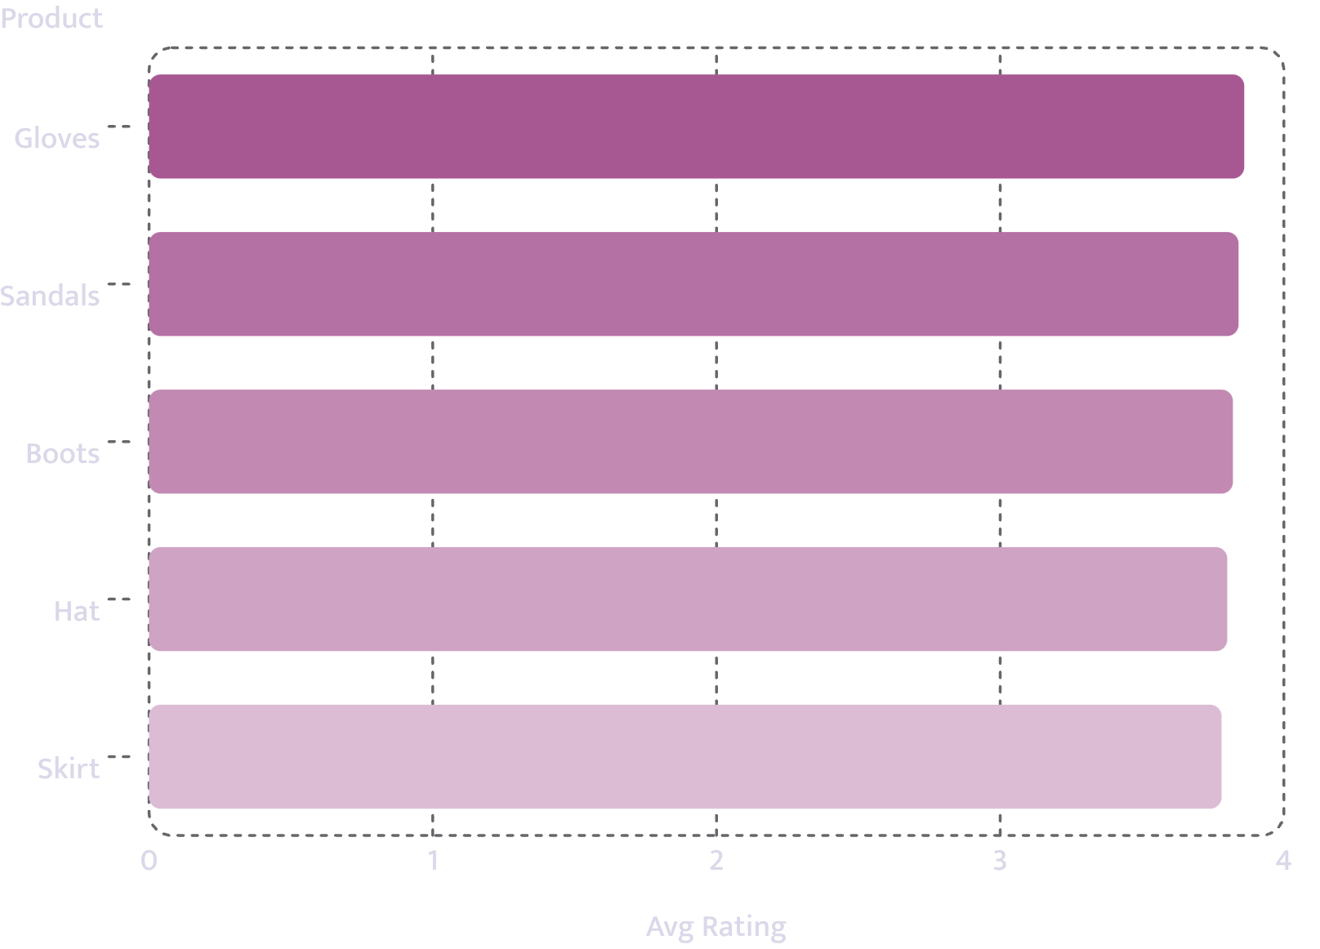
Top Products by Rating
Highest-rated items
Gloves lead at 3.86 avg rating. All top 5 products cluster tightly between 3.78–3.86.

Slide 6
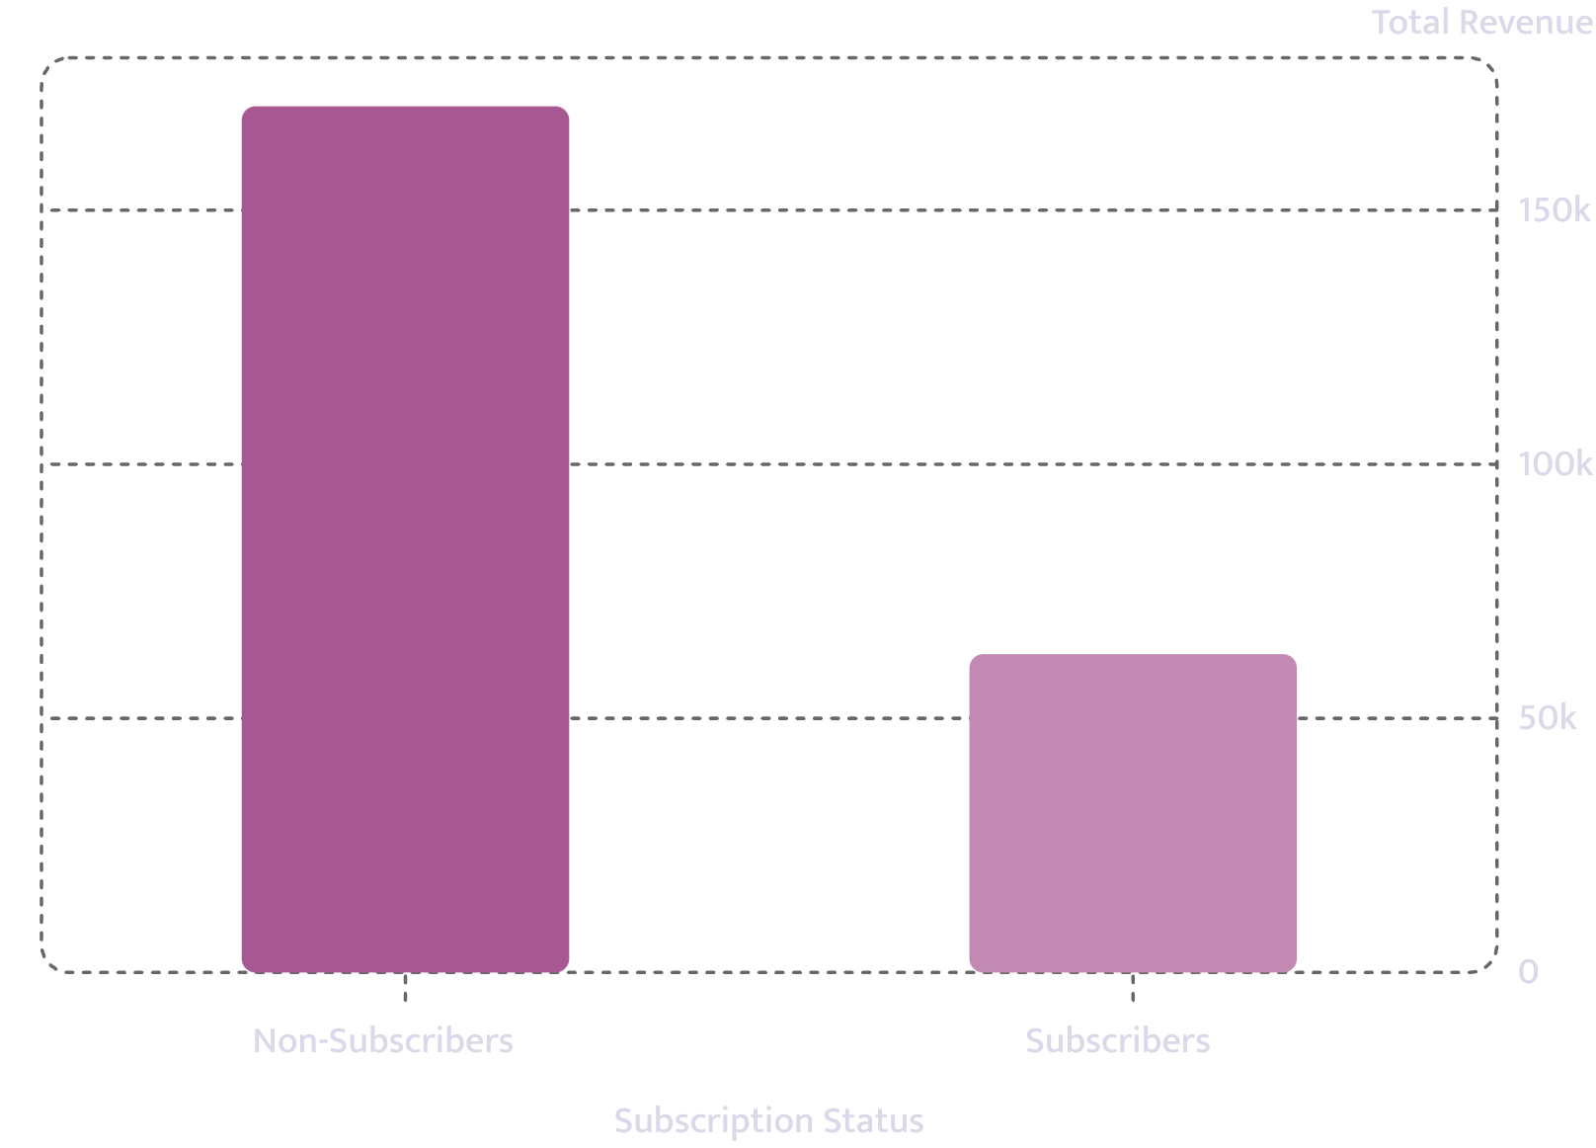
Subscribers vs. Non-Subscribers
Non-subscribers drive 73% of revenue
Subscribers spend slightly less on average ($59.49 vs $59.87), but represent only 27% of customers.

Slide 7
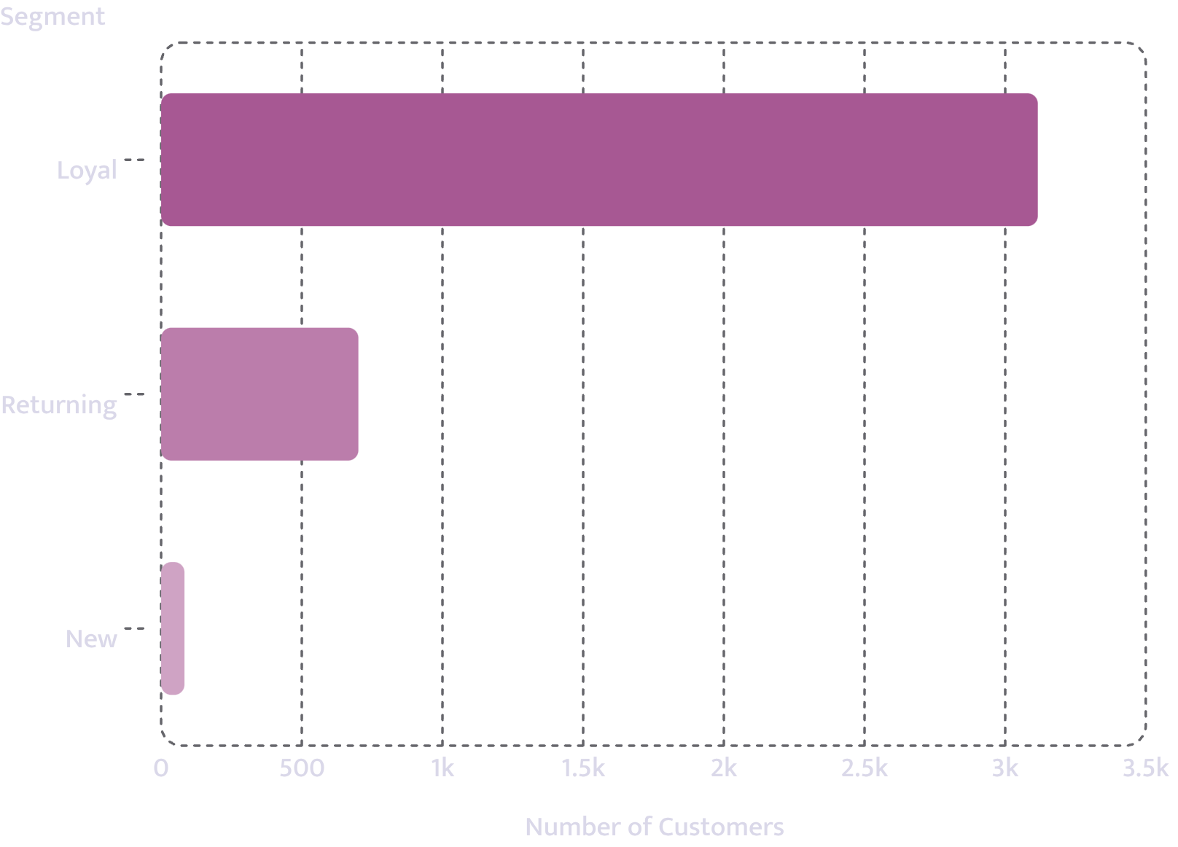

Customer Segmentation
Loyal customers dominate
80% of customers are classified as Loyal. Only 83 new customers in the dataset.
Repeat buyers with >5 purchases: 958 subscribed vs 2,518 did not.

Slide 8
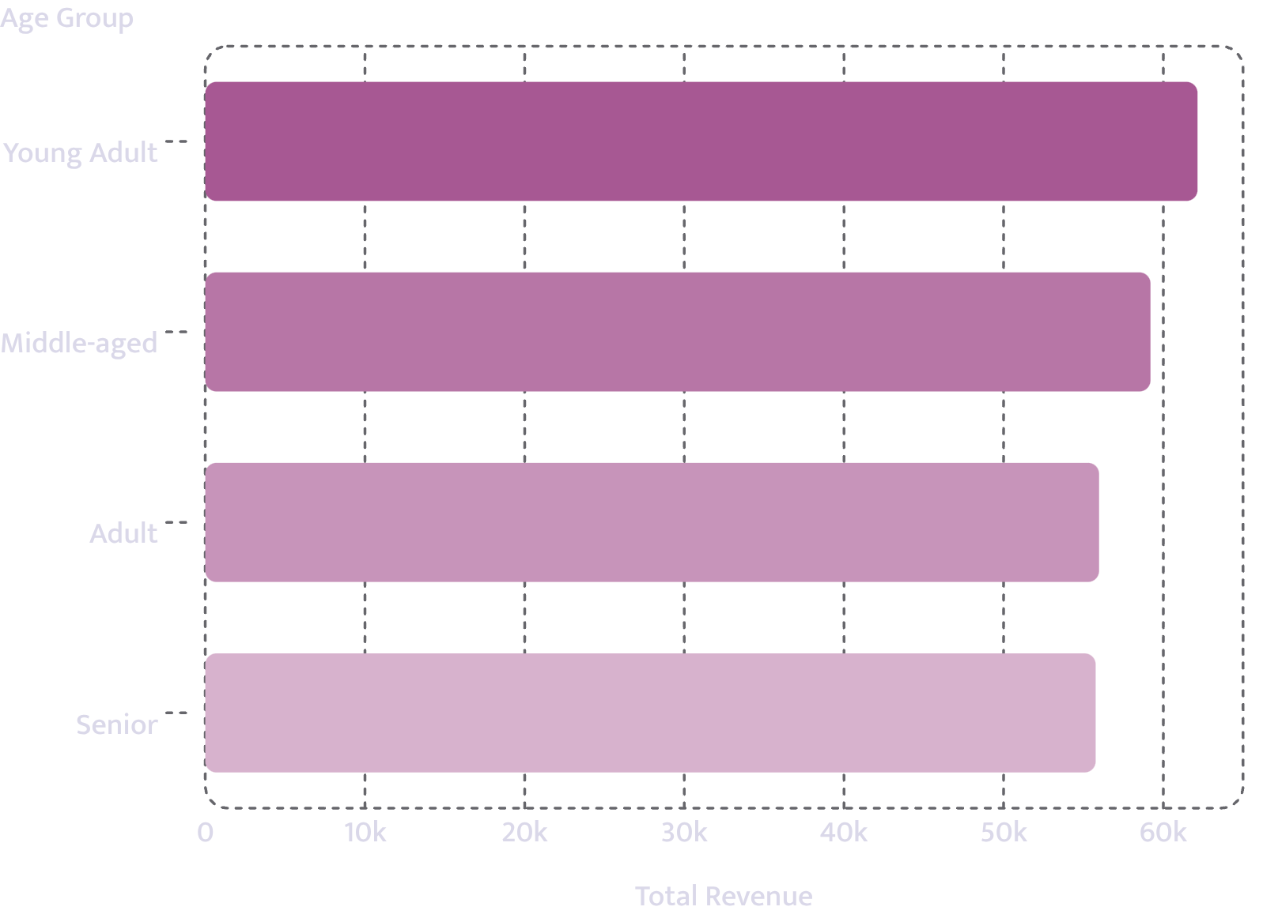
Revenue by Age Group
Young Adults lead in revenue
Young Adults contribute the most ($62,143), with revenue declining slightly across older groups.

Slide 9
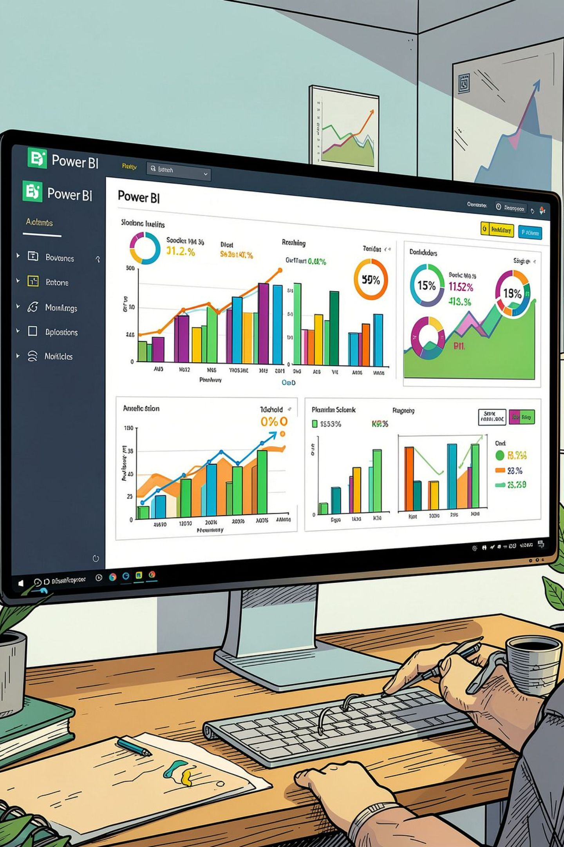
Power BI Dashboard
Key Metrics
Revenue by Category
3.9K customers · $59.76 avg purchase · 3.75 avg rating
Clothing $100K · Accessories $75K · Footwear $30K · Outerwear $15K
Filters
Subscription Status, Gender, Category, Shipping Type

Slide 10




Business Recommendations
Boost Subscriptions
Loyalty Programs
Promote exclusive subscriber benefits
Reward repeat buyers toward "Loyal" segment
Review Discount Policy
Targeted Marketing
Balance sales lifts with margin control
Focus on high-revenue age groups & express-shipping users

