Slide 1
ITSM Weekly Report — 20260407
Auto-generated | 5 groups | AI-powered insights
Generated by ITSM Automation Agent | Confidential

Slide 2
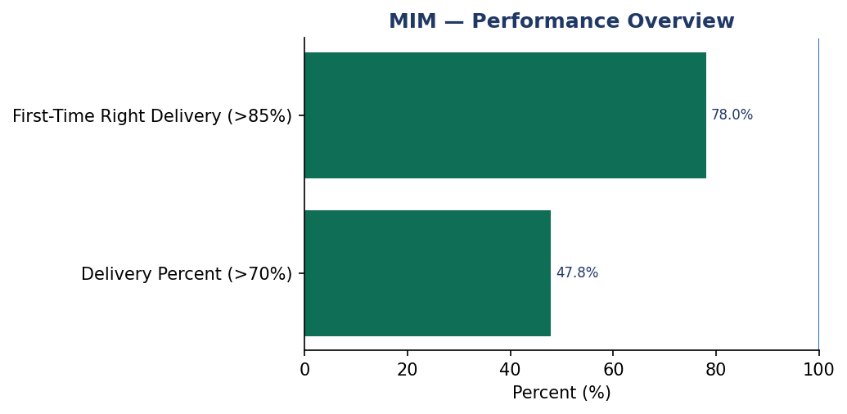
MIM | Date: 20260407
Summary
The MIM team has 1 data records for this period.
KPI Name | Actual | Target | Status
Delivery Percent | 47.83 | >70.0% | FAIL
First-Time Right Delivery | 78.0 | >85.0% | FAIL
Insights
AI analysis unavailable. Manual review recommended.

Slide 3
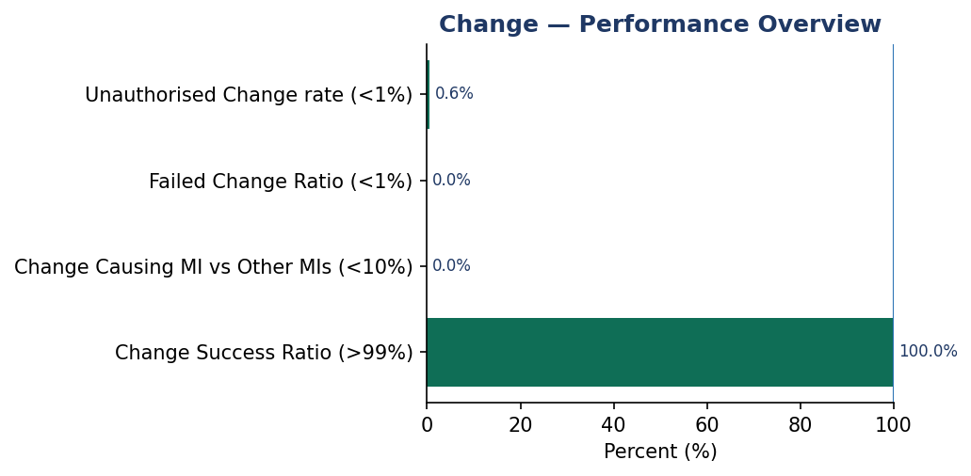
Change | Date: 20260407
Summary
The Change team has 1 data records for this period.
KPI Name | Actual | Target | Status
Change Success Ratio | 100.0 | >99.0% | PASS
Change Causing MI vs Other MIs | 0.0 | <10.0% | PASS
Failed Change Ratio | 0.0 | <1.0% | PASS
Unauthorised Change rate | 0.0061 | <1.0% | PASS
Insights
AI analysis unavailable. Manual review recommended.

Slide 4
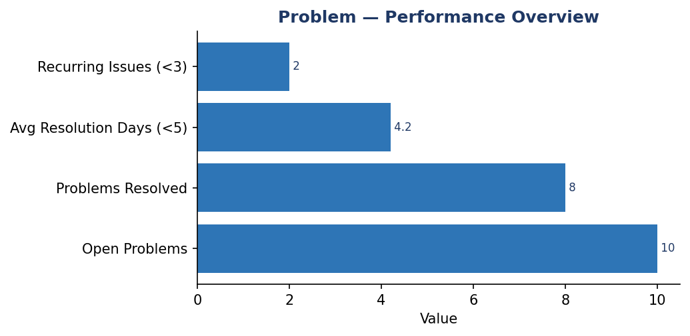
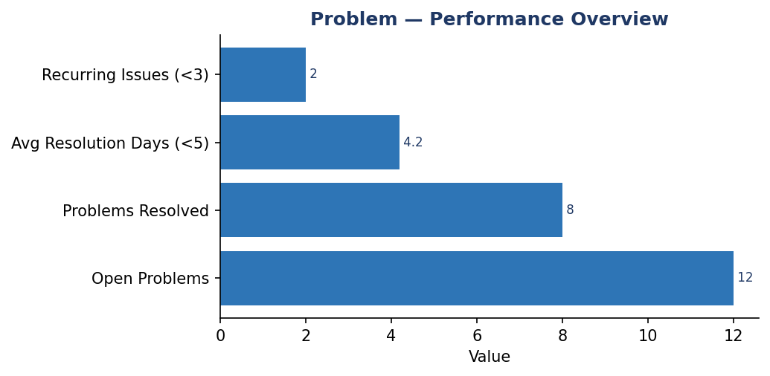
Problem | Date: 20260407
Summary
The Problem team has 1 data records for this period.
KPI Name | Actual | Target | Status
Avg Resolution Days | 4.2 | <5.0 | PASS
Recurring Issues | 2.0 | <3.0 | PASS
Insights
AI analysis unavailable. Manual review recommended.

Slide 5
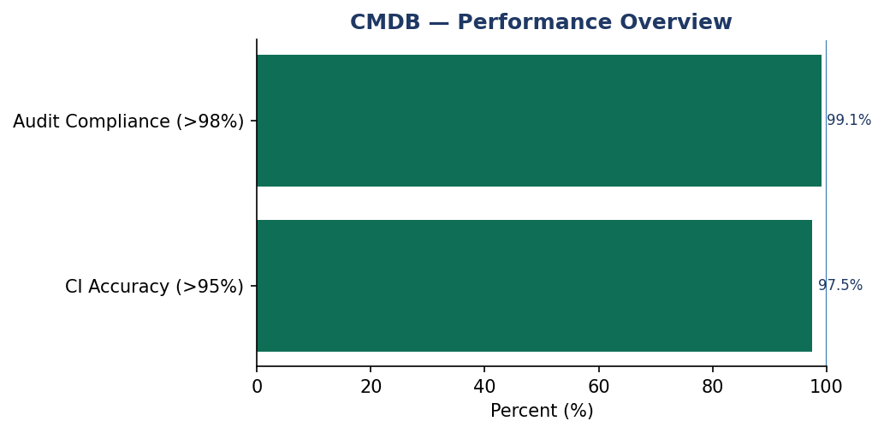
CMDB | Date: 20260407
Summary
The CMDB team has 1 data records for this period.
KPI Name | Actual | Target | Status
CI Accuracy | 97.5 | >95.0% | PASS
Audit Compliance | 99.1 | >98.0% | PASS
Insights
AI analysis unavailable. Manual review recommended.

Slide 6
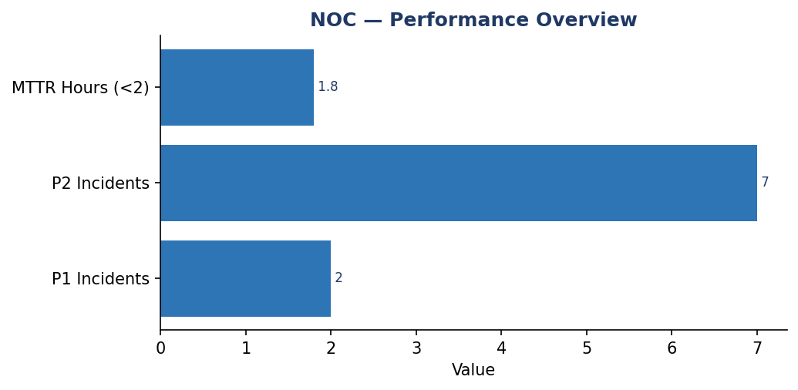
NOC | Date: 20260407
Summary
The NOC team has 1 data records for this period.
KPI Name | Actual | Target | Status
MTTR Hours | 1.8 | <2.0 | PASS
SLA Compliance | 96.39999999999999 | >95.0% | PASS
Insights
AI analysis unavailable. Manual review recommended.

