Slide 1
ITSM Weekly Report — 20260408
Auto-generated | 5 groups | AI-powered insights
Generated by ITSM Automation Agent | Confidential

Slide 2
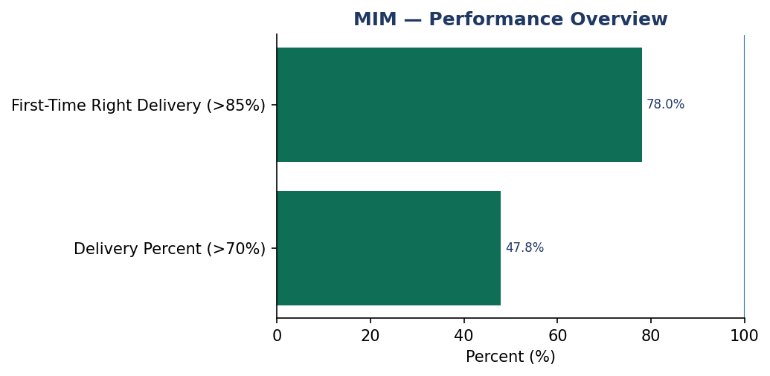
MIM | Date: 20260408
Summary
The MIM team has 1 data record(s) in the current reporting window. Performance highlights indicate First-Time Right Delivery (>85%): 78.0%, Delivery Percent (>70%): 47.8%. Potential risk areas include Delivery Percent (>70%): 47.8%, First-Time Right Delivery (>85%): 78.0%. Recommended action is to sustain high-performing KPIs while prioritizing targeted corrective actions for underperforming indicators in the next cycle.
KPI Name | Actual | Target | Status
Delivery Percent | 47.83 | >70.0% | FAIL
First-Time Right Delivery | 78.0 | >85.0% | FAIL
Insights
AI analysis unavailable. Rule-based summary was applied.
Review low-performing KPIs and assign action owners.

Slide 3
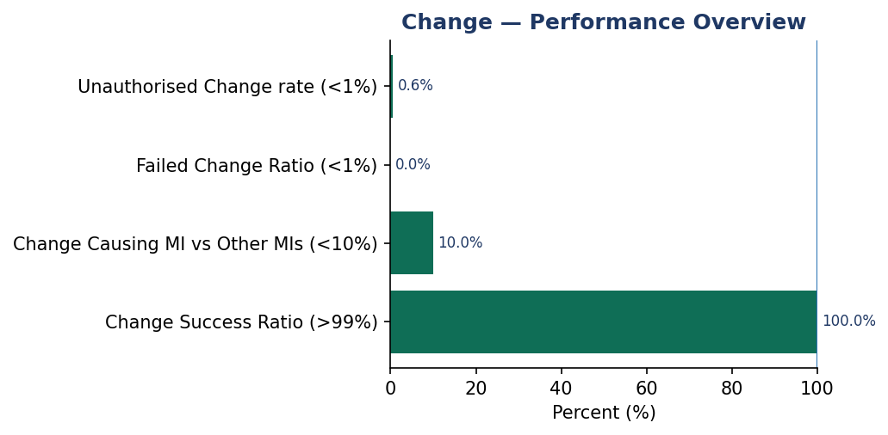
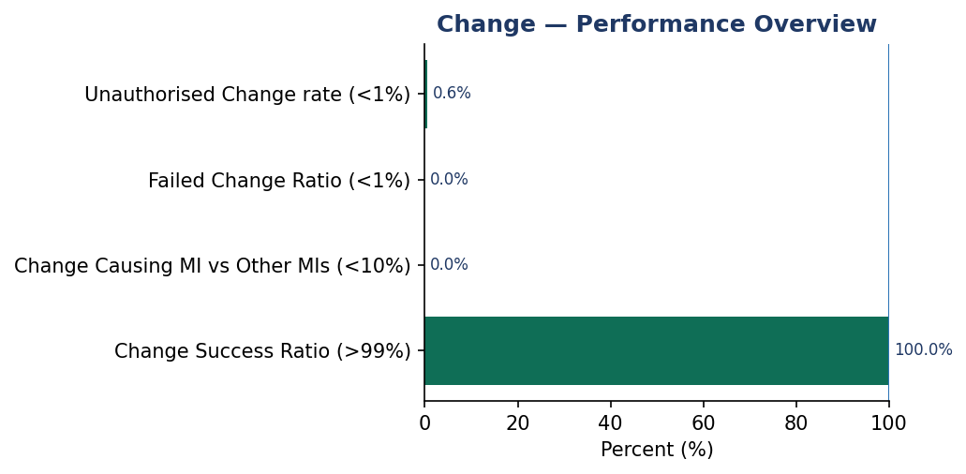
Change | Date: 20260408
Summary
The Change team has 1 data record(s) in the current reporting window. Performance highlights indicate Change Success Ratio (>99%): 100.0%, Change Causing MI vs Other MIs (<10%): 10.0%. Potential risk areas include Failed Change Ratio (<1%): 0.0%, Unauthorised Change rate (<1%): 0.6%. Recommended action is to sustain high-performing KPIs while prioritizing targeted corrective actions for underperforming indicators in the next cycle.
KPI Name | Actual | Target | Status
Change Success Ratio | 100.0 | >99.0% | PASS
Change Causing MI vs Other MIs | 10.0 | <10.0% | FAIL
Failed Change Ratio | 0.0 | <1.0% | PASS
Unauthorised Change rate | 0.0061 | <1.0% | PASS
Insights
AI analysis unavailable. Rule-based summary was applied.
Review low-performing KPIs and assign action owners.

Slide 4
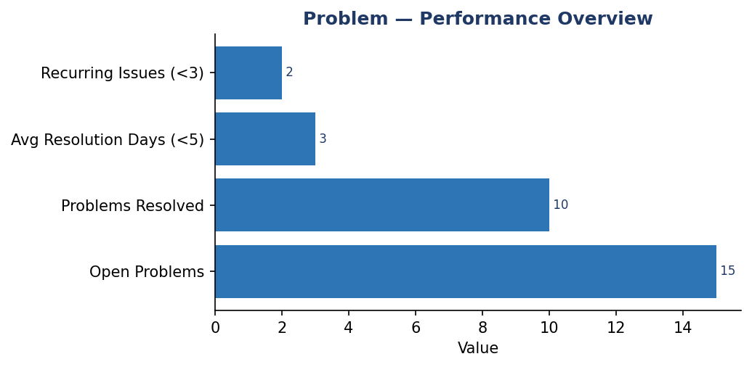
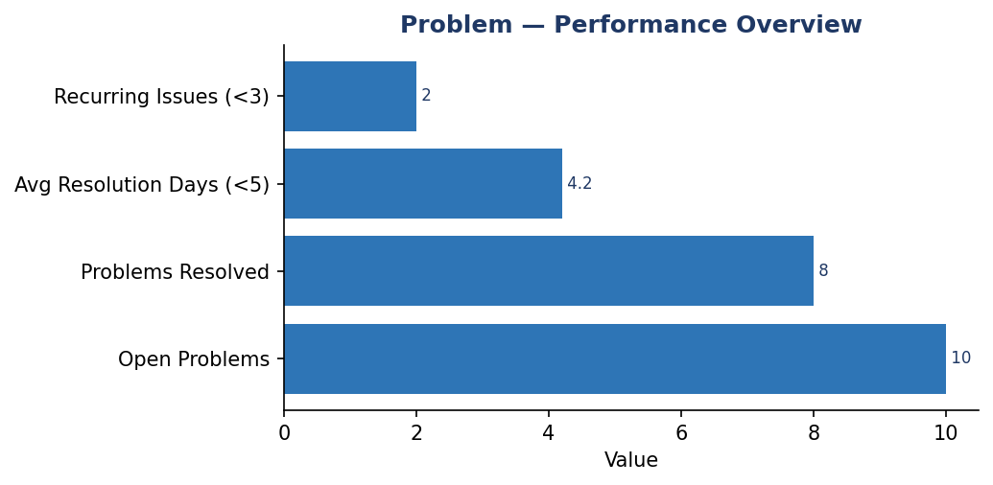
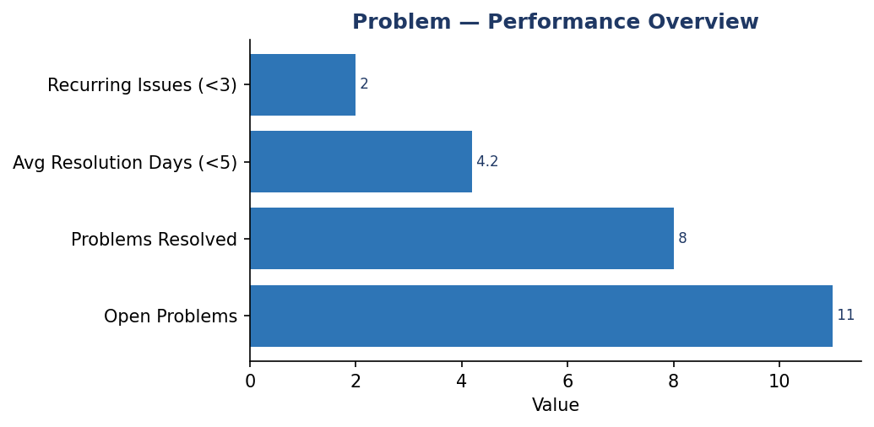
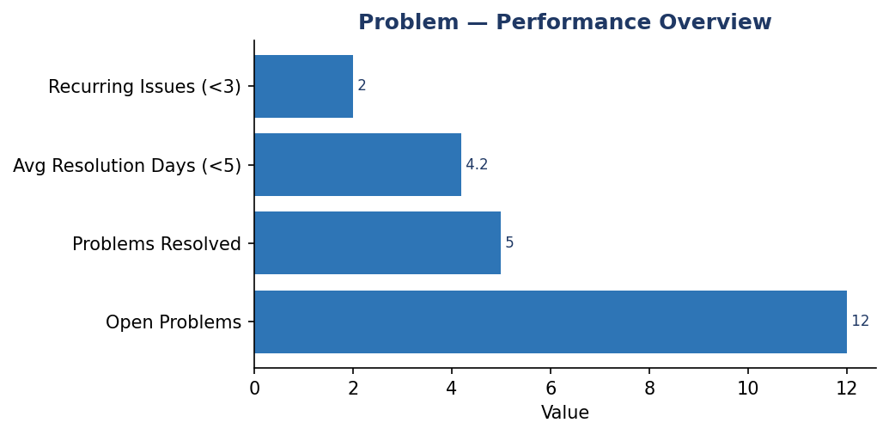
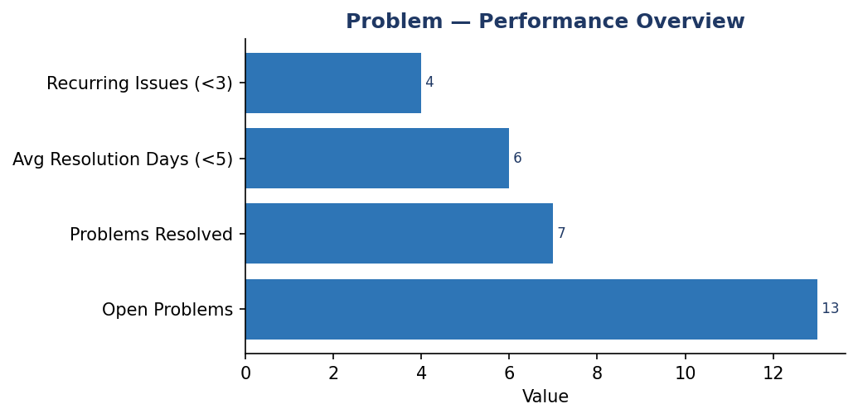
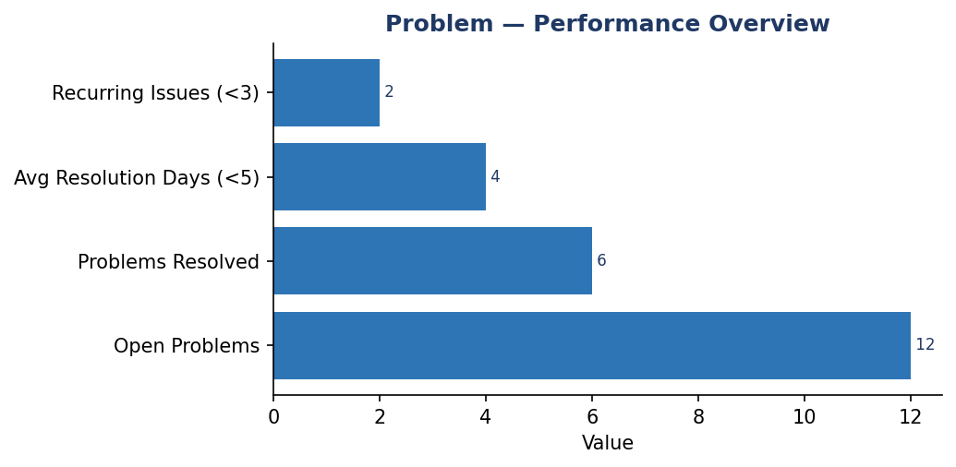
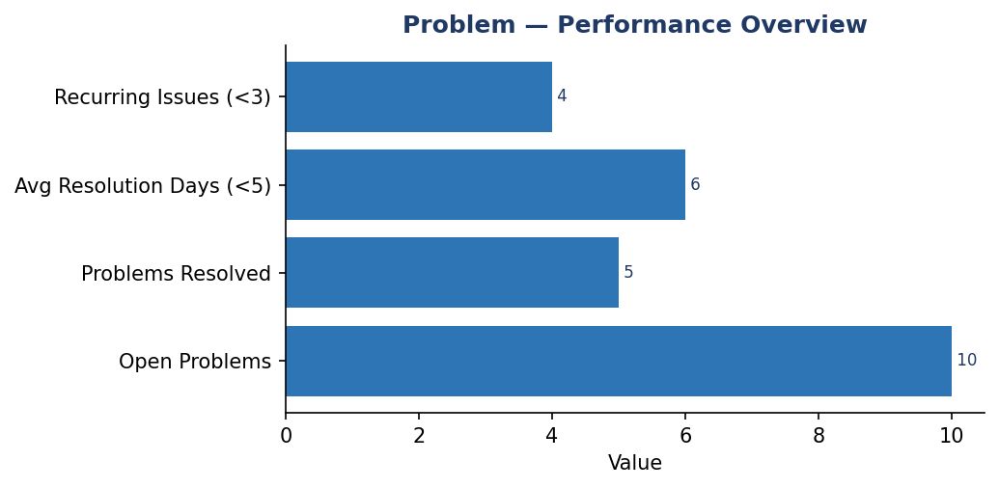
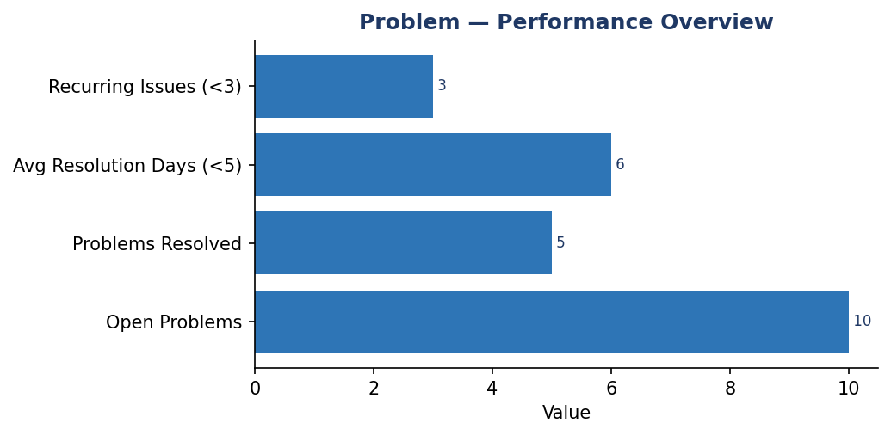
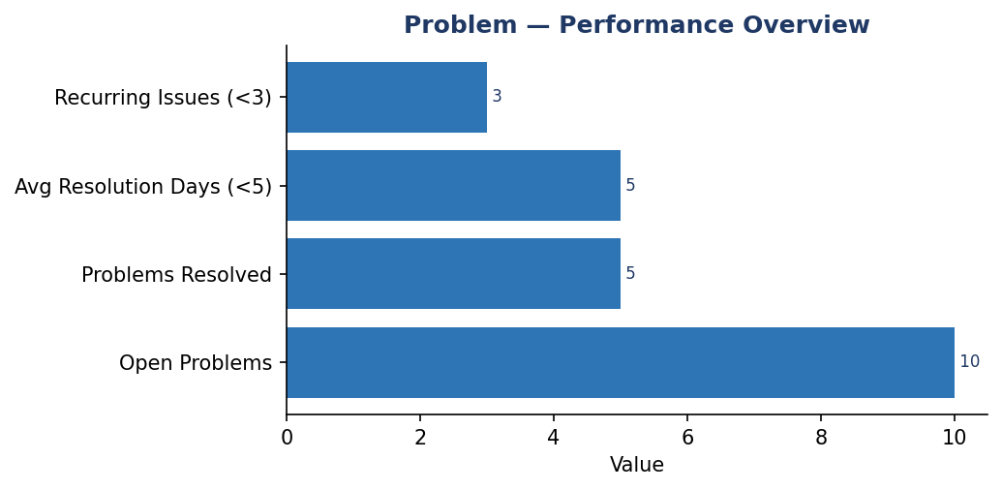
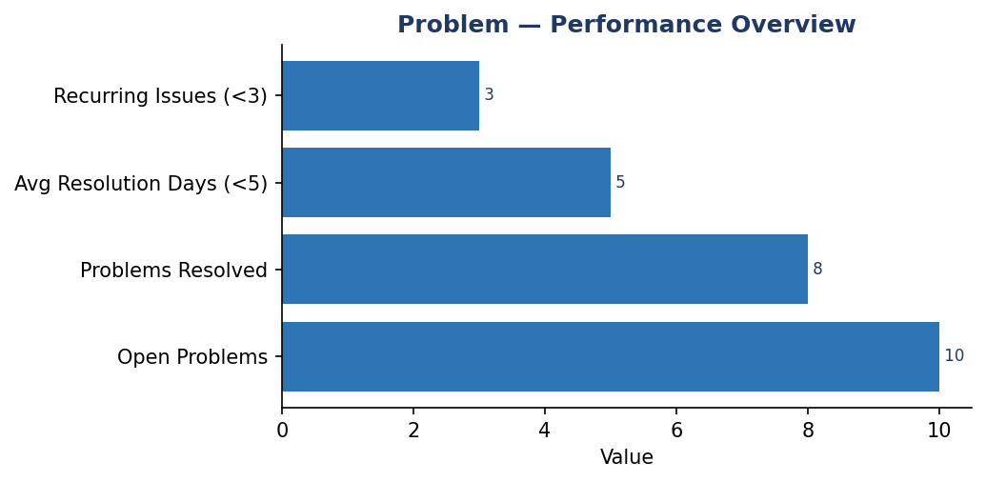
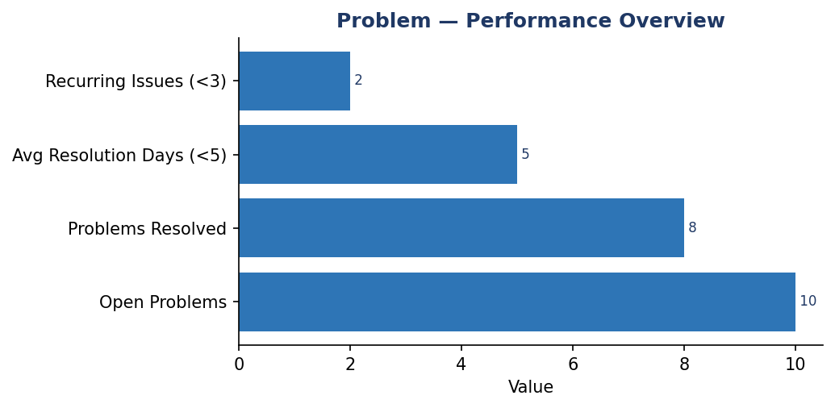
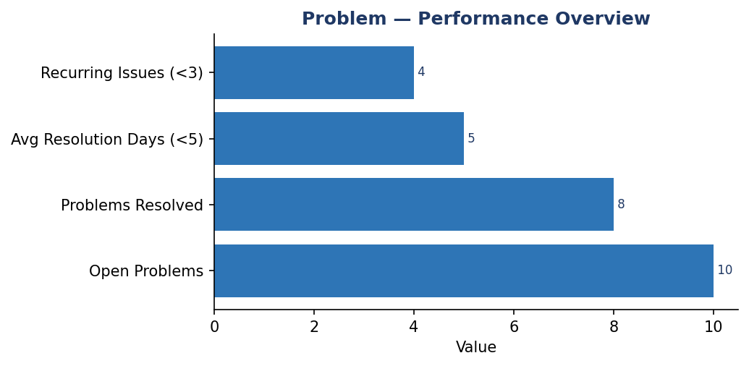
Problem | Date: 20260408
Summary
The Problem team has 1 data record(s) in the current reporting window. Performance highlights indicate no standout KPI values were detected. Potential risk areas include no clear risk KPI was detected. Recommended action is to sustain high-performing KPIs while prioritizing targeted corrective actions for underperforming indicators in the next cycle.
KPI Name | Actual | Target | Status
Avg Resolution Days | 3.0 | <5.0 | PASS
Recurring Issues | 2.0 | <3.0 | PASS
Insights
AI analysis unavailable. Rule-based summary was applied.
Review low-performing KPIs and assign action owners.

Slide 5
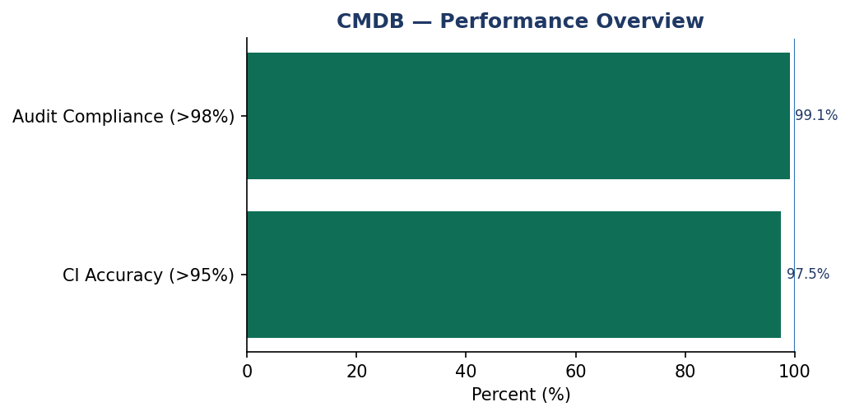
CMDB | Date: 20260408
Summary
The CMDB team has 1 data record(s) in the current reporting window. Performance highlights indicate Audit Compliance (>98%): 99.1%, CI Accuracy (>95%): 97.5%. Potential risk areas include CI Accuracy (>95%): 97.5%, Audit Compliance (>98%): 99.1%. Recommended action is to sustain high-performing KPIs while prioritizing targeted corrective actions for underperforming indicators in the next cycle.
KPI Name | Actual | Target | Status
CI Accuracy | 97.5 | >95.0% | PASS
Audit Compliance | 99.1 | >98.0% | PASS
Insights
AI analysis unavailable. Rule-based summary was applied.
Review low-performing KPIs and assign action owners.

Slide 6
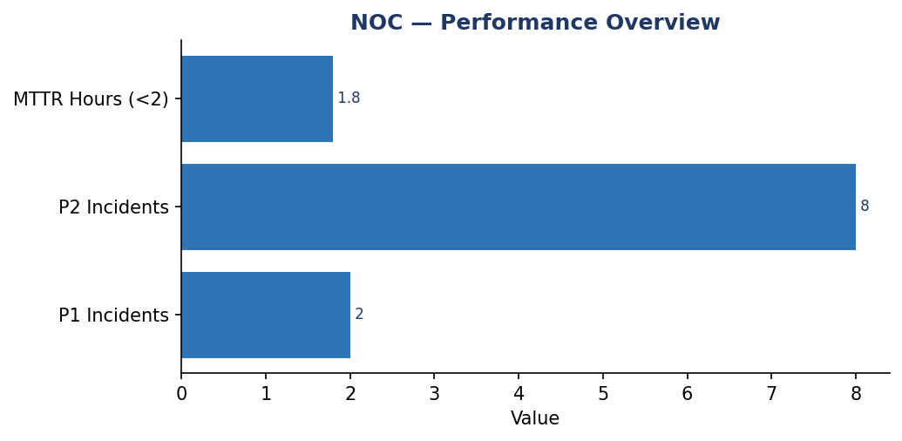
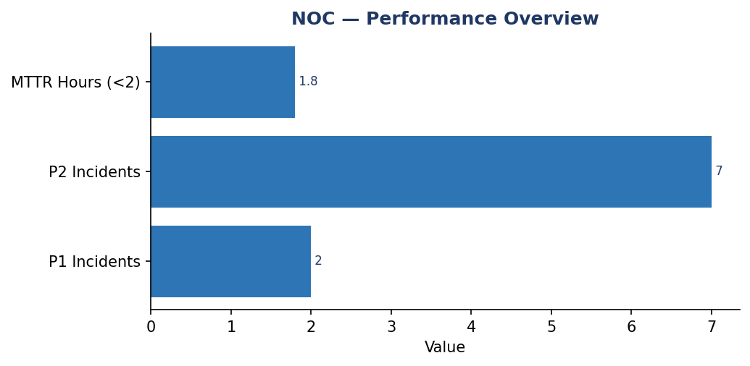
NOC | Date: 20260408
Summary
The NOC team has 1 data record(s) in the current reporting window. Performance highlights indicate SLA Compliance (>95%): 96.4%. Potential risk areas include SLA Compliance (>95%): 96.4%. Recommended action is to sustain high-performing KPIs while prioritizing targeted corrective actions for underperforming indicators in the next cycle.
KPI Name | Actual | Target | Status
MTTR Hours | 1.8 | <2.0 | PASS
SLA Compliance | 96.39999999999999 | >95.0% | PASS
Insights
AI analysis unavailable. Rule-based summary was applied.
Review low-performing KPIs and assign action owners.

