Slide 1
ITSM Weekly Report — 20 Apr 2026
Auto-generated | 7 groups | AI-powered insights
Generated by ITSM Automation Agent | Confidential

Slide 2
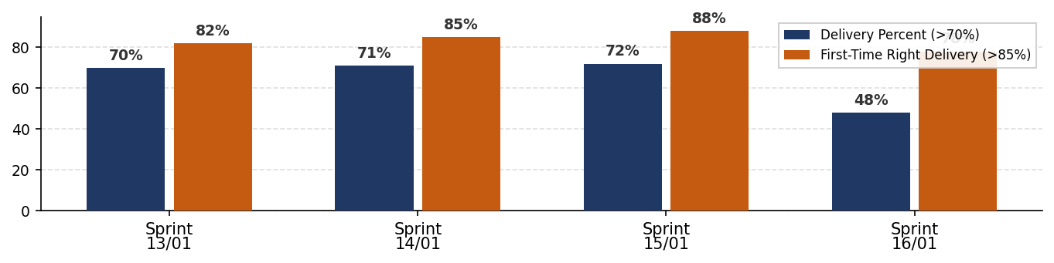
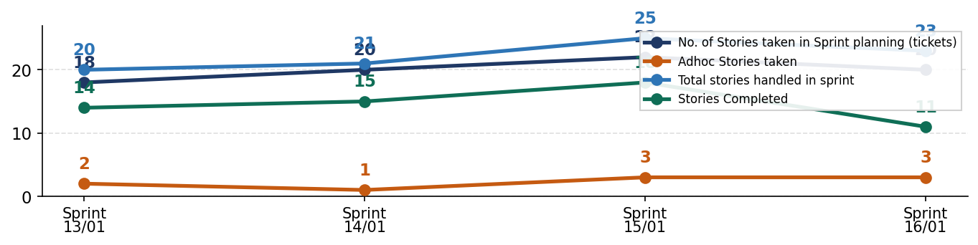
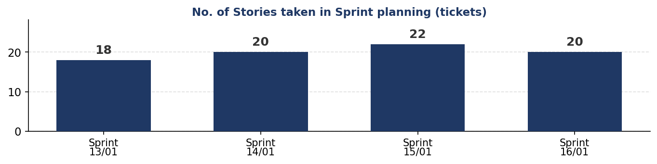
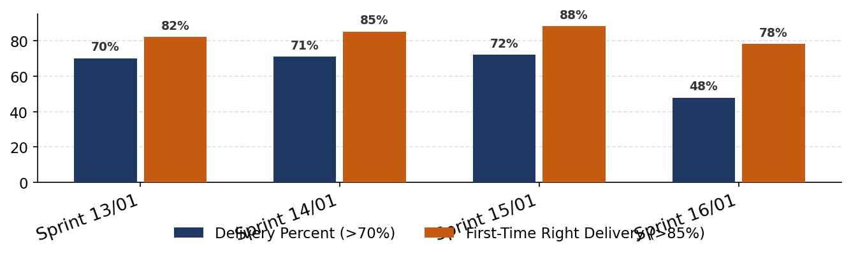
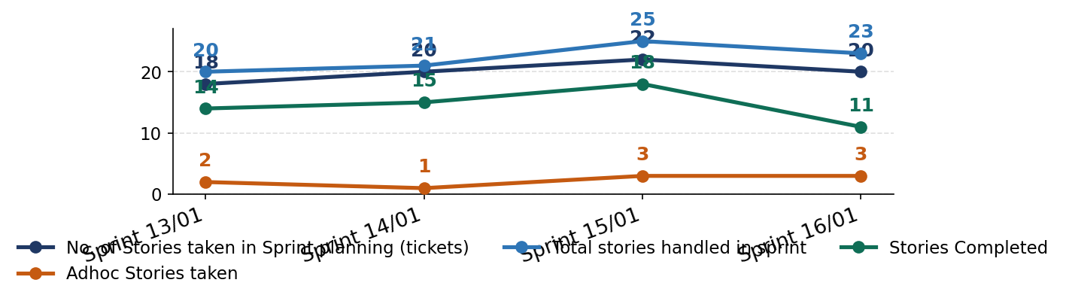
MIM | 20 Apr 2026
Summary
The MIM team has 4 data record(s) in the current reporting window. Performance highlights indicate First-Time Right Delivery (>85%): 78.0%, Delivery Percent (>70%): 47.8%. Potential risk areas include Delivery Percent (>70%): 47.8%, First-Time Right Delivery (>85%): 78.0%. Recommended action is to sustain high-performing KPIs while prioritizing targeted corrective actions for underperforming indicators in the next cycle.
Key Achievements
• MIM data was processed successfully.
• Automated KPI snapshot generated for this period.
KPI / Metric | Latest | Target | Status
Delivery Percent | 47.8% | >70.0%
First-Time Right Delivery | 78.0% | >85.0%
Adhoc Stories taken | 3 | — | INFO
Stories Completed | 11 | — | INFO
Overall Performance | AMBER | —
Key Achievements & Recommended Actions
✔ MIM data was processed successfully.
✔ Automated KPI snapshot generated for this period.
Actions:
→ AI analysis unavailable. Rule-based summary was applied.
→ Review low-performing KPIs and assign action owners.

Slide 3
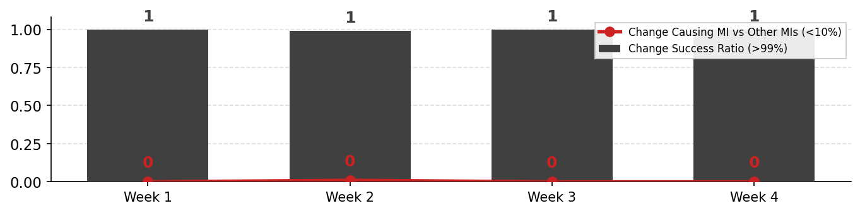
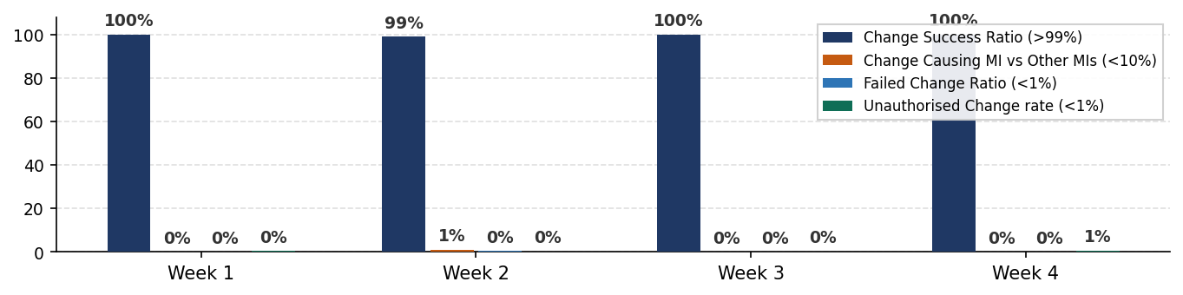
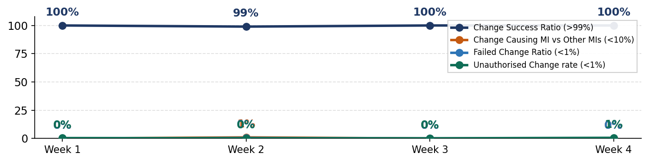
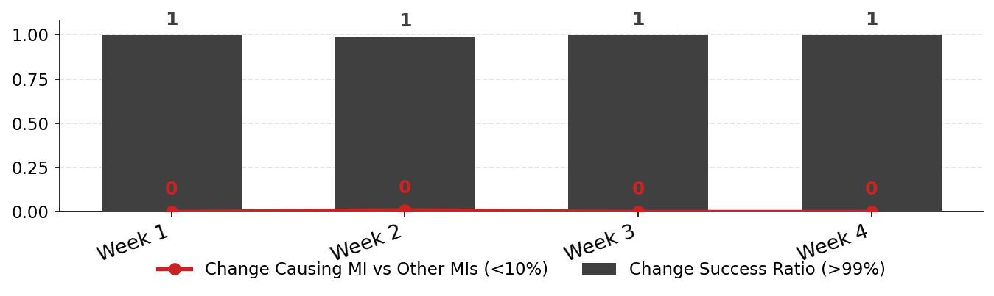
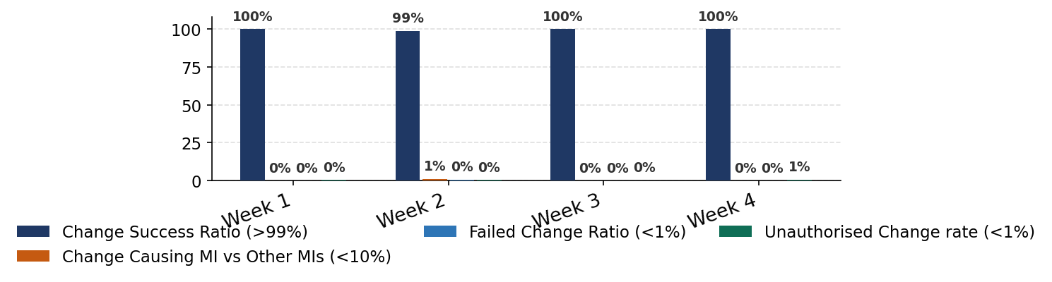
Change | 20 Apr 2026
Summary
The Change team has 4 data record(s) in the current reporting window. Performance highlights indicate Change Success Ratio (>99%): 100.0%, Unauthorised Change rate (<1%): 0.6%. Potential risk areas include Change Causing MI vs Other MIs (<10%): 0.0%, Failed Change Ratio (<1%): 0.0%. Recommended action is to sustain high-performing KPIs while prioritizing targeted corrective actions for underperforming indicators in the next cycle.
Key Achievements
• Change data was processed successfully.
• Automated KPI snapshot generated for this period.
KPI / Metric | Latest | Target | Status
Change Success Ratio | 100.0% | >99.0%
Change Causing MI vs Other MIs | 0 | <10.0%
Failed Change Ratio | 0.0% | <1.0%
Unauthorised Change rate | 0.6% | <1.0%
Overall Performance | AMBER | —
Key Achievements & Recommended Actions
✔ Change data was processed successfully.
✔ Automated KPI snapshot generated for this period.
Actions:
→ AI analysis unavailable. Rule-based summary was applied.
→ Review low-performing KPIs and assign action owners.

Slide 4
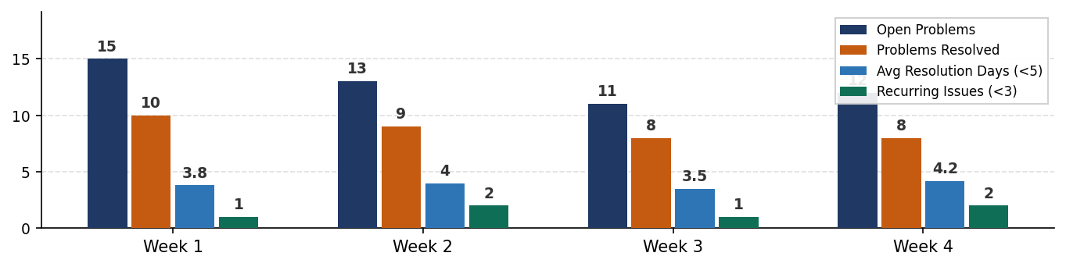
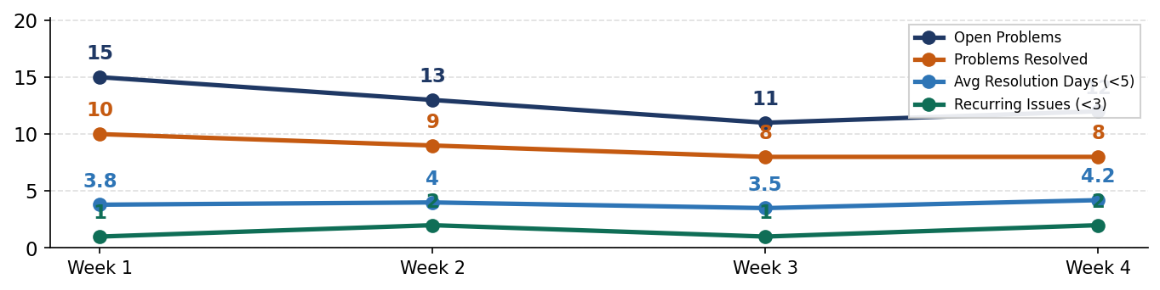
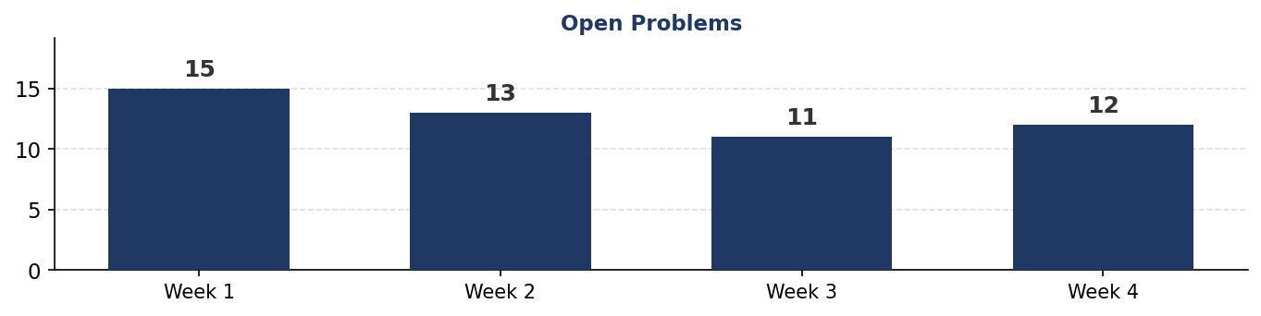
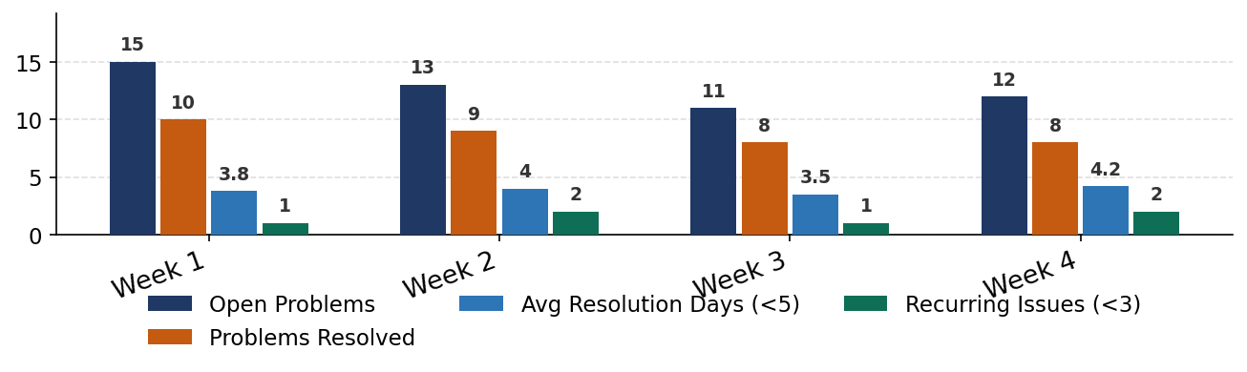
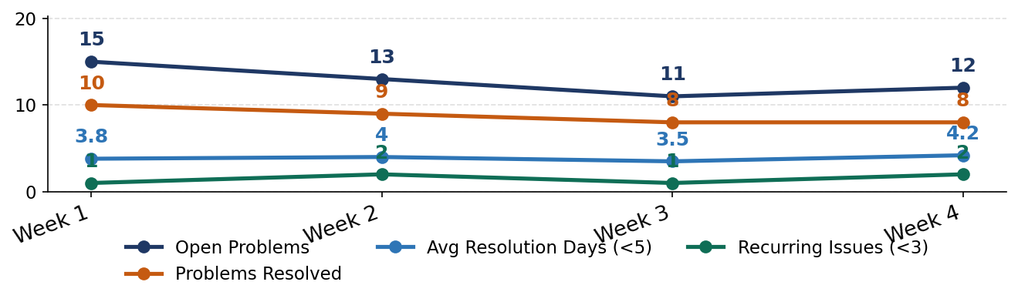
Problem | 20 Apr 2026
Summary
The Problem team has 4 data record(s) in the current reporting window. Performance highlights indicate no standout KPI values were detected. Potential risk areas include no clear risk KPI was detected. Recommended action is to sustain high-performing KPIs while prioritizing targeted corrective actions for underperforming indicators in the next cycle.
Key Achievements
• Problem data was processed successfully.
• Automated KPI snapshot generated for this period.
KPI / Metric | Latest | Target | Status
Avg Resolution Days | 4.2% | <5.0
Recurring Issues | 2 | <3.0
Open Problems | 12 | — | INFO
Problems Resolved | 8 | — | INFO
Overall Performance | AMBER | —
Key Achievements & Recommended Actions
✔ Problem data was processed successfully.
✔ Automated KPI snapshot generated for this period.
Actions:
→ AI analysis unavailable. Rule-based summary was applied.
→ Review low-performing KPIs and assign action owners.

Slide 5
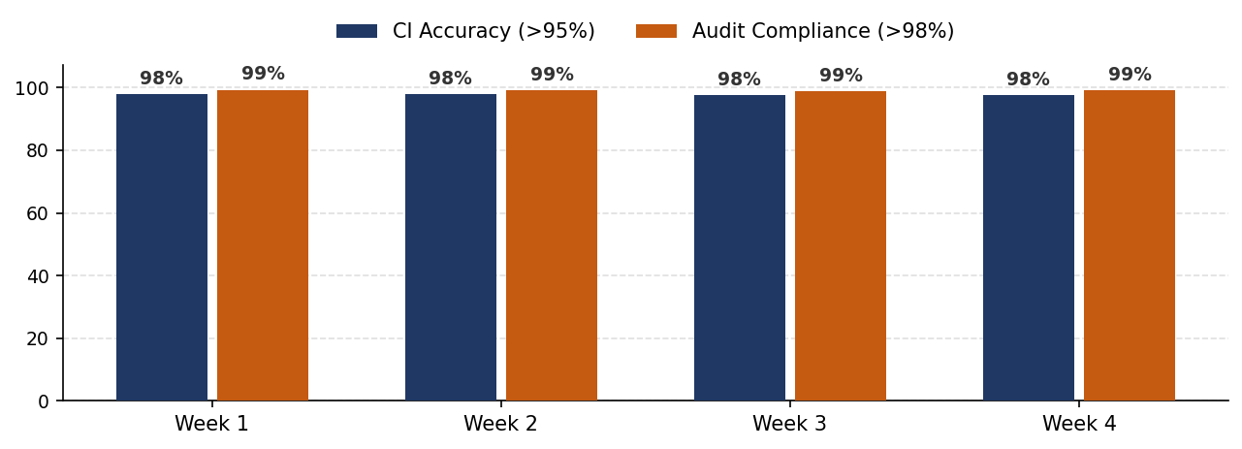
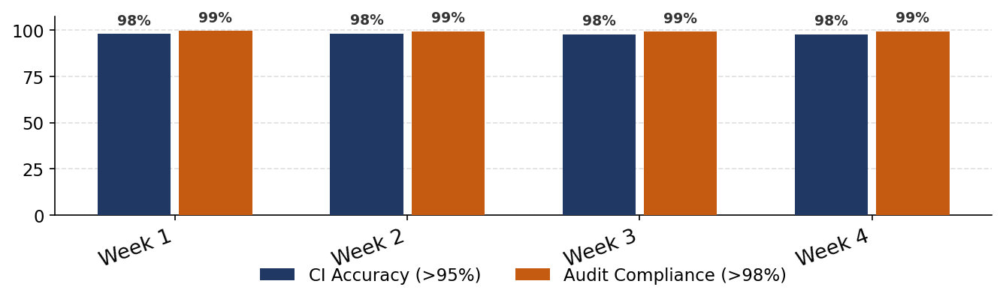
CMDB | 20 Apr 2026
Summary
The CMDB team has 4 data record(s) in the current reporting window. Performance highlights indicate Audit Compliance (>98%): 99.1%, CI Accuracy (>95%): 97.5%. Potential risk areas include CI Accuracy (>95%): 97.5%, Audit Compliance (>98%): 99.1%. Recommended action is to sustain high-performing KPIs while prioritizing targeted corrective actions for underperforming indicators in the next cycle.
Key Achievements
• CMDB data was processed successfully.
• Automated KPI snapshot generated for this period.
KPI / Metric | Latest | Target | Status
CI Accuracy | 97.5% | >95.0%
Audit Compliance | 99.1% | >98.0%
Orphan CIs | 5 | — | INFO
Stale Records (>30 days) | 12 | — | INFO
Overall Performance | AMBER | —
Key Achievements & Recommended Actions
✔ CMDB data was processed successfully.
✔ Automated KPI snapshot generated for this period.
Actions:
→ AI analysis unavailable. Rule-based summary was applied.
→ Review low-performing KPIs and assign action owners.

Slide 6
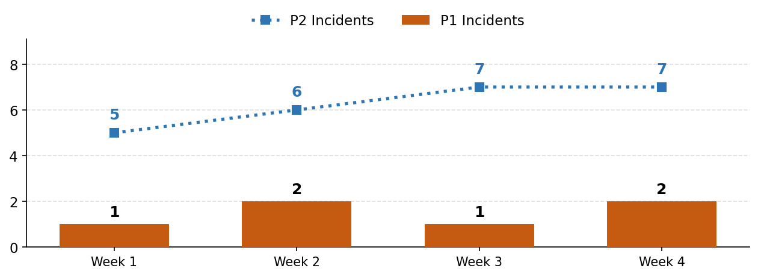
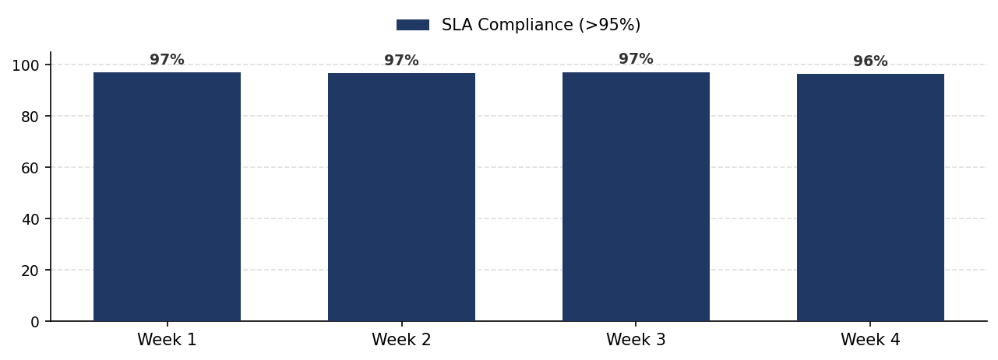
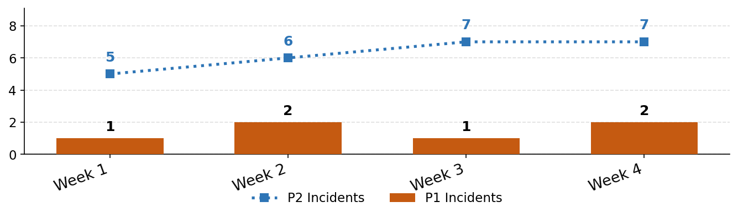
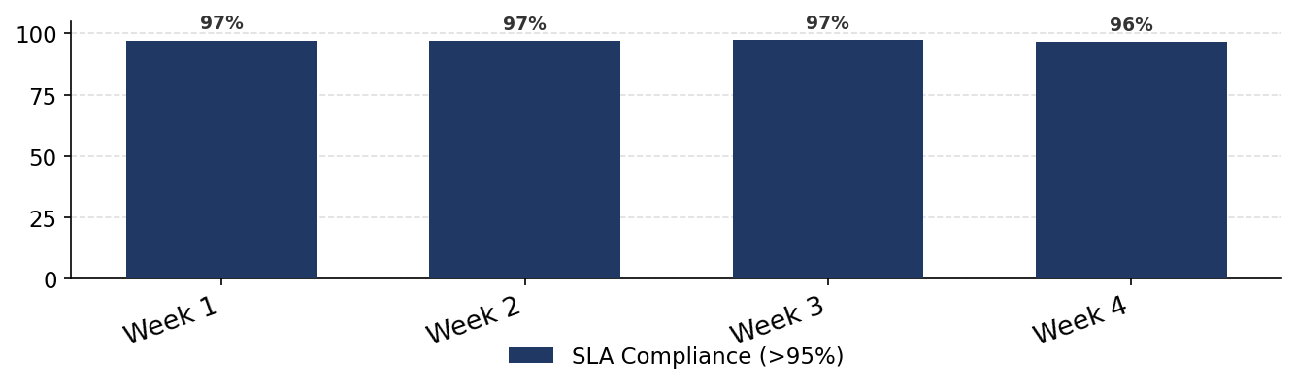
NOC | 20 Apr 2026
Summary
The NOC team has 4 data record(s) in the current reporting window. Performance highlights indicate SLA Compliance (>95%): 96.4%. Potential risk areas include SLA Compliance (>95%): 96.4%. Recommended action is to sustain high-performing KPIs while prioritizing targeted corrective actions for underperforming indicators in the next cycle.
Key Achievements
• NOC data was processed successfully.
• Automated KPI snapshot generated for this period.
KPI / Metric | Latest | Target | Status
MTTR Hours | 1.8 | <2.0
SLA Compliance | 96.4% | >95.0%
P1 Incidents | 2 | — | INFO
P2 Incidents | 7 | — | INFO
Overall Performance | AMBER | —
Key Achievements & Recommended Actions
✔ NOC data was processed successfully.
✔ Automated KPI snapshot generated for this period.
Actions:
→ AI analysis unavailable. Rule-based summary was applied.
→ Review low-performing KPIs and assign action owners.

Slide 7
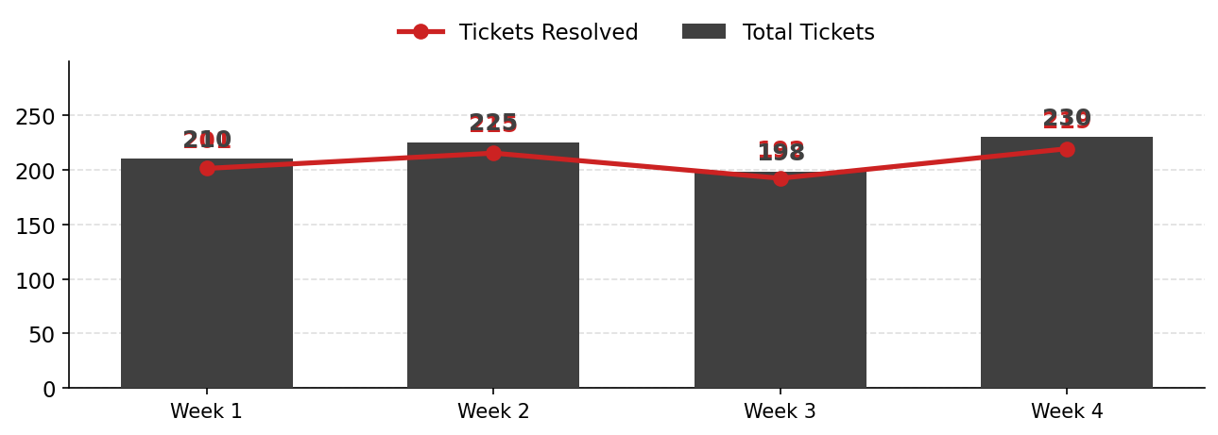
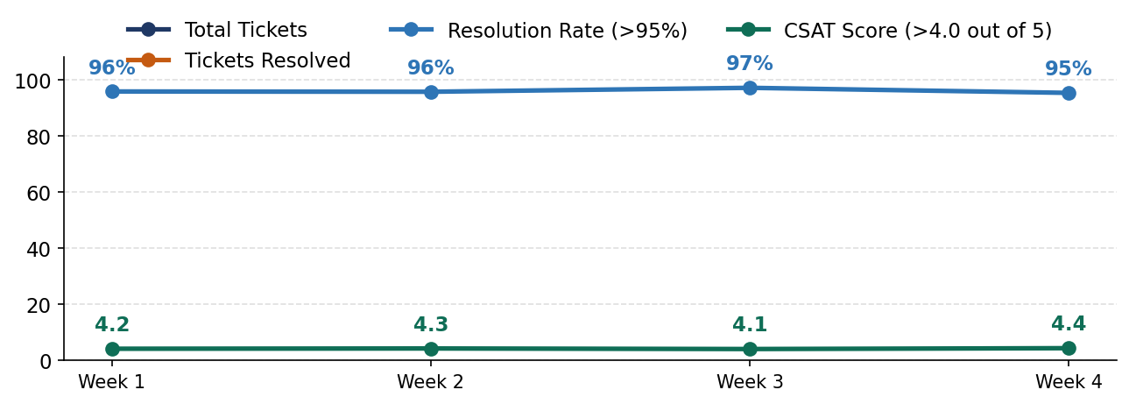
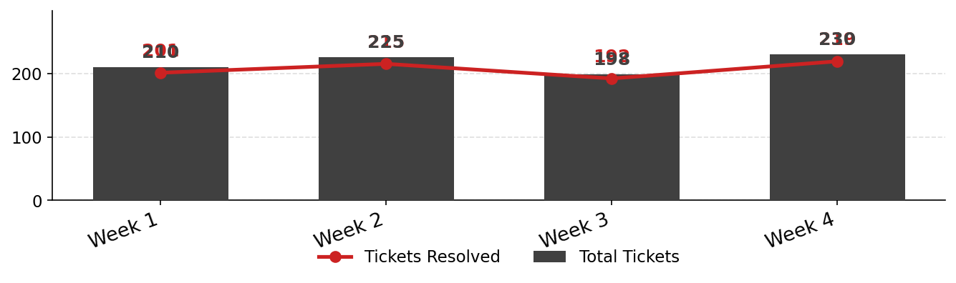
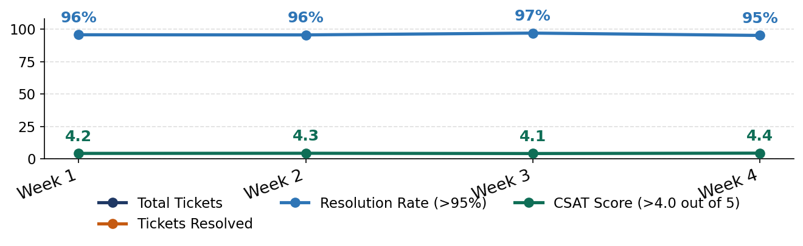
ServiceNow | 20 Apr 2026
Summary
The ServiceNow team has 4 data record(s) in the current reporting window. Performance highlights indicate Resolution Rate (>95%): 95.2%, First Call Resolution (>80%): 84.0%. Potential risk areas include First Call Resolution (>80%): 84.0%, Resolution Rate (>95%): 95.2%. Recommended action is to sustain high-performing KPIs while prioritizing targeted corrective actions for underperforming indicators in the next cycle.
Key Achievements
• ServiceNow data was processed successfully.
• Automated KPI snapshot generated for this period.
KPI / Metric | Latest | Target | Status
Resolution Rate | 95.2% | >95.0%
First Call Resolution | 84.0% | >80.0%
Total Tickets | 230 | — | INFO
Tickets Resolved | 219 | — | INFO
CSAT Score (>4.0 out of 5) | 4.4 | — | INFO
Overall Performance | AMBER | —
Key Achievements & Recommended Actions
✔ ServiceNow data was processed successfully.
✔ Automated KPI snapshot generated for this period.
Actions:
→ AI analysis unavailable. Rule-based summary was applied.
→ Review low-performing KPIs and assign action owners.

Slide 8
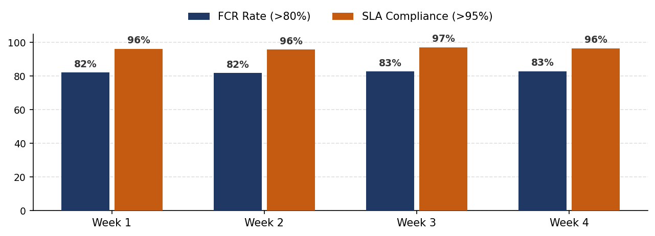
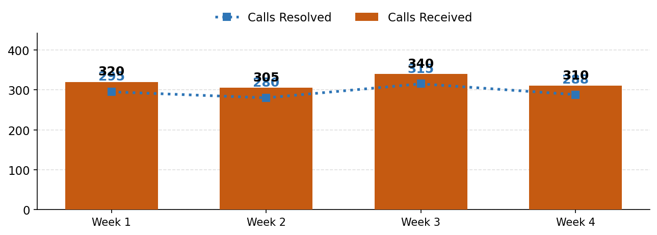
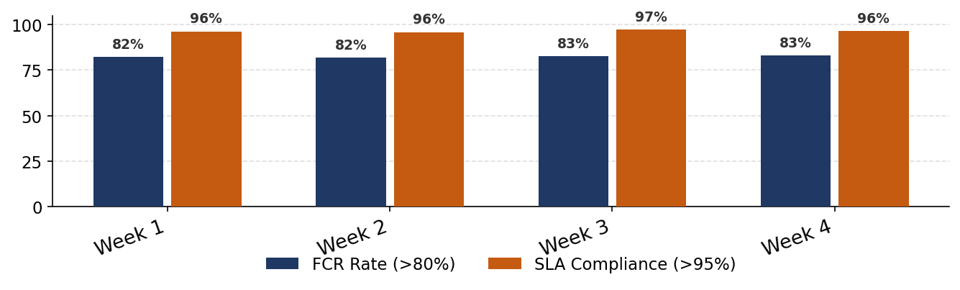
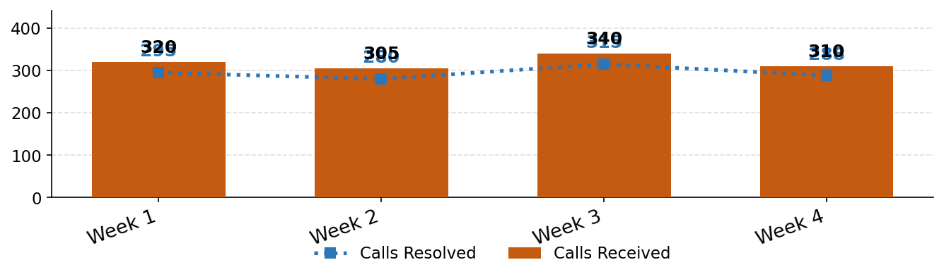
Service Desk | 20 Apr 2026
Summary
The Service Desk team has 4 data record(s) in the current reporting window. Performance highlights indicate SLA Compliance (>95%): 96.5%, FCR Rate (>80%): 82.9%. Potential risk areas include FCR Rate (>80%): 82.9%, SLA Compliance (>95%): 96.5%. Recommended action is to sustain high-performing KPIs while prioritizing targeted corrective actions for underperforming indicators in the next cycle.
Key Achievements
• Service Desk data was processed successfully.
• Automated KPI snapshot generated for this period.
KPI / Metric | Latest | Target | Status
FCR Rate | 82.9% | >80.0%
Avg Handle Time Mins | 8.4 | <10.0
SLA Compliance | 96.5% | >95.0%
Calls Received | 310 | — | INFO
Calls Resolved | 288 | — | INFO
Overall Performance | AMBER | —
Key Achievements & Recommended Actions
✔ Service Desk data was processed successfully.
✔ Automated KPI snapshot generated for this period.
Actions:
→ AI analysis unavailable. Rule-based summary was applied.
→ Review low-performing KPIs and assign action owners.

