Slide 1
TNC-BOT: TERMS & CONDITIONS INTERPRETER
RAG-Grounded Assistant & Chrome Floating Extension
Platform: FastAPI, React, SQLite, PyMuPDF, OCR & Chrome API

Slide 2
PROBLEM STATEMENT & CONTEXT
• Legalese Complexity: Terms of Service and Privacy Agreements are intentionally long, dense, and written in obfuscated legal terms.
• Rights Vulnerability: Users blindly sign away crucial rights regarding private data ownership, session telemetry, and generative AI model training consent.
• Limitations of Existing Tools: Static regex browser plugins only search keywords, failing to support custom uploaded PDF/image contracts or dynamic Q&A.
• Need for Automation: Requires a local intelligence layer to extract key topics, translate chosen paragraphs, and answer queries grounded in the agreement text.

Slide 3
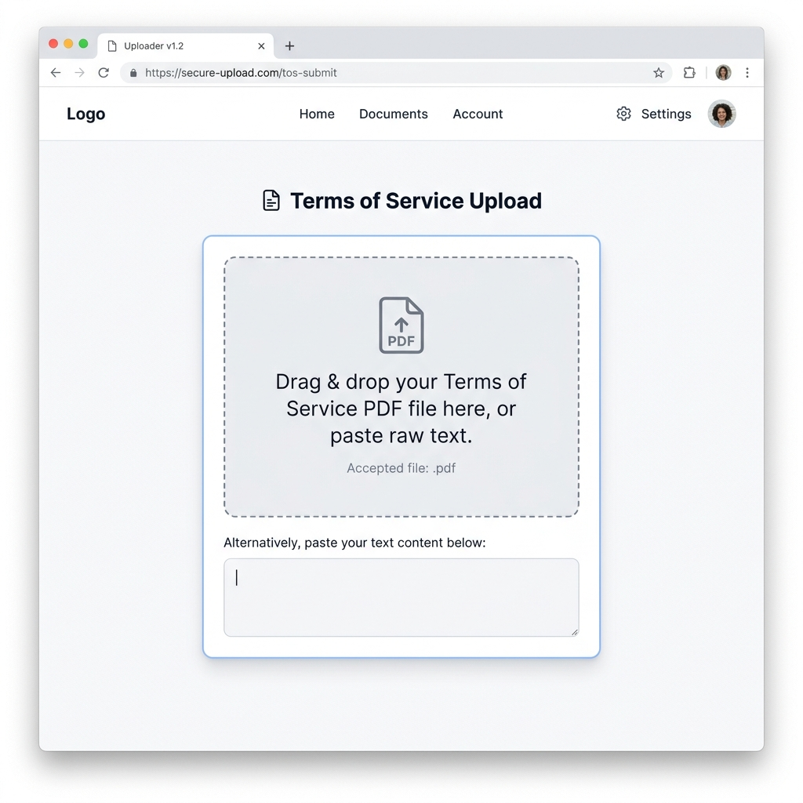
PROPOSED SOLUTION & SCOPE
• Automated PDF & OCR: Fast text ingestion via PyMuPDF. Scanned image agreements fallback to Tesseract OCR.
• Structured Extraction: Enforces strict Pydantic schemas to extract summaries and topic-based clauses.
• Local Vector Index: Partitions contracts into overlapping chunks and stores embeddings in SQLite.
• Grounded Chat Bot: Queries vector index to inject relevant context paragraphs with citations.

Slide 4
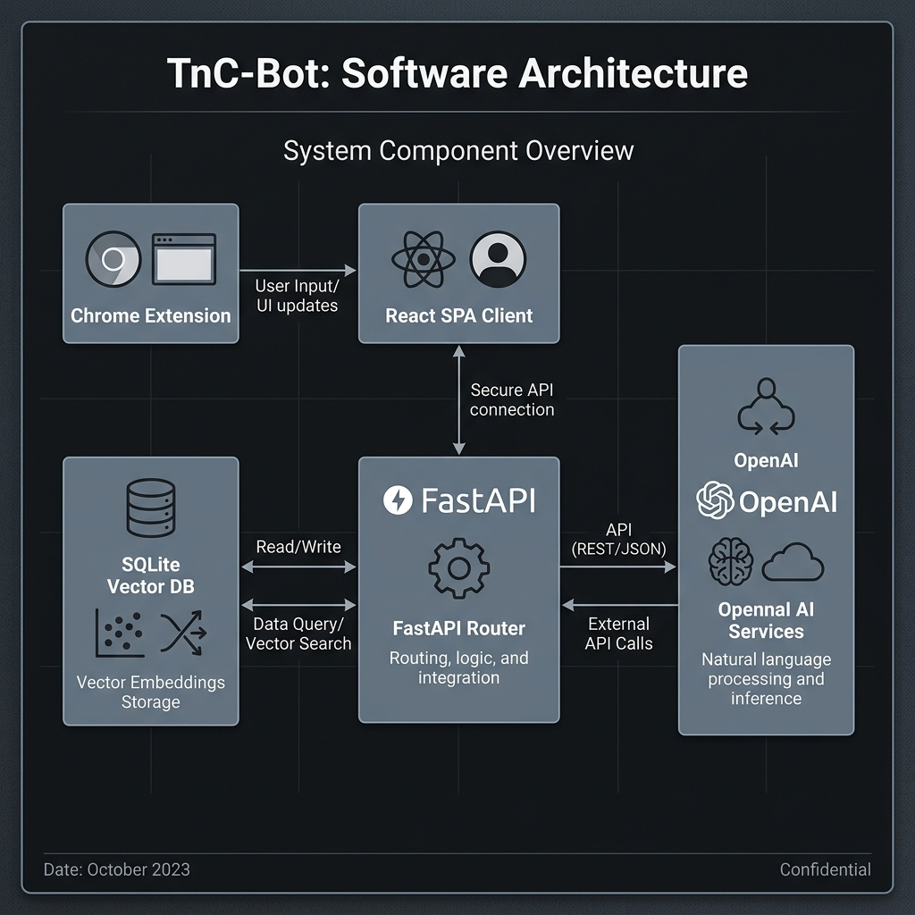
SYSTEM ARCHITECTURE FLOW
• Client UI Layers: Chrome browser content script scraper captures text. React SPA shows side-by-side layouts.
• FastAPI Gateway: FastAPI backend handles document ingestion endpoints and chat retrieval queries.
• SQLite & Vector DB: Stores embeddings coordinates and cached JSON summary records locally.

Slide 5
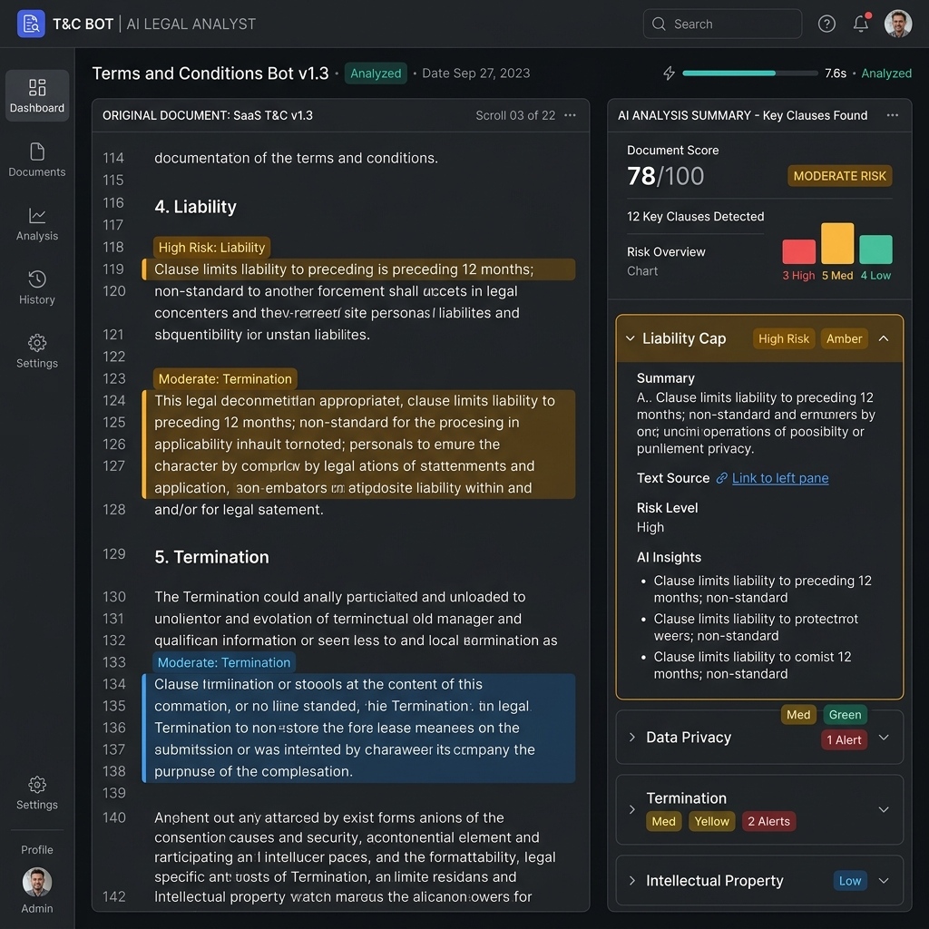
DETAILED IMPLEMENTATION PIPELINE
Step 1-2: Ingestion & Chunks: Extracts text from PDF/OCR. Partitions into 1000-char blocks.
Step 3: SQLite Embeddings: Generates vectors for similarity mapping with Jaccard fallbacks.
Step 4-5: LLM Summarization: LLM extracts summary & key clauses. Custom translators map styles.
Step 6-7: RAG Chat & Extension: Grounded assistant streams chat. Scrapers inject floating popup panels.

Slide 6
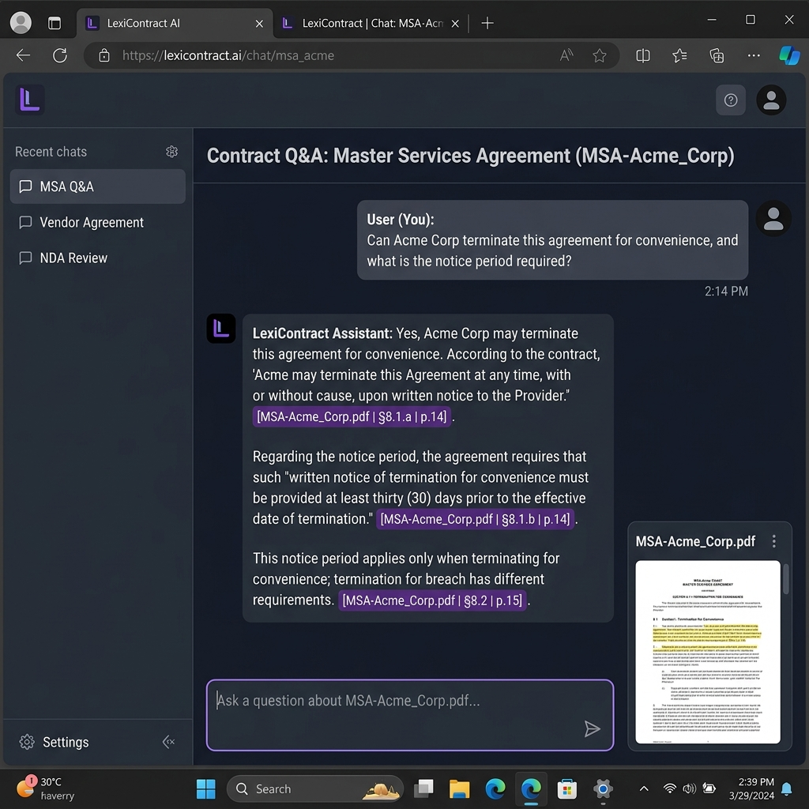
QUALITY VERIFICATION & TEST SUITE
✔ PDF & OCR Extraction [PASSED] Digital layouts parsed. Scan files run OCR fallbacks successfully.
✔ JSON Completions [PASSED] Parses summaries and categorized clauses into UI structures.
✔ Explanation Translators [PASSED] Transforms legal terms to Teen analogies.
✔ Grounded Chat Streaming [PASSED] Queries retrieve DB context blocks with citations.

Slide 7
CONCLUSION & FUTURE ROADMAP
• Deployment Verification: Successfully deployed a fully functional FastAPI / SQLite vector database backend combined with React single-page workspaces and Chrome overlay panels.
• Resilience & Fallbacks: The inclusion of image OCR steps and keyword overlap indexes (Jaccard) ensures operational fallback reliability when api keys or network links are disabled.
• Milestone 3 (Future Scope): Multi-agreement policy comparison tools. Auditing policy change history and showing visual highlights of document modifications over version histories.
• Milestone 4 (Future Scope): Automated consent opt-out scripts. Injecting scrapers that auto-submit cookie restrictions and calculating numeric legal risk score weights.

