Slide 1

HridAI
HAPPIEST HEALTH DIGITAL TWIN CHALLENGE 2026
A digital twin that sees heart failure coming.
Team Octas · Aditya Jain · PGDM (BM) 2026–28, XLRI Jamshedpur
Notes:
Introduce HridAI: a per-patient digital twin for the 30 days after a heart-failure discharge.

Slide 2




Ramesh, 72, goes home after a heart-failure admission
7 days to act
Day 0
Day 9
Day 16
Day 23
Discharged home with a smartwatch and scale
Fluid starts building, silently
HridAI alerts the cardiologist
Without action: back in emergency
Weight, night heart rate, HRV, breathing and sleep all shifted days earlier. Nobody was reading them together.
Notes:
Every signal was measurable days before the crisis. The gap is that no one reads them together, against the patient's own baseline.

Slide 3



The month after discharge is when patients come back
~1 in 3
~10 yrs
6.5 days
died within a year of a heart-failure admission
younger at presentation than patients in Western registries
median warning a wearable gave before rehospitalisation
Trivandrum Heart Failure Registry, Kerala
Trivandrum Heart Failure Registry
LINK-HF study, Circ Heart Fail 2020
Notes:
Heart failure is a chronic cardiovascular condition with a heavy, younger burden in India. LINK-HF showed the warning signal exists.

Slide 4



Today's home tool is a single weight rule
One noisy signal
CURRENT GUIDANCE
Daily weight swings by a kilo with food, clothes and scales.
Call your doctor if weight rises more than
2 kg in 3 days
Often skipped
Elderly patients miss weigh-ins, so the rule never sees the rise.
58%
of readmissions caught in time in our test
Ignores the rest
Heart rate, HRV, breathing and sleep change too, and go unread.

Slide 5






Every sensor sees a little of the hidden fluid
Weight ▲
Steps ▼
Night HR ▲
Hidden fluid
litres + trend
Sleep ▼
HRV ▼
SpO2 ▼
Breathing ▲
Notes:
Instead of a black box per signal, HridAI estimates the one quantity they all point to: litres of excess fluid and which way it is moving.

Slide 6





How the twin thinks, every night
Sync
Personalise
Estimate
Forecast
Act
Days 0–2 learn this person's normal
Discharge record sets each signal's response
Kalman filter: fluid + trend ± uncertainty
Chance of ≥ 2 L within 5 days
Alert at 60%: the doctor calls
Why a state-space twin? Works with 30 days of data per patient · explains every alert · handles missing days · gives calibrated probabilities

Slide 7
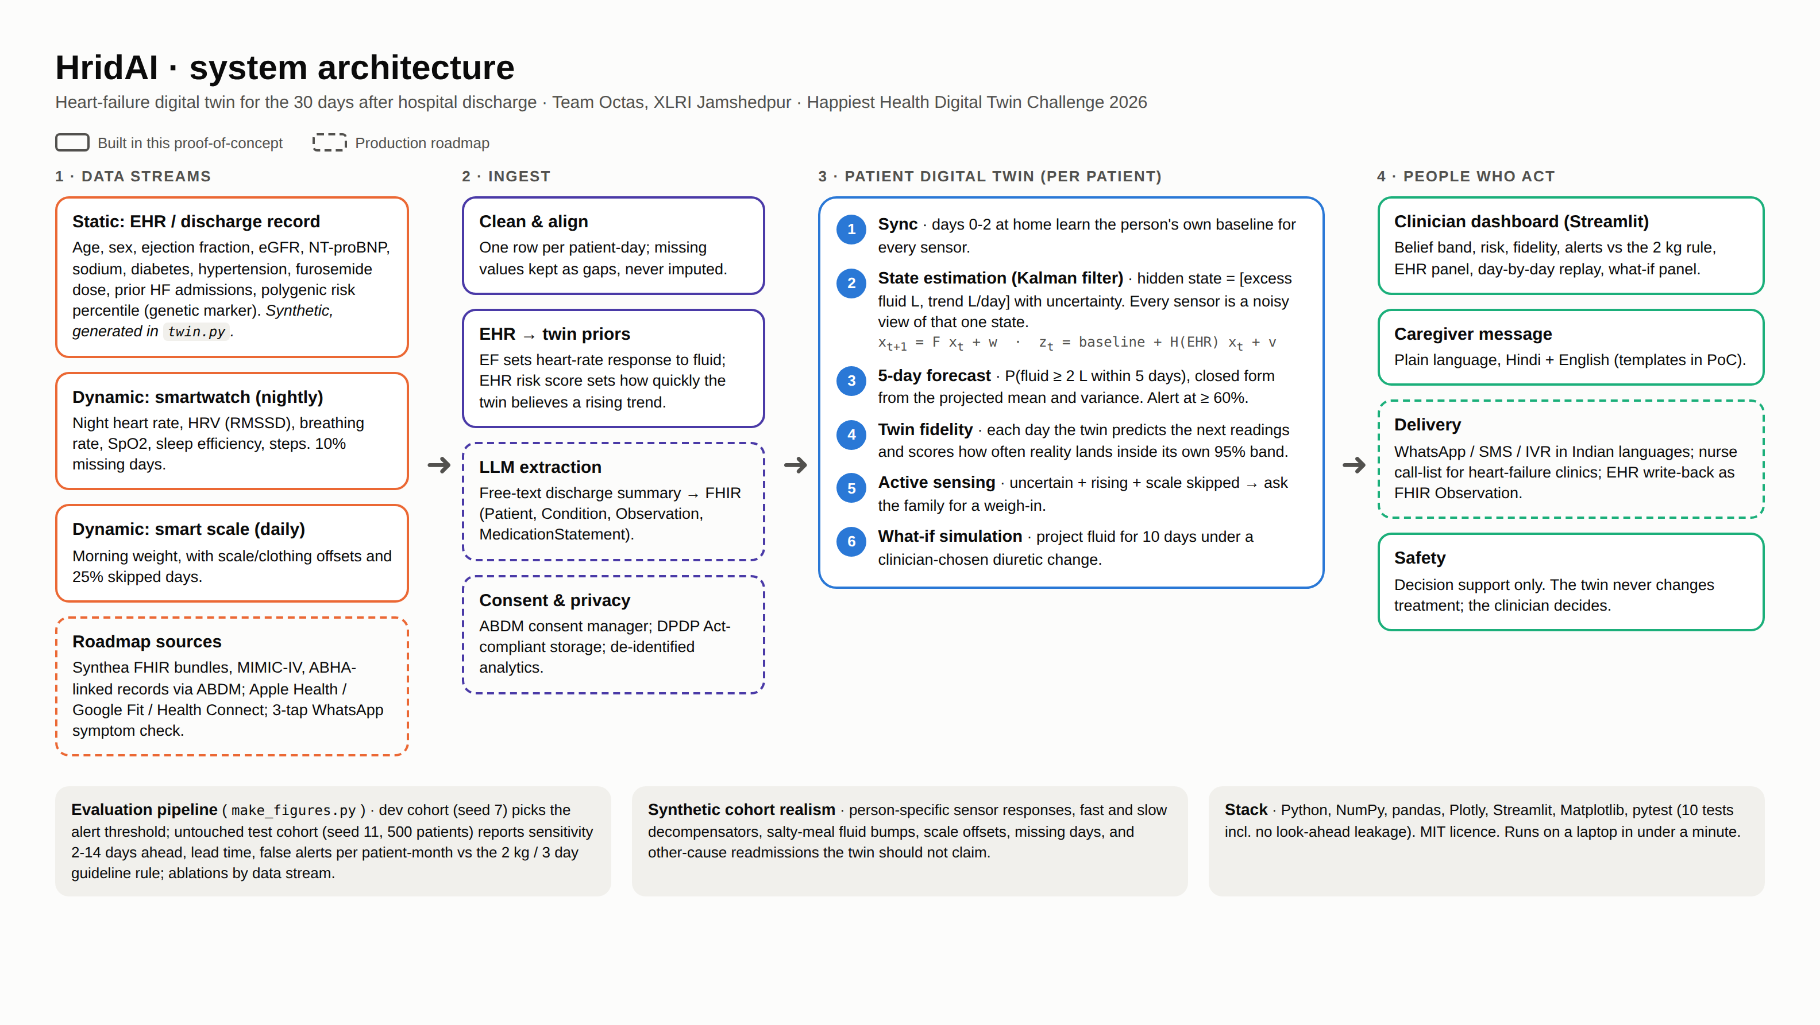
Architecture: two data streams in, one virtual patient

Slide 8



Three things that make it a real twin
Twin fidelity
Active sensing
What-if
Every night it predicts the readings, then scores how many landed inside its own 95% band.
Unsure, rising, and the scale was skipped? It asks the family for a weigh-in.
The clinician tests a diuretic change on the twin before making it. The twin never acts alone.

Slide 9
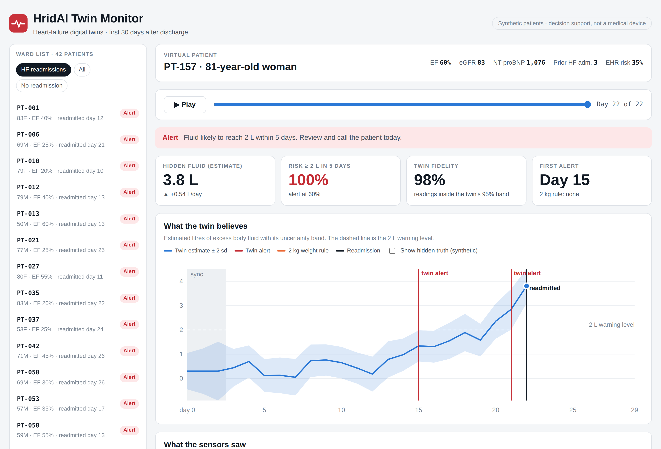

The doctor's view: a live, working twin
Replay any patient day by day
Fluid estimate with uncertainty
Alerts vs the 2 kg rule
Seven sensor trends
What-if treatment panel
Hindi and English family messages
Open live dashboard
Runs in any browser. No install.

Slide 10
HridAI catches more readmissions, with fewer false alarms
4 days
median warning before readmission
500
synthetic test patients, 89 heart-failure readmissions
Alert threshold chosen on a separate development cohort. Synthetic data, so real-world performance needs clinical validation.

Slide 11
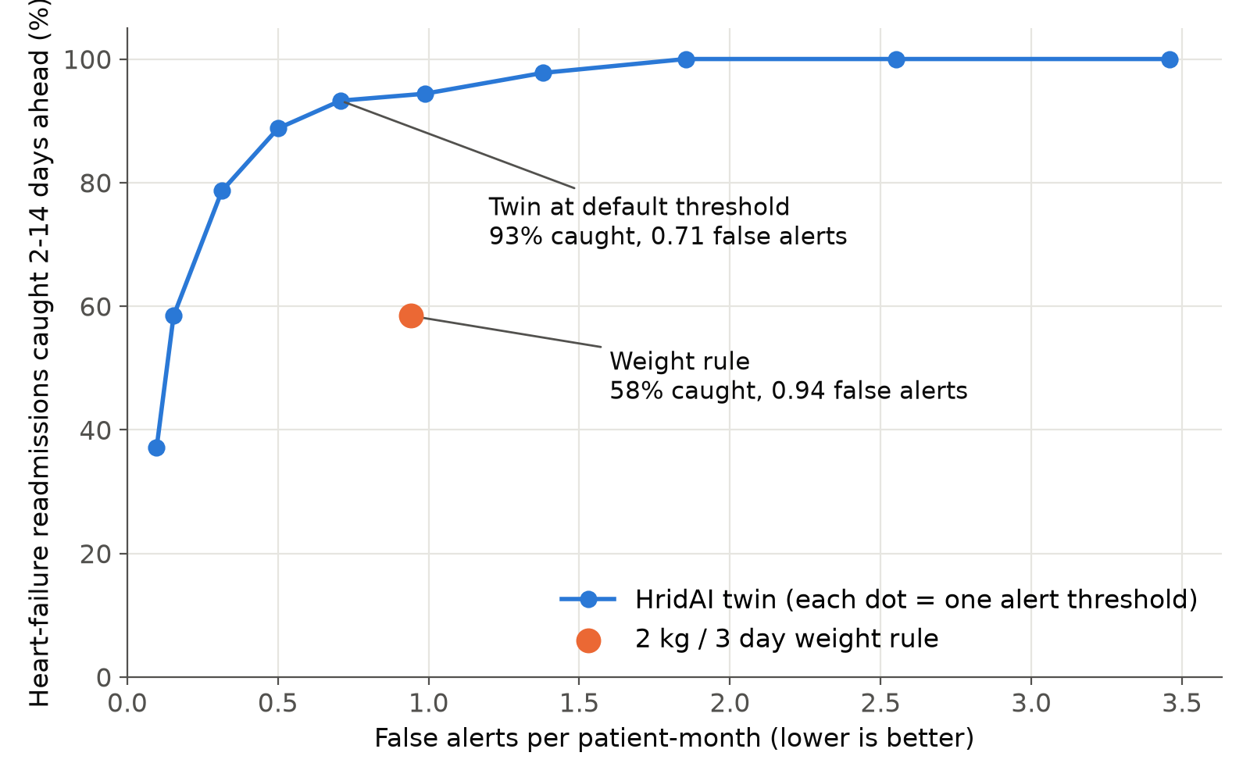
Every setting beats the rule; fusing streams drives it
Each blue dot is a different alert threshold, so a clinic can choose more warning or fewer alarms.

Slide 12
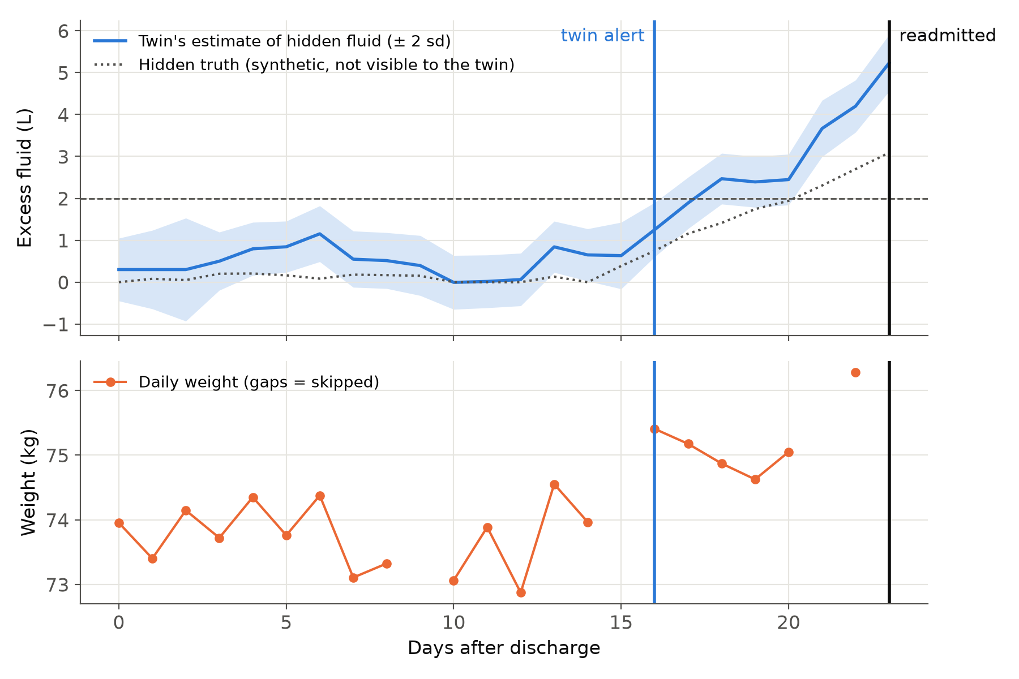
One test patient: a week of warning the rule never gave
Day 16
HridAI alert
Day 23
readmitted
Never
the 2 kg rule fired

Slide 13






Synthetic data, built to be hard on the twin
Every body differs
Fast crashes
Salty-meal bumps
Sensor responses vary per patient
Some decompensate in 4–5 days
Fluid spikes that fix themselves
Scale offsets
Missing data
Other readmissions
Clothes, different scales
25% weigh-ins, 10% watch nights
Causes the twin must not claim
EHR: age, sex, EF, eGFR, NT-proBNP, sodium, comorbidities, diuretic dose, prior admissions, polygenic risk · Wearables: 7 nightly / daily signals

Slide 14



Built for Indian homes and clinics
< ₹5,000 kit
PILOT PLAN
Consumer smartwatch + Bluetooth scale, reusable
1
cardiology ward
ABHA / ABDM
100
consecutive heart-failure discharges
Records and consent on India's health rails
30
days of monitoring each
Indian languages
Family messages over WhatsApp or SMS
1
primary outcome: 30-day readmissions vs matched controls
Who pays: hospitals (fewer readmissions), insurers (avoided claims), clinic networks (remote-monitoring service).

Slide 15
What the prototype does not yet prove, and what comes next
LIMITS
NEXT STEPS
Synthetic data: results are optimistic
Sensor responses assumed, not fitted to Indian patients
What-if is illustrative, not pharmacology
Not a medical device: needs ethics approval and CDSCO review
Import Synthea FHIR records and open wearable data
Learn each patient's sensor responses online
Read free-text discharge summaries into the EHR
Prospective pilot with a partner hospital

Slide 16
See heart failure coming. Act days earlier.
Try the live twin
Aditya Jain · Team Octas · XLRI Jamshedpur
Open source under the MIT licence

