Slide 1
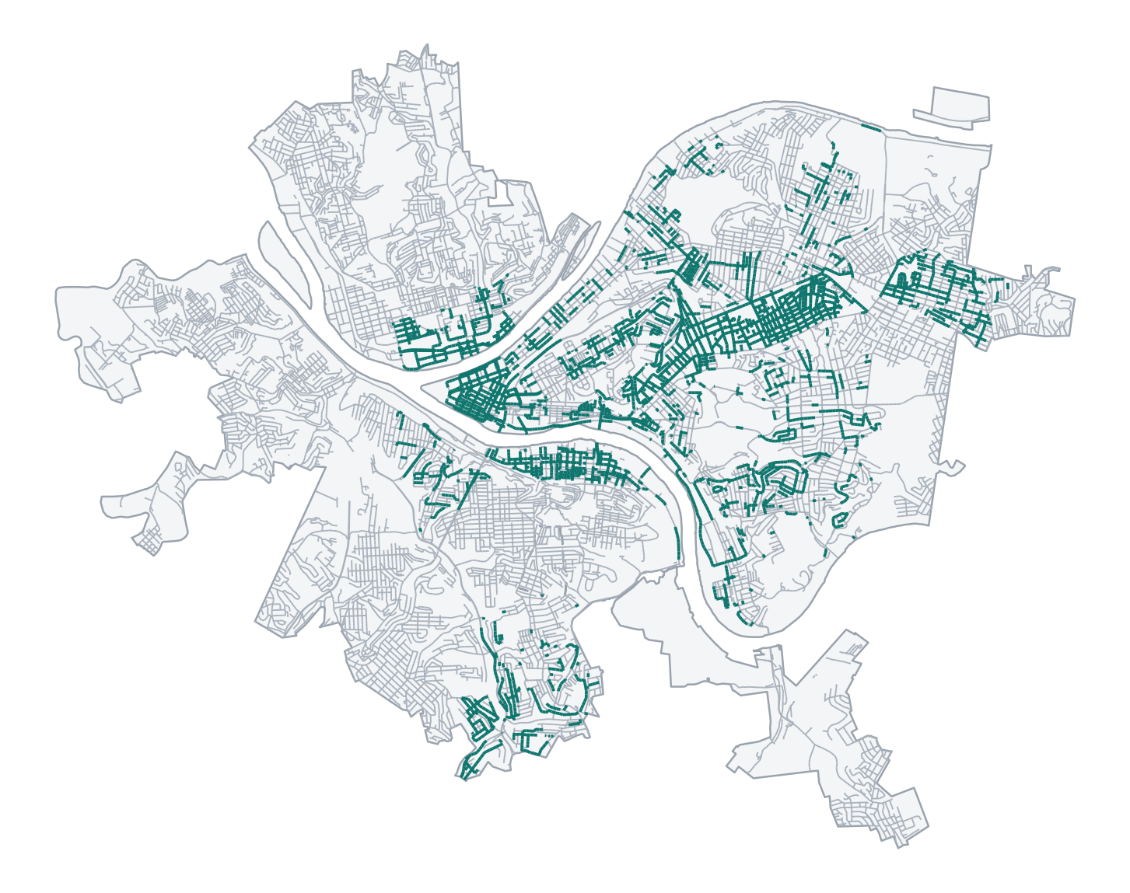
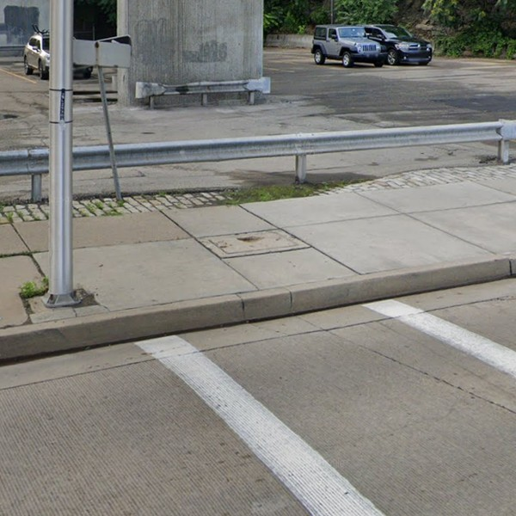
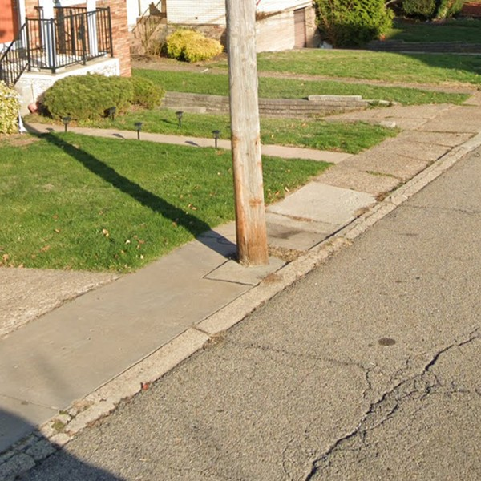
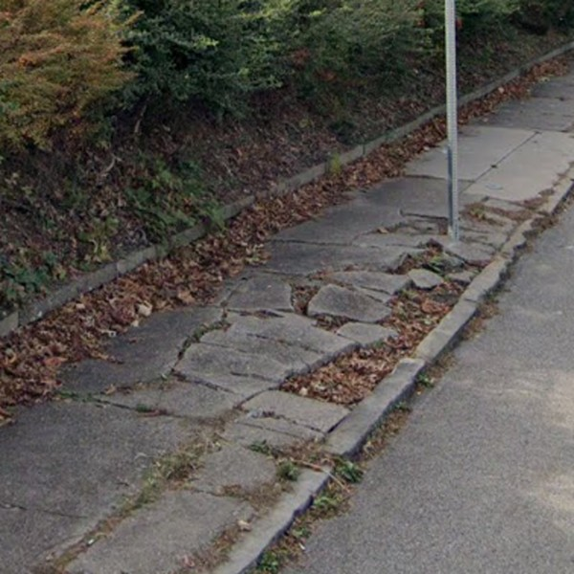
01 THE PROBLEM · WHO HAS IT
Team YOLO · Aditya Katkuri · Prateik Sinha · Giridhar Vadhul · JS Durand
Pittsburgh still finds sidewalk barriers by hand, and it's slow
17%
of streets checked
by hand in 6 years
HOW BARRIERS ARE FOUND TODAY
On foot
$1,600 / mile
A surveyor walks every block
field survey
Street View, by hand
$64 / mile
People click through panoramas
≈ 6 miles per staff-week
Automated sweep
21,071 photos
A model checks every photo
checked in under 10 minutes
Missing curb ramp
Obstacle
Surface problem
WHO GETS STUCK, AND THEIR CAREGIVERS
19,194
54,826
14,733
struggle to walk
seniors, 65 and over
kids under 5, in strollers
1 / 5
Notes:
(about 45 seconds)
• Hi, we're Team YOLO, and this is Sidewalk Scanner.
• Sidewalk barriers hit nineteen thousand Pittsburghers who struggle to walk, fifty-five thousand seniors, fifteen thousand kids in strollers, and their caregivers.
• One missing curb ramp, or a pole in the sidewalk, and a wheelchair can't get through.
• The City needs these barriers for its new ADA plan, but finding them is slow.
• Walking surveys cost sixteen hundred dollars a mile.
• Checking Street View by hand covers about six miles a week per person.
• After six years, only seventeen percent of Pittsburgh is checked. That's the teal on the map.
• A model is far faster: ours checked twenty-one thousand photos in under ten minutes.

Slide 2
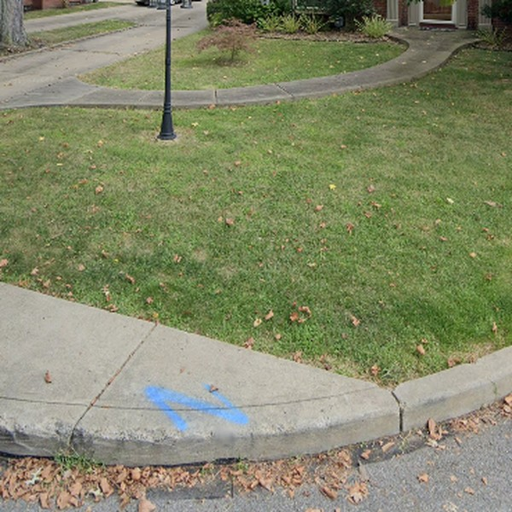
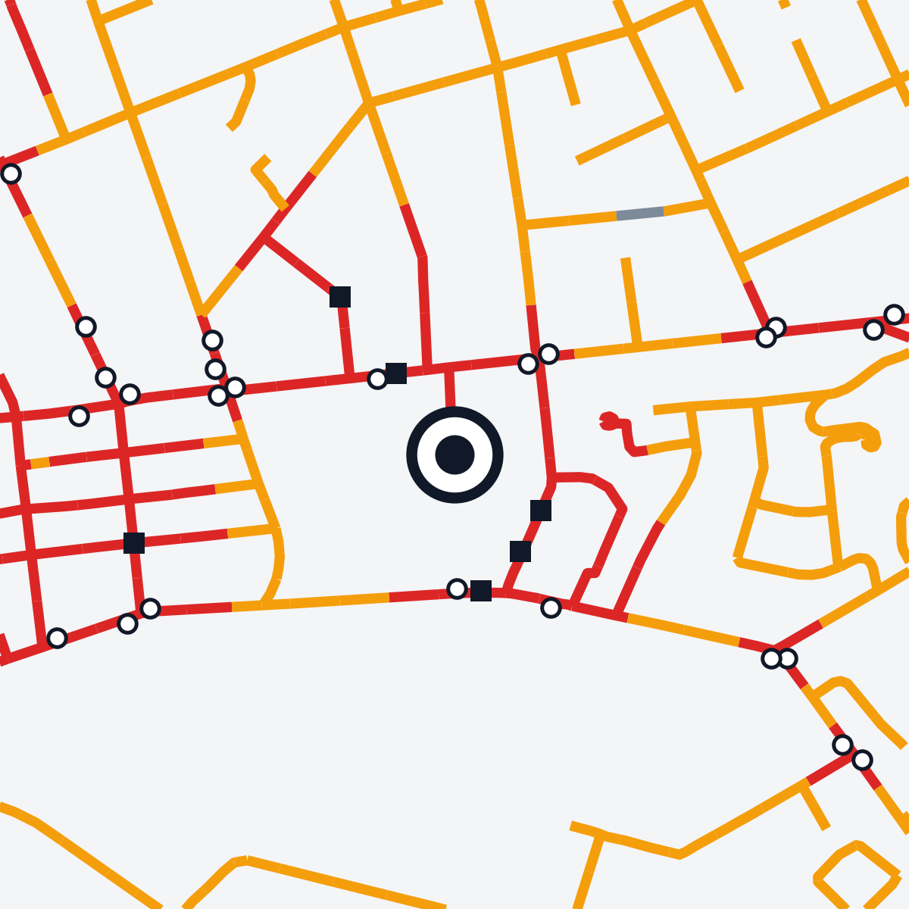
02 WHAT WE BUILD · WHAT CHANGES
Sidewalk Scanner · Team YOLO
We turn street photos into a barrier list, sorted by tier
1 Photo
2 Classify
3 Locate
4 Tier
5 Worklist
Missing curb ramp
Tier 1
CITY WORKLIST
No ramp Squirrel Hill N.
Obstacle
Obstacle Bluff
40.4463° N, 79.9438° W
Squirrel Hill North
136 m to a preschool
143 m to a bus stop
Surface problem
Surface North Oakland
No ramp Downtown
No barrier
Surface Greenfield
Street-level photo of a sidewalk
Image classifier picks one of four classes
Every photo carries its coordinates
Tier 1
Tier 2
Tier 3
Planners check Tier 1 first, then schedule repairs
■ school, clinic, care ○ busy stop
TODAY
WITH SIDEWALK SCANNER
• People walk streets or click through Street View
• About 6 miles per staff-week
• 17% of Pittsburgh checked in 6 years
• A model sweeps every street photo
• Re-run whenever new imagery arrives
• Planners check Tier 1 first: 28% of street km
2 / 5
Notes:
(about 25 seconds)
• Here's how it works.
• A street photo goes in, and the model says: missing curb ramp, obstacle, surface problem, or no barrier.
• Every photo has GPS, so we know exactly where each barrier is.
• Each barrier then gets a tier. Tier one is near hospitals, schools and busy bus stops.
• So instead of waiting years, the City gets one citywide list, and planners check Tier one first.

Slide 3
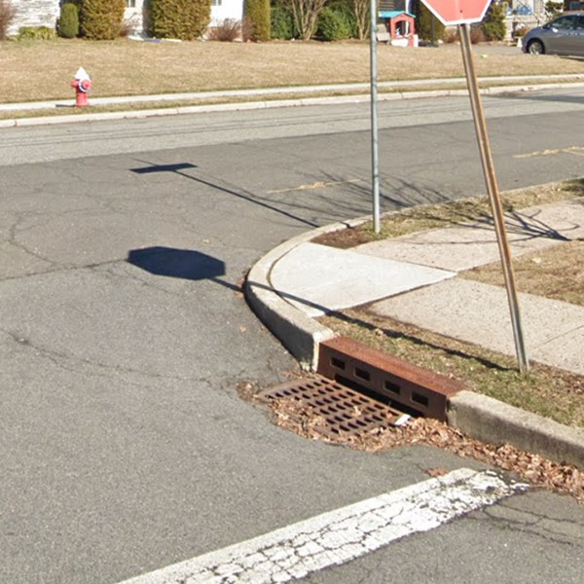
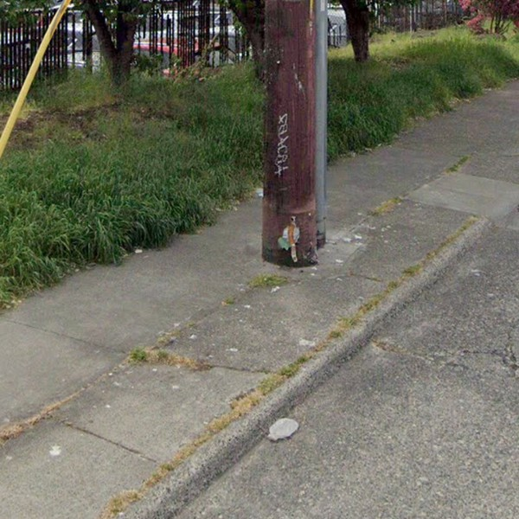
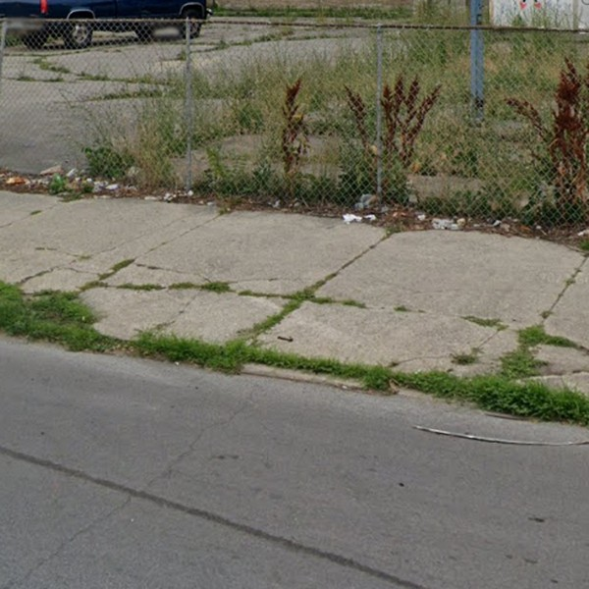
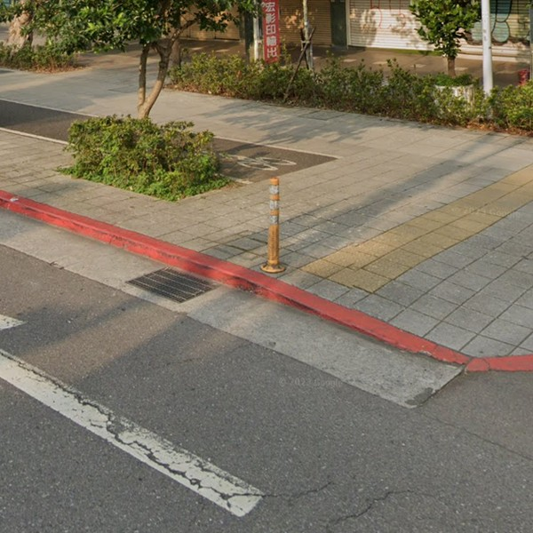
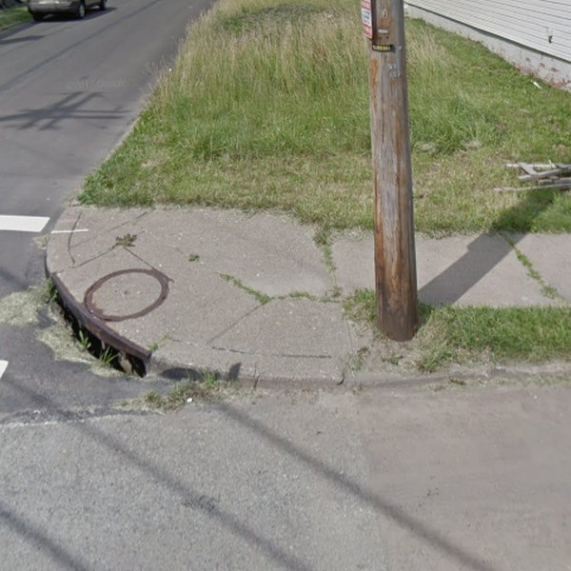
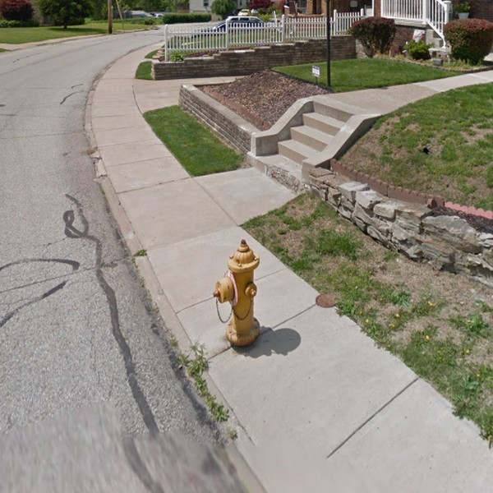
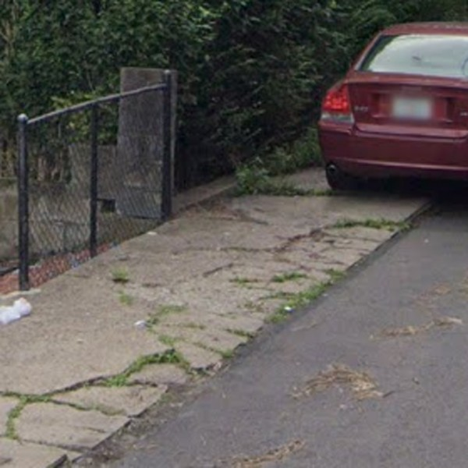
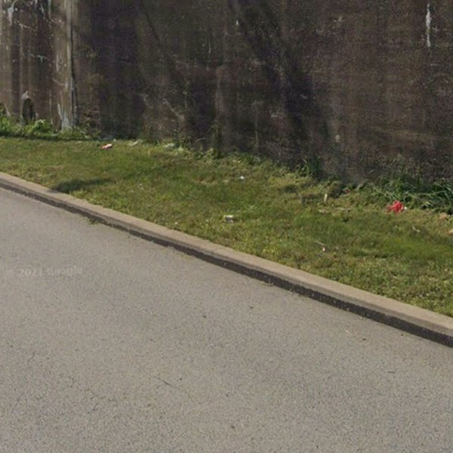
03 DATA
Sidewalk Scanner · Team YOLO
We learn from 18 cities and test on Pittsburgh
Missing curb ramp
Obstacle
Surface problem
No barrier*
SPLIT BY CITY, NOT AT RANDOM
18 OTHER CITIES · TRAINING
Train 18 cities · 20,512 photos
Test Pittsburgh · 559 photos
WHERE EACH PIECE COMES FROM
1
Project Sidewalk photos
Teaneck · 5,107
Seattle · 2,931
Chicago · 3,962
Taipei · 8,512
21,071 crowd-labelled Street View crops, 19 cities
PITTSBURGH · HELD-OUT TEST
2
Project Sidewalk Pittsburgh API
25,690 labels with GPS: where each test photo is
3
WPRDC + PRT open data
Hospitals, schools, clinics, 2,696 bus stops: the tiers
Pittsburgh · 200
Pittsburgh · 15
Pittsburgh · 162
Pittsburgh · 182
4
RampNet dataset
Label = crowd verdict. Confirmed → that barrier. *Rejected → “no barrier”.
214,376 street panoramas (New York, Portland, Bend)
Only detects whether a curb ramp is there
3 / 5
Notes:
(about 30 seconds)
• We don't have to label anything to start.
• Project Sidewalk has published about twenty-one thousand street photos from nineteen cities, each voted on by the crowd.
• We train on eighteen cities and test on Pittsburgh's five hundred fifty-nine photos.
• Pittsburgh's Project Sidewalk data tells us where each photo is.
• City open data on hospitals, schools and bus stops gives us the tiers.
• We also have RampNet, about two hundred fourteen thousand panoramas, but it only tells us whether a curb ramp is there.

Slide 4
04 EVALUATION
Sidewalk Scanner · Team YOLO
Scored on Pittsburgh only: per barrier type, per tier
TWO NUMBERS, PER TIER
TARGETS
Found
(recall)
Right
(precision)
≥ 80%
Of the real barriers in Tier 1, what share did we flag?
Of our Tier 1 flags, what share are real barriers?
of Tier 1 flags are real barriers
> 40% · > 27%
HOW WE CHECK THE TRUTH
559
300
In person
of obstacles · surface problems found, beating human labellers
held-out Pittsburgh photos with crowd votes
Mapillary photos we hand-label
We go to sampled spots and check them ourselves
2 baselines
beat zero-shot CLIP and a zero-shot vision-language model
4 / 5
Notes:
(about 35 seconds)
• We score it only on Pittsburgh, with two questions for each tier.
• Found: of the real barriers, how many did we catch?
• Right: of our flags, how many are real?
• For the truth, we use five hundred fifty-nine Pittsburgh photos the model never sees in training.
• We hand-label three hundred Mapillary photos, and we visit sampled spots to check them ourselves.
• Our targets: at least eighty percent of Tier one flags are real, and we catch more obstacles and surface problems than human labellers.

Slide 5
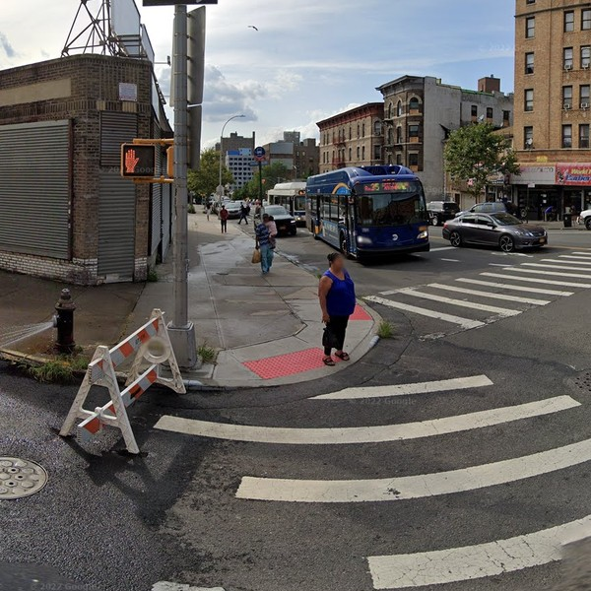
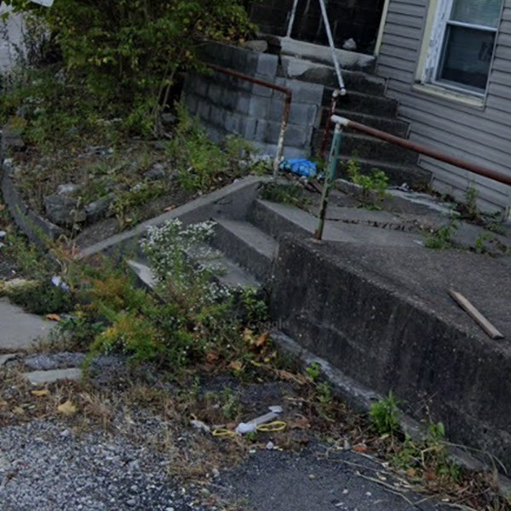
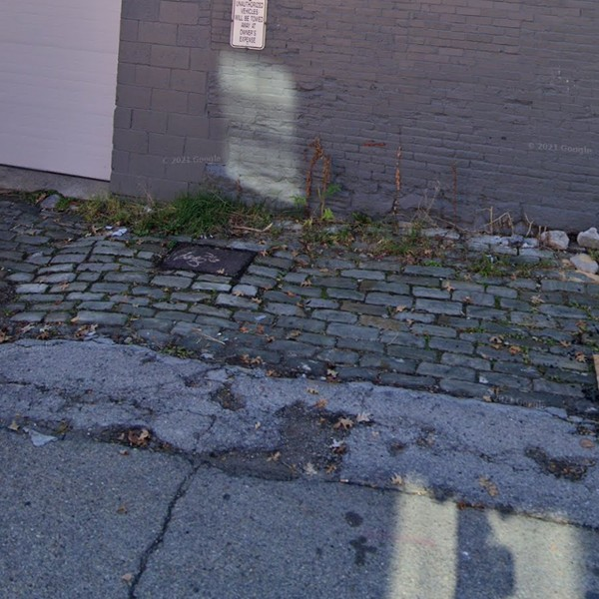
05 RISK · HELP WANTED
Sidewalk Scanner · Team YOLO
Biggest risk: a model trained elsewhere may fail in Pittsburgh
1 Different city, different streets
Where we'd love help
1,128
public stairways in Pittsburgh
1
Imagery
Photos of unaudited streets
plus hills, brick and narrow sidewalks
Trained on: New York
Pittsburgh: stairs
Pittsburgh: cobblestone
2
A DOMI planner
Is our tier rule right? What list would you use?
→ Test only on Pittsburgh, and check spots in person
2 Photo coverage unknown
3 Sparse labels
3
Disability advocates
1,324 km
Review the tiers and the errors that matter most
label
no label
no label
?
of unaudited streets. How many have usable photos?
4
GPU hours
One ramp, three photos, one label
To adapt the model to Pittsburgh
→ Map photo coverage first
→ RampNet labels every nearby photo
5 / 5
Notes:
(about 35 seconds)
• Our biggest risk is that a model trained in other cities won't work here.
• RampNet comes from New York, Portland and Bend, but Pittsburgh has hills, over a thousand public stairways, and brick sidewalks.
• That's why we test only on Pittsburgh and check spots in person.
• We also don't know yet how many unaudited streets have usable photos.
• And labels are sparse: a barrier is labelled once, but shows up in many photos.
• We'd love help with imagery, a DOMI planner, disability advocates, and GPU time. Thank you!

