Slide 1
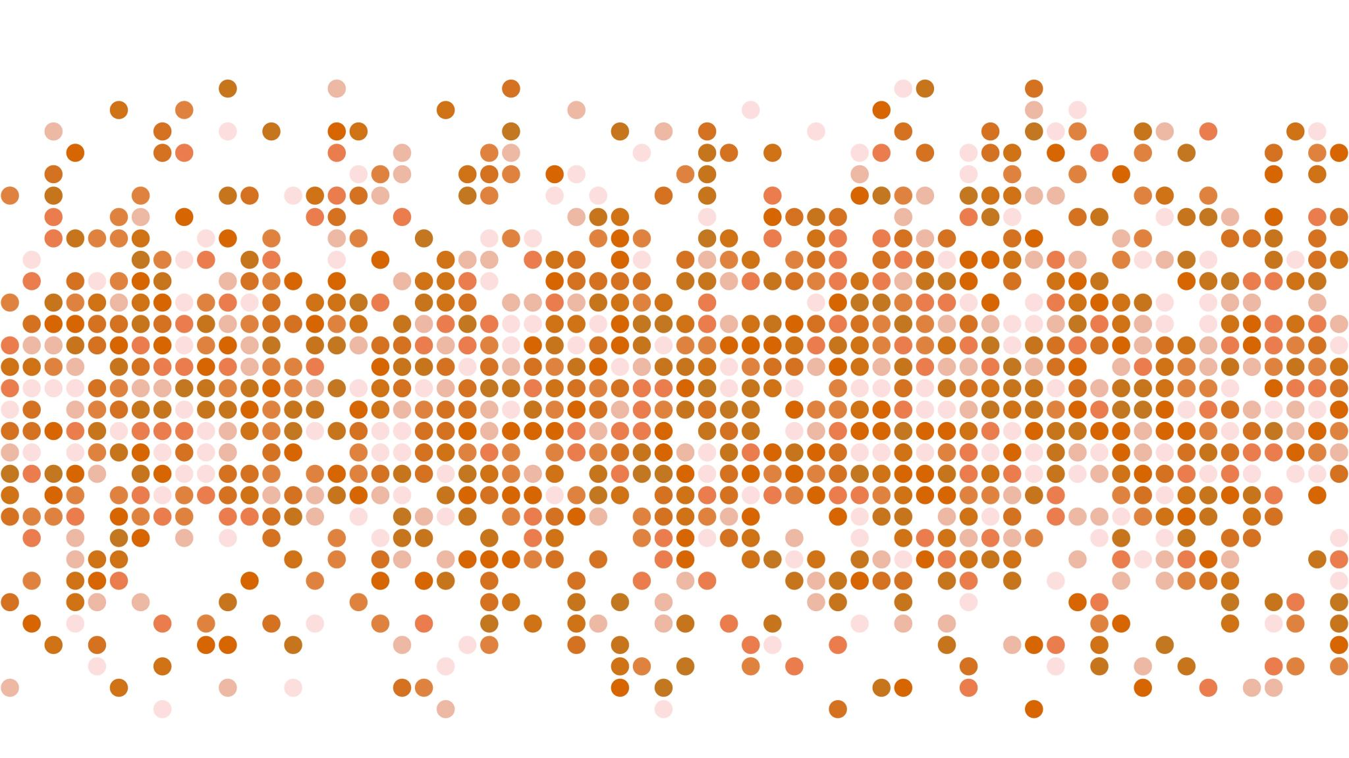
AI Analytics of AIS Data
~ Under The Guidance of Dr Luo Wei
GeoSpatialX lab

Slide 2
Project Members
Nitish Singla
Rishabh Jain
Shubham Sharma
Aditya Katkuri

Slide 3
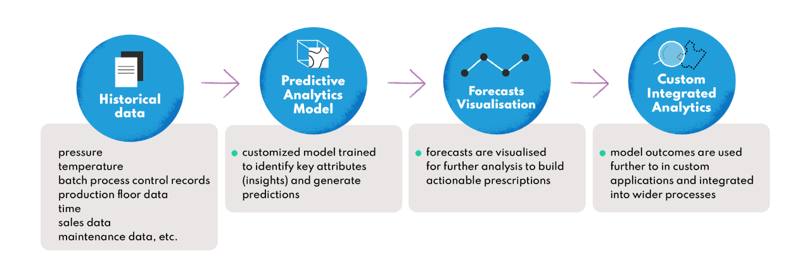
Proposed Workflow

Slide 4
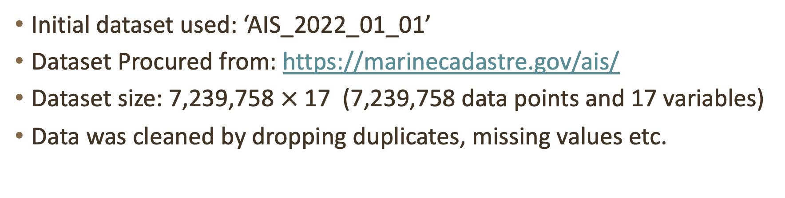
Progress Until 29th Dec 2022
Initial dataset used: ‘AIS_2022_01_01’
Dataset Procured from: https://marinecadastre.gov/ais/
Dataset size: 7,239,758 $×$ 17 (7,239,758 data points and 17 variables)
Data was cleaned by dropping duplicates, missing values etc.

Slide 5
Vessel Type ‘80’ was selected, which are tanker vessels.
Further data cleaned by dropping data points that have invalid MMSI (i.e., no. of digits in MMSI greater or lesser than 9).
Decreasing the area of focus:-
Restricted the latitude values to min 20 and max 25 (i.e., 20=<LAT<=25).
Longitude value wasn’t restricted to allow as we don’t need to worry about the length of the trajectory.

Slide 6

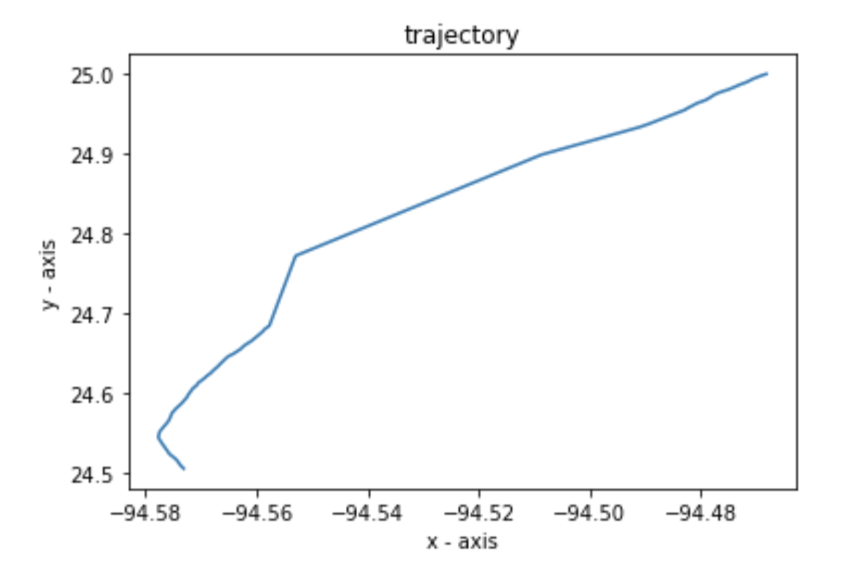
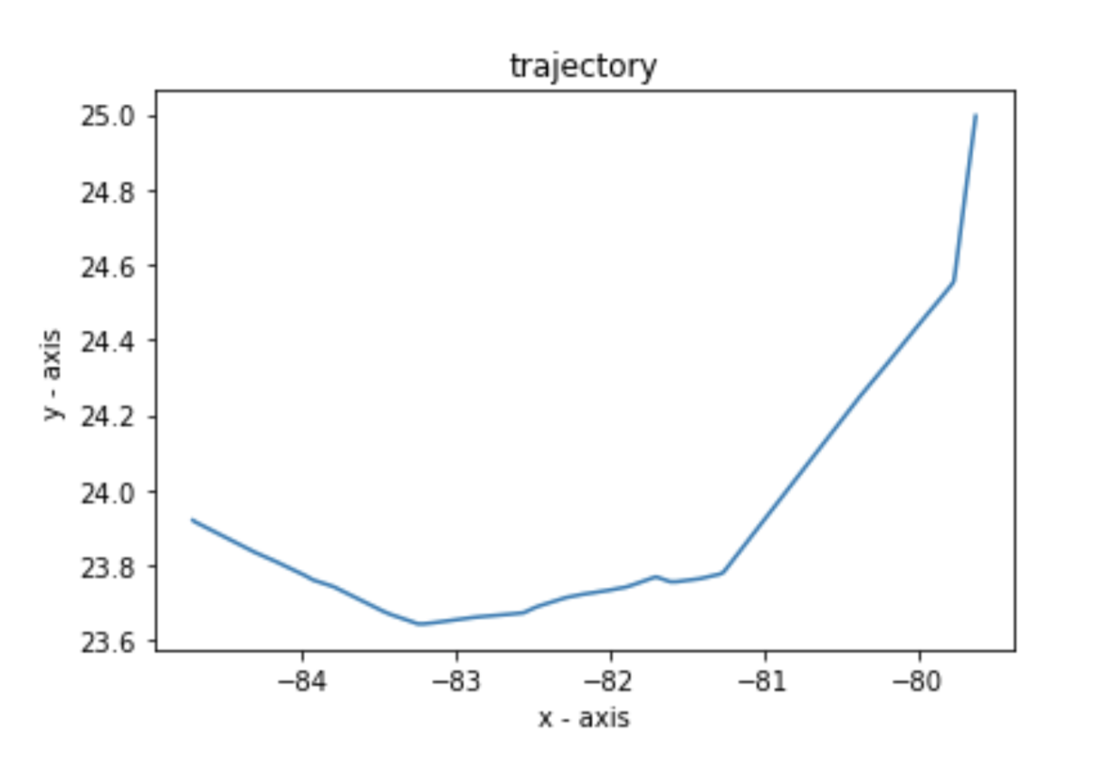
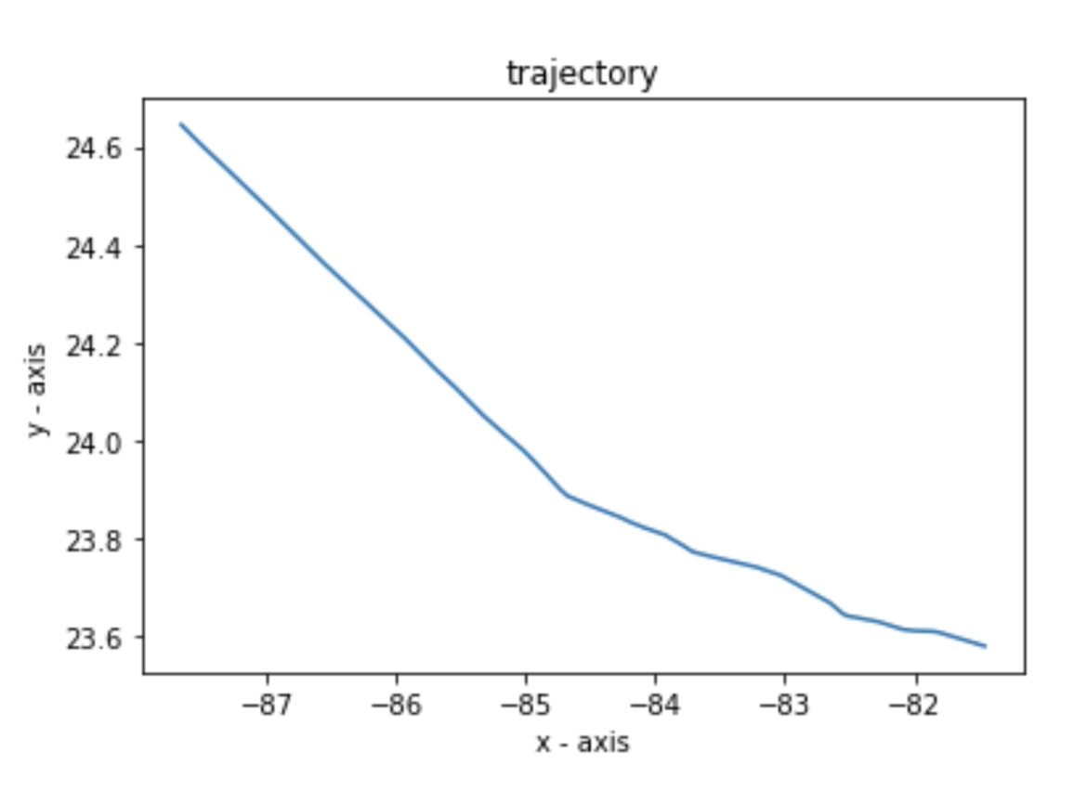
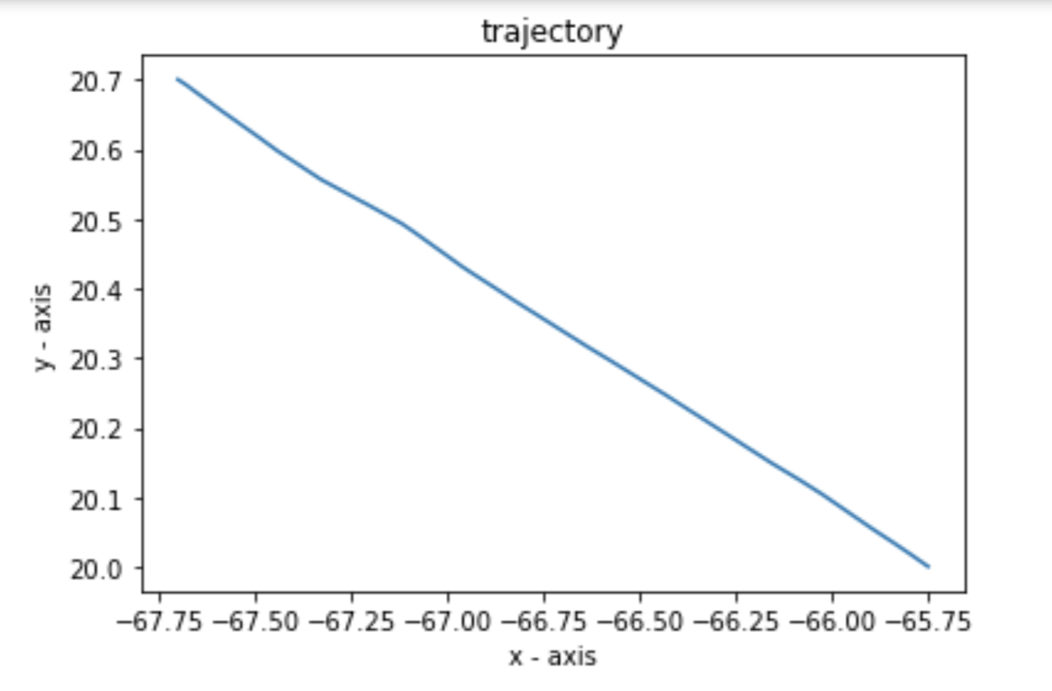

There are 118 different vessels in our new area of focus (i.e., 118 diff MMSI’s)
Updated dataset size: 22,586 $× 17$
15 Vessels were chosen and their given trajectory was observed.
Few Examples:

Slide 7
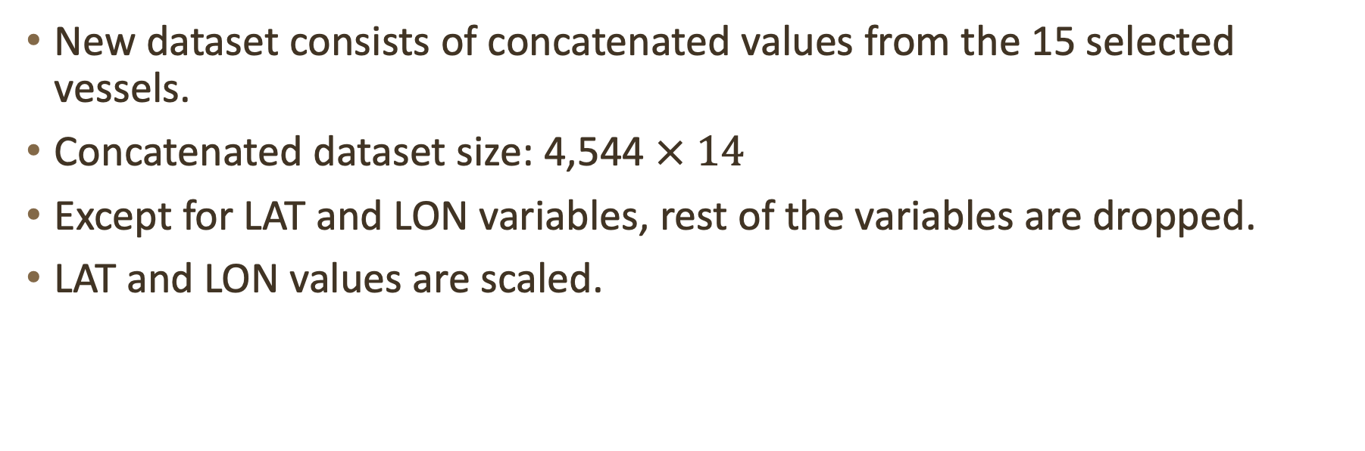
New dataset consists of concatenated values from the 15 selected vessels.
Concatenated dataset size: 4,544 $× 14$
Except for LAT and LON variables, rest of the variables are dropped.
LAT and LON values are scaled.

Slide 8
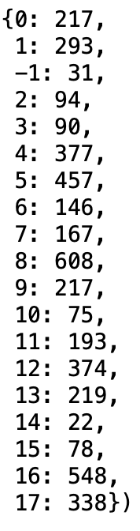
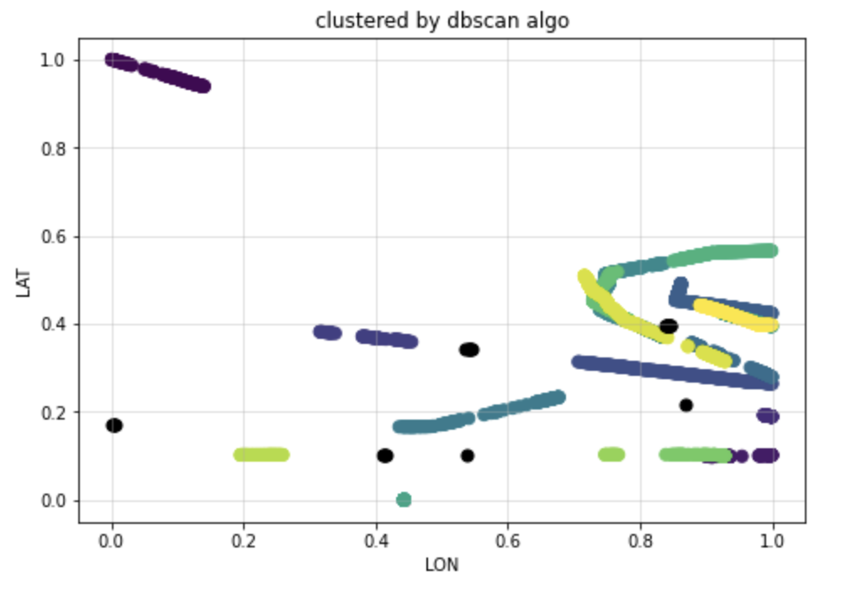

Clustering:-
DBSCAN algorithm is used to find clusters and outliers.
Total 18 clusters were detected (out of which 1 was outlier and was dropped).

Slide 9
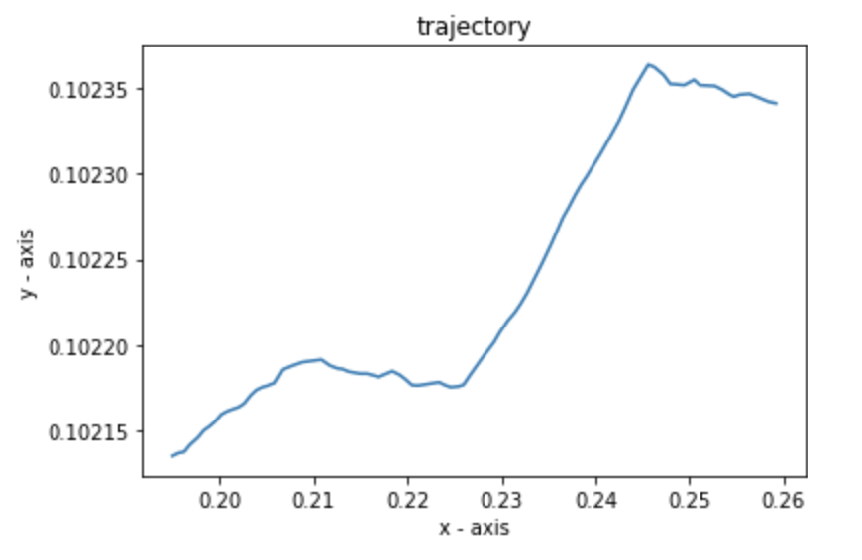
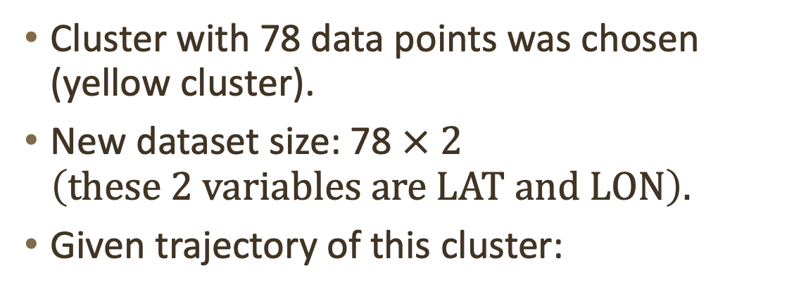
Cluster with 78 data points was chosen (yellow cluster).
New dataset size: 78 $× 2$ $\left(these 2 variables are LAT and LON\right).$
Given trajectory of this cluster:

Slide 10
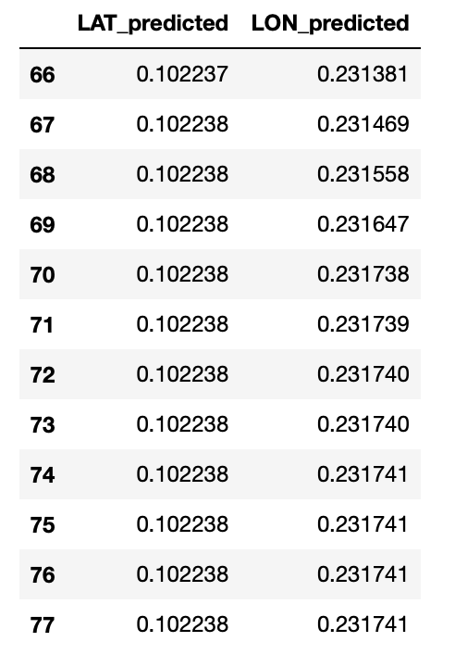
VARMAX model was used to predict the trajectory of the chosen cluster.
First 66/78 data points were used to train the model.
Last 12 data points were predicted by the trained model.
The predicted trajectory was compared with the already known 12 datapoints.

Slide 11
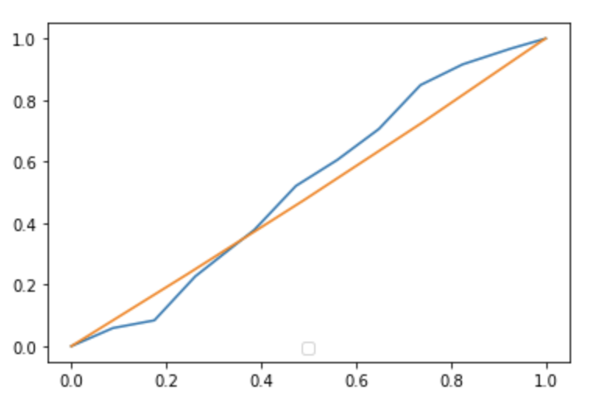
The predicted values and original LAT and LON values are scales and plotted accordingly.
Original, Predicted

Slide 12
Summary
Data Cleaning -> Clustering using DBSCAN -> Prediction of Trajectory of the chosen cluster using VARMAX model.

Slide 13
Next Steps
Trajectory prediction of single vessel from the chosen cluster.
Inclusion of more datasets (AIS_01_02, AIS_03 etc).
Accuracy
Forecasts Visualization using React.js
Suggestions?

Slide 14
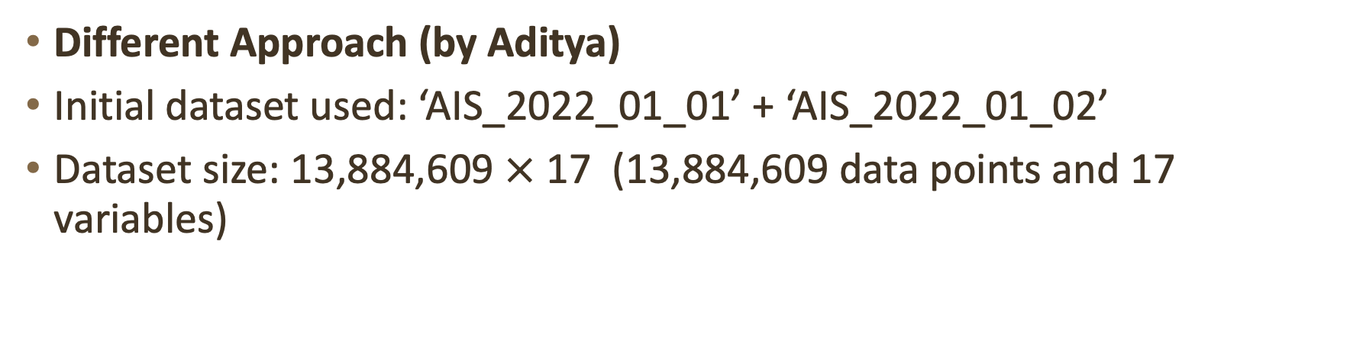
Progress From 12th Jan Until 26th Jan
Different Approach (by Aditya)
Initial dataset used: ‘AIS_2022_01_01’ + ‘AIS_2022_01_02’
Dataset size: 13,884,609 $×$ 17 (13,884,609 data points and 17 variables)

Slide 15
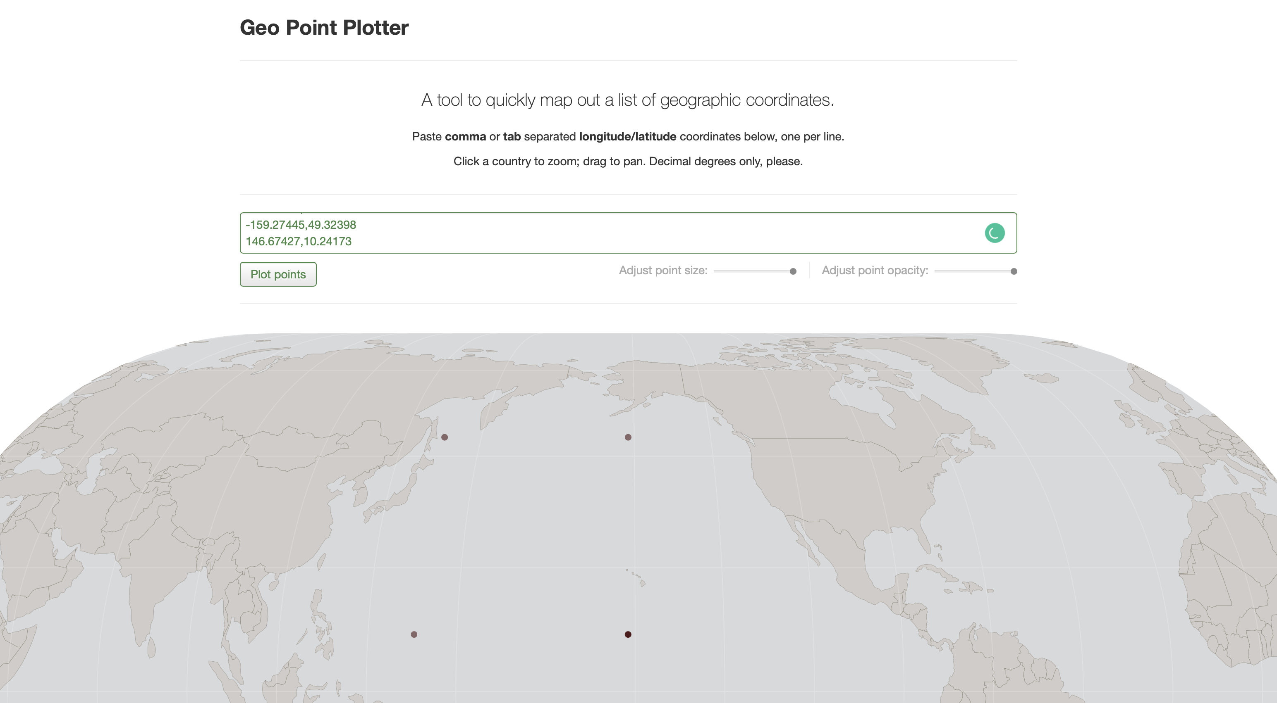

Slide 16
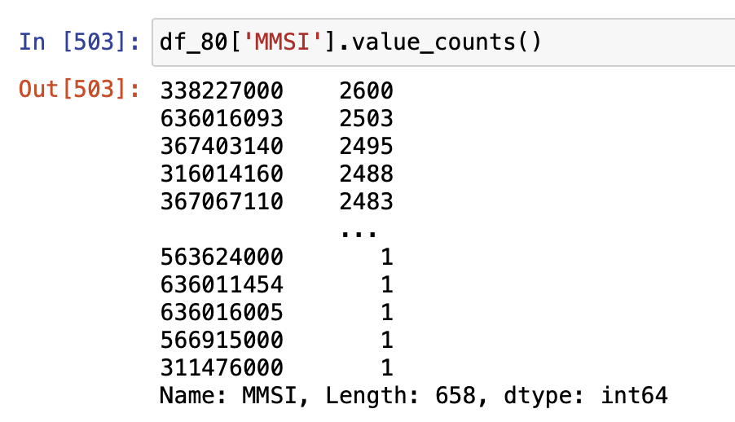
Vessel type 80 was chosen.
New dataset consists of 658 different vessels.

Slide 17
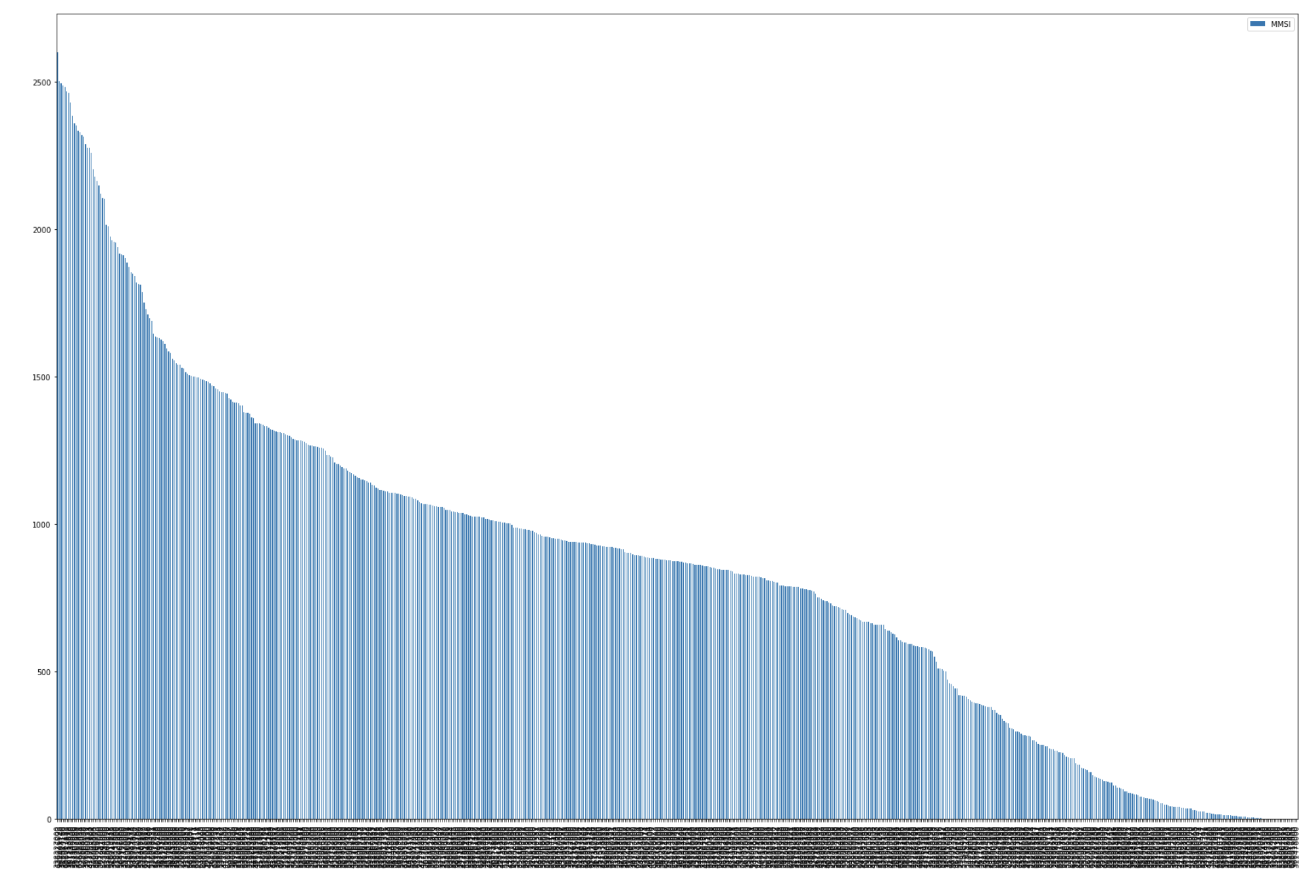

Slide 18
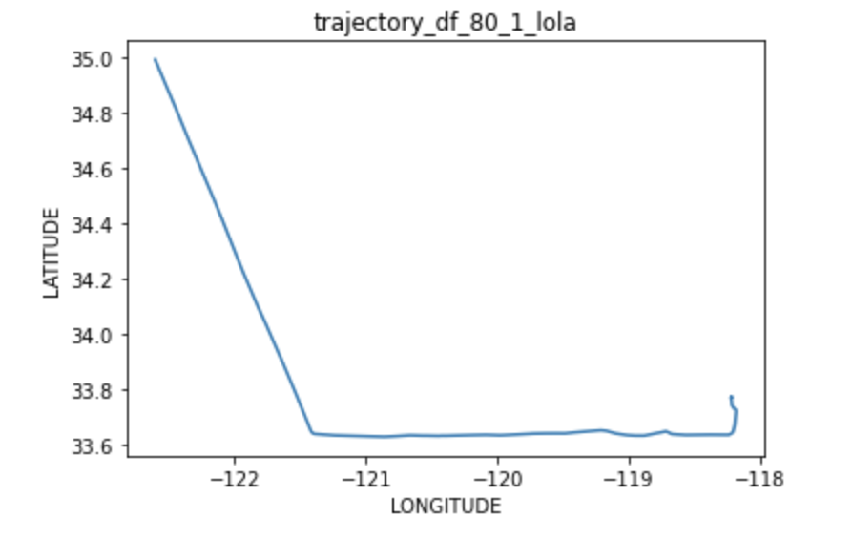
MMSI with highest data points was selected.
There are 2600 data point for the selected vessel.

Slide 19
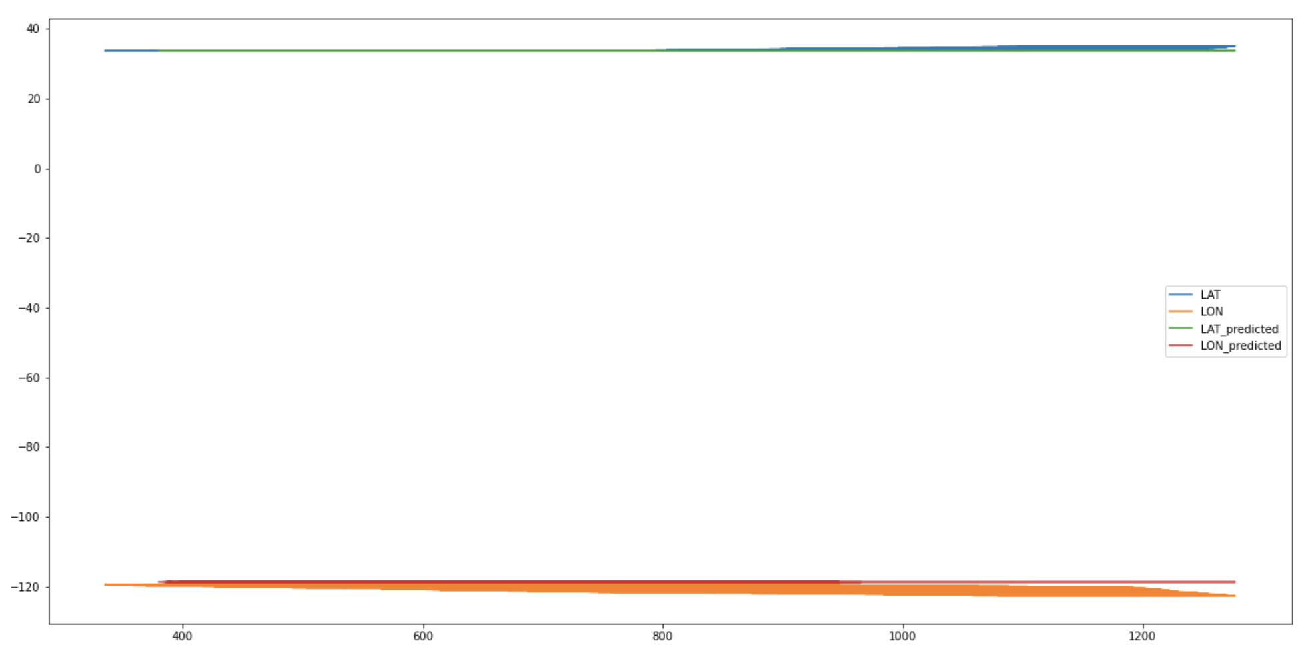
VARMAX model was used to predict.
Training set has 1,800 data points.
Testing set has 900 data points.

Slide 20
Summary
More data added -> Data Cleaning -> Prediction of Trajectory of the chosen cluster using VARMAX model.

Slide 21
Next Steps
Trajectory prediction of single vessel using multiple models.
Inclusion of relevant datasets.
Accuracy.
Suggestions?

