Slide 1


Mid-Semester Project Presentation
Agentic AI and RAG-Based Framework for Digital Forensics
Presented by:
R2142230710 - Aditya Khatri
R2142230733 - Abhay Kumar Kashyap
R2142230767 - Devansh Singh Rawat
R2142231145 - Vanshika Trikha
Mentored By
Dr. Anish Kumar Vishwakarma
Assistant Professor, School of Computer Science
University of Petroleum & Energy Studies, October 2026

Slide 2
Content
1. Introduction
2. Literature Review
3. Objectives
4. Methodology
5. Working Model
6. Results
7. Conclusion
8. References
STATUS AT MID-SEMESTER
The framework runs end to end on local models, behind an API and a web interface.
6 of 7 sub-objectives complete; evaluation is complete for the local tools.
81 automated tests and CI pass.
Language-model judges are built but not yet benchmarked.
Notes:
Outline of the talk. Today covers the problem, what was reviewed, what we set out to do, how the work was organised, what is built and what the measurements show. The right-hand box gives the one-sentence status.

Slide 3
Introduction
THE PROBLEM
WHERE IT APPLIES
Generative AI produces fluent text and photorealistic faces at very low cost.
A single detector returns a probability but no evidence, and often fails on a new generator, domain or compression level.
Forensic use needs the evidence examined, how reliable the result is, and a clear signal when a person must decide.
Digital evidence screening in cybercrime investigations
Newsroom and fact-checking workflows
KYC and identity-fraud checks on facial media
Enterprise media verification
Academic and publishing screening of machine-written text
PROBLEM STATEMENT
Design an end-to-end framework that examines text and images with complementary tools, combines their outputs in a controlled way, cites retrieved supporting knowledge, and refers doubtful cases to a person.
Notes:
The problem: generated text and faces are cheap and convincing, so appearance is no longer evidence. Single detectors give a score without evidence and fail on new sources. We therefore treat detection as an investigation: several tools, retrieved knowledge, and a verifier that can say it is not sure. Application areas on the right.

Slide 4
Introduction: Concepts and Datasets
TECHNICAL CONCEPTS USED
DATASETS AND INPUT FORMAT
Fine-tuned transformer: DeBERTa-v3-base text classifier
Binoculars: perplexity ratio of two language models
CNN with Grad-CAM: EfficientNet-B4 face-swap detector
CLIP linear probes: face, general-image and scope guard
Calibration: temperature scaling on a separate split
RAG: ChromaDB with a similarity cut-off and cited sources
Reflexion: one judge re-check when tools disagree
LangGraph: typed-state orchestration
Modality | Data | Use
Text | HC3, MAGE, RAID | 136k-row training mix; held-out sets
Face swap | WildDeepfake, FF++ (C32), Celeb-DF v2 | Training mix; held-out tests
Synthetic faces | GRAVEX-200K, DeepDetect-2025 | CLIP face probe
Art, scenes | DeepDetect, AI-art set | General image probe
Input: UTF-8 text (20 to 20,000 words) or JPEG, PNG, WebP up to 10 MB, checked by content.
Leakage control: text split by source document, images by video; Cohere and the paraphrase, synonym and homoglyph attacks never used in training; Face2Face and FaceShifter are the zero-shot test.
Notes:
Technical concepts on the left are the ones the system actually uses. The dataset table on the right shows the sources; the important design point is the split: text by document, images by video, and whole generators and manipulation methods held out of training.

Slide 5
Literature Review: Related Work
Work | Area | Contribution | Limitation or gap
Dugan et al. (RAID), 2024 | Text | Robustness benchmark: 11 generators, 8 domains, 11 attacks | In-domain accuracy alone is insufficient
Hans et al. (Binoculars), 2024 | Text | Zero-shot detection with two language models | Varies with generator and domain
Rossler et al. (FF++), 2019 | Image | Controlled facial-manipulation benchmark | Depends on method and compression
Zi et al. (WildDeepfake), 2020 | Image | Real-world, in-the-wild deepfake data | Detection only, no evidence reasoning
Lewis et al. (RAG), 2020 | RAG | Retrieval gives explicit external knowledge | Output quality follows retrieval quality
Zhang et al. (ForenAgent), 2026 | Agentic | Iterative tool use for forgery analysis | Latency and reliability are open
Notes:
The reviewed work covers text benchmarks, zero-shot detection, image forensics benchmarks and agentic reasoning. The common finding is that performance depends on the distribution, which is why our evaluation holds out generators, attacks and datasets.

Slide 6
Literature Review: Inference and Gap
INFERENCE FROM THE LITERATURE
SEEN IN OUR OWN FIRST MODELS
Performance is distribution-dependent. Unseen generators, attacks and compression lower accuracy.
Signals are complementary. Statistical, learned and semantic evidence fail in different places.
Explanation must be tied to evidence. Retrieval helps, but scores and uncertainty must stay visible.
0.66
0.52
text AUROC on MAGE, after 1.00 on HC3
image AUROC on FF++ (chance), after 0.97 on WildDeepfake
SWOT
Strengths | Weaknesses
Multi-signal, modular, explainable | Latency; calibration effort
Opportunities | Threats
Video, provenance, watermarking | New generators; evasion
RESEARCH GAP
No unified text-and-image workflow that combines tools, grounds the result in retrieved knowledge and verifies disagreement before reporting.
Notes:
Three conclusions from the literature, and the gap: existing work is organised around single detectors or single modalities. Our own early results reproduced the same pattern, which is the evidence on the right.

Slide 7
Objective
MAIN OBJECTIVE
Develop an Agentic AI and RAG-based framework that detects AI-generated or manipulated text and images with complementary tools and produces explainable, evidence-grounded, confidence-aware reports.
No. | Sub-objective | Status | Basis
1 | Multi-signal text detector | Done, modified | DeBERTa-v3, Binoculars, LLM judge
2 | Image forensics pipeline | Done, modified | EfficientNet-B4, CLIP probes, scope guard
3 | LangGraph orchestrator | Done | Routing, verifier loop, Reflexion
4 | Shared RAG knowledge base | Done | Literature, generator profiles, case memory
5 | Verifier and escalation | Done | Calibrated fusion, human referral
6 | Evaluation and ablations | Partly done | 9 held-out sets; judge rows pending
7 | Prototype and deployment | Done, modified | FastAPI, web interface, Docker, CI
Notes:
Main objective and the seven sub-objectives from the synopsis with their honest status. Three are done with modifications, which are explained on the methodology slide and recorded in the decision log.

Slide 8
Methodology
REFERENCE MODEL
Iterative, evaluation-driven development with frozen thresholds and untouched test sets.
TIMELINE AND DELIVERABLES
Ph. | Task | Deliverable | Status
A | Literature, architecture | Gap analysis, state schema | Done
B | Text models | Classifier, probe, judge | Done
C | Image models | CNN, CLIP, scope guard | Done
D | Orchestration | Routing, fusion, Reflexion | Done
E | RAG and verifier | Knowledge base, citations | Done
F | Interface, evidence store | Web UI, audit records | Done
G | Evaluation, report | Ablations, report | In progress
STEPS
Prepare data with leakage checks
Train each tool with early stopping
Calibrate on a separate split
Orchestrate, fuse and verify
Serve through API and web interface
Evaluate on held-out data; diagnose; fix
Notes:
The working method was iterative and evaluation-driven: build, measure on held-out data, diagnose the failure, fix, measure again. That loop found the two biggest problems, the text and image generalisation gaps. Timeline shows all seven phases and their status.

Slide 9
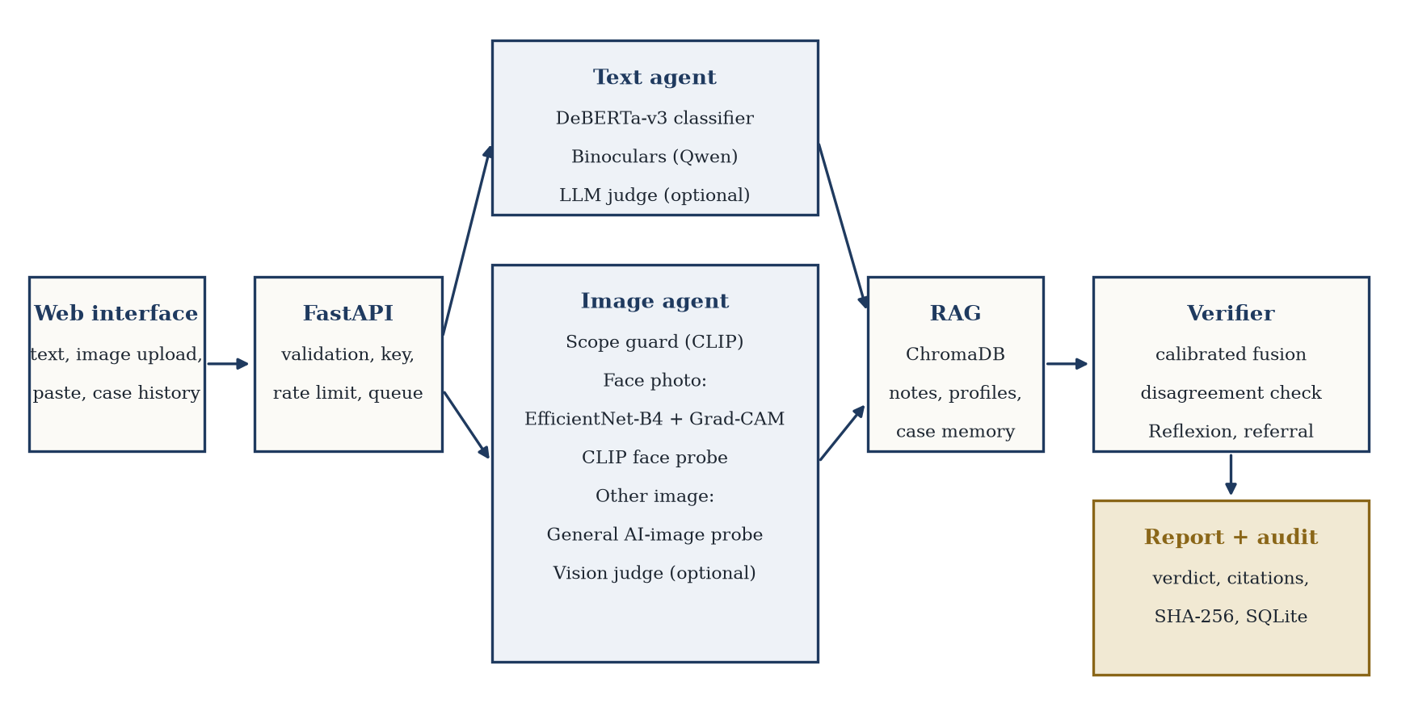
Working Model: Architecture
REQUIREMENTS
Functional
Accept text or image
Verdict with confidence
Per-tool readings and Grad-CAM
Cited reference material
Referral of doubtful cases
Hashed audit record
Non-functional
Runs on one 16 GB GPU
Inputs validated by content
No secrets in the repository
Reproducible tests and CI
github.com/Aditya-Khatri-7/Major-Project-
Notes:
System architecture as built. A request is validated, routed by modality, scored by independent tools, enriched with cited reference material and reconciled by the verifier, then written to an audit record. Requirements on the right; the link to the repository holds the full specification.

Slide 10
Working Model: Modules and Deliverables
Module | Attained | Remaining
Core engineering | Typed state, settings, JSON logs, 81 tests, CI with Docker build | Distributed tracing
Text agent | DeBERTa-v3, Binoculars, judge adapter, input normalisation, calibration | Judge calibration
Image agent | Scope guard, EfficientNet-B4, CLIP probes, Grad-CAM, robustness test | Unseen-method transfer
Orchestration | Routing, fusion, disagreement rule, Reflexion, referral | Live Reflexion measurements
RAG | 21-chunk knowledge base, cut-off and query rewrite, case memory with corrections | Larger curated corpus
Product | Web interface, API key, rate limit, SQLite audit store, Docker | PDF export of a case
Changes from the synopsis, with reasons, are kept in DECISIONS.md: XGBoost removed, DeBERTa-v3 instead of RoBERTa, CLIP probes instead of frequency tools, web interface instead of React.
Notes:
Attained deliverables against what remains. The remaining items are mostly gated by the judge API quota rather than by missing design.

Slide 11
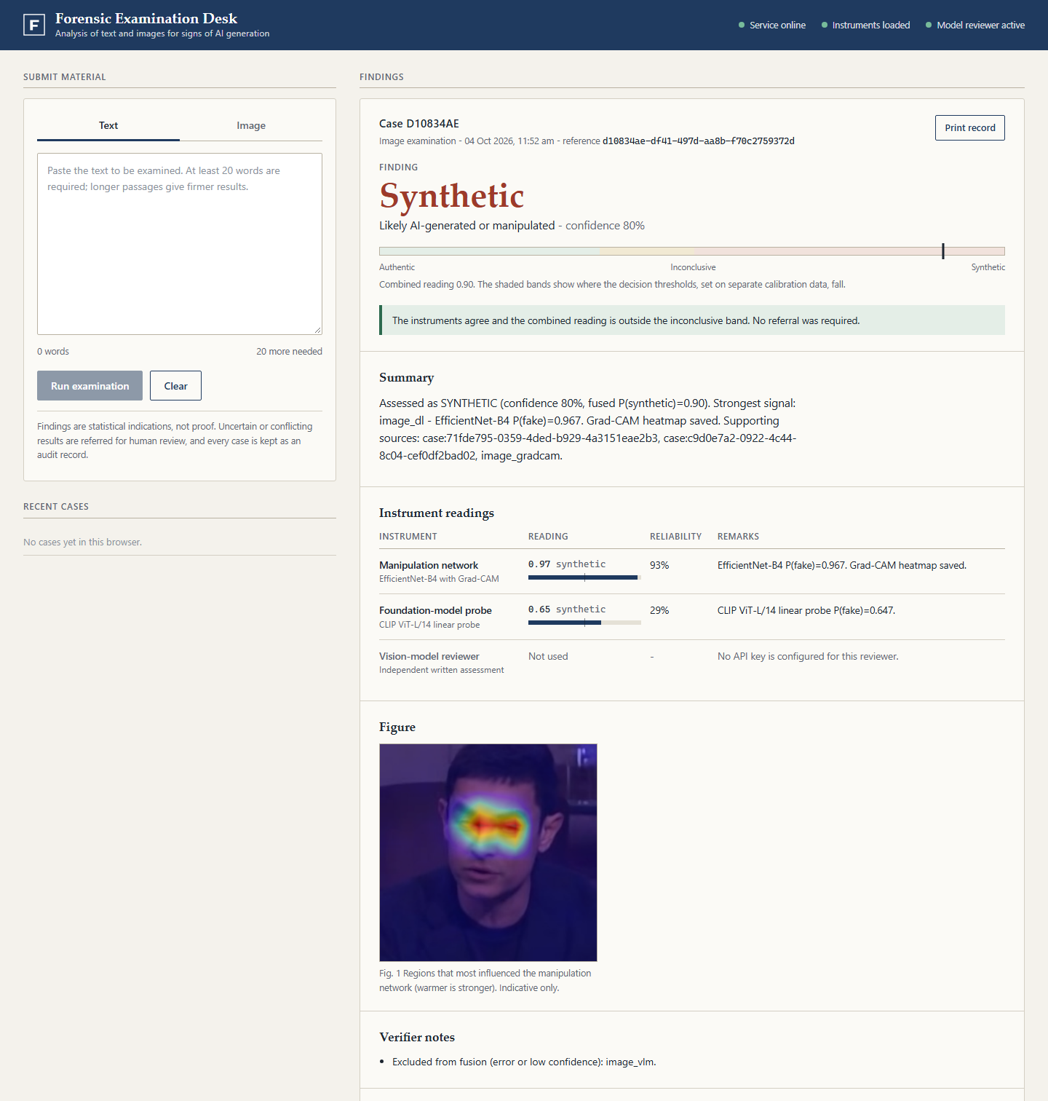
Working Model: Interface
WHAT THE SCREEN SHOWS
Finding and meter: verdict, confidence and the combined reading against the decision thresholds
Instrument readings: each tool's score and reliability, or why it was not used
Grad-CAM figure: regions that influenced the network
Verifier notes and referral: why a case was or was not sent to a person
Reference material: cited sources; the system's own earlier cases are marked unverified
Examiner's determination: a human label that feeds case memory
Notes:
This is the interface a reviewer sees. The finding sits at the top with a meter that shows where the combined reading lies relative to the decision thresholds, then each instrument's reading, the Grad-CAM figure, verifier notes and cited reference material. Earlier cases generated by the system are labelled unverified.

Slide 12
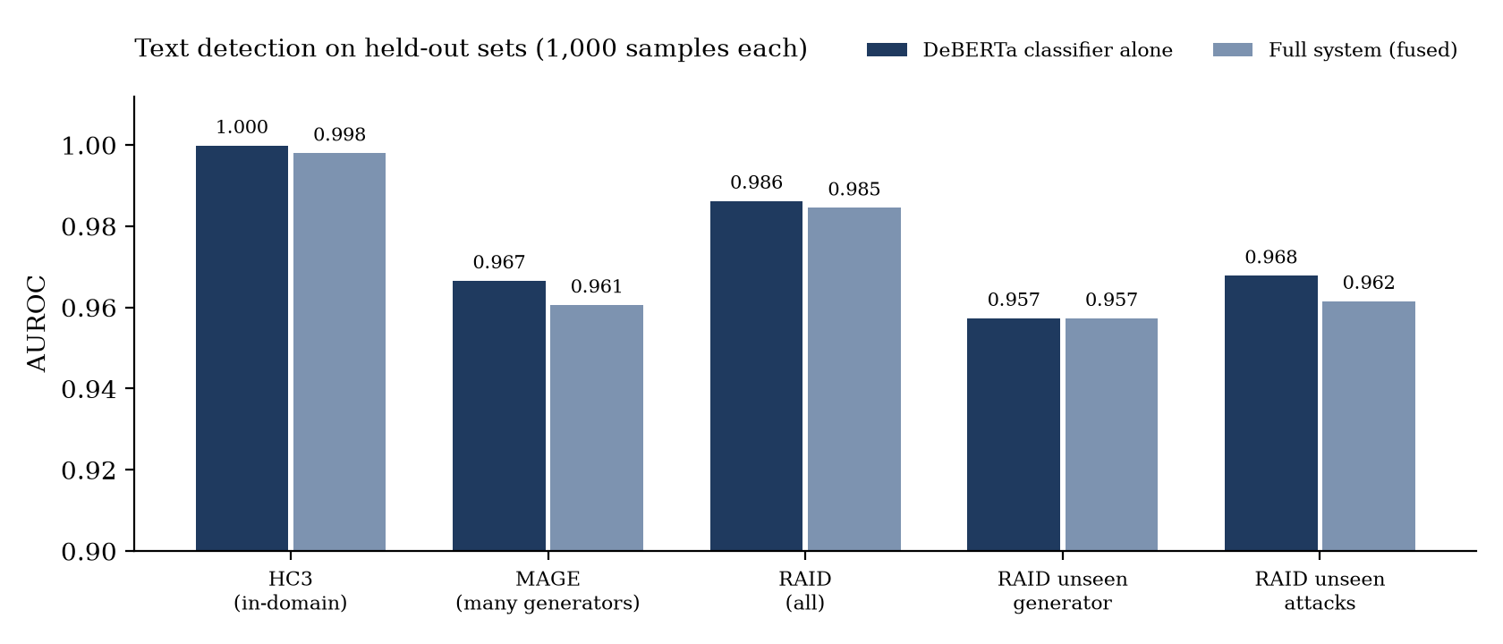
Results: Text
0.957 to 0.998
AUROC on five held-out sets, including an unseen generator and unseen attacks
58 to 61%
AI text caught at 1% false positives on the hardest sets (MAGE, unseen attacks)
92 to 99.6%
Input normalisation alone lifted the homoglyph attack from AUROC 0.72 to 0.99, without retraining. Binoculars adds no accuracy (fused AUROC −0.001 to −0.006), so its weight is capped at 0.10.
accuracy on cases the system decides; 30 to 52% are referred to a person
Notes:
Five held-out sets, 1000 samples each. The classifier carries the result; fusing Binoculars changes AUROC by at most 0.006, so it is kept as a low-weight second opinion. At a strict one percent false-positive budget the hardest sets are detected 58 to 61 percent of the time. The system refers 30 to 52 percent of cases and is 92 to 99.6 percent accurate on the rest.

Slide 13
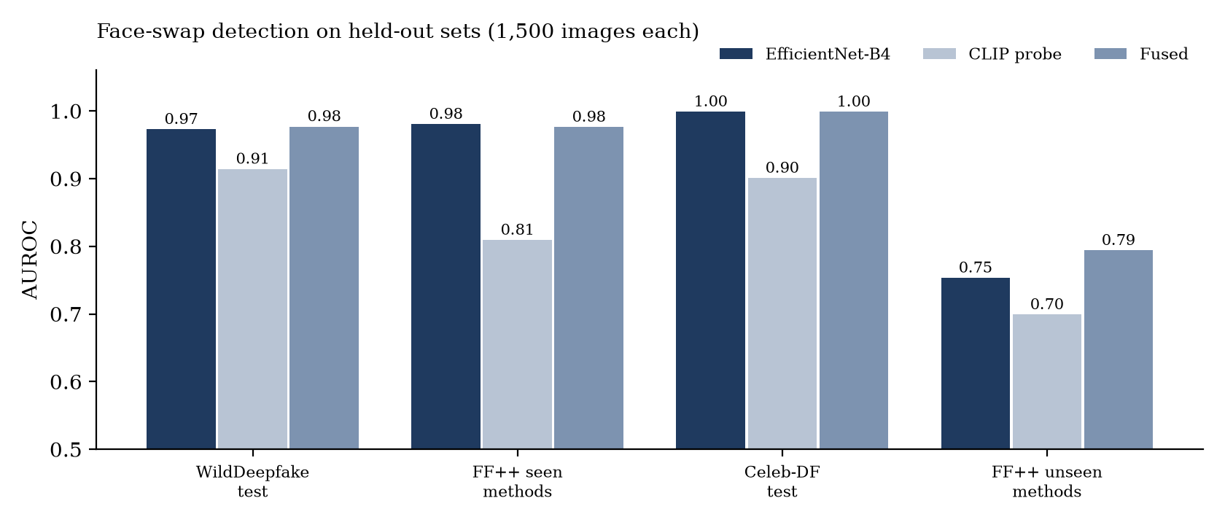
Results: Images
0.976 to 0.999
AUROC on WildDeepfake, FF++ (seen) and Celeb-DF
0.794
AUROC on unseen methods; 13% of fakes caught at 1% false positives
A model trained on WildDeepfake alone scored 0.52 on FF++. Cause: full frames versus face crops, and one training source. Face crops plus a three-dataset mix raised it to 0.98.
Self-blended images, one extra manipulation method and a CLIP-only probe each failed to close the unseen-method gap; fusing CLIP with the CNN gave +0.04.
Notes:
Face-swap detection on four held-out sets, 1500 images each. Seen datasets are strong. The honest result is the last bar: on manipulation methods the system never saw, AUROC is 0.794 and only 13 percent of fakes are caught at one percent false positives. Celeb-DF and FF++ were in the training mix with video-disjoint tests, so only Face2Face and FaceShifter are truly zero-shot.

Slide 14
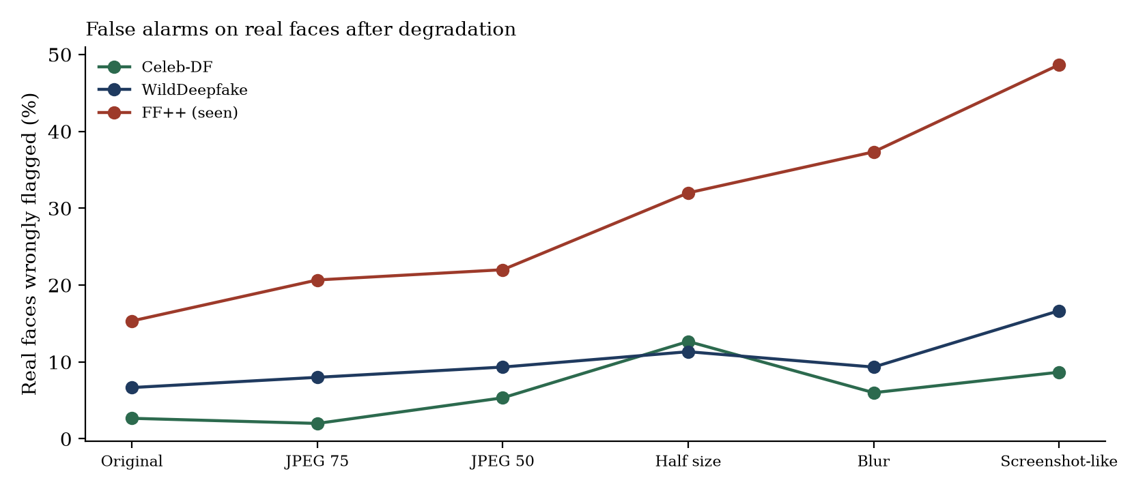
Results: Robustness and Fixes
Problem found | Fix and effect
Text 0.66 on MAGE | Mixed corpora, held-out generators: 0.97
Images 0.52 on FF++ | Face crops, three sources: 0.98
Homoglyph attack 0.72 | Input normalisation: 0.99
Illustration judged authentic | Scope guard, general probe
75% of MAGE referred | Weak tools advisory: 52%
Stale image calibration | Re-scored, refit, benchmarks rerun
Real faces wrongly flagged rise from 3% to 9% (Celeb-DF), 7% to 17% (WildDeepfake) and 15% to 49% (FF++) under screenshot-like damage, while AUROC mostly holds.
A second threshold fitted on degraded calibration images halves false alarms on Celeb-DF (9% to 4%) and WildDeepfake (17% to 8%) for 2 to 4 points of fakes caught. FF++ stays at 37%.
Notes:
To mimic social-media handling we degraded images and re-scored with thresholds unchanged. Ranking quality survives, but false alarms on real faces rise, worst on FaceForensics++. Material that was re-uploaded needs a human check. The table lists the problems the evaluation exposed and their fixes.

Slide 15
Conclusion
JUSTIFICATION OF OBJECTIVES
PLAN FOR THE END-SEMESTER STAGE
End-to-end system built and tested: 81 tests, CI and Docker build green
Calibrated fusion with referral: 92 to 99.6% accuracy on decided cases (text and seen image sets)
Cited, auditable reports with human corrections feeding case memory
Calibrate and benchmark the judges; measure Reflexion
Detect re-uploads and apply the degraded-image threshold
Second unseen synthetic-face set; non-native-English text audit
Retrain the CNN with synthetic faces; test frequency evidence
PDF export of a case; final report
LIMITATIONS WE STATE OPENLY
Unseen deepfake methods reach only 0.794 AUROC. Re-uploaded images raise false alarms. The vision judge missed the demo deepfake (0.05 with 85% confidence), so judge weights are kept low until calibrated. Detection is probabilistic, not proof.
Notes:
Six of seven sub-objectives are complete and evaluation is complete for the local tools. The main finding is methodological: in-domain scores hid collapses on other sources, and diagnosing them was most of the work. We state the limitations ourselves: unseen manipulation methods, re-uploaded images, and judges not yet benchmarked because the free API quota is 20 requests per day.

Slide 16
Reference
A: CITED PAPERS
B: ADDED DURING IMPLEMENTATION
[1] Dugan et al., RAID: A Shared Benchmark for Robust Evaluation of Machine-Generated Text Detectors, ACL 2024
[2] Mitchell et al., DetectGPT, ICML 2023
[3] Hans et al., Spotting LLMs With Binoculars, ICML 2024
[4] Rossler et al., FaceForensics++, ICCV 2019
[5] Zi et al., WildDeepfake, ACM Multimedia 2020
[6] Lewis et al., Retrieval-Augmented Generation for Knowledge-Intensive NLP Tasks, NeurIPS 2020
[7] Zhang et al., Code-in-the-Loop Forensics, arXiv:2512.16300, 2026
[8] Wang et al., LaP-Forensics, arXiv:2607.25962, 2026
[9] Selvaraju et al., Grad-CAM, ICCV 2017
[10] Tan and Le, EfficientNet, ICML 2019
[11] Li et al., Celeb-DF, CVPR 2020
[12] He et al., DeBERTa, ICLR 2021
[13] Radford et al., CLIP, ICML 2021
[14] Shinn et al., Reflexion, NeurIPS 2023
[15] Li et al., MAGE: Machine-generated Text Detection in the Wild, ACL 2024
[16] Yan et al., Corrective Retrieval Augmented Generation, arXiv:2401.15884
Notes:
Cited work. The first eight are from the synopsis; the rest were added during implementation.

Slide 17
Thank You

