Slide 1
🛣️
PAVEMIND · AI
PavemindAI
AI-Powered Pothole Detection
& Road Safety Intelligence Platform
IBM Internship Project
Group 74 · AIML74 · UPES Dehradun
PRESENTED BY ADITYA KHATRI
Notes:
Open with confidence. Say the tagline out loud, then hand over or click to next slide.

Slide 2
01 · THE PROBLEM
Roads are failing faster than they're inspected.
Manual pothole surveying is slow, subjective, and stops the moment someone stops looking.
~2M
9,300+
0
Potholes reported
yearly in India
Road-crash deaths linked
to poor road conditions
Automated way to rank
roads for repair priority
"Cities can't fix what they can't measure. PavemindAI turns any dashcam into a road-condition sensor."
PavemindAI
02 / 11
Notes:
Open with the pain: manual, slow, unquantified. Emphasize there's no ranked list today — municipal teams guess.

Slide 3
02 · OUR SOLUTION
One system. From dashcam to decision.
Three layers, one workflow — detect, grade, and prioritise every pothole automatically.
🎯
📐
📊
DETECT
GRADE
PRIORITISE
Find every pothole
Judge how bad it is
Rank the roads
Custom-trained YOLOv12 model scans image and video, identifying potholes frame by frame with tight bounding boxes.
Each pothole is measured in real-world centimetres and classified as Minor, Moderate, or Severe using a multi-factor score.
A single 0–100 Road Health Score per scan tells maintenance teams which roads to repair first — on an interactive dashboard.
PavemindAI
03 / 11
Notes:
The three pillars. Detect → Grade → Prioritise. Every other slide expands one of these.

Slide 4
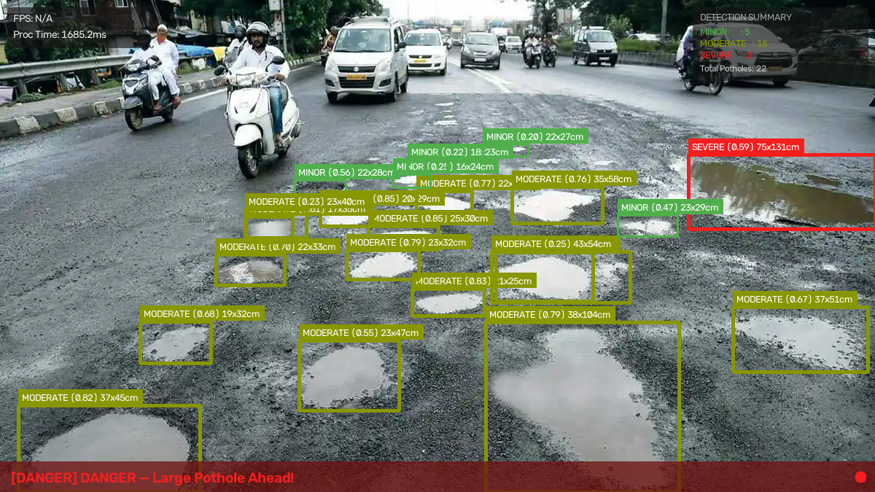
03 · IN ACTION
This is one frame from the system.
22 potholes detected · every one measured in cm · overall alert: DANGER
5
MINOR
16
MODERATE
1
SEVERE
HEALTH
0 / 100
PavemindAI
04 / 11
Notes:
This is the actual output on a real Indian road scene. Point out: each box has severity + cm dimensions. The red banner at bottom is the live driver alert.

Slide 5
04 · ARCHITECTURE
How it works, end to end.
Six steps from raw footage to a live dashboard.
01
02
03
04
05
06
📹
⚡
🤖
📐
🗄️
⚛️
▶
▶
▶
▶
▶
Upload
FastAPI
YOLOv12
Severity
MongoDB
React UI
Image or
video
Backend
receives
Object
detection
Multi-factor
scoring
Persist
results
Live
dashboard
⚙️
Video runs in the background
🛡️
Fails safe with a local fallback
Uploads return instantly — the pipeline processes off-request while the UI polls for progress.
If MongoDB goes down, the system silently switches to local JSON storage and keeps working.
PavemindAI
05 / 11
Notes:
Walk left-to-right through the pipeline. Emphasize the two engineering wins at the bottom.

Slide 6
05 · TECH STACK
Built on production-grade tools.
Chosen for speed to build, speed to run, and speed to demo.
🤖 AI / Vision
⚡ Backend
⚛️ Frontend
YOLOv12-nano
FastAPI
React + Vite
Ultralytics
MongoDB Atlas
Leaflet Maps
ByteTrack
PyMongo
Recharts
OpenCV
imageio + FFmpeg
Framer Motion
NumPy
Python 3.11
Redux Toolkit
PavemindAI
06 / 11
Notes:
Name each stack briefly. If asked why FastAPI, say async background tasks. If asked why YOLO, say single-pass = real-time.

Slide 7
06 · SEVERITY ENGINE
Every pothole gets graded.
Real-world size, shape, model confidence, and how consistently it appears — combined into one score.
MINOR
MODERATE
SEVERE
< 30 cm width
30 – 70 cm width
≥ 70 cm width
Small surface wear — monitor over time, no immediate action needed.
Scheduled maintenance recommended — vehicle wear-and-tear risk.
Immediate repair priority — real hazard to two-wheelers and suspensions.
"Road Condition Good"
"Drive Carefully"
"DANGER — Large Pothole Ahead!"
PavemindAI
07 / 11
Notes:
Three tiers. Emphasize that thresholds are on REAL centimetres, not pixel area — so distance-independent.

Slide 8
07 · THE HEADLINE METRIC
One number that ranks any road.
Turns detections into decisions — the value maintenance teams can actually act on.
HEALTH SCORE FORMULA
EXAMPLE SCORES
Health = 100 − ( 15 × Severe + 6 × Moderate + 2 × Minor )
Good road
94
1 SEVERE costs 15 points — immediate repair
Poor road
62
1 MODERATE costs 6 points — scheduled maintenance
1 MINOR costs 2 points — monitor only
Critical
18
Severe defects weighted super-linearly — one deep pothole outranks many shallow ones for repair priority.
PavemindAI
08 / 11
Notes:
This is the money slide. Say: this number is what makes it actionable — a city can rank 500 roads in one query.

Slide 9
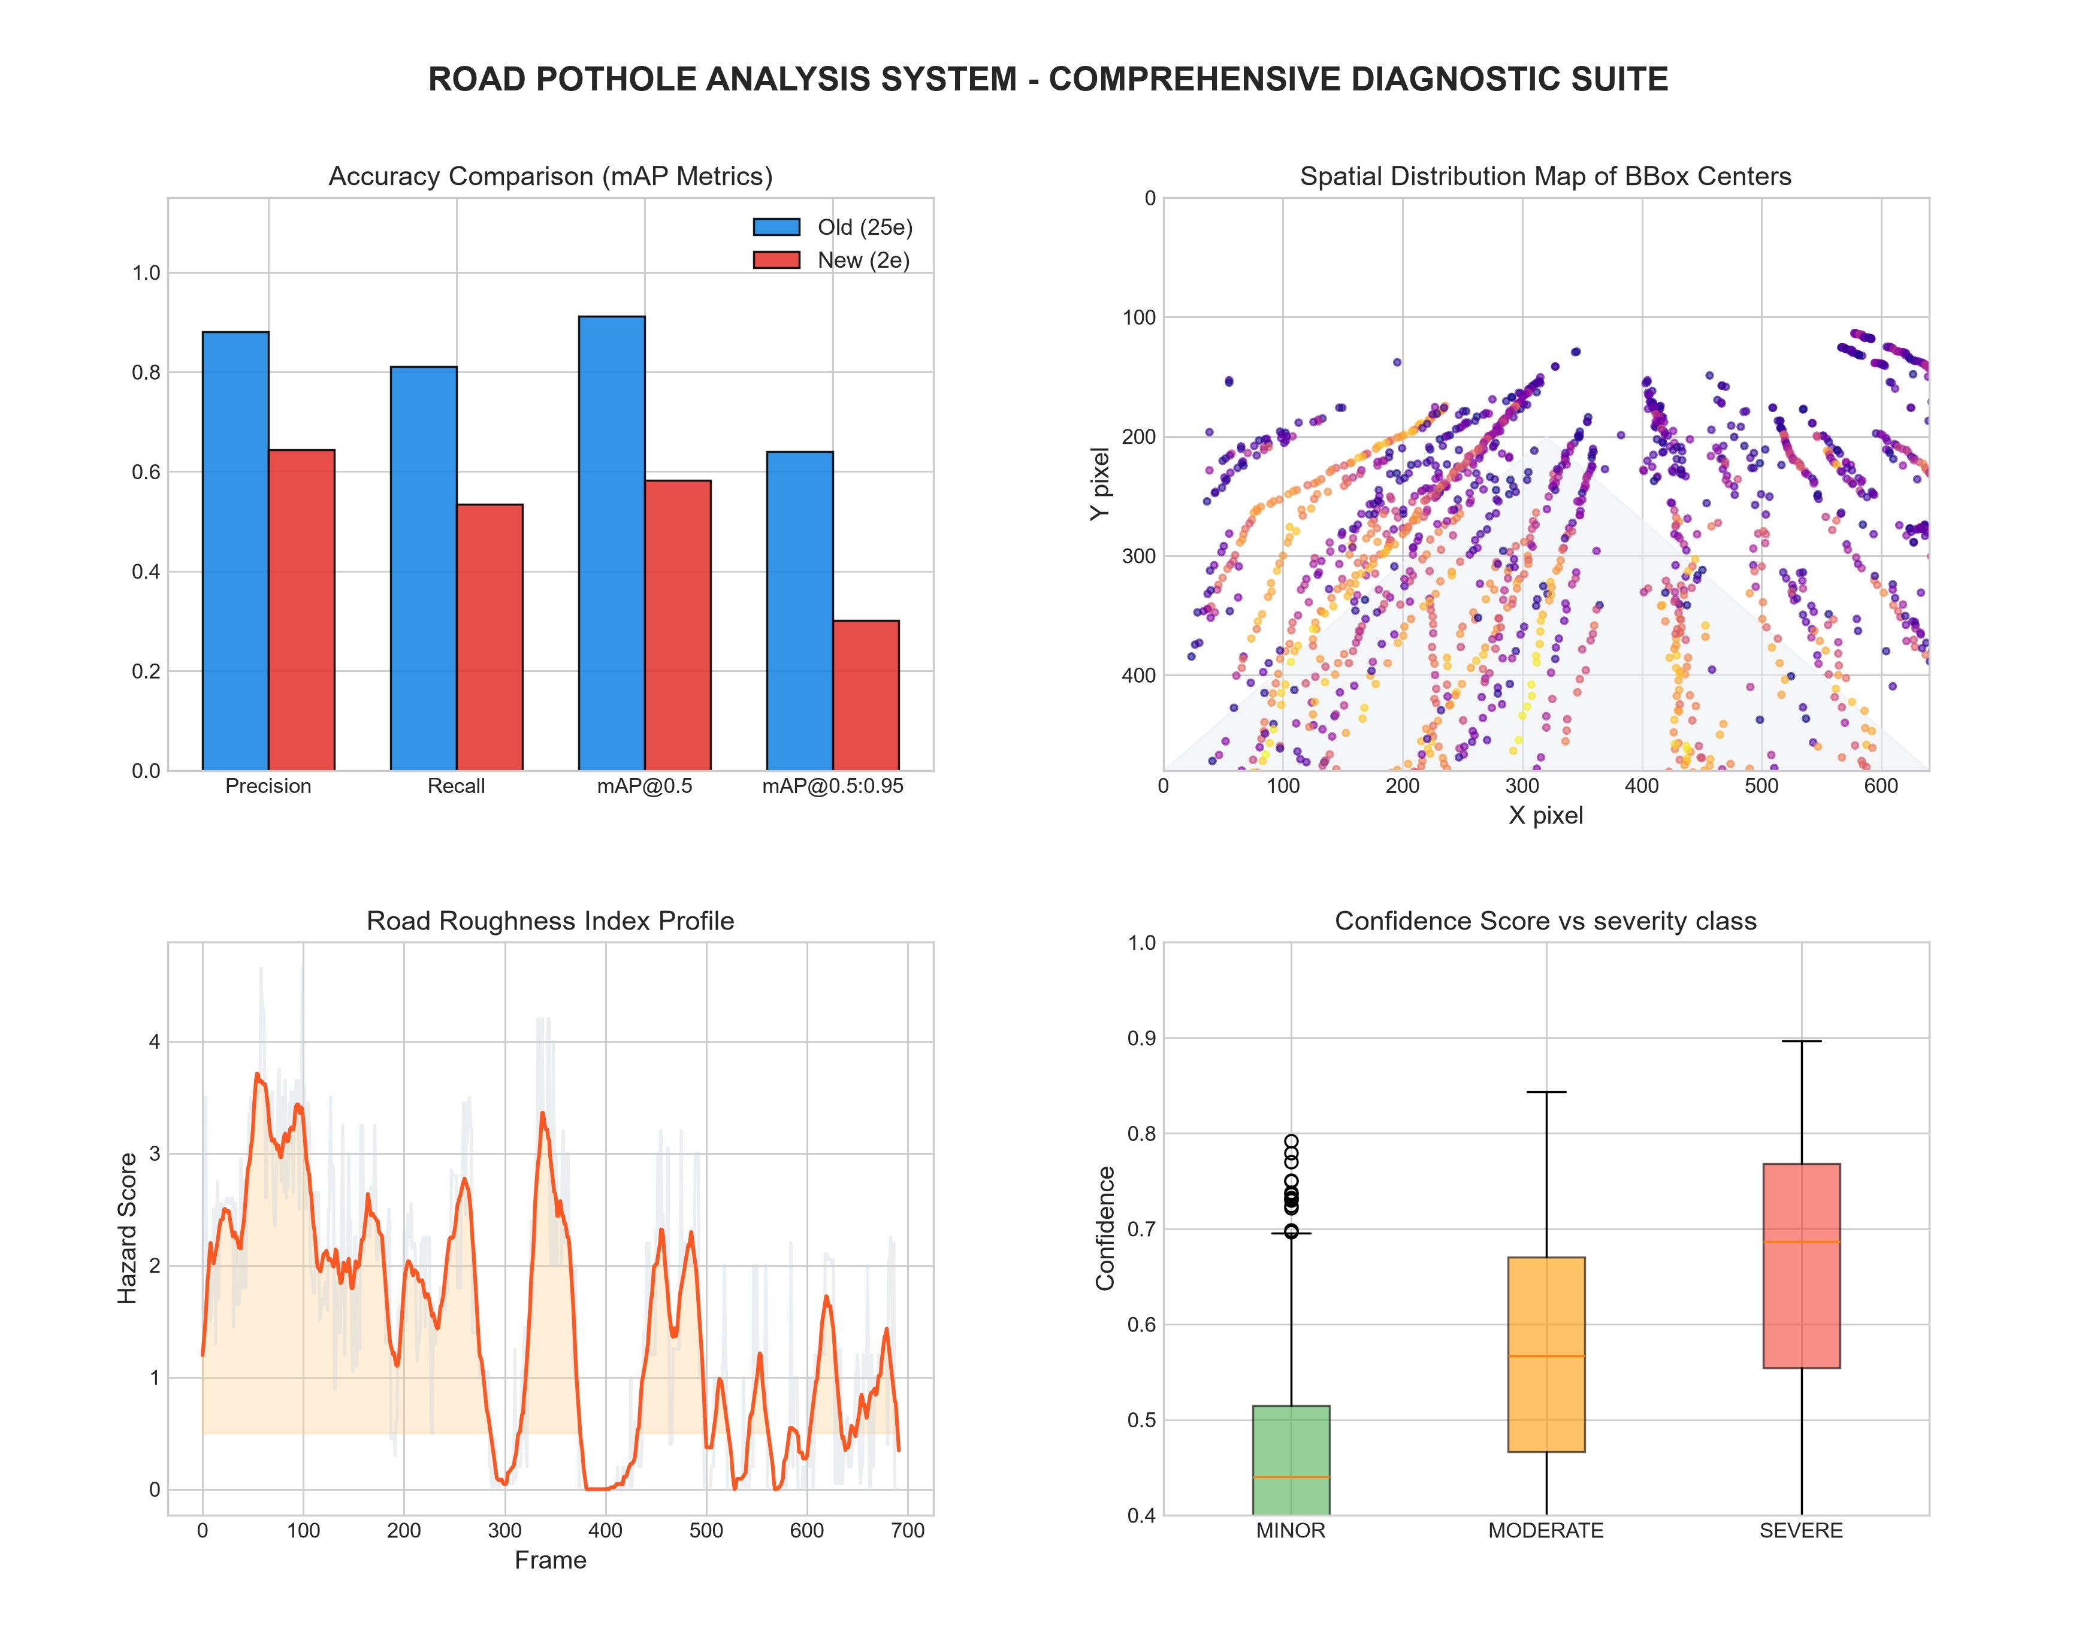
08 · ANALYTICS
Every scan becomes data.
Aggregated model performance, spatial distribution, roughness timeline, and severity–confidence patterns.
📊
Model accuracy
Precision, Recall, mAP@50 & mAP@50-95
🗺️
Spatial map
Where in each frame potholes cluster
📈
Roughness timeline
Per-frame hazard score across the video
📦
Confidence vs class
Model confidence by severity tier
PavemindAI
09 / 11
Notes:
This is a real chart the system generates. Point at each quadrant using the legend on the right.

Slide 10
09 · IMPACT
Who uses this, and how.
A deployment path municipalities can adopt without new hardware.
🏛️
Municipal corporations
Automated survey of every road their vehicles already drive.
WHY IT WORKS
No new hardware.
Any dashcam works.
🚌
Public transit fleets
Dashcams on buses become passive road-condition sensors.
🚧
Maintenance contractors
✓
One vehicle covers km/day — no manual survey
Data-backed priority list replaces guesswork and complaints.
✓
Ranked, quantified priority list — not complaints
🚗
Individual drivers
✓
Historical data — track deterioration over time
Real-time danger alerts on-screen for severe hazards ahead.
✓
Export CSV, JSON, and processed video per scan
PavemindAI
10 / 11
Notes:
Emphasize: zero hardware cost. Just software on top of dashcams that fleets already have.

Slide 11
THANK YOU
Questions?
PavemindAI · Detect. Grade. Prioritise.
IBM Internship · Group 74 · UPES Dehradun
Presented by Aditya Khatri
Notes:
Close on the tagline. Invite questions. Have the dashboard ready to demo live if asked.

