Slide 1
PROJECT REPORT · GROUP PRESENTATION
IBM SkillsBuild Internship | Academic Year 2025–26
PaveMind AI
Intelligent Road Pothole Detection
& Severity Analysis Platform
SUBMITTED BY
Group 74 · AIML · UPES Dehradun
Aditya Khatri · Ujjawal Gupta · Arsh Rathi
PROJECT DOMAIN
Artificial Intelligence & Machine Learning · Computer Vision
Notes:
Cover slide. Introduce yourself, the team, and the project title. Keep it under 20 seconds — hand off to slide 2.

Slide 2
PAVEMIND · AI
01 · INTRODUCTION
02 / 13
The problem, and what we contribute.
Reactive pothole repair — driven by citizen complaints or periodic surveys — leaves defects unaddressed for weeks. PaveMind AI automates the entire loop.
THE PROBLEM
OUR CONTRIBUTIONS
Road inspection today is manual, slow, and unquantified.
Five research contributions.
Reactive cycles. Repairs wait for complaints or scheduled surveys — weeks of delay per defect.
1
Fine-tuned YOLOv12 Nano (2.6 M params) achieving mAP@0.5 of 91.23% on a merged 765-image dataset.
No prioritisation. Municipal teams have no ranked list of which roads need repair first.
2
Camera-geometry-based physical size estimator — no 3D sensor hardware required.
3
Multi-factor severity scoring — size, depth, confidence, aspect, temporal persistence.
No physical measurement. Existing detectors report boxes in pixels, not actionable engineering values.
4
Seven-stage false-positive mitigation pipeline against sky, clouds, tyre tracks, and noise.
No end-to-end system. Published work stops at the model — not deployed, not integrated.
5
End-to-end deployed system — FastAPI + MongoDB + React 19 with GPS heatmap.
Intelligent Road Pothole Detection & Severity Analysis Platform
Group 74 · AIML · UPES Dehradun
Notes:
Speak to both columns: on the left, what's broken today. On the right, our five contributions — these map directly to the abstract of the paper.

Slide 3
PAVEMIND · AI
02 · RELATED WORK
03 / 13
From vibration sensors to real-time object detection.
How pothole detection has evolved — and the gap in existing published systems that PaveMind AI closes.
Early
2015+
2016+
2024
Vibration Sensors
CNN Classifiers
YOLO Family
PaveMind AI
Accelerometers detected road-induced jolts. Effective in controlled conditions but highly sensitive to vehicle suspension and speed — inconsistent across vehicle types.
ResNet and VGG-based sliding-window detectors. Higher accuracy than sensors but inference too slow for real-time dashcam use.
Redmon et al. unified detection and classification into a single forward pass — real-time performance became viable. YOLOv5 → v12 improved accuracy and efficiency.
YOLOv12n + geometric size estimation + severity scoring + end-to-end deployment. Fills the gap: existing work stops at bounding boxes.
GAP IN LITERATURE: Published systems typically address only bounding-box localisation. They do not provide real-world physical dimensions, multi-tier severity classification, or end-to-end deployment.
Intelligent Road Pothole Detection & Severity Analysis Platform
Group 74 · AIML · UPES Dehradun
Notes:
Timeline slide. Speak briefly — the point is the last card: existing YOLO work stops at boxes, we go three layers further.

Slide 4
PAVEMIND · AI
03 · DATASET PREPARATION
04 / 13
Two datasets merged. 765 images, 2,024 pothole instances.
Merged and remapped for diverse road conditions across India, USA, and Japan.
DATA SOURCES
TRAIN / VAL / TEST SPLIT
Source
Images
Annotations
Notes
Kaggle Pothole Dataset
665
~1,350
Varied lighting
CRDDC / RDD2022 (D40)
100
~674
Multi-country
Split
Images
Instances
Avg / img
Train
535
1,386
2.59
Validation
153
438
2.86
MERGED TOTAL
765
2,024
Single class
Test
77
200
2.60
Preprocessing: resize 640×640 · mosaic patching · horizontal flip · HSV jitter · random scaling
Intelligent Road Pothole Detection & Severity Analysis Platform
Group 74 · AIML · UPES Dehradun
Notes:
Point to the merged 765 total. Then to the 70/20/10 split — mention random shuffle before split. 25 epochs on 535 training images.

Slide 5
PAVEMIND · AI
04 · MODEL ARCHITECTURE
05 / 13
YOLOv12 Nano. 2.6 M parameters. 6.3 GFLOPs.
Chosen for its accuracy-to-parameter ratio and CPU-friendly deployment.
Model Variant
Parameters
KEY INNOVATIONS
YOLOv12n
2.56 M
1
Area Attention (A²) Module
Novel spatial attention that partitions feature maps into horizontal and vertical regions — efficient long-range dependency modelling without quadratic self-attention cost.
Nano
2,556,923
2
Reversed ELAN (R-ELAN)
Reversed residual pathway for feature reuse — improves gradient flow and training stability during fine-tuning.
Compute
Input Resolution
6.3
640 × 640
3
Edge-Optimised Design
Nano variant targets consumer-grade CPU and edge deployment while maintaining competitive accuracy across benchmarks.
GFLOPs
pixels
Base weights yolov12n.pt (COCO)
Epochs 25 (patience 5)
Batch 4 (CPU-safe)
Optimizer auto → AdamW
Export PyTorch + ONNX
Intelligent Road Pothole Detection & Severity Analysis Platform
Group 74 · AIML · UPES Dehradun
Notes:
Emphasize small model (2.6M params) but strong accuracy. Mention transfer learning from COCO for fast convergence.

Slide 6
PAVEMIND · AI
05 · METHODOLOGY · FALSE-POSITIVE MITIGATION
06 / 13
A seven-stage validation pipeline.
Raw YOLO output on road footage produces predictable false positives. Six geometric gates + one confidence gate reject them before any downstream analysis.
#
GATE
REJECTION CRITERION
TARGET CLASS
STATUS
1
Confidence
score < 0.45
Shadows, image noise
REJECT
2
Horizon
lower edge y < 40% of frame
Clouds, sky regions
REJECT
3
Sky
upper edge y < 30% of frame
Background hills
REJECT
4
Aspect Ratio
ratio < 0.80 or > 5.00
Tyre tracks, narrow cracks
REJECT
5
Scale
area < 150 px²
Pixel noise, gravel
REJECT
6
Coverage
box area > 25% of frame
Windshield, bonnet
REJECT
7
Validation
passes all above → analyse
— proceeds to severity —
PASS →
EFFICACY: All seven identified false-positive categories were fully eliminated by the gate pipeline in evaluation.
Intelligent Road Pothole Detection & Severity Analysis Platform
Group 74 · AIML · UPES Dehradun
Notes:
Walk down the seven gates. The insight: geometry does what confidence alone cannot. Emphasize the last row — full elimination.

Slide 7
PAVEMIND · AI
06 · METHODOLOGY · MEASUREMENT & SCORING
07 / 13
From pixels to centimetres. From centimetres to severity.
Camera-geometry projection recovers real-world dimensions with no 3D sensor. A weighted score then classifies each detection.
PHYSICAL DIMENSION ESTIMATION
MULTI-FACTOR SEVERITY SCORE
Perspective projection, no depth sensor.
Five signals → one score → three classes.
Given calibrated camera parameters — mounting height, focal length, tilt angle — the system computes distance to each detection and derives physical width and road-plane depth in centimetres.
Physical Size
0.45
estimated width (primary)
Depth Proxy
0.20
road-plane depth
DEFAULT CALIBRATION
Detection Confidence
0.15
YOLO output score
Camera height
1.3 m
typical dashcam mount
Aspect Ratio
0.10
circularity
Focal length
800 px
for 640×640 input
Temporal Persistence
0.10
across frames
Camera tilt
18 °
downwards from horizon
MINOR
MODERATE
SEVERE
All parameters configurable at runtime — no fixed hardware assumption.
< 0.45
0.45–0.70
≥ 0.70
Intelligent Road Pothole Detection & Severity Analysis Platform
Group 74 · AIML · UPES Dehradun
Notes:
Walk left-to-right. Say pinhole geometry once, then move to the 5-factor score. Point at the weight bars.

Slide 8
PAVEMIND · AI
07 · ROAD HEALTH INDEX
08 / 13
One number, 0 to 100. The headline metric.
Aggregates every detection in a scan into a single interpretable score for maintenance prioritisation dashboards.
FORMULA
RHI = max ( 0 , 100 − 15 × N_{severe} − 6 × N_{moderate} − 2 × N_{minor} )
WHY THESE WEIGHTS
EXAMPLE SCORES
INTERPRETATION
▲
15 pts for SEVERE
Good road
94
85 – 100
Excellent
Immediate hazard — vehicle damage, liability
6 pts for MODERATE
62
60 – 84
Acceptable
▲
Poor road
Scheduled maintenance window
30 – 59
Poor
▲
2 pts for MINOR
Critical
18
0 – 29
Critical
Monitor for progression
Intelligent Road Pothole Detection & Severity Analysis Platform
Group 74 · AIML · UPES Dehradun
Notes:
This is the money slide. Emphasize: one number lets a city rank 500 roads in one SQL query. Actionable, not descriptive.

Slide 9
PAVEMIND · AI
08 · END-TO-END SYSTEM ARCHITECTURE
09 / 13
Three layers. One deployable system.
Core analysis engine · REST API backend · React 19 web dashboard.
01
02
03
CORE ANALYSIS ENGINE
REST API BACKEND
WEB DASHBOARD
ML inference & analysis core
8 endpoints, non-blocking pipeline
Premium dark-themed SPA
Python · Ultralytics · OpenCV · NumPy
FastAPI · MongoDB Atlas · ByteTrack · H.264
React 19 · Vite · Leaflet · Recharts
SeverityEngine — filter, estimate, score
Image + video upload with background processing
KPI overview & road-health distribution charts
AlertSystem — dynamic banner generation
ByteTrack multi-object tracking for identity
Image analyzer — multi-file drag-and-drop
AnalyticsManager — JSON, CSV, TXT export
H.264 (yuv420p) output — native browser playback
Video tracker — real-time progress + playback
Visualizer — OpenCV overlay rendering
MongoDB Atlas + transparent local JSON fallback
Leaflet GPS heatmap — severity-coloured markers
Intelligent Road Pothole Detection & Severity Analysis Platform
Group 74 · AIML · UPES Dehradun
Notes:
Three columns = three tiers. Emphasize FastAPI background tasks + MongoDB fallback + React 19 dashboard.

Slide 10
PAVEMIND · AI
09 · EXPERIMENTAL RESULTS · MODEL BENCHMARK
10 / 13
mAP@0.5 of 91.23% at 2.6 million parameters.
Selected 25-epoch configuration versus 2-epoch baseline, evaluated on the held-out test split.
mAP@0.5
mAP@0.5:0.95
Precision
Recall
91.23 %
64.02 %
88.04 %
81.05 %
+56.6% vs 2e
+112.2% vs 2e
+36.6% vs 2e
+51.8% vs 2e
TRAINING BENCHMARK COMPARISON
Metric
Selected (25 epochs)
Baseline (2 epochs)
Improvement
Precision
0.8804 (88.04%)
0.6443 (64.43%)
+36.6%
Recall
0.8105 (81.05%)
0.5342 (53.42%)
+51.8%
mAP@0.5
0.9123 (91.23%)
0.5827 (58.27%)
+56.6%
mAP@0.5:0.95
0.6402 (64.02%)
0.3017 (30.17%)
+112.2%
Avg CPU latency
281.43 ms
279.53 ms
—
Throughput (CPU)
3.55 FPS
3.58 FPS
—
Intelligent Road Pothole Detection & Severity Analysis Platform
Group 74 · AIML · UPES Dehradun
Notes:
Emphasize the mAP@0.5 improvement (+56.6%) with no throughput penalty. Say the 25e model is the deployed production config.

Slide 11
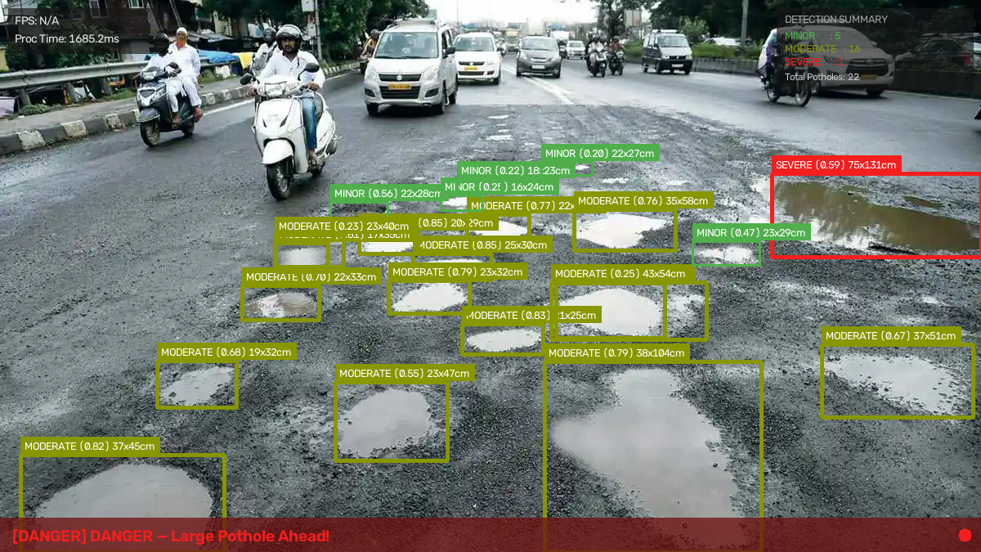
PAVEMIND · AI
10 · LIVE DETECTION PERFORMANCE
11 / 13
In the wild. Real Indian road footage.
692-frame sequence · 2,302 total detections · 5.5 FPS average on CPU.
SEQUENCE STATISTICS
692
frames processed
2,302
total detections
181.9
ms / frame avg
5.5
FPS on CPU
SEVERITY BREAKDOWN
SEVERE
852
37.0%
MINOR
731
31.8%
MODERATE
719
31.2%
Sample frame · 17 potholes detected · widths 30 – 375 cm · overall alert: DANGER
Intelligent Road Pothole Detection & Severity Analysis Platform
Group 74 · AIML · UPES Dehradun
Mean confidence 0.57 · Avg width 73.7 cm
Notes:
Point to real image on left. Emphasize: 17 potholes in one frame, cm dimensions on each. Then the stats: 5.5 FPS on CPU is real-world usable.

Slide 12
PAVEMIND · AI
11 · CONCLUSION & FUTURE SCOPE
12 / 13
Production-grade accuracy on commodity hardware.
PaveMind AI is immediately deployable in municipal road maintenance contexts.
CONCLUSION
FUTURE SCOPE
A lightweight model with a principled pipeline delivers actionable output.
Where PaveMind AI goes next.
1
GPU Inference
Detection accuracy
Deploy on CUDA server for 30+ FPS real-time video.
mAP@0.5 = 91.23%, Precision = 88.04% at just 2.6 M params
2
Monocular Depth
Actionable output
Integrate MiDaS to replace geometric depth approximation.
Camera-geometry estimator gives real-world cm measurements — no 3D sensor
3
Mobile Application
React Native app for field inspection teams.
Full deployment
Road Authority API
REST API, MongoDB persistence, React dashboard — not a notebook
4
Municipal integration with automated SMS / email alerts.
Robust in the wild
5
Cloud Deployment
Seven-stage FP pipeline handles Indian, US, and Japanese road conditions
Vercel + Hugging Face Spaces for public demo access.
Intelligent Road Pothole Detection & Severity Analysis Platform
Group 74 · AIML · UPES Dehradun
Notes:
Close with the four outcomes on the left. If asked about scope, point at the five items on the right.

Slide 13
PAVEMIND · AI
Thank you.
Questions & Discussion
PRESENTED BY
Aditya Khatri · Ujjawal Gupta · Arsh Rathi
Group 74 · AIML · UPES Dehradun · IBM SkillsBuild Internship 2025–26
Notes:
Pause. Invite questions. If asked about anything, refer back to the specific slide.

