Slide 1
PROJECT REPORT · GROUP PRESENTATION
IBM SkillsBuild Internship | Academic Year 2025–26
PaveMind AI
Intelligent Road Pothole Detection
& Severity Analysis Platform
SUBMITTED BY
Group 74 · AIML · UPES Dehradun
Aditya Khatri · Ujjawal Gupta · Arsh Rathi
PROJECT DOMAIN
Artificial Intelligence & Machine Learning · Computer Vision
Notes:
Cover. Introduce team + project title. 15-20 seconds max.

Slide 2
PAVEMIND · AI
01 · THE PROBLEM
02 / 10
Roads fail faster than they're inspected.
Pothole surveying today is reactive, slow, and unquantified — repair decisions rely on complaints and guesswork.
TODAY
TODAY
TODAY
Weeks
Manual
None
typical delay between pothole formation
and any repair action
how road condition is surveyed —
crews driving with clipboards
of the automated tools give a
ranked repair priority list
"Cities can't fix what they can't measure. PaveMind AI turns any dashcam into a road-condition sensor."
Intelligent Road Pothole Detection & Severity Analysis Platform
Group 74 · AIML · UPES Dehradun
Notes:
Set up the pain. Reactive, manual, unquantified. Hand off to the solution.

Slide 3
PAVEMIND · AI
02 · OUR SOLUTION
03 / 10
One system. From dashcam to decision.
PaveMind AI watches road footage and produces an actionable, ranked report of pothole severity — automatically.
01
02
03
DETECT
GRADE
PRIORITISE
Find every pothole
Judge how bad each is
Rank the roads
A deep-learning model scans image and video frame by frame, identifying potholes with tight bounding boxes.
Every detection is classified into three tiers — Minor, Moderate, or Severe — using a combination of visual signals.
Results roll up into a single Road Health Score, shown on an interactive dashboard with GPS maps and analytics.
Intelligent Road Pothole Detection & Severity Analysis Platform
Group 74 · AIML · UPES Dehradun
Notes:
Three pillars. Detect → Grade → Prioritise. Next slides expand each.

Slide 4
PAVEMIND · AI
03 · HOW IT WORKS
04 / 10
The end-to-end pipeline.
From a raw upload to a live dashboard — everything happens automatically.
01
02
03
04
05
06
Upload
Backend
AI Model
Grading
Storage
Dashboard
▶
▶
▶
▶
▶
Image or
video file
Receives &
queues job
Detects
potholes
Assigns
severity
Saves scan
+ results
Displays
live
Runs in the background
Works offline too
Long video jobs don't block the interface — a progress bar updates live.
If the cloud database is unreachable, the system quietly falls back to local storage.
Intelligent Road Pothole Detection & Severity Analysis Platform
Group 74 · AIML · UPES Dehradun
Notes:
Walk left-to-right. Emphasize automation. Don't get pulled into HOW the AI works.

Slide 5
PAVEMIND · AI
04 · TECH STACK
05 / 10
Built on production-grade tools.
Modern stack — deep learning for vision, async Python for the API, React for the interface.
AI & VISION
BACKEND
FRONTEND
YOLOv12 (Ultralytics)
FastAPI
React 19
OpenCV
MongoDB Atlas
Vite
NumPy
PyMongo
Leaflet Maps
PyTorch
imageio + FFmpeg
Recharts
ONNX
Python 3.11
Framer Motion
Intelligent Road Pothole Detection & Severity Analysis Platform
Group 74 · AIML · UPES Dehradun
Notes:
Read the stack briefly. If asked 'why FastAPI' → 'async + auto docs.' Don't over-explain.

Slide 6
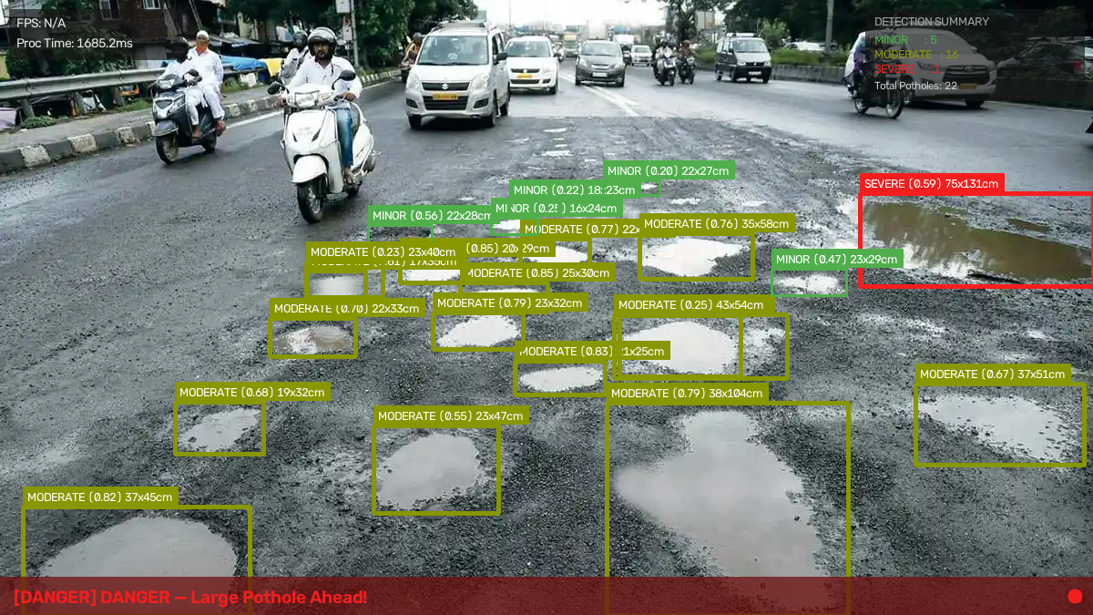
PAVEMIND · AI
05 · IN ACTION
06 / 10
One frame. Every pothole found.
A real Indian road scene — potholes detected, measured, and classified simultaneously.
MODEL ACCURACY
91.23%
mAP@0.5 detection accuracy
DETECTED IN THIS FRAME
SEVERE
1
MODERATE
16
MINOR
5
Sample detection · widths estimated in centimetres · live driver alert banner
Intelligent Road Pothole Detection & Severity Analysis Platform
Group 74 · AIML · UPES Dehradun
Notes:
Point to the image. Many potholes in ONE frame — each with cm measurements. Then the 91% accuracy on the right.

Slide 7
PAVEMIND · AI
06 · SEVERITY CLASSIFICATION
07 / 10
Every pothole gets graded.
Three tiers, three responses — from monitor-only to immediate hazard alert.
MINOR
MODERATE
SEVERE
Small surface wear.
Monitor over time.
Noticeable defect.
Schedule maintenance.
Real hazard.
Immediate repair priority.
"Road Condition Good"
"Drive Carefully"
"DANGER — Large Pothole Ahead"
Intelligent Road Pothole Detection & Severity Analysis Platform
Group 74 · AIML · UPES Dehradun
Notes:
Three tiers. Point to the alert banner. Do NOT get into HOW severity is decided.

Slide 8
PAVEMIND · AI
07 · ROAD HEALTH SCORE
08 / 10
One number that ranks any road.
Every scan produces a Road Health Score between 0 and 100 — the metric maintenance teams can act on.
THE HEADLINE METRIC
SAMPLE SCORES
From detections to decisions.
What a Road Health Score looks like.
Well-maintained road
94
Aggregates every detection in a scan
/ 100
Excellent
The score reflects the total damage across the entire stretch of road.
Wear-and-tear road
62
Severe defects weigh more than minor ones
/ 100
Fair
One deep pothole shifts the score more than several shallow patches — matching real repair priority.
Critical repair needed
18
Makes any two roads instantly comparable
/ 100
Poor
A single number lets a city rank hundreds of roads on one dashboard.
Intelligent Road Pothole Detection & Severity Analysis Platform
Group 74 · AIML · UPES Dehradun
Notes:
Emphasize: one number = actionable. Cities can rank 500 roads at once. DO NOT reveal the exact formula.

Slide 9
PAVEMIND · AI
08 · IMPACT
09 / 10
Who uses this — and how.
A deployment path municipalities can adopt today, without buying any new hardware.
Municipal corporations
WHY IT WORKS
Automated survey of every road their vehicles already drive.
No new hardware.
Any dashcam works.
Public transit fleets
Dashcams on buses become passive road-condition sensors.
Maintenance contractors
Data-backed priority list replaces guesswork and complaints.
One vehicle covers many kilometres per day
Ranked priority list — not citizen complaints
Individual drivers
On-screen alerts for severe hazards ahead in real time.
Historical trend data per road over time
One-click exports: CSV, JSON, processed video
Intelligent Road Pothole Detection & Severity Analysis Platform
Group 74 · AIML · UPES Dehradun
Notes:
Impact slide. Zero hardware cost is the punchline.

Slide 10
PAVEMIND · AI
Thank you.
Questions & Discussion
PRESENTED BY
Aditya Khatri · Ujjawal Gupta · Arsh Rathi
Group 74 · AIML · UPES Dehradun · IBM SkillsBuild Internship 2025–26
Notes:
Pause. Invite questions. If asked something technical you don't want to answer publicly, deflect: 'Great question — happy to walk you through it after the session.'

