Slide 1
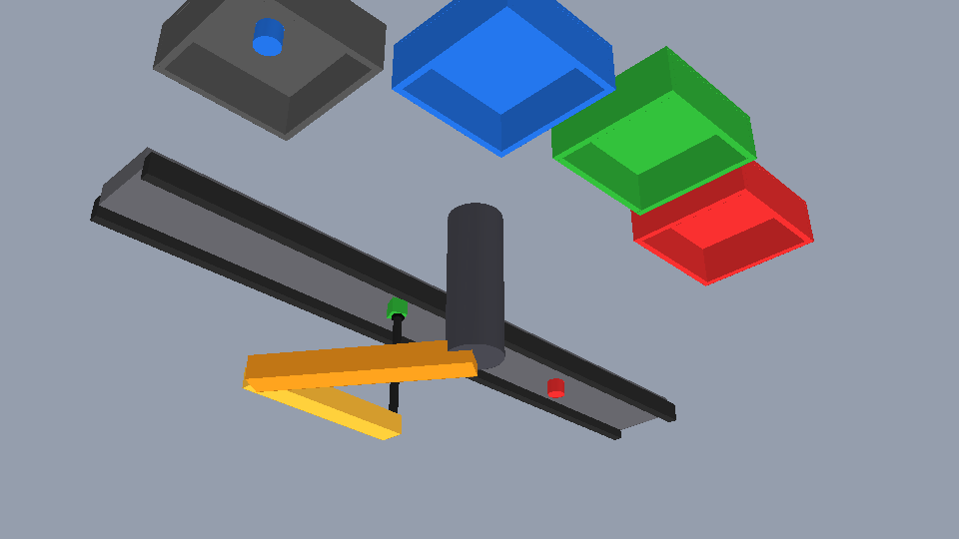
Vision-Guided Sorting Arm on a Conveyor
Presenter: Aditya Khatri
Predictive visual servoing of a SCARA arm: colour and shape sorting in CoppeliaSim
Project P14 | Group G10 | Batch B4 | CSAI4014 Algorithms for Intelligent Systems and Robotics
Member | SAP ID
Aditya Khatri | 500119453
Simran Jeet Gill | 500122195
Divya Israni | 500121919
Amritanshi Singh | 500119477
Anchit Saxena | 500122868
Submitted to: Course Faculty, CSAI4014, School of Computer Science, UPES, Dehradun | October 2026
CSAI4014 AISR | Project P14, Group G10, Batch B4
1
Notes:
Introduce yourself with name and SAP ID. Project P14: vision-guided sorting arm on a conveyor, built in CoppeliaSim (the assigned platform) with Python and OpenCV and cross-checked in MuJoCo.

Slide 2
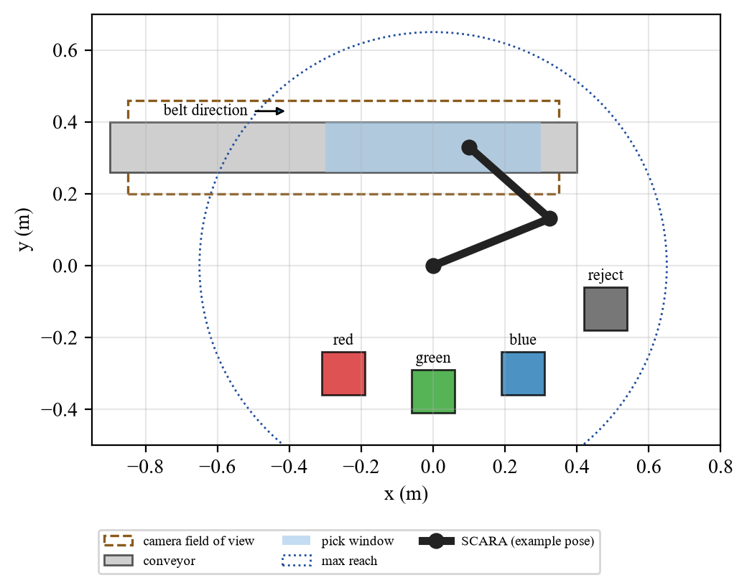
Problem and Motivation
Presenter: Aditya Khatri
• Task: detect parts by colour AND shape on a moving belt; cubes to R / G / B bins, cylinders (wrong shape) to a reject bin
• Domain: quality inspection and sorting in manufacturing
• Hard part: the part moves during the 80 ms camera delay and the arm motion; belt speed ripples
• Today: many cells stop the belt and waste throughput
CSAI4014 AISR | Project P14, Group G10, Batch B4
2
Notes:
Task: the camera must decide colour AND shape. Cubes go to the R/G/B bins, cylinders (wrong shape) go to the reject bin. Domain: quality inspection and sorting in manufacturing. Say why stopping the belt wastes throughput.

Slide 3
Objectives (measurable)
Presenter: Aditya Khatri
# | Objective | Target | Achieved
O1 | Classify colour + shape | >= 99 % at noise <= 25 | 100 % / 100 %
O2 | Grasp error, moving belt | <= 5 mm to 0.35 m/s | 2.7 to 3.4 mm
O3 | Sorting success, robust to ripple | >= 95 % at <= 0.20 m/s | 100.0 %; 15 % ripple 88 %
O4 | Throughput vs stop-and-go | >= 2 x at 0.25 m/s | 2.2 x
O5 | Inspection: wrong accept / reject | <= 0.1 % | 1 of 3213 cylinders, 0 rejects
Assumptions: rendered orthographic camera, suction = attach constraint, kinematic conveyor, 3 colours, 2 shapes, simulation only.
CSAI4014 AISR | Project P14, Group G10, Batch B4
3
Notes:
Read the Achieved column. Five objectives. State the assumptions honestly.

Slide 4
Existing Solutions and the Gap
Presenter: Simran Jeet Gill
Approach | Strength | Limitation
Stop-and-go conveyor | accurate, simple | about half the throughput
Encoder line tracking (FANUC, ABB) | fast, mature | closed software
Visual servoing theory | feedback cancels model error | rarely applied to delayed moving parts
Kalman tracking | optimal estimate | grasp benefit rarely quantified
Gap: no open study that combines tracker + intercept planner + visual servo and compares it with baselines on two physics engines.
CSAI4014 AISR | Project P14, Group G10, Batch B4
4
Notes:
Stop-and-go is accurate but slow, commercial line tracking is closed, visual servoing and Kalman tracking are known but rarely compared on moving, delayed targets. That is our gap.

Slide 5
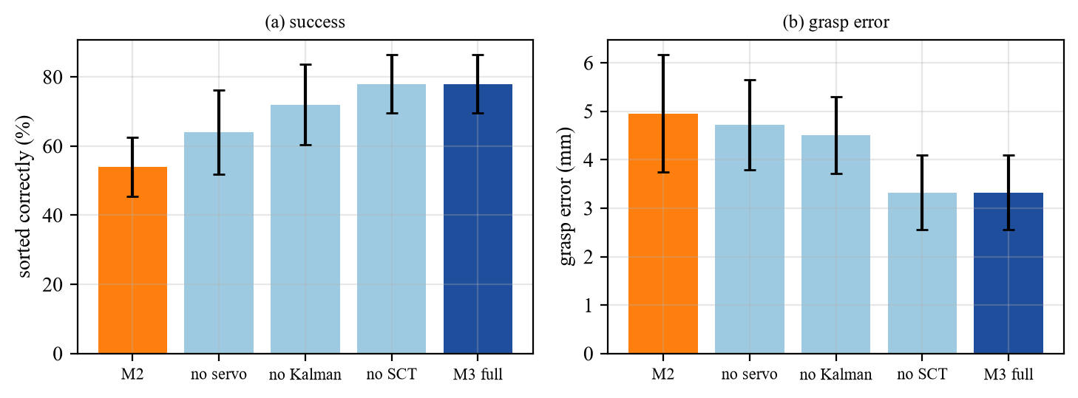
Novelty
Presenter: Simran Jeet Gill
• N1 Visual-servo descent: grasp error 4.7 to 3.3 mm, success 64 to 78 %
• N2 Kalman + encoder: success 70 to 78 % vs line fit (p < 0.001)
• N3 Robust to 15 % ripple: 88 % vs 49 %
• N4 Same code on CoppeliaSim and MuJoCo, 890 + runs
• N5 Negative result: scheduling rule gives no gain
CSAI4014 AISR | Project P14, Group G10, Batch B4
5
Notes:
Five novelty points with numbers. Say the scheduling rule gave no gain: an honest negative result. Mention the 30-seed confirmation study.

Slide 6
Syllabus Mapping
Presenter: Simran Jeet Gill
AISR topic (Project List) | Where it is used
Robotic Perception | vision sensor, HSV colour, contour shape, homography, Kalman tracking
D-H Transformations | D-H table, matrices A1 A2 A3, FK / IK, Jacobian
Closed-Loop Control | joint PID + feedforward, visual-servo descent
Application Domains | quality inspection and sorting in manufacturing
CSAI4014 AISR | Project P14, Group G10, Batch B4
6
Notes:
Use the official four topics of the Project List: Robotic Perception, D-H Transformations, Closed-Loop Control, Application Domains.

Slide 7
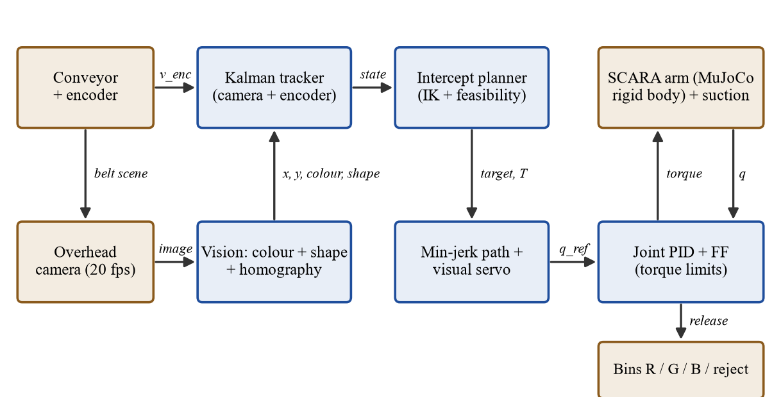
System Architecture
Presenter: Divya Israni
20 fps vision sensor, 80 ms latency, encoder fusion, joint control inside the physics step
CSAI4014 AISR | Project P14, Group G10, Batch B4
7
Notes:
Follow one part from the vision sensor to the bin. Explain encoder fusion and the 80 ms latency.

Slide 8

Robot and Environment Model
Presenter: Divya Israni
• Arm: SCARA, L1 0.35 m, L2 0.30 m, suction tool
• D-H: table + matrices, closed-form IK
• Physics: CoppeliaSim (Bullet), torque limits 45 / 18 N m
• Belt: 0.05 to 0.35 m/s, 3 % ripple
• Parts: 75 % cubes, 25 % cylinders
CoppeliaSim scene during the descent
CSAI4014 AISR | Project P14, Group G10, Batch B4
8
Notes:
Arm L1 0.35 m, L2 0.30 m, rigid-body physics with torque limits. Parts: 75 percent cubes, 25 percent cylinders. CoppeliaSim scene on the right.

Slide 9
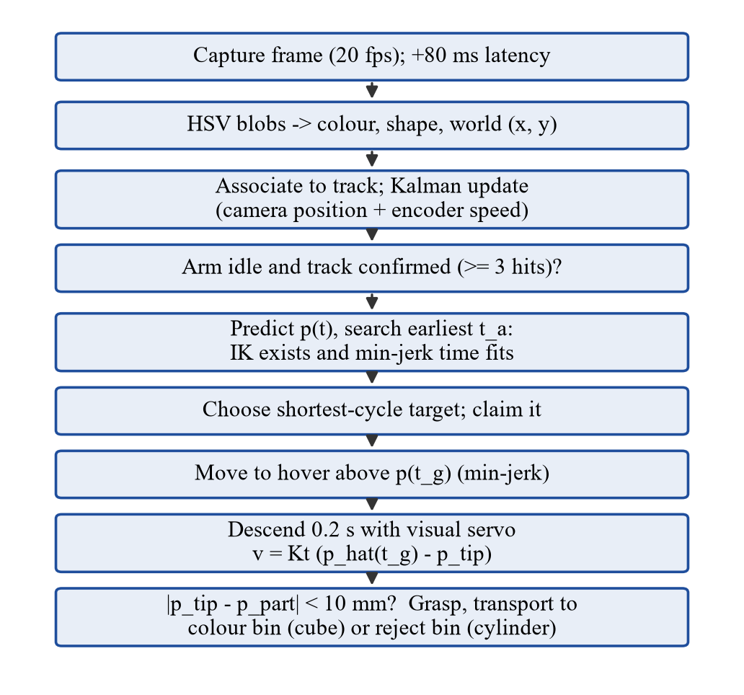
Algorithm 1: Intercept Planning
Presenter: Divya Israni
• Predict: p(t) = p_hat + v_hat (t - t_f), compensates 80 ms
• Search: earliest t_a with IK solution and min-jerk time T <= available
• Select: shortest cycle among feasible targets
• Skip: parts that cannot be reached in time
CSAI4014 AISR | Project P14, Group G10, Batch B4
9
Notes:
Explain the flowchart: predict, find the earliest feasible intercept time with inverse kinematics and minimum-jerk time, pick the shortest cycle. Parts that cannot be reached in time are skipped.

Slide 10
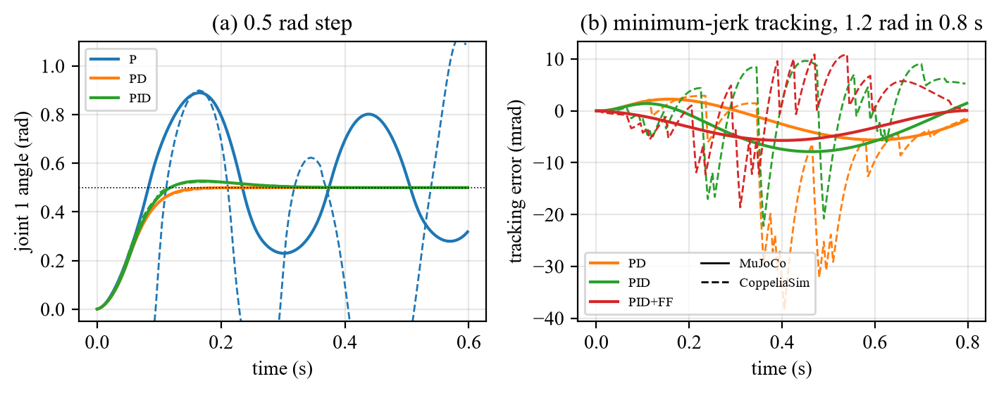
Algorithm 2 and Controller Design
Presenter: Amritanshi Singh
• Servo: v_cmd = Kt (p_hat(t_g) - p_tip), dq = J^-1 v_cmd
• PID: wn = 50 rad/s, zeta = 1, Ki = 0.2 Kp wn
• FF: J_n q_r'' + B_n q_r' cuts the PID tracking error by 28 %
• In CoppeliaSim: PID + FF runs in a joint-callback script
Max tracking error (MuJoCo arm): PID 7.9 mrad, PID + FF 5.7 mrad
CSAI4014 AISR | Project P14, Group G10, Batch B4
10
Notes:
The visual servo aims at the predicted contact point, not the present position. Gains from natural frequency 50 rad/s and damping 1. In CoppeliaSim the PID runs in a joint callback script.

Slide 11
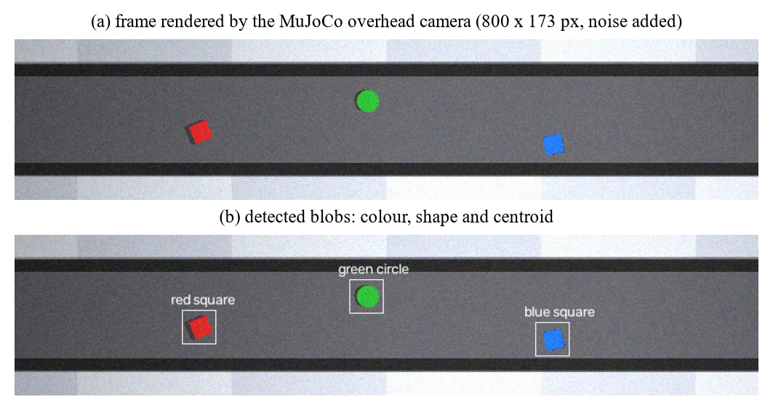
Simulation Setup
Presenter: Amritanshi Singh
• Platform: CoppeliaSim V4.10 (assigned) + Python + OpenCV
• Second engine: same code on MuJoCo for the large statistics
• Run: python demo_cs.py
• Check: success = part physically in its bin
Vision-sensor frame and detections
CSAI4014 AISR | Project P14, Group G10, Batch B4
11
Notes:
Platform and commands. Show the vision-sensor frame with colour and shape labels. Mention the physical sorting check and the unit tests.

Slide 12
Live Demonstration
Presenter: Amritanshi Singh
Switch to CoppeliaSim now
• Run: python demo_cs.py
• Show: arm waits ahead, descends while tracking; cubes to colour bins, cylinders to reject bin
• Compare: --method m2 --speed 0.3 shows misses
CSAI4014 AISR | Project P14, Group G10, Batch B4
12
Notes:
Run python demo_cs.py live. Point out: arm waits ahead of the part, descends while correcting, cubes into colour bins, cylinders into the reject bin. Then run --method m2 --speed 0.3 to show misses.

Slide 13
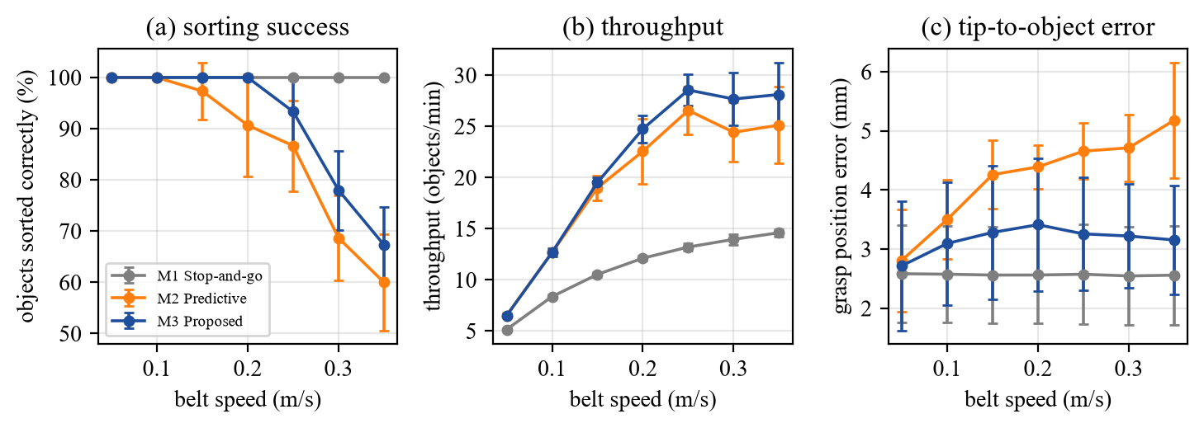
Results 1: Speed Study
Presenter: Anchit Saxena
M3: 2.7 to 3.4 mm grasp error, 2.2 x the throughput of stop-and-go at 0.25 m/s. Above 0.25 m/s one arm cannot serve every part.
CSAI4014 AISR | Project P14, Group G10, Batch B4
13
Notes:
Stop-and-go is 100 percent but slow. M3 keeps about 3 mm error. Above 0.25 m/s one arm cannot serve all parts: capacity limit, not accuracy.

Slide 14
Results 2: Comparison of Methods
Presenter: Anchit Saxena
Method (0.25 m/s) | MuJoCo success % | CoppeliaSim success % | Grasp error mm
M1 stop-and-go | 100 | 100 | 2.6
M2 predictive | 87 | 85 | 4.7
M3 proposed | 93 | 95 | 3.3
• Ripple 15 %: M3 88 % vs M2 49 % (30 seeds: p < 0.001)
• Ablation: M2 55, no servo 67, no Kalman 70, full 78 %
• Both engines: same ranking M3 > M2
CSAI4014 AISR | Project P14, Group G10, Batch B4
14
Notes:
Table compares methods on both engines. Ripple, ablation and p-values from the confirmation study. Same ranking on CoppeliaSim and MuJoCo.

Slide 15
Team Contribution
Presenter: Anchit Saxena
Member | Technical module
Aditya Khatri | SCARA kinematics, D-H, CoppeliaSim and MuJoCo cells, visual servo
Simran Jeet Gill | Vision sensor image, HSV detector, shape classifier, homography
Divya Israni | Kalman tracker, intercept planner, ablation
Amritanshi Singh | PID + feedforward, joint callback, tuning, step tests
Anchit Saxena | Experiments, stop-and-go baseline, renders, live demo
CSAI4014 AISR | Project P14, Group G10, Batch B4
15
Notes:
Each member states their own technical module and the files they wrote. Every claim is traceable to commits and to the video.

Slide 16
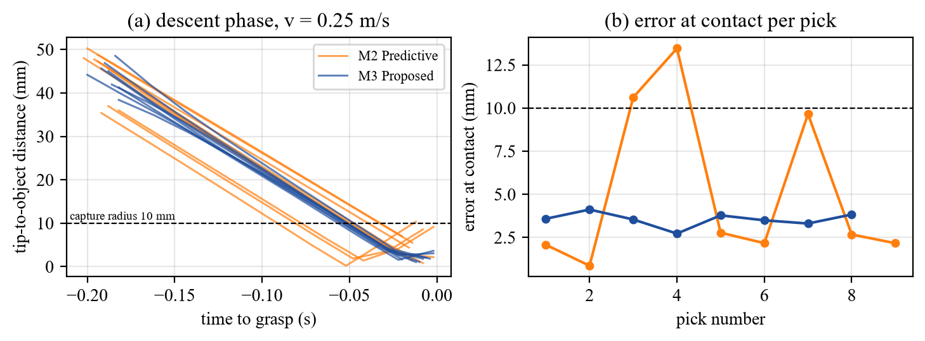
Conclusion and Industry Use
Presenter: All members
• Findings: visual servo and Kalman both help; scheduling did not
• Domain: quality inspection and sorting in manufacturing
• Real robot: triggered camera, hand-eye calibration, vacuum delay
• Future: second arm, learned detector, ROS and real-arm test
• Team: we taught each other our modules
Same trial: M2 has misses above 10 mm, M3 none
CSAI4014 AISR | Project P14, Group G10, Batch B4
16
Notes:
Findings, industry use, transfer to a real robot, future work. Say what the team learned together.

Slide 17
Thank You
Presenter: All members
Questions?
GitHub: https://github.com/Aditya-Khatri-7/Robotics-assignment-project-b4
E-mails (@stu.upes.ac.in): aditya.119453, simran.122195, divya.121919, amritanshi.119477, anchit.122868
Group G10 | Aditya Khatri, Simran Jeet Gill, Divya Israni, Amritanshi Singh, Anchit Saxena
CSAI4014 AISR | Project P14, Group G10, Batch B4
17
Notes:
Thank the audience, show the GitHub link and take questions. Every member should be ready to answer about the whole project.

