Slide 1
PROJECT TITLE : Secure Data Hiding in Images Using Steganography
CAPSTONE PROJECT
Presented By:
Aditya Nath Deepak
College Name & Department : Vishwakarma Institute Of Technology , Pune - Computer Engineering (Dept.)

Slide 2
OUTLINE
Problem Statement
Technology used
Wow factor
End users
Result
Conclusion
Git-hub Link
Future scope

Slide 3
Problem Statement
With the increasing need for secure digital communication, traditional encryption methods can attract unwanted attention and become susceptible to attacks. This project introduces a steganography-based approach that embeds secret messages within images, ensuring secure and covert data transmission. By leveraging image processing techniques, the hidden message remains undetectable to unauthorized users while preserving the image's visual integrity. This project aims to provide a steganography-based approach to hide secret messages inside images, ensuring secure and undetectable communication.

Slide 4
Technology used
This project is developed using Python and utilizes the OpenCV library for image processing. OpenCV allows efficient reading, modifying, and writing of image files, enabling the seamless embedding and extraction of hidden messages. The project runs on Windows/Linux platforms and requires minimal computational resources.
Programming Language: Python
Libraries: OpenCV (for image processing) , OS , String .
Platform: Windows/Linux

Slide 5
Wow factors
Undetectable Communication: Unlike traditional encryption, steganography ensures messages remain hidden within images without raising suspicion.
Secure Passcode Protection: The embedded message can only be retrieved using the correct passcode, adding an extra layer of security.
No Noticeable Distortion: The original image appears unchanged to the human eye, maintaining its quality while carrying hidden data.
Stealthy Communication: Hidden messages are seamlessly embedded within images, making them undetectable.
Passcode Protection: Only users with the correct passcode can extract the hidden message.
Preserved Image Quality: The encryption does not cause noticeable distortion in the image.

Slide 6
End users
This project benefits individuals and organizations requiring secure data transmission:
Cybersecurity Experts: Professionals who need covert data communication.
Government & Military Agencies: Secure exchange of classified information.
Journalists & Activists: Protection of sensitive communications.
General Users: Anyone requiring private communication without detection.
Cybersecurity experts
Organizations dealing with confidential data
Individuals requiring private and secure communication

Slide 7
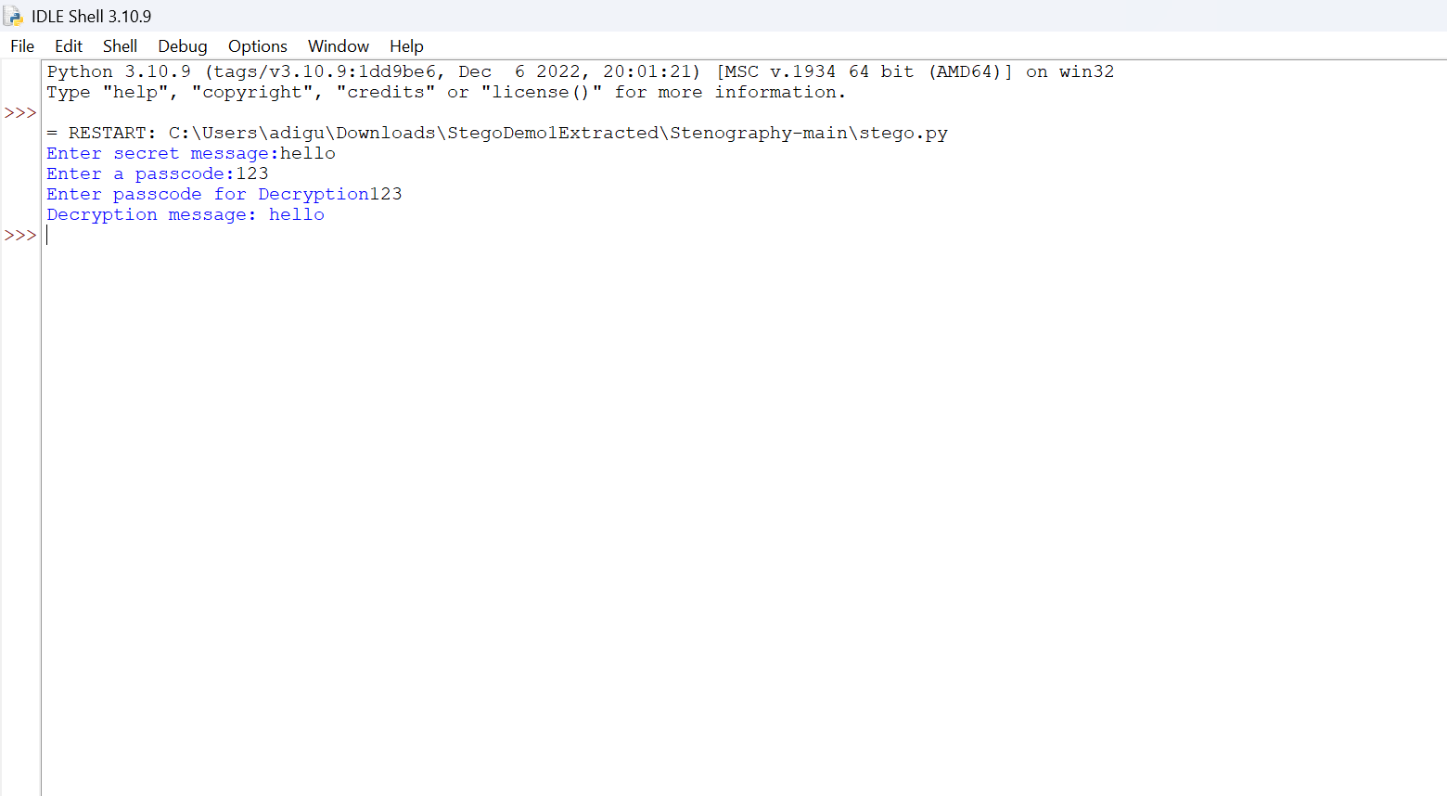
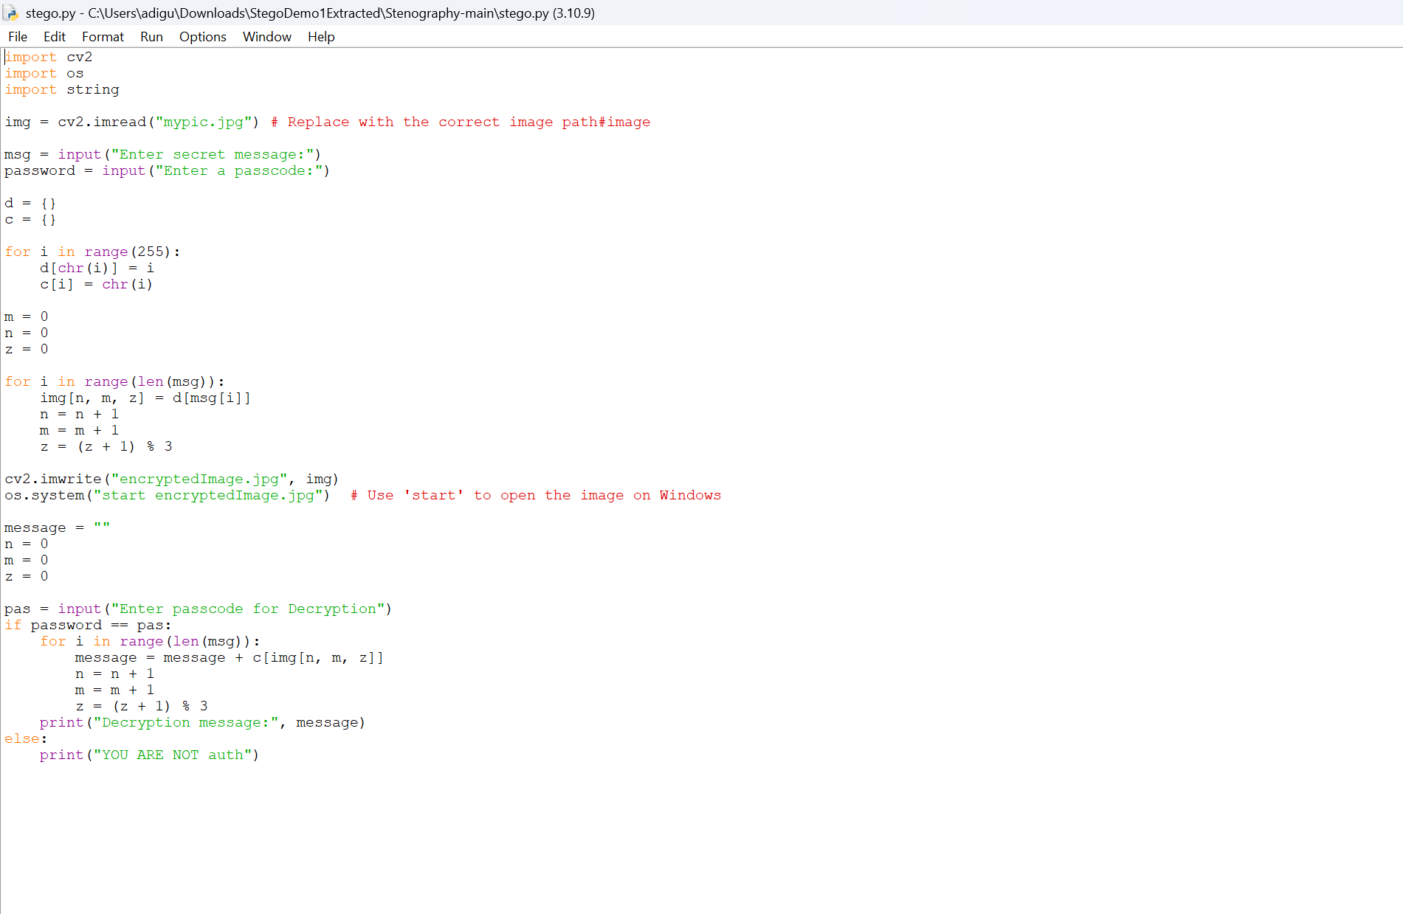
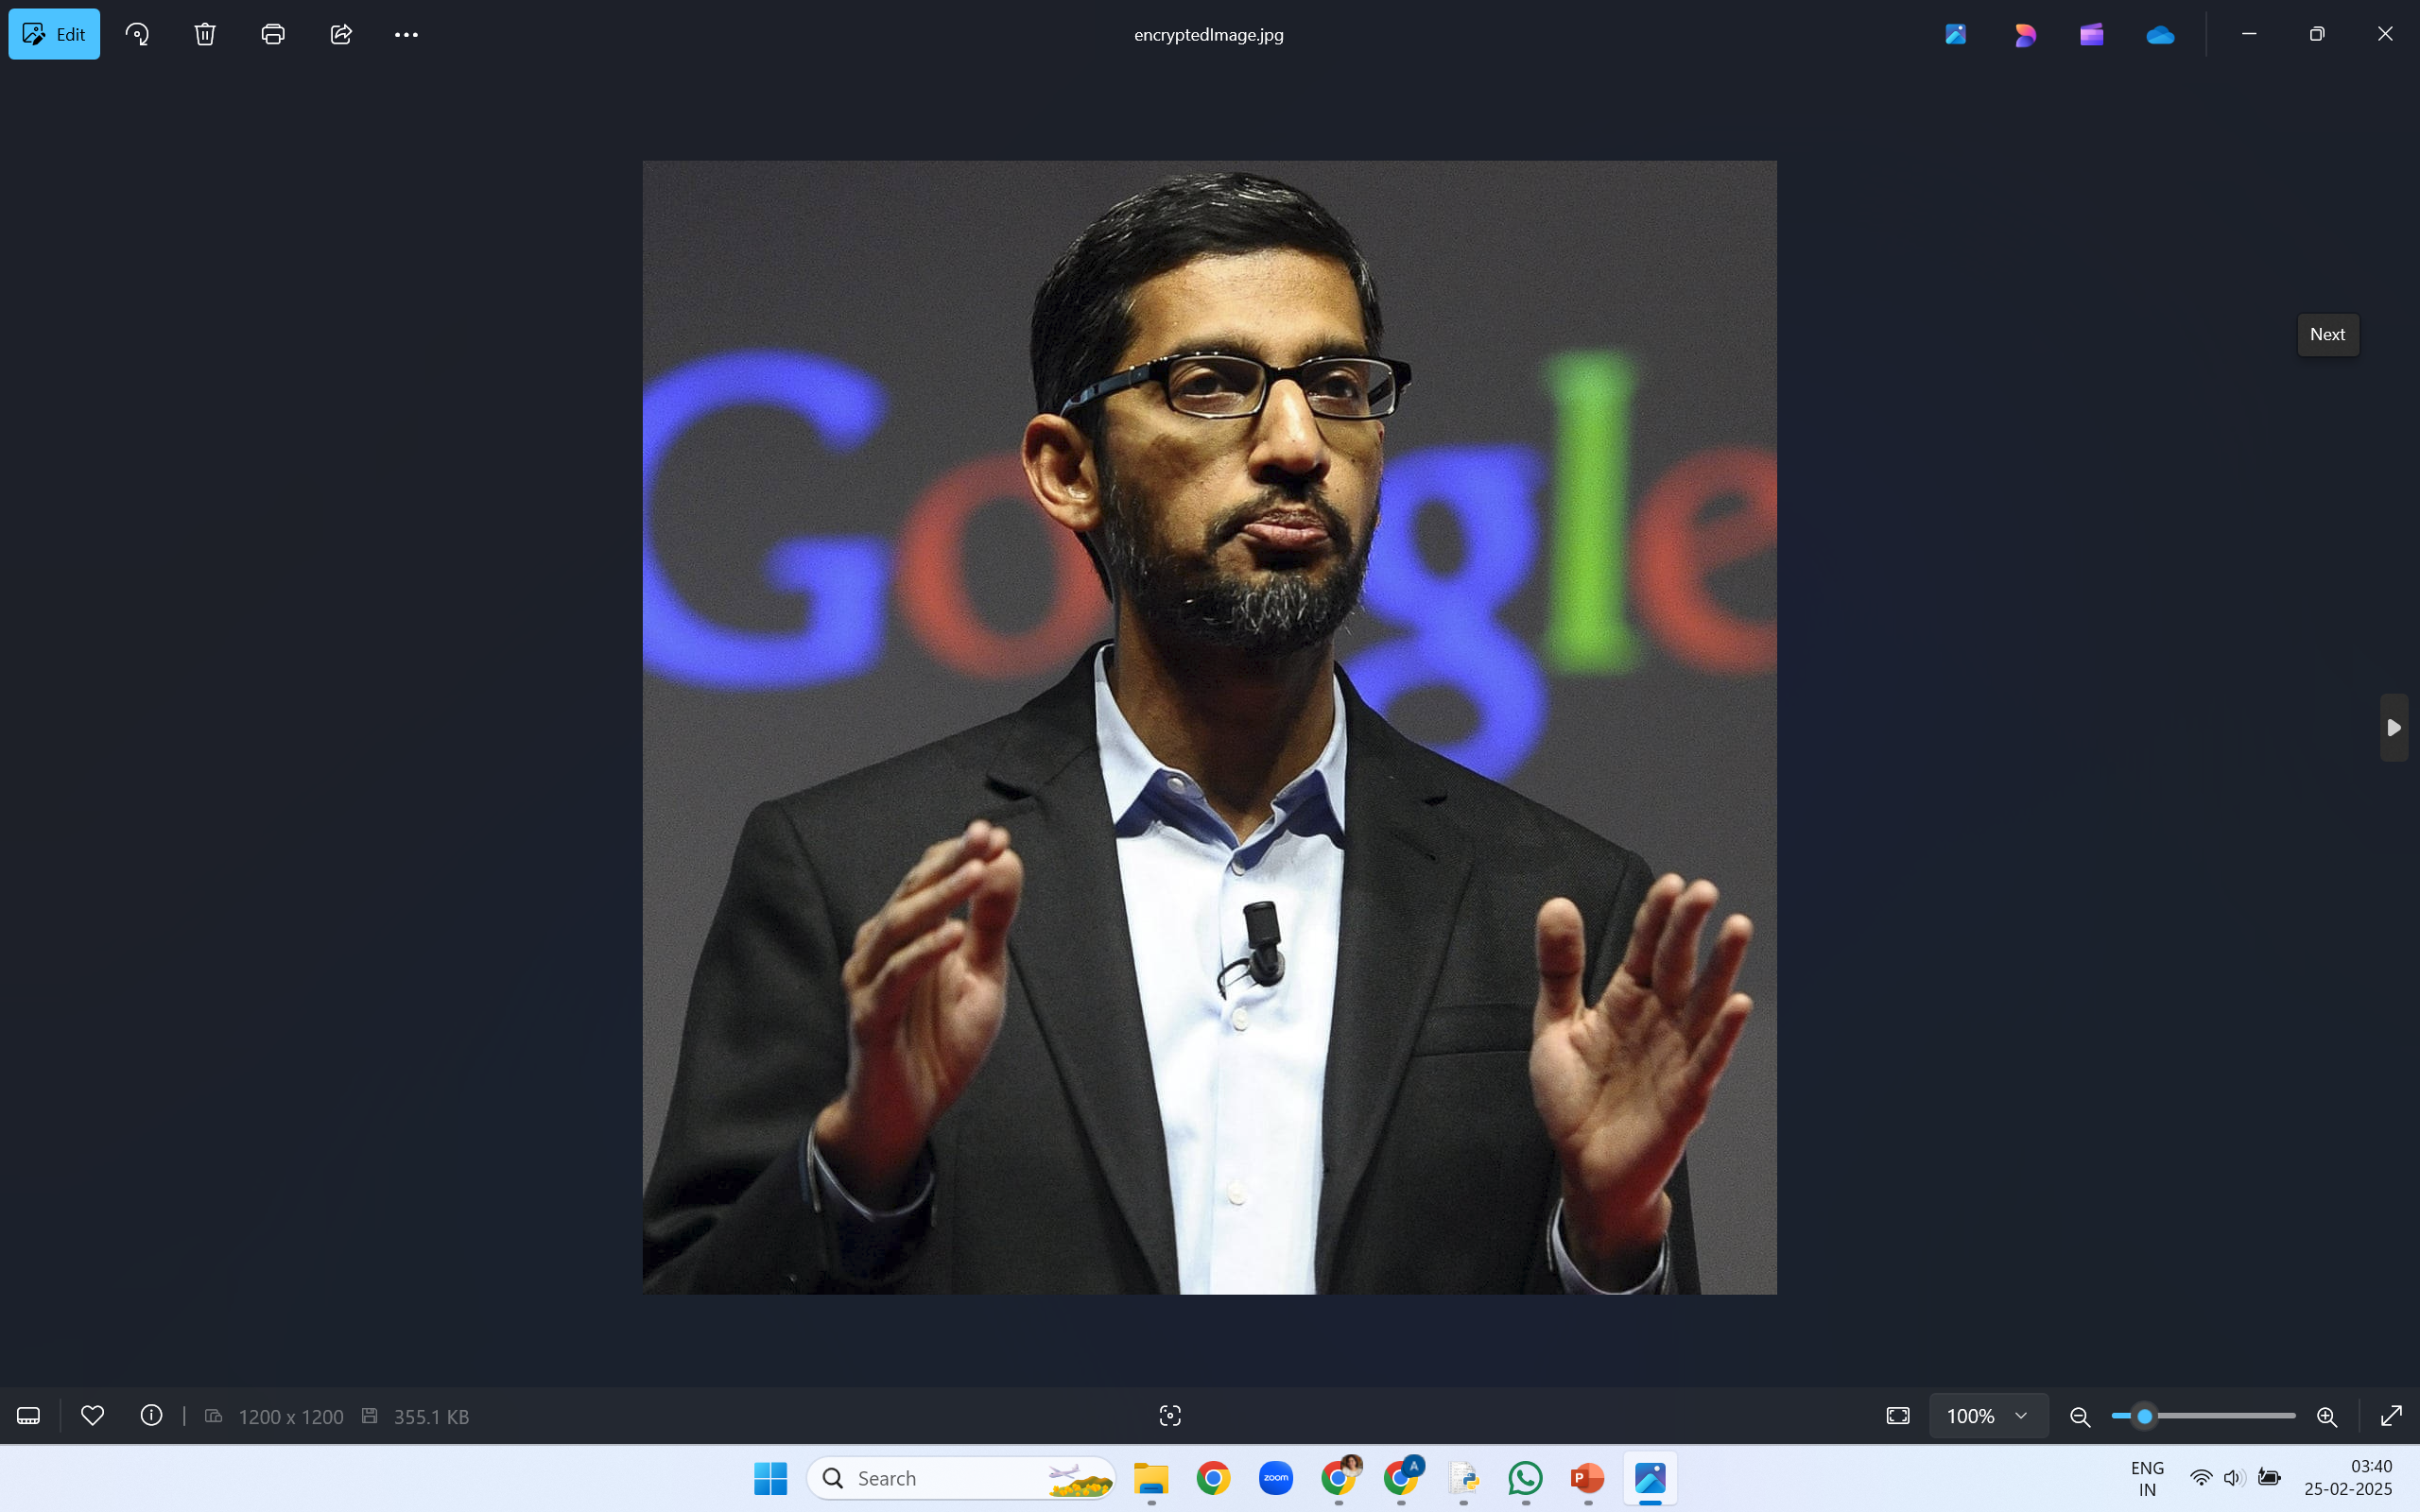
Results (screenshots)
Output image
Code image
Output Encrypted Image

Slide 8
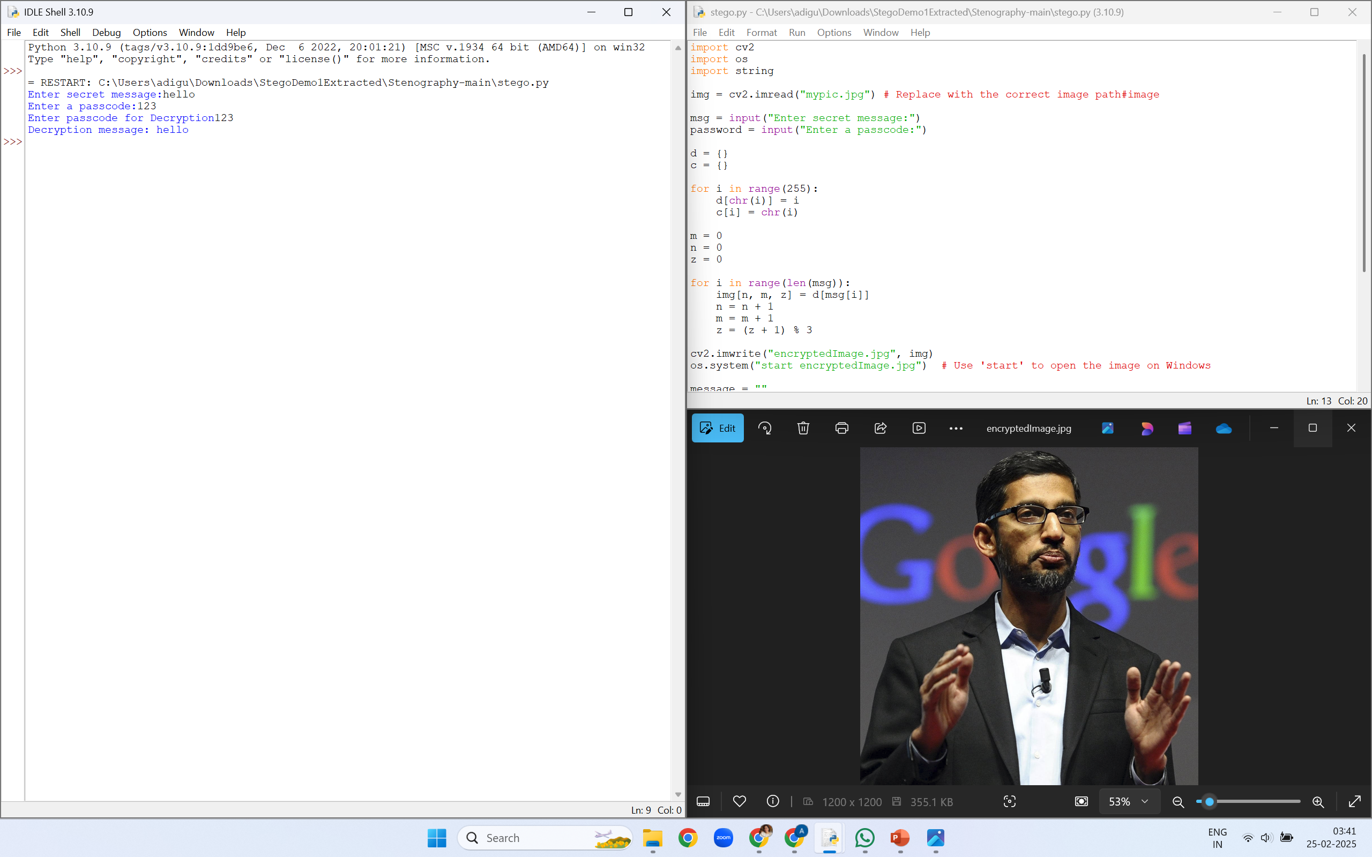
Results (screenshots)

Slide 9
Conclusion
This project demonstrates how steganography can be effectively used for secure data transmission. By embedding text within image pixels, it allows covert communication without raising suspicion. The integration of OpenCV ensures seamless processing, making it a practical approach to modern cybersecurity challenges. This project demonstrates how steganography can be effectively used for secure data transmission. By embedding text within image pixels, it enables covert communication without raising suspicion. The integration of OpenCV ensures seamless processing and accessibility.

Slide 10
GitHub Link
https://github.com/Aditya-Nath-Deepak/Aicte_Stego_Project.git
A README file has been created too.

Slide 11
Future scope
Expanding support for various image formats (PNG, BMP, GIF).
Implementing advanced encryption techniques for added security.
Developing a user-friendly graphical interface for non-technical users.
Extending the project for use in mobile and cloud-based applications.
Expanding support to multiple image formats (PNG, BMP, etc.)
Implementing advanced encryption techniques for added security
Developing a user-friendly GUI for broader adoption
Extending functionality for mobile applications

Slide 12
THANK YOU

