Slide 1

INFO 5100 Application Engineering and Development
MediLink Seamlessly Connecting Healthcare Services Through a Unified Digital Ecosystem
Team Members: Aditya Pimpalkar: 002060468 (pimpalkar.a@northeastern.edu)
Diksha Sahare: 002479925 (sahare.d@northeastern.edu)
Komal Khairnar: 002472617 (khairnar.ko@northeastern.edu)

Slide 2
Project Overview
MediLink is a role-based healthcare ecosystem designed to seamlessly connect hospitals, ambulance services, diagnostics, and pharmacies into a unified digital platform.
It offers an intuitive interface to manage patient data, appointments, and medical records across multiple enterprises, ensuring smooth operations and communication between healthcare providers.
The ambulance service component facilitates real-time tracking, efficient allocation, and safe transportation of patients to and from healthcare facilities.
The diagnostics module streamlines medical testing and laboratory services, including scheduling and report generation.
The pharmacy module provides a robust inventory management system to ensure timely availability of medications.
MediLink integrates advanced security features to safeguard sensitive patient information against unauthorized access.
By creating a centralized, scalable system, MediLink enhances operational efficiency and elevates patient satisfaction.

Slide 3
Problem Statement
The healthcare ecosystem faces significant challenges that impede its efficiency, coordination, and service quality for patients, providers, and administrators.
For Patients:
Fragmented Access: Difficulty connecting with essential services like ambulances, diagnostic labs, and pharmacies.
Inefficient Communication: Disconnected platforms result in delays in receiving timely care.
Lack of Transparency: Uncertainty about service availability, costs, and timelines affects decision-making.
For Healthcare Enterprises:
Resource Management Bottlenecks: Challenges in assigning personnel and managing inventory across organizations.
Operational Gaps: Lack of visibility into system-wide operations reduces efficiency and accountability.
Inconsistent Interactions: Manual and error-prone communication between enterprises, such as hospitals and pharmacies.
These issues collectively impact the quality of care delivery, causing delays, inefficiencies, and reduced patient satisfaction.

Slide 4
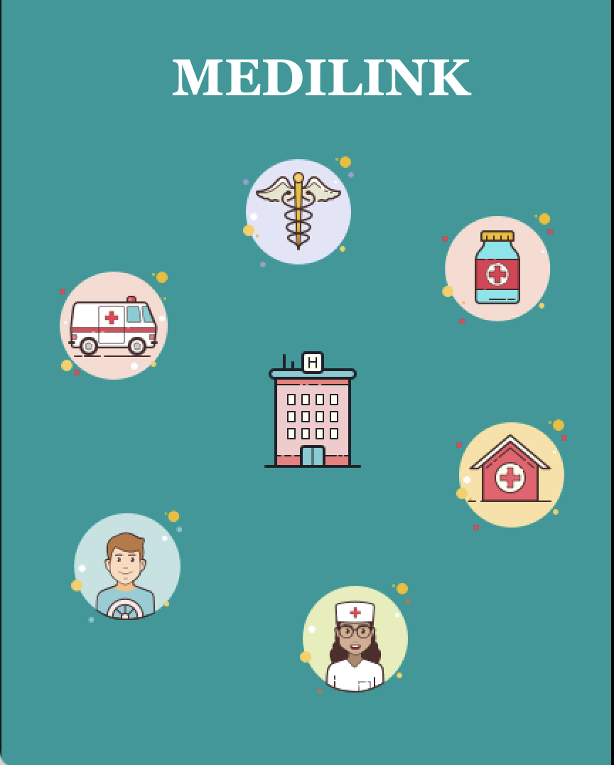
Solution
MediLink is a robust, role-based healthcare ecosystem designed to:
Streamline operations: Unify hospitals, diagnostics, emergency services, and pharmaceuticals.
Enhance patient experiences: Provide seamless access to healthcare services through a centralized platform.
Foster collaboration: Enable real-time communication and coordination across healthcare stakeholders.
Core Features:
Centralized Platform: Connects all healthcare stakeholders for real-time collaboration.
Role-Specific Dashboards: Tailored workflows for administrators, technicians, and service providers.
Efficient Resource Allocation: Automates ambulance assignments, diagnostic scheduling, and pharmacy orders.
Transparency and Trust: Provides patients with visibility into services, costs, and timelines for informed decisions.
Scalable Infrastructure: Designed to support expanding roles and organizations, adapting to growing healthcare needs seamlessly.
MediLink ensures a unified, efficient, and patient-centric healthcare ecosystem, bridging the gaps in care delivery and enhancing outcomes for all stakeholders.

Slide 5
Significance and role of enterprises
Emergency Services Enterprise
The Emergency Services enterprise plays a pivotal role in the MediLink ecosystem by providing timely and reliable medical transportation during emergencies. It ensures:
Real-time Monitoring: Tracks ambulance availability and status in real time to enable prompt dispatch.
Efficient Coordination: Seamlessly integrates with hospitals to ensure smooth patient handoffs and immediate care upon arrival.
Critical Support: Reduces response times during emergencies, ensuring patients receive urgent medical attention when it matters most. By bridging the gap between emergencies and healthcare providers, the Emergency Services enterprise significantly enhances patient outcomes during critical situations.
Healthcare Providers Enterprise
The Healthcare Providers enterprise serves as the cornerstone of the MediLink ecosystem, offering a centralized platform for delivering patient care and medical treatment. It includes:
Core Operations Management: Handles patient admissions, bed allocation, appointment scheduling, and medical record maintenance.
Integrated Care: Coordinates with diagnostics, emergency services, and pharmacies to provide end-to-end patient care.
Comprehensive Treatment: Supports doctors, nurses, and administrators in delivering efficient and effective medical services. This enterprise ensures that healthcare delivery remains patient-focused, accessible, and of the highest quality, positioning it as the heart of the MediLink ecosystem.

Slide 6
Significance and role of enterprises
Diagnostics Enterprise
The Diagnostics enterprise is essential to the MediLink ecosystem, providing critical laboratory and medical testing services. Its role includes:
Accurate Diagnosis: Enables timely and precise detection of medical conditions, supporting informed decision-making by healthcare providers.
Streamlined Operations: Works closely with hospitals to ensure seamless scheduling and result sharing for tests.
Enhanced Outcomes: Facilitates early detection and diagnosis, leading to better treatment plans and improved patient recovery rates. By serving as a bridge between healthcare providers and patients, the Diagnostics enterprise ensures efficient and accurate testing services, contributing significantly to holistic care.
Pharmaceuticals Enterprise
The Pharmaceuticals enterprise is a cornerstone of the MediLink ecosystem, ensuring the availability of essential medications and supplies. Its contributions include:
Inventory Management: Maintains a robust and transparent inventory of medicines across the supply chain.
Timely Dispensing: Works with pharmacies and healthcare providers to deliver prescribed medications without delays.
Medication Safety and Adherence: Ensures patients receive the correct medicines while promoting safe usage and compliance.By providing a reliable and efficient supply of drugs, the Pharmaceuticals enterprise supports patient health and enhances overall system efficiency, making it an indispensable part of MediLink.

Slide 7
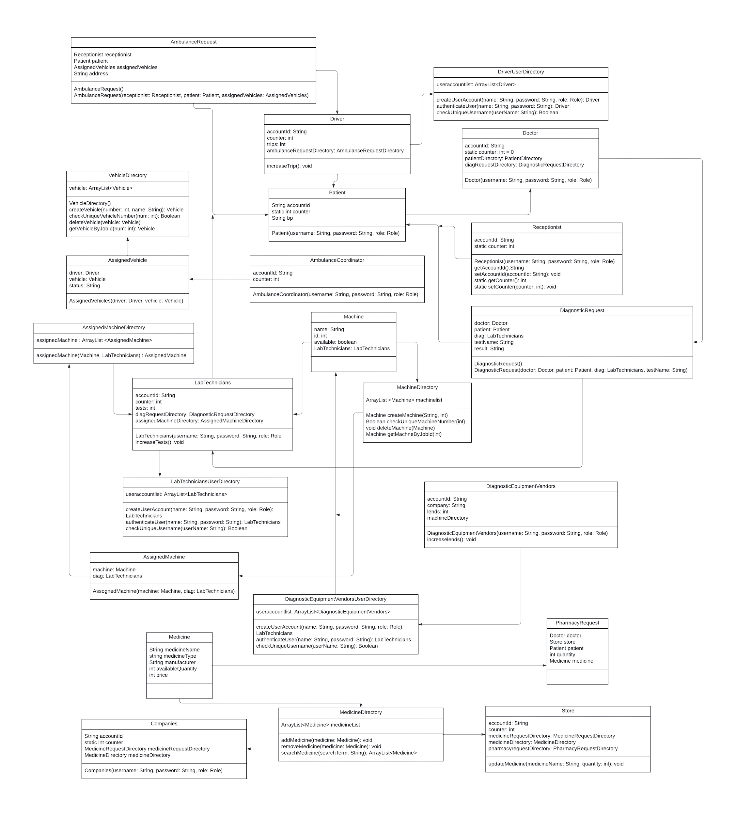
UML Class Diagram

Slide 8
Use Cases
Ecosystem Use Cases
Patient Journey
A Patient requests an ambulance via the Emergency Services platform.
An Ambulance Administrator assigns the nearest ambulance, and an Ambulance Driver transports the patient to the hospital.
The Receptionist checks patient details, assigns a room if required, and schedules a consultation with a Doctor.
The Doctor diagnoses the patient and either refers them to a Specialist or prescribes medication.
If lab testing is needed, the Receptionist schedules an appointment with the Diagnostic Labs, where a Lab Technician performs tests and delivers reports.
The Doctor reviews the results and adjusts the treatment plan.
If medicines are required, the Pharmacist dispenses the medication prescribed by the doctor.

Slide 9
Use Cases
Enterprise Interactions
The Diagnostics Admin coordinates with Diagnostic Equipment Vendors for lab device maintenance and procurement.
The Pharmaceutical Admin ensures medicine availability by liaising with Pharmaceutical Manufacturers.
The System Admin ensures seamless data exchange and platform security across enterprises.
System Flow Example
Step 1: A patient logs into the MediLink platform and requests an ambulance.
Step 2: The ambulance service assigns a driver who picks up the patient and drops them at the hospital.
Step 3: The receptionist registers the patient, books an appointment, and assigns a room.
Step 4: The doctor conducts a diagnosis and refers the patient for further testing or treatment.
Step 5: Diagnostic labs perform tests and share reports.
Step 6: The doctor reviews the results and prescribes medicines, which the patient collects from a pharmacy.

Slide 10
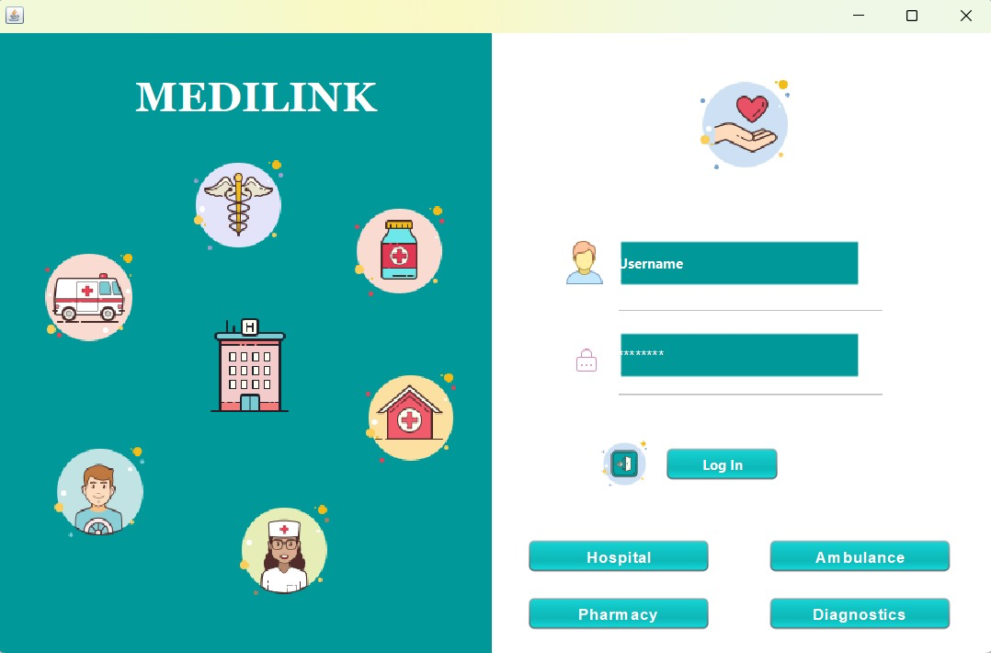
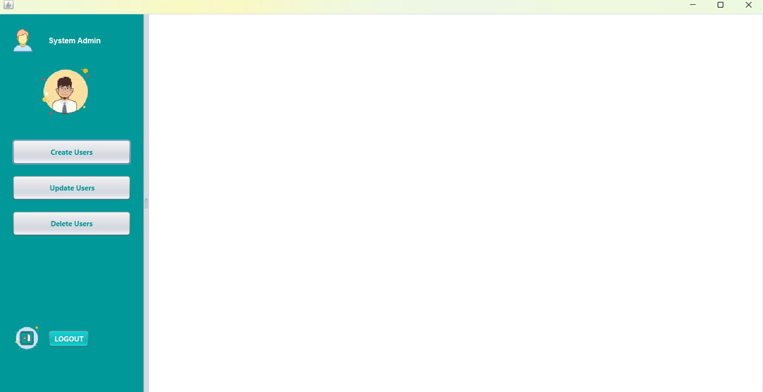
Few snapshots of the application

Slide 11
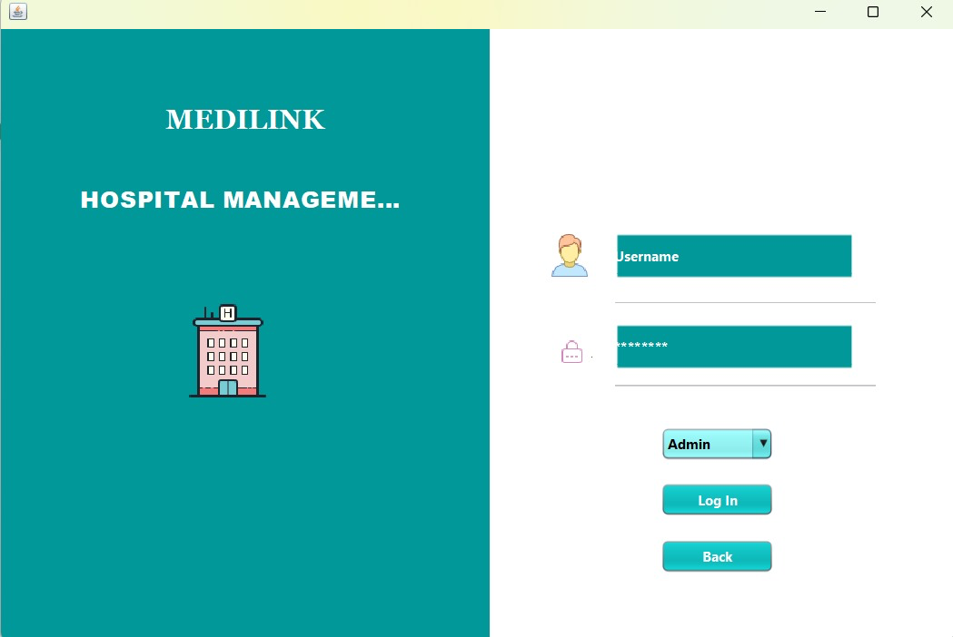
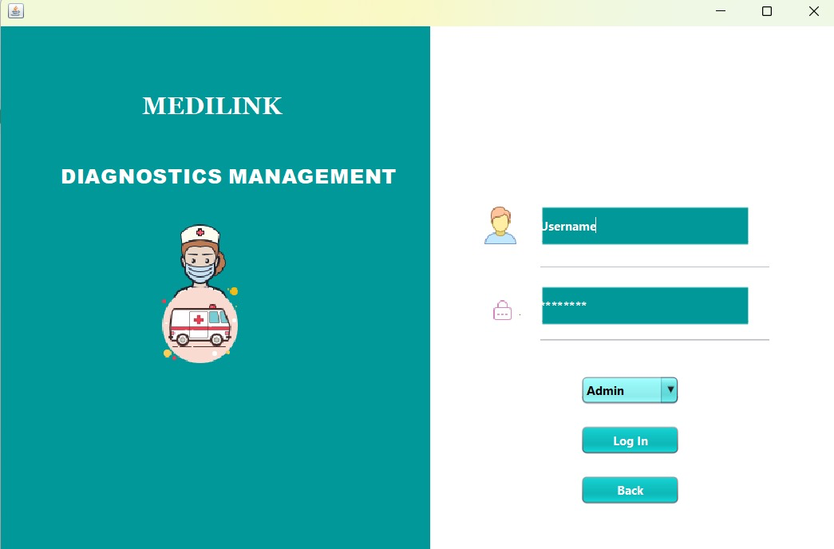
Few snapshots of the application

Slide 12
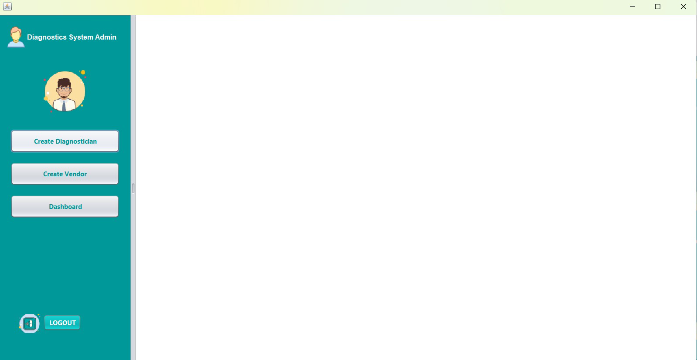
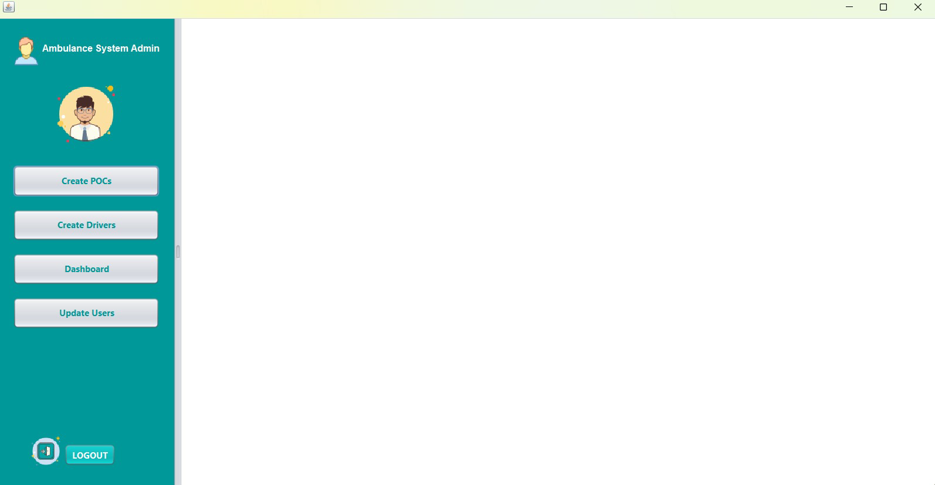
Few snapshots of the application

Slide 13
Thanks!

