Slide 1
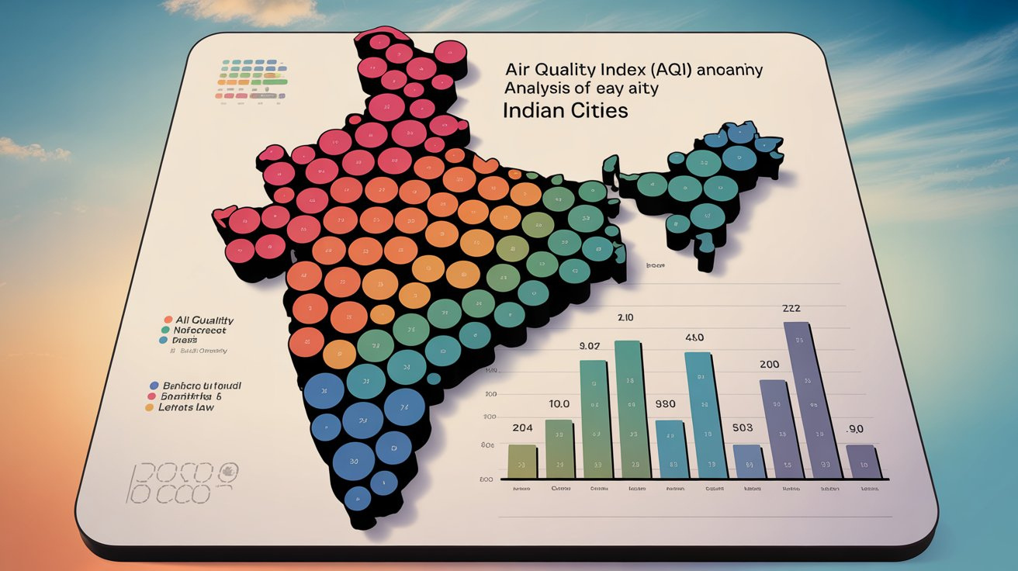

By- Kaggle Master
Aditya Prakash
Abhay Pratap Yadav
Yashveer Singh
Vipul

Slide 2


Introduction
This project analyzes AQI data of Indian cities using Benford’s Law to detect any anomalies in digit distribution. The goal is to check if the AQI data follows a natural pattern or shows signs of manipulation.

Slide 3
Dataset Overview
Source: air_quality_index_of_indian_cities.csv
Contains AQI readings across different cities in India
Used for analyzing the first and second digit distribution of AQI values

Slide 4
Methodology
1. Clean and preprocess the AQI dataset
2. Extract first and second digits of AQI values
3. Compare distributions with Benford’s Law expectations
4. Perform Chi-Square test for statistical validation
5. Visualize the data using Matplotlib/Seaborn

Slide 5

Benford's Law
Definition :
Benford's Law states that in many real-life collections of numbers, the first digit is more likely to be small. Specifically, the number 1 appears as the leading digit about 30% of the time, while larger digits occur less frequently. The probability 𝑃 ( 𝑑 ) P(d) that a digit 𝑑 d (from 1 to 9) is the first digit is:
𝑃 ( 𝑑 ) = log ( 1 + 1 / 𝑑 )

Slide 6
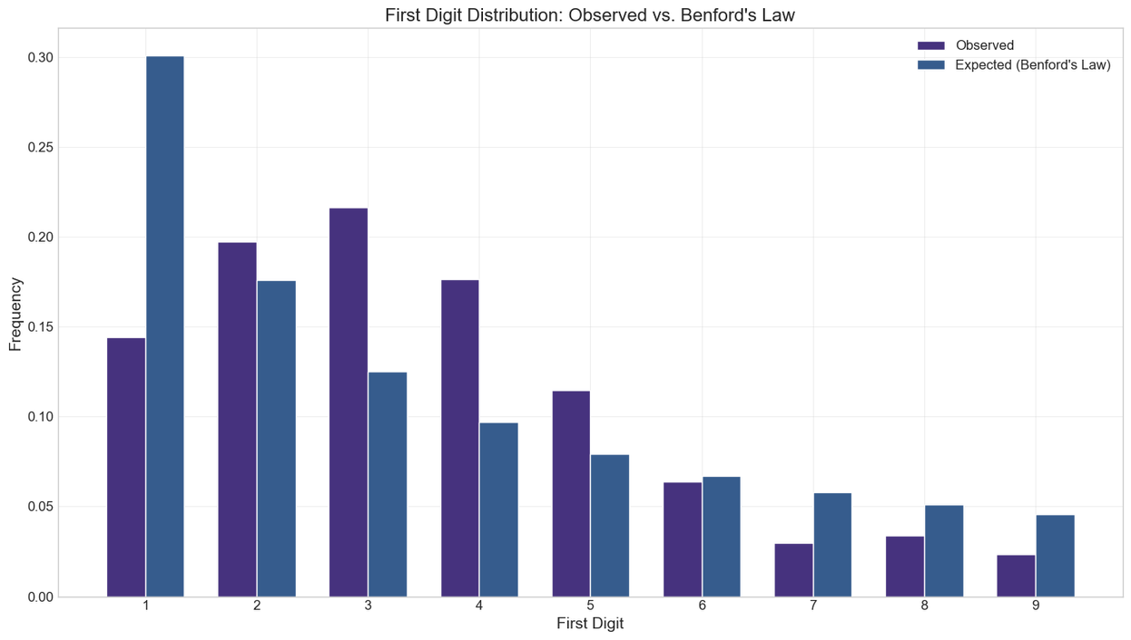
First Digit Analysis
• Distribution of first digits compared with Benford's expected distribution
• Visualizations show close alignment, indicating natural data behavior

Slide 7
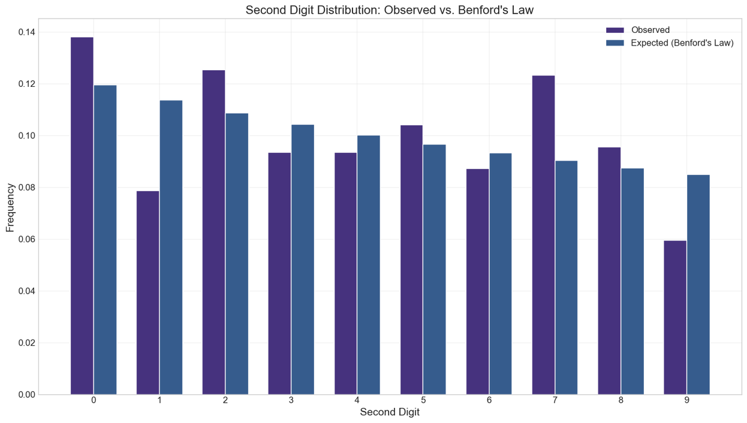
Second Digit Analysis
• Distribution of second digits slightly deviates from Benford's
• Minor anomalies detected but not significant enough to suggest manipulation

Slide 8
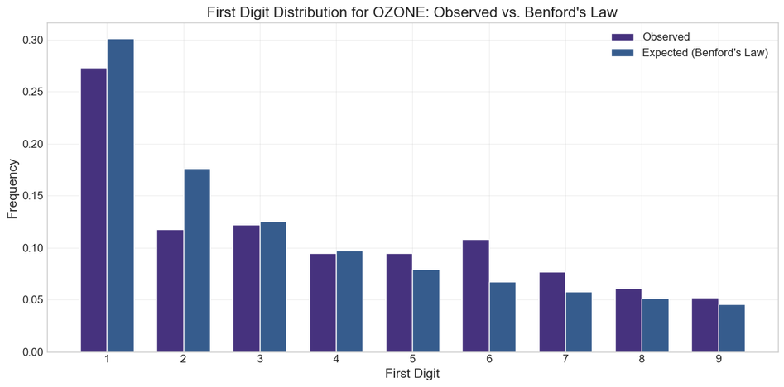
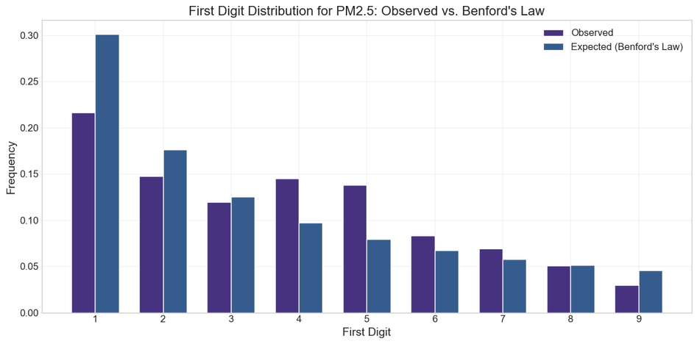
Results and Observations
AQI data largely follows Benford’s Law
First digit distribution is statistically aligned with expected pattern
Second digit shows acceptable variation
No strong evidence of data tampering

Slide 9
Individual Contributions
Aditya Prakash : Helped in understanding the given dataset and prepared it for analysis in the ipython Notebook.
Abhay Pratap Yadav : Contributed to writing the code in the ipython Notebook and helped interpret the results.
Vipul : Focused on analyzing the dataset and created visualizations (graphs/charts) to represent the air quality data.
Yashveer Singh : Compiled the overall project work and prepared the PowerPoint presentation for the final submission.

Slide 10

Thank you!

