Slide 1
Status Report: ML-based Investment Advisor
Thong Bui, Sarah Kelley, Zhongqiao Jin, Natarajan Shankar

Slide 2
What’s changed?
Data Provider
Paid service being used for Data, Data provider is Intrinio
Data: Integrate historical stock prices, news and twitter data for the S&P 500 companies
Stock price data starts from 2000
Revenue data is now restricted to years 2009 - 2017
10-K and 10-Q in electronix XBRL format not available for prior years
News from 2015
Twitter data - not using because cannot get historical data
Prediction options changed:
Targeted long-term: 30, 45, 60 days
Modeling:
Still the same as we planned
Main model uses time-series and LSTM to predict future stock prices
Use news and revenue data as supportive features
Notes:
Sarah

Slide 3
Brief impact rationale
Overall impact remains the same: prototype tool to help inventors without access to a financial planner
Effect of changes on impact:
Lack of twitter/streaming data means it is less extensible to a real-time tool
Slightly less flexibility in time-frame selection
Somewhat more limited training data may limit accuracy
Notes:
Sarah

Slide 4
Progress
What’s been done:
Data:
S&P 500 stock prices and volumes are collected
News: 160 companies are collected from 2015
Revenue data: mostly done from 2010
Data analysis has been done based on the existing dataset
UI:
Basic but functional Flask App
Plug in points developed for final model
Models:
baseline using LSTM,
main models using time-series and LSTM on small samples
To be done:
Data: remaining data issues
UI: graphic design, add features, user testing
Models: integrate with the remaining data, train and predict
Integration
More details are to be discussed later
Where in process?
What have been done?
What’s left to do
Notes:
Sarah

Slide 5
Features in Predictive Model
Stock price and Volume
Revenue data
Basic EPs
Net Income
Operating Revenue
Total Gross Profit
Total Revenue
News Data:
Sentiment analysis -> scores (subjectivity, positivity)
Sell, buy
Notes:
Thong -

Slide 6
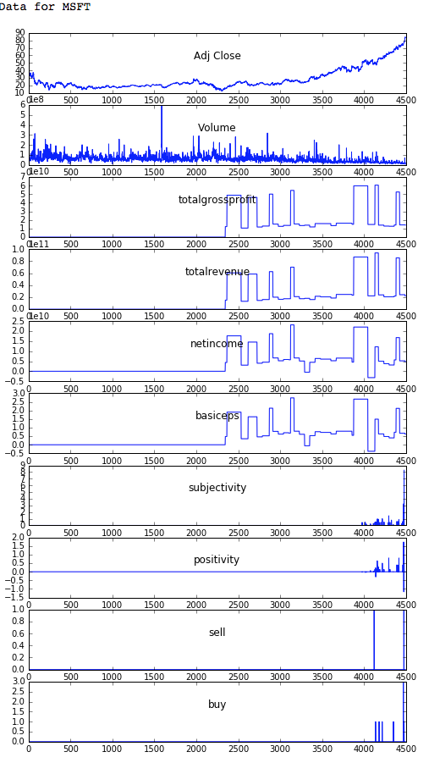
Highlights - Data Analysis
Data Analysis:
Stock data starts from 2000: Adj Close, Volume
Revenue data start from 2009:
Can we map Q1, Q2, Q3, Q4, FY to correct dates?
Keep totalgrossprofit, totalrevenue, netincome, basiceps
operatingrevenue is 0s so we decided to drop them
News data is only available for the last ~500 days
subjectivity, positivity, sell, buy
scandal, decline are consistently zero so we don’t use them
buy, sell are sparse.
Data quality concerns
Notes:
Thong -

Slide 7
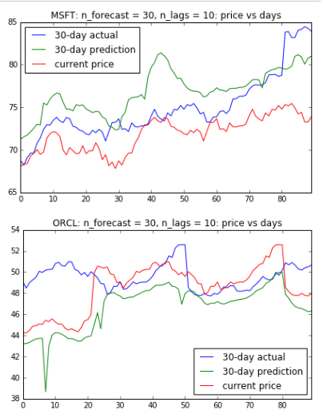
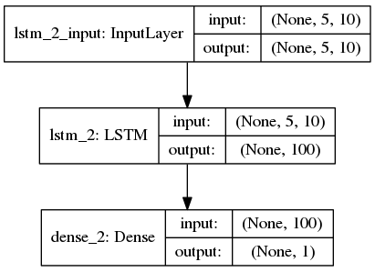
Highlights - Models
Key Results - Models using time-series and LSTM
For each stock:
Create time-series dataset to predict different long-term prices: 30, 45, 60 days
Use LSTM
Notes:
Thong - Next, Zhongqiao will talk about the UI progress we have made

Slide 8
UI so Far
Existing UI Progress
Functioning Flask app
HTML integration with Flask to display different pages
WTForms to power interactive features
UI currently allows user to input variables amount, time frame and risk tolerance and then returns mock answers
Functions built to plug-in actual model results after training is complete
Risk Disclosure Page helps user to ware of the risk they will take by using our recommendation
Alternative Recommendation Page will provide additional information which can help user to better integrate recommendations with their own investment decisions
Supportive Stock Price Prediction chart. User can leverage those predicted price in their own analysis
Flask App working
Flask integrated with WTForms
Plug-in points developed
Notes:
Zhongqiao -

Slide 9
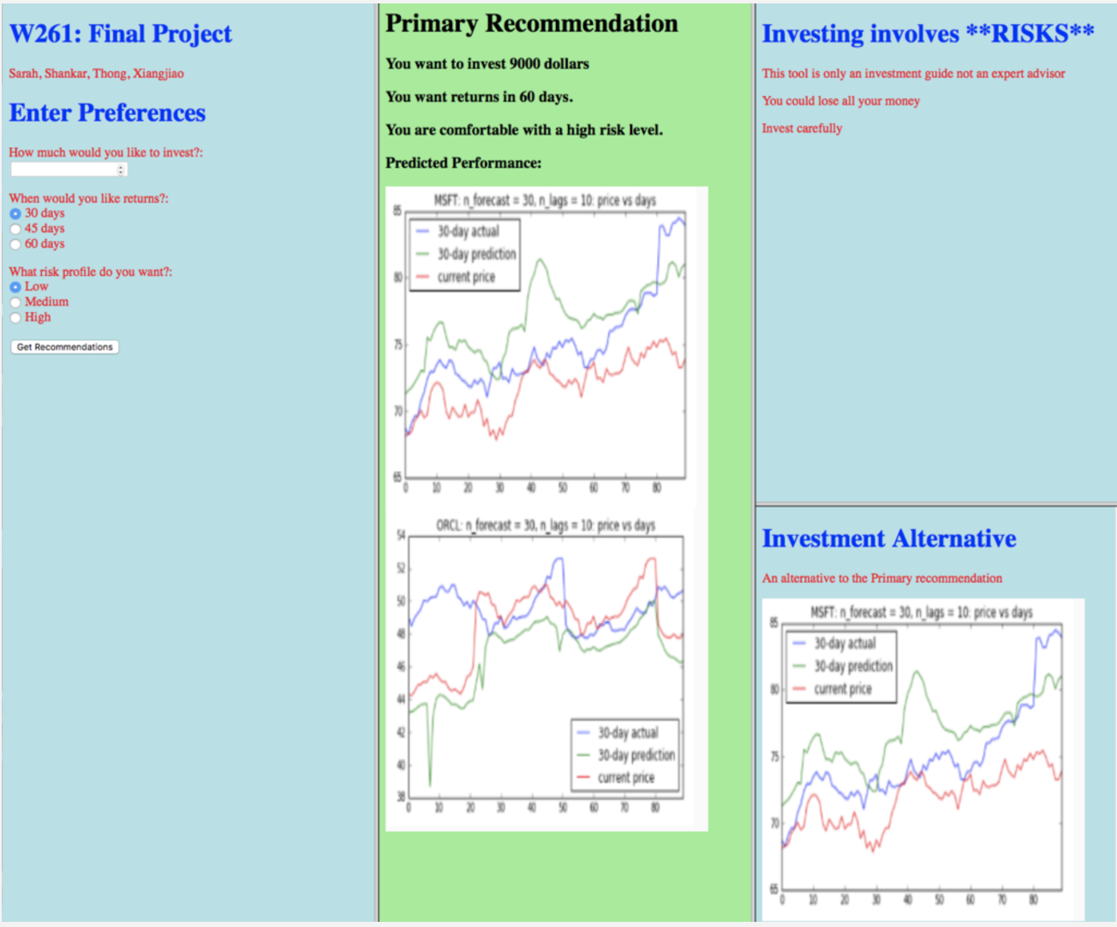
UI so Far
Draft UI sample
Draft UI sample
Notes:
Zhongqiao -

Slide 10
Next steps
Challenges
UI:
Implement display framework
Make the Flask and HTML foundation stable
Experiment with aesthetics, for visual impact
Integrate UI with the back end components
Improve quality of core data and derived data:
NLP data has gaps
Revenue data does not map to correct dates
Iteratively refine the predictive model:
Model quality depends upon data quality
Perform iterative tuning of the model for better predictions
Generate 30, 45, 60 day predictions for all of SP500
Iterations take multiple days
Integration, Model, Test, Refine:
Iterative work
Documentation:
Basic operational documentation
Final presentation
Notes:
Shankar

Slide 11
Internal Milestones
Taskline to Final
Nov 16 : Discuss Strengths/Weaknesses
Nov 19 : NLP and Revenue data in final form
Thanksgiving : Ongoing refinement of data and model
week
Nov 27 : UI stabilized
Nov 27 : Refined Model available, data is stable
Dec 1 : Final push, full training run started
Dec 1 - Dec 12 : Integration and iterative improvement
Dec 12 : Final presentation
Nov 27 : E
Notes:
Shankar

Slide 12

Thank you!
Q&A

