Slide 1
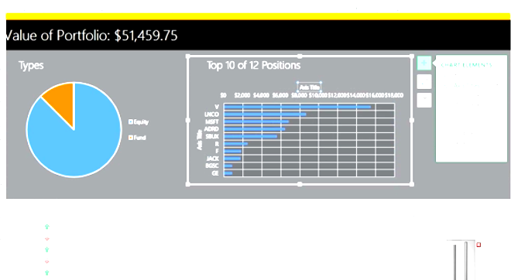
ML-based Investment Advisor
Thong Bui, Sarah Kelley, Zhongqiao Jin, Shankar
Notes:
Sarah -

Slide 2
Problem definition & content
Goal: Build a tool that suggests an ideal stock portfolio for long-term investments.
Angle: Use natural language processing and time series techniques to gain insight from news articles to use as part of a stock prediction model.
Target User: Tech-savvy, moderately-low stakes investors.
Limitation: Initially, at least, not real time and restricted to S&P 500.
Notes:
Sarah -

Slide 3
Impact
Very well researched space, lots of interest and talent already working on these issues
This implementation includes:
Time Series Data
News Data processed by NLP
Current iteration is for stock picks; could benefit tech-savvy small investors who don’t have enough investment money to justify an investment advisor
Could also be generalized to more rapid trading also
Clear use case for real-time adaptation of stock portfolios in response to breaking news
Impact depends deeply on how predictive our model is
Notes:
Sarah -

Slide 4
Team learning goals
Develop our understanding of financial models/forecasting
Based on the feature performance used in the model, we will learn the level of impacts each feature will have to the stock price movement
We would also learn the portfolio theory according to different risk aversion, return period, initial funding settings
Increase our knowledge of time series methods
By implementing time series model in our product, it will help us not only from theoretical perspective but also via a practically way to understand how to model works
Explore practical, results-driven applications of natural language processing
We will explore the usage of NLP in financial models, we can see whether the NLP data will help the prediction of stock price
Notes:
Zhongqiao

Slide 5
Approach
Data: Integrate historical stock prices, news and twitter data relating to stocks from the S&P 500
Modelling:
Extract possible features from text data
e.g. News related to high profile personnel changes; regulatory issues; newsworthy successes or failures
Build baseline model
Using time series model to predict the future stock price.
Will take NLP data as supportive features
Iterative model improvements
If time allows, will try Neural Network model such as LSTM to enhance the current model
Notes:
Zhongqiao

Slide 6
Exploring and evaluating the data
Data
Financial Data: Historical data, from 2000-01-01 - present
Stock price
Quarterly Revenue
Quarterly P/E ratio (only limited data available)
News Data:
RSS feeds
Company news, Technology trends
Historical : Comprehensive news, but unstructured, data is available
Parsing and categorizing will be challenging
Twitter Data:
Official corporate tweets
Other related chatter
Evaluation of Data Quality
Underway, working on data access via APIs
As predictive model evolves, data refinement is anticipated
Notes:
Shankar

Slide 7
Initial findings
Data quality varies
Some with lots of noise
Needs pre-processing to extract useful data
Consolidated textual data does not go all the way back to 2000-01-01
Data has variety
Comes in various formats, most of the data is well understood
Data is mostly static
It’s not a stream and the flow is not a firehose
Data feed rates are not a challenge in the processing pipeline
Quantitative Data is structured
Different vendors provide different formats, CSV is the most useful
Textual Data is unstructured
Data processing model will help refine data
Model will iteratively help define what data needs to feed into it
Once trained, models will be stable over macro time
Notes:
Shankar

Slide 8
Ethical and Legal Risks
Ethically: We don’t want to harm people with bad investment advice.
Mitigation: Clear warning that this is for exploratory purposes only until model is well tested.
Need some kind of disclaimer/warning about uncertainty. How do we get people to actually read it?
How do we mitigate negative impact on less savvy investors?
Legally: Giving bad investment advice is not illegal (?)
If we developed the platform to actually invest people’s money directly, we would have a lot of issues about data security/privacy etc also
We will be collecting very limited data and no personally identifying information
Notes:
Shankar

Slide 9
Issues / questions
What, if any, are the legal implications of providing investment advice?
How do we handle ethical issues, especially if less financially savvy people ended up using the product?
Quality of Twitter data: too much noise? TBD
Historical data for PE ratios, revenues, dividends and financial news? TBD
Other features to consider? Bollinger bands, daily returns, etc.
Performance concerns of NLP on analyzing the large volume of historical news?
Notes:
Thong

Slide 10
Work plan and next steps
Current Status: Stock price data collected. Fetching rest of the data is in progress.
Next Step: NLP on news and data integration; begin development of ML models
Timeline: details
NLP Feature Extraction 11/01
Basic UI shell 11/10
Baseline Model 11/20
Final User Testing 12/06
Overall Approach: SCRUM, Iterative, parallel development
Notes:
Thong

