Slide 1
ML-based Investment Advisor
Thong Bui, Sarah Kelley, Zhongqiao Jin, Natarajan Shankar

Slide 2
Framing the problem

Slide 3
Impact

Slide 4
Approaches and Methods
Suitability/effectiveness of approaches and methods given focal problem(s) (including appropriate handling of any ethical or legal considerations)
Data collection:
current data limitations (start from 2015)
Modeling
Front-end tool to help pick top stocks from S&P500

Slide 5
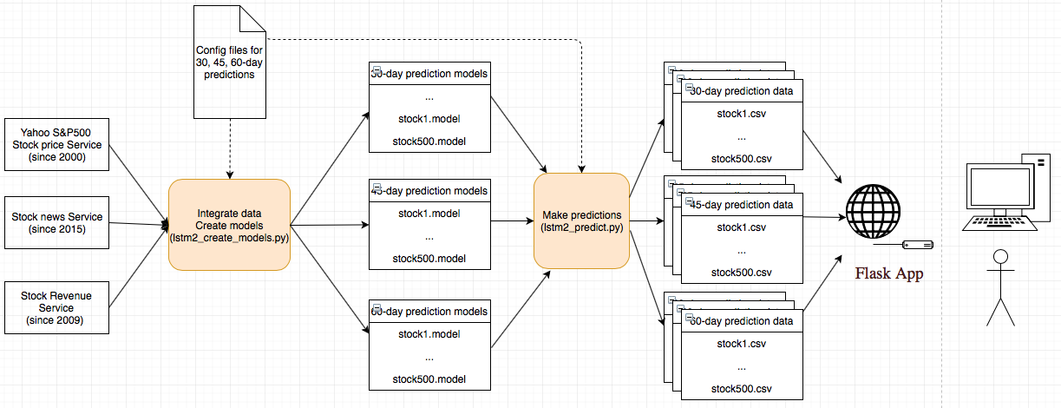
System Architecture
Notes:
Thong:
Main github: https://github.com/thongnbui/MIDS_capstone
Specific codes for:
Lstm2_create_models.py
lstm2_predict.py

Slide 6
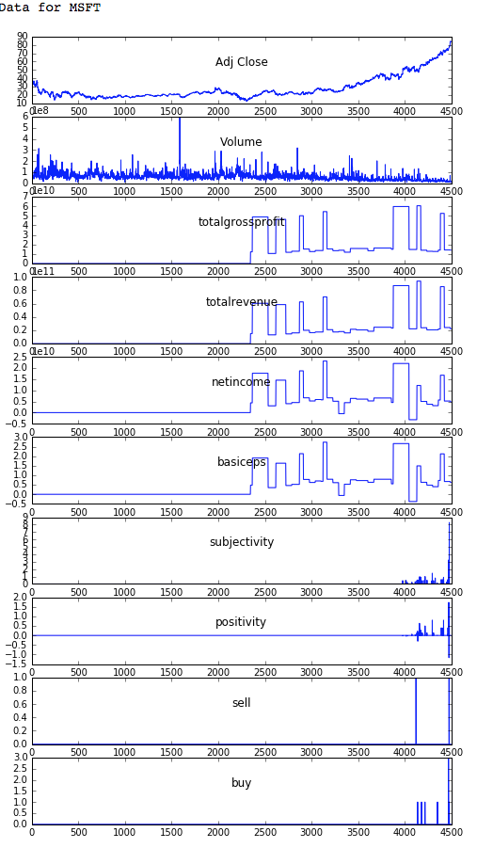
Data Collection
Notes:
Thong - More on LSTM:
In other words, the prediction of nth sample in a sequence of test samples can be influenced by an input that was given many time steps before.
Preserving the long term dependencies in the network is done by its Gating mechanisms. The network can store or release memory on the go through the gating mechanism

Slide 7
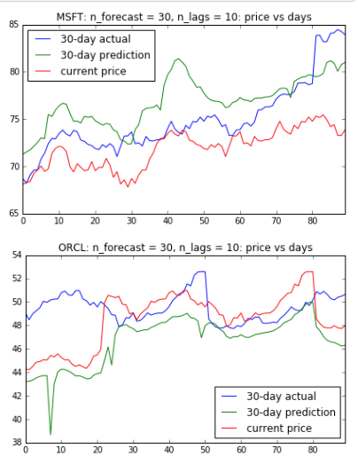
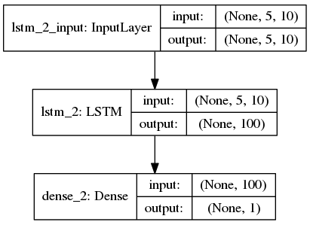
Models & Predictions
Models using time-series and LSTM
For each stock:
Create time-series dataset to predict different long-term prices: 30, 45, 60 days
Train data: before the last 90 days. Test data: last 90 days
LSTM: Recurrent networks, of which LSTM is one of the most successful, are generally useful when you're dealing with a time series.
Very good at holding long term memories
Cross-validation against test data (last 90-day)
Minimize overfitting: early stopping (see details)
Notes:
Thong - More on LSTM:
In other words, the prediction of nth sample in a sequence of test samples can be influenced by an input that was given many time steps before.
Preserving the long term dependencies in the network is done by its Gating mechanisms. The network can store or release memory on the go through the gating mechanism

Slide 8
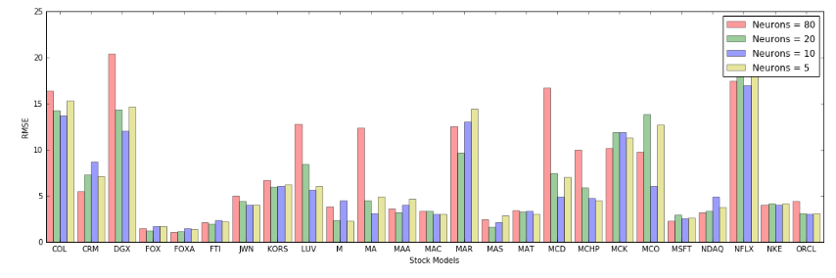
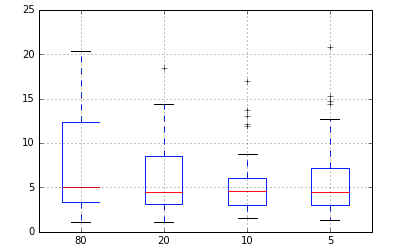
Models & Predictions (cont’d)
Parameter Tuning
We pick some parameters to tune for optimal RMSE and use them in config file for modeling
Ex: The optimal number of neurons for models to predict 30-day stock prices can be different from 45 or 60-day models (see the end of this notebook for more details)
Notes:
Thong - More on LSTM:
In other words, the prediction of nth sample in a sequence of test samples can be influenced by an input that was given many time steps before.
Preserving the long term dependencies in the network is done by its Gating mechanisms. The network can store or release memory on the go through the gating mechanism

Slide 9
Results
Level of impact/usefulness/insightfulness of results (in terms of both progress since last presentation and overall)
Pick the best stocks from a big pool of S&P500

Slide 10
Evaluation
Meanings of RMSE and SD (standard deviation)
RMSE: how closely matched the prediction price is with actual price
SD: how much the prediction price is changed during this period (last 90 days)
Low risk: predicted SD < 0.45 quantile
Medium risk: predicted SD is between [0.45, 0.75]
High risk: predicted SD > 0.75
Notes:
Thong -

Slide 12
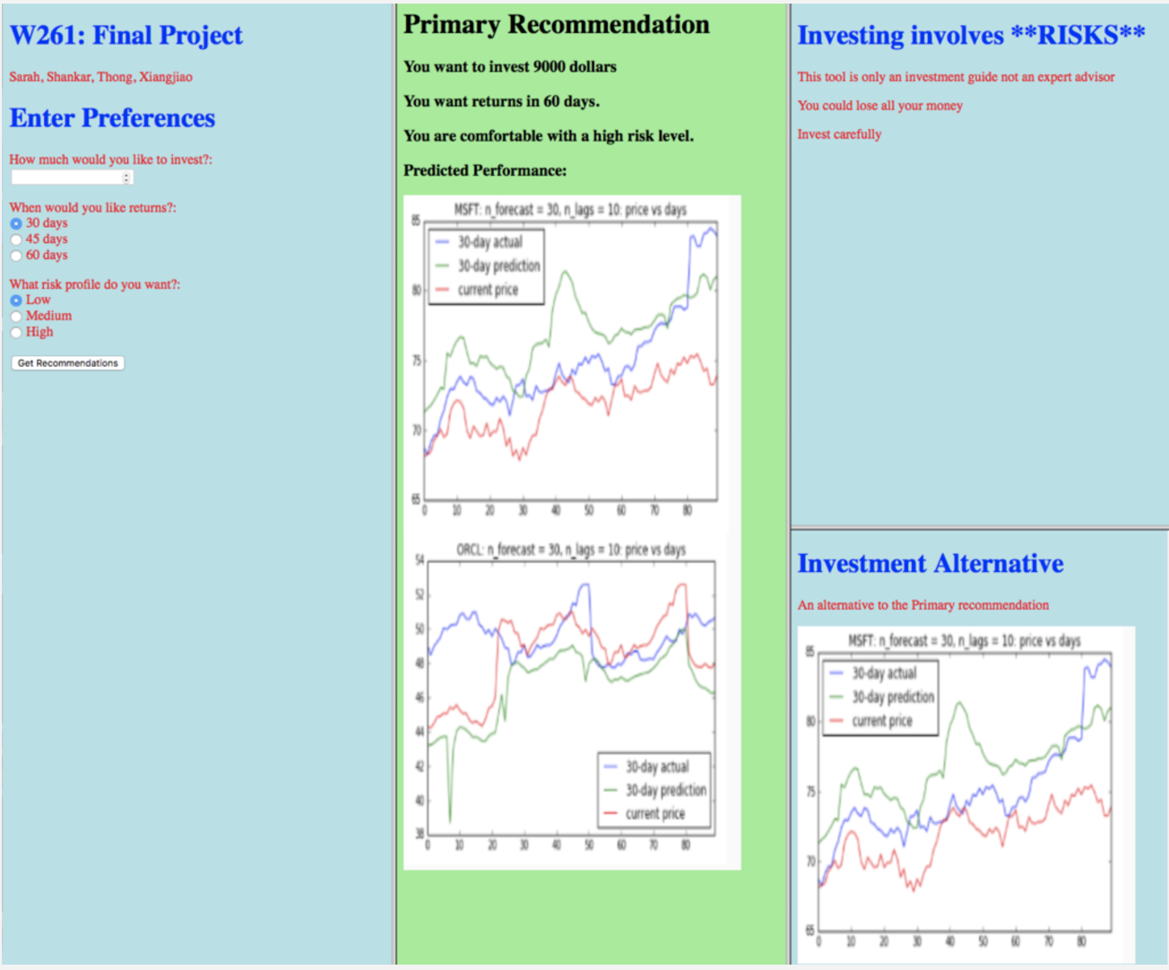
Previous UI
Draft UI sample
Notes:
Zhongqiao -

Slide 13
Demo
We have webapp ready

Slide 14
Next steps
What questions are still open? Where might you go from here?
Data quality limitation:
From 2015: If we pay for some financial services (expensive) to get better quality of news and quarterly reports, we can use data before 2008 stock crash -> better for training and predictions
Store data in some DB
UI: we are not UI experts so there are still room to improve

Slide 15
Thank you!
Q&A
Github: https://github.com/thongnbui/MIDS_capstone
documents:

