Slide 1


Consumer Segmentation for Bath-soap
Aditya Putta

Slide 2
Marketing Strategy
Targeting customer based on different parameters
-> Demographic
-> Basis for purchase
-> Purchase behaviour

Slide 4
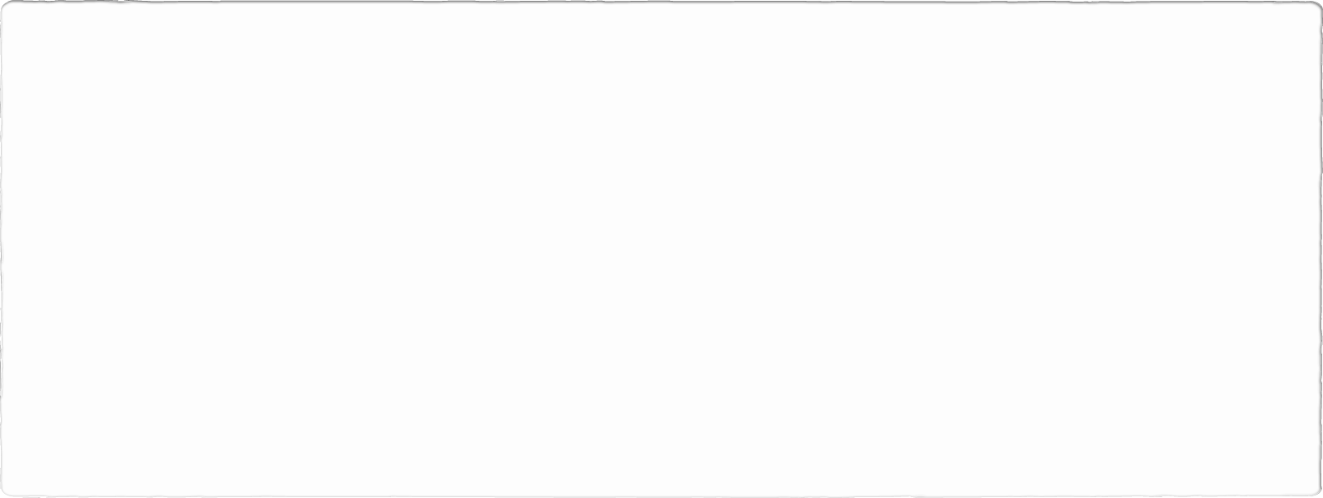
Building Model
Group 1 | Group 2 | Group 3
Mix Socioeconomic class | Low socioeconomic class | High Socioeconomic class
High Family member | High transaction per brand | Higher education level
High transaction value, total volume and total value | High transaction volume | Higher affluence index
Utilize different brand for different product | Brand Loyal | Not Loyal to any specific brand
Do not follow suggestion for purchase | Purchase product without promotion | Purchase product with promotion

Slide 5
Suggestions
Target customer based on Socioeconomic class
Target customer who have low Affluence index
Target customer based on high total volume

Slide 6
Thank You

