Slide 1
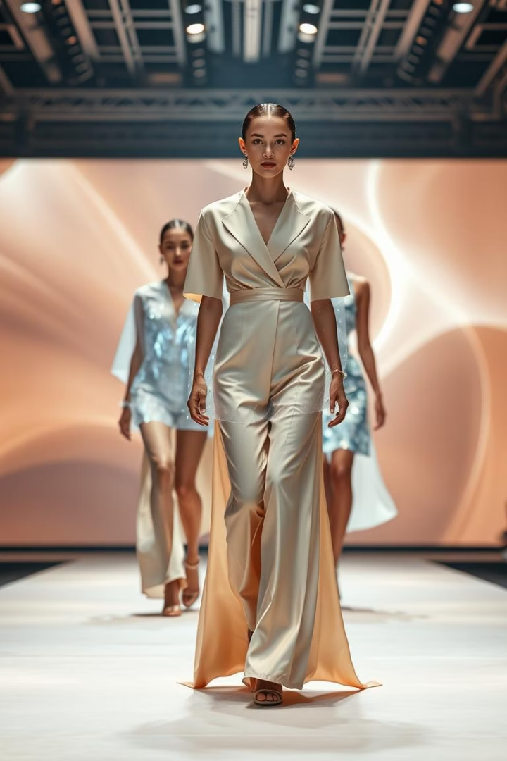
Precision Fashion: HOG and KNN for Image Classification
Welcome to our presentation on fashion product image classification. We explore an efficient approach using Histogram of Oriented Gradients (HOG) and K-Nearest Neighbors (KNN). This project is implemented in a Python Jupyter Notebook, demonstrating practical application for data science students and professionals.

Slide 2




Unlocking Image Classification with HOG and KNN
Objective
HOG Features
Classify fashion images with high accuracy. We leverage HOG for feature extraction. KNN handles the classification. It performs well even on small datasets.
Extract rich descriptive features from images. This captures object shape and appearance. It focuses on gradient orientation and magnitude.
KNN Classification
Utilize K-Nearest Neighbors for robust classification. It finds the closest training examples. This determines the class of a new data point.

Slide 3

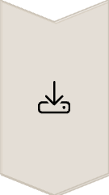
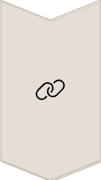
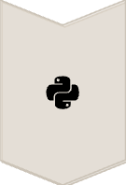
Streamlining Dataset Preparation
Dataset Acquisition
Obtain a ZIP file. It contains styles.csv with product metadata. An images folder links to product IDs. Python code extracts these files in the notebook.
Metadata Integration
Link product IDs from the CSV to image files. This creates a cohesive dataset. It ensures proper data association for classification.
Automated Extraction
Python code handles unzipping and organization. This prepares the data for processing. It streamlines the initial setup phase.

Slide 4
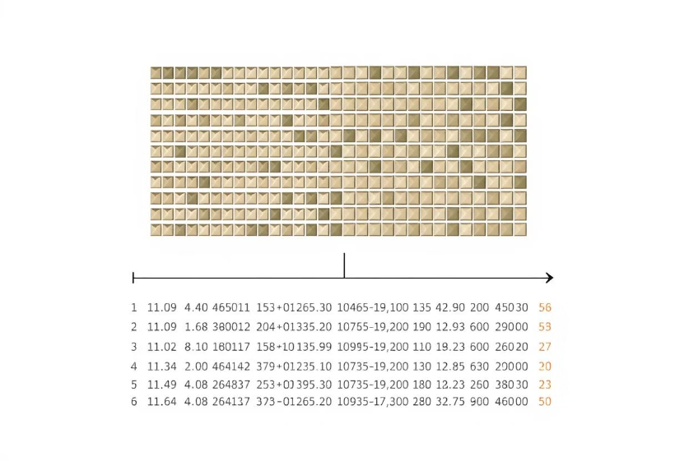
Mastering Feature Extraction with HOG
Image Preprocessing
Images are resized to 128x128 pixels.
Converted to grayscale for simplification.
Reduces computational complexity.
HOG Application
Use skimage.feature.hog. This function captures directional gradient features. It creates a robust feature vector for each image. This highlights edges and shapes effectively.

Slide 5






Training and Evaluating the KNN Model
Model Training
Train the KNN classifier. It uses the extracted HOG feature vectors. The model learns patterns from the training data.
Data Splitting
Divide the dataset into training and test sets. This ensures unbiased model evaluation. Typically 80% for training, 20% for testing.
Performance Evaluation
Achieve around 98% accuracy. Validate through confusion matrices. Classification reports provide detailed metrics. This ensures reliable performance assessment.

Slide 6

Why HOG-KNN is a Game Changer
98%
Accuracy
High classification accuracy achieved. Validated across diverse fashion items.
1
Interpretability
Lightweight and easily interpretable solution. HOG features are visually intuitive.
500
Small Data
Especially suitable for small image datasets. Avoids complex deep learning models.
100%
Extendability
Easily extendable to other datasets. Adaptable to various image classification tasks.

Slide 7

Key Takeaways and Future Directions
Efficient Classification
HOG and KNN provide a robust method. Effective for fashion image classification.
Interpretability & Scalability
Offers a clear and manageable solution. Ideal for constrained environments and small datasets.
Future Enhancements
Explore additional feature descriptors. Investigate ensemble methods for improved performance.

