Slide 1


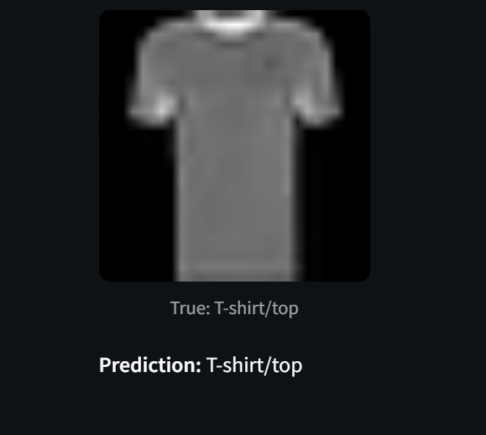
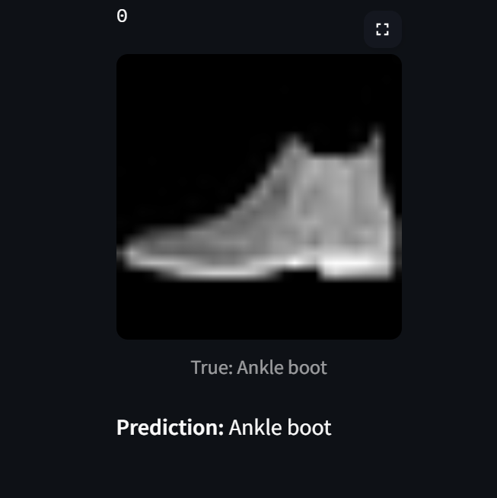
RV College of
Engineering
What Is AI & ML? Your New Helper
🔍 What is Computer Vision?
It’s like giving eyes and brain to a computer
Helps it see and recognize patterns in images
Just like we identify clothes by looking, AI learns to do the same!
Notes:
1

Slide 2
RV College of
Engineering
AI in Your Daily Stitching
Why It Matters for the Garment Industry
🏭 How it helps: ✔️ Sorts clothes automatically in warehouses ✔️ Makes online shopping smarter (find similar items) ✔️ Helps manage inventory faster ✔️ Reduces human error
Notes:
2

Slide 3
RV College of
Engineering
Layman Analysis & Take-Home Points
✔️ Smarter Stores
✔️ Faster Procesing
✔️ Happier Customer
Notes:
3

