Slide 1
Analysis of Individual Indicators for Buy/Sell/Neutral Decisions
ADITYA SINGH
29-10-2024

Slide 2
Overview of financial metrics and decisions
Simple Moving Average (SMA) : SMA is a technical indicator that calculates the average of a specific number of past prices (usually closing prices). It helps smooth out price fluctuations, providing a clearer view of trends.
Formula: SMA=(P1+P2+...+Pn)/n where ‘Pi’ is the price at each period, and ‘n’ is the number of periods.

Slide 3
Bollinger Band : Bollinger Bands are a volatility indicator that consists of a moving average (usually a 20-day SMA) and two standard deviation lines above and below the SMA. They show the range within which prices typically move.
How it Works:
Formula:
Middle Band: 20-day SMA
Upper Band: SMA + (2 × Standard Deviation)
Lower Band: SMA − (2 × Standard Deviation)

Slide 4
CCI : The Commodity Channel Index measures the difference between the current price and its average over a specified period, helping to identify cyclical trends and overbought/oversold conditions.
How it Works:
Formula: CCI=(Typical Price−SMA)/(0.015 × MeanDeviation)​
A high positive CCI (>100) indicates overbought conditions (potential sell signal).
A low negative CCI (<-100) indicates oversold conditions (potential buy signal).

Slide 5
Table displaying BUY,SELL, or NEUTRAL decision for each individual indicator
INDICATOR | VALUE | DECISION
SMA | (SMA_20 crosses above SMA_50) OR (SMA_50 crosses above SMA_200) | BUY
SMA | (SMA_20 crosses below SMA_50) OR (SMA_50 crosses below SMA_200) | SELL
2. Bollinger Band | Price Below Lower Band | BUY
Bollinger Band | Price Above Upper Band | SELL
3. CCI | Price < -100 | BUY
 | Price > +100 | SELL
For rest of the scenarios decision is NEUTRAL individually.

Slide 6
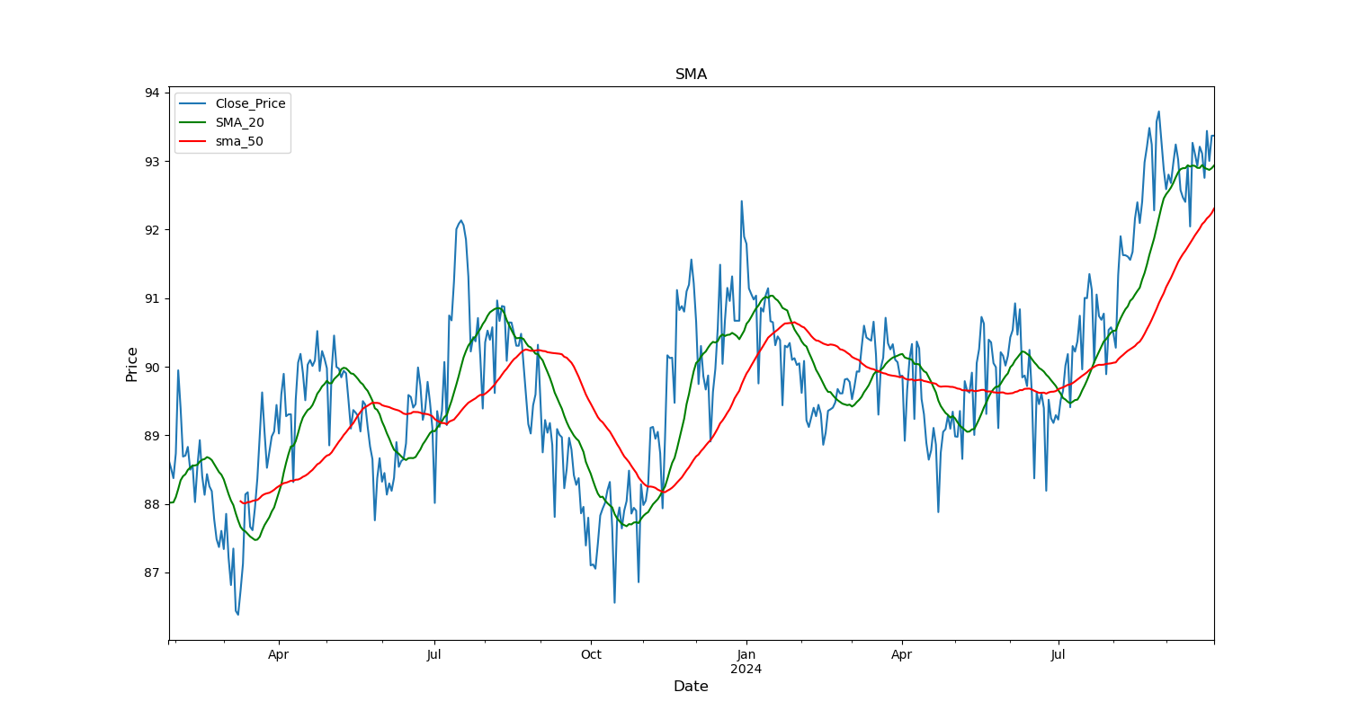
Graphs that visually represent the metrics and the corresponding decisions.
SMA_20 crosses above SMA_50 → BUY
SMA_20 crosses below SMA_50 →SELL

Slide 7
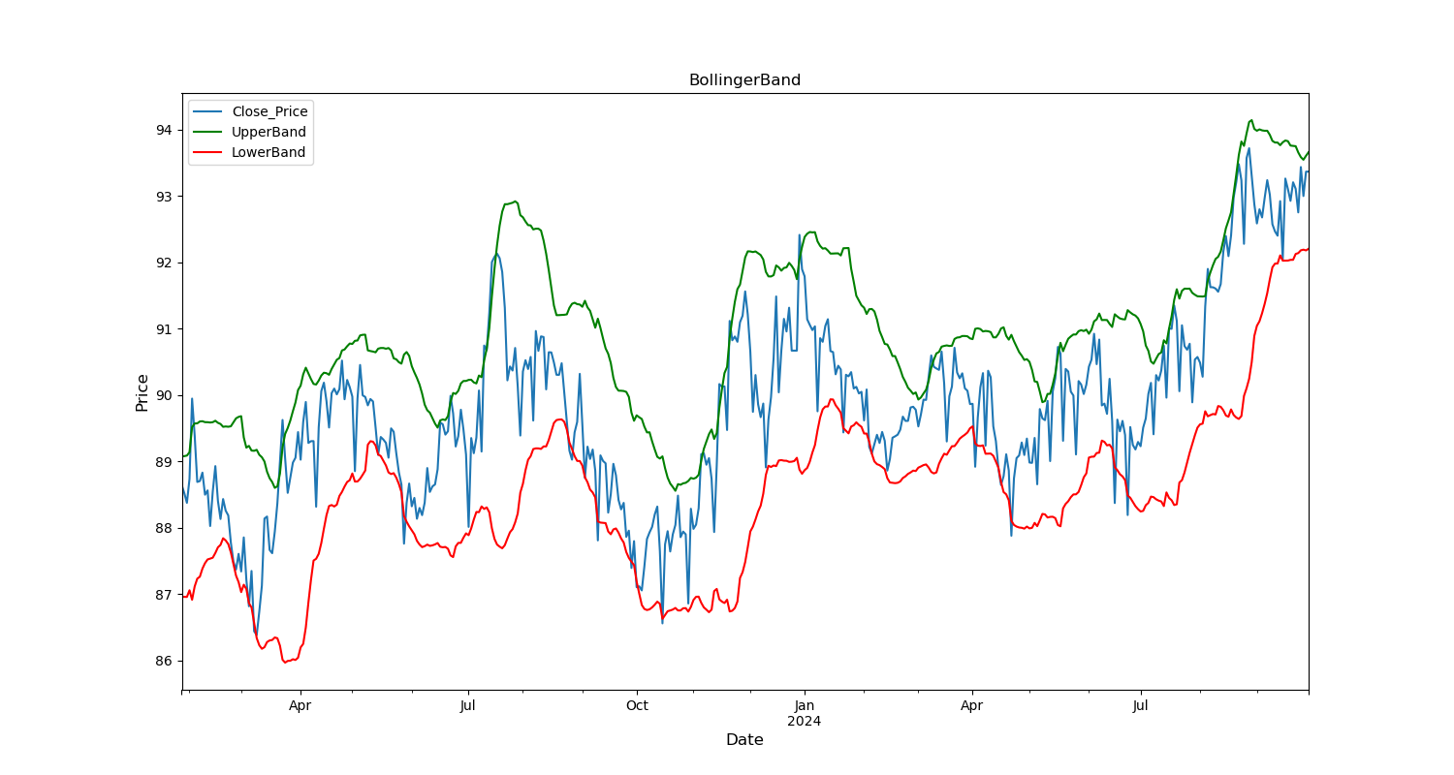
Close Price below Lower Band → BUY
Close Price above Upper Band → SELL

Slide 8
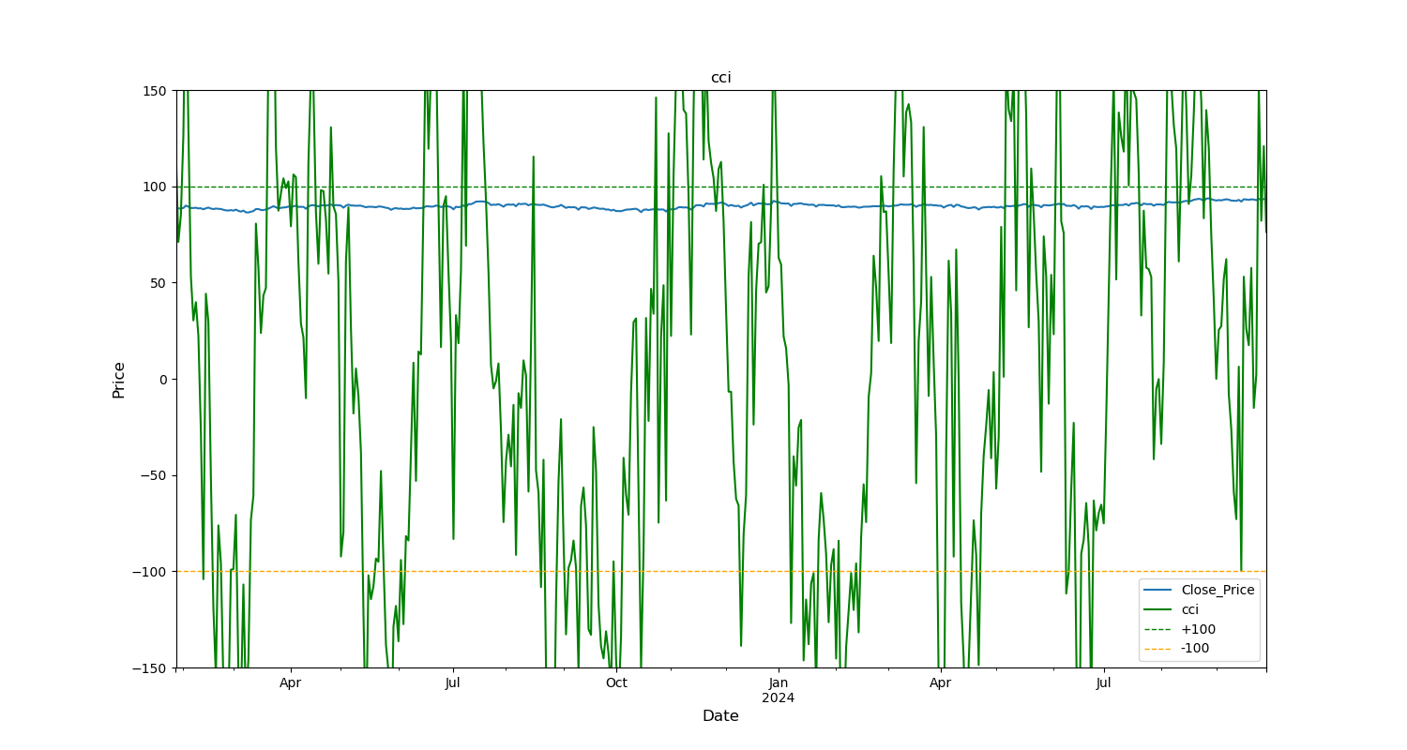
CCI above +100 → SELL CCI below -100 → BUY

Slide 9
Assumptions
SMA_20 and SMA_50 is better suited for daily and weekly timeframe instead of SMA_200 or any larger one.
For weekly timeframe we have resampled at ‘W-MON’ instead of ‘W-SUN’
Any price value lying below upper_band and above lower_band is treated as NEUTRAL
Any CCI lying between -100 and +100 is treated as NEUTRAL

Slide 10
Methodology
Data Scraping using ‘yfinance’ library.
Data preprocessing
Created columns corresponding to specified technical indicators for daily and weekly timeframe both.
Based on the dataset, created functions to determine whether to buy or sell.
(ex: for 2024-09-30 got NEUTRAL output for both daily and weekly timeframe)
Applied each indicator individually without combining signals to determine BUY or SELL.
Used Python Matplotlib to generate graphs for deeper analysis.

Slide 11
Thank you for your attention! I look forward to the opportunity to discuss how my passion and skills align with Alphashots.ai’s vision.
Email: adityahere.2024@gmail.com

