Slide 1
EECS 489 Computer Networks Fall 2019
Mosharaf Chowdhury
Material with thanks to Aditya Akella, Sugih Jamin, Philip Levis, Sylvia Ratnasamy, Peter Steenkiste, and many other colleagues.

Slide 2
Agenda
Introductions
What is (this course on) networking about?
Class policies, logistics, and roadmap

Slide 3
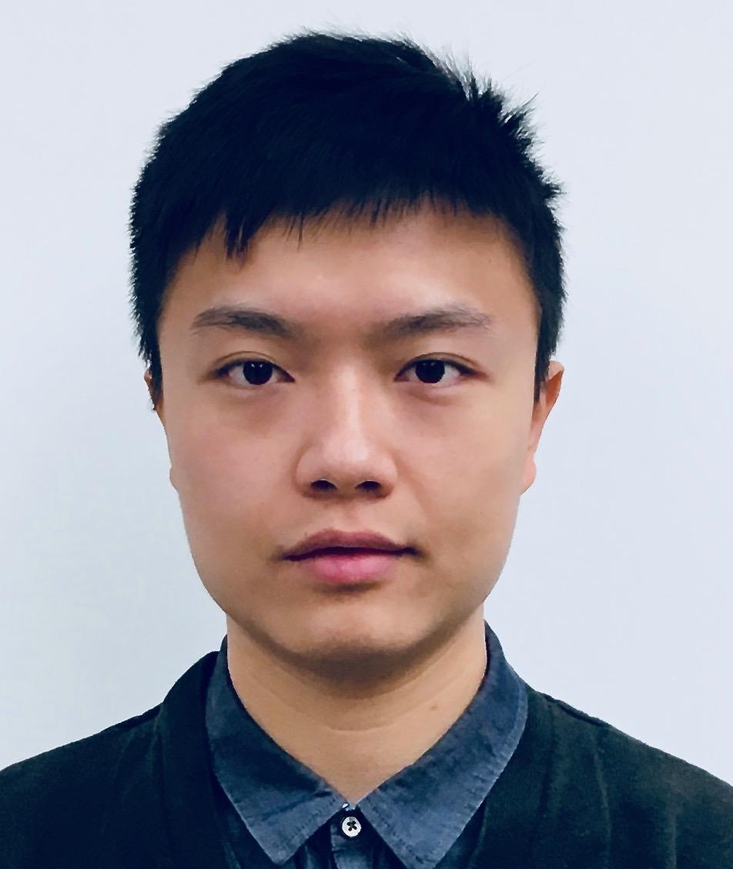
GSI: Leonard Lin
PhD student in EECS
Office hours: See course webpage
No office hours or discussions this week

Slide 4
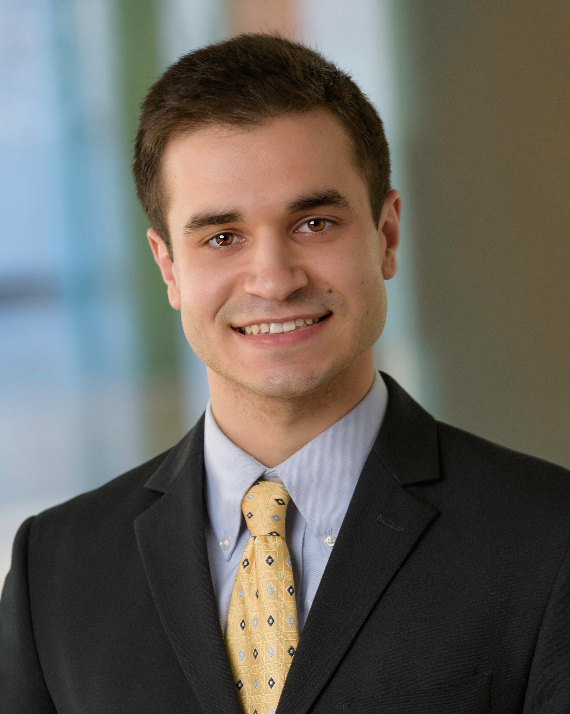
GSI: Joseph Buiteweg
Master’s student in EECS
Office hours: See course webpage
No office hours or discussions this week

Slide 5
Mosharaf Chowdhury
Ph.D. in Computer Science from Berkeley in 2015
On the Michigan faculty since 2016
Research focus on application-infrastructure symbiosis in large-scale networked systems
Office hours: Wednesday 2PM – 4PM in 4820 BBB, starting from September 11*
Also, by appointment (pre-scheduled via email)

Slide 6
My teaching style
Third-time teaching an undergraduate course!
I’m still learning!
I will listen to (constructive) feedback
“Speak faster/s-l-o-w-e-r/LOUDER”
“Pace is too fast/too s-l-o-w”
“I’m falling asleep…”
Interrupt me as needed
For the first time, all lectures will be recorded

Slide 7
489 in EECS curriculum
EECS 281
High-level logic ⇒ Programs
Coding skills learned in 281 are critical for 489 assignments
EECS 482
How do machines work?
Execute programs, interact with users, etc.
Some concepts of 482 may be useful, but are optional

Slide 8
What is missing?
How do we access most services?
Examples include search engines, social networks, video streaming, etc.
How do two machines communicate?
When they are directly connected
When they are not directly connected
Using a network

Slide 9
What is a network?
A system of “links” that interconnect “nodes” in order to move “information” between nodes
Yes, this is very vague

Slide 10
There are many different types of networks
Internet
Telephone network
Transportation networks
Wireless networks
Optical networks
Datacenter networks
We will focus primarily on the Internet

Slide 11
The Internet is transforming everything
The way we do business
E-commerce, advertising, cloud-computing
The way we have relationships
Facebook friends, E-mail, IM, virtual worlds
The way we learn
Wikipedia, MOOCs, search engines
The way we govern and view law
E-voting, censorship, copyright, cyber-attacks

Slide 12
The Internet consists of many end-systems
car navigator
heart pacemaker
smartphone
end-system
iPad
Linux server
MAC laptop
Windows PC

Slide 13
Connected by switches
end-system
switch

Slide 14
And links
link
phone lines
end-system
switch
fibers
wireless links
cable TV lines

Slide 15
Managed by many parties
link
phone company
end-system
switch
university net
cable company
Internet Service Provider

Slide 16

Transfers data
link
end-system
switch
path
data
Internet Service Provider

Slide 17



Shared among many services
Facebook server
Fortnite server
instant messaging
instant messaging
Firefox accessing Facebook
Fortnite client

Slide 18
A federated system
The Internet ties together different networks by the IP protocol
One interface to bind them all together
Google
Fiber
Comcast
AT&T

Slide 19
Why a common interface?
The Internet ties together different networks
>18,000 ISP networks
Interoperability between users and networks as well as between different networks

Slide 20
MASSIVE Scale
4.3 Billion users
>1.8 Billion websites
>200 Billion emails sent per day
>2 Billion smartphones
>2.4 Billion Facebook users
>1 Billion hours of YouTube watched per day
Routers that switch 10 Terabits/second
Links that carry 100 Gigabits/second
Notes:
https://www.internetlivestats.com

Slide 21
Diversity in all dimensions
Technology
Optical, wireless, satellite, copper
Endpoint devices
From wearable devices and cell phones to datacenters and supercomputers
Applications
Video streaming, social networking, file transfer, Skype, live TV, gaming, remote medicine, IM
Users
Malicious, naïve, savvy, embarrassed, paranoid

Slide 22
The Internet is also
Constantly evolving
Decentralized
Many parties with (often conflicting) interests
Failure-prone
Physical errors, logic errors, human errors, etc.
Constrained by technology
Speed of the light is the limit (so far!)

Slide 23
Have we found the right solution?
We don’t really know
What we do know
The early Internet pioneers came up with a solution that was successful beyond all imagining
Several enduring architectural principles and practices emerged from their work
Still, it is just one design with many questions

Slide 24
The Internet is a lesson
In how to reason through the design of a very complex system
What are our goals and constraints?
What’s the right prioritization of goals?
How do we decompose a problem?
Who does what? How?
What are the interfaces between components?
What are the tradeoffs between design options?

Slide 25
What is EECS 489 about?
To learn about (at a high level)
How the Internet works
Why it works the way it does
How to reason about complicated design problems
What it’s not about
How to write web services
How to design web pages
…

Slide 26
5-minute break!

Slide 27
Class workload
Four assignments
First one is an individual assignment
The rest are in groups of 3
Exams:
Midterm: October 21/23 (TBA)
Final: December 19 1:30 PM – 3:30 PM (TBA)

Slide 28
Grading
 | Allocation
Assignment 1 | 5%
Assignment 2 | 15%
Assignment 3 | 15%
Assignment 4 | 15%
Midterm | 25%
Final | 25%

Slide 29
Topics we will cover
Basics
Packets, circuits, multiplexing, delay, loss, protocols
How do endpoints/applications use the network
DNS, CDN, HTTP, TCP
What make networks tick
IP, routing protocols, BGP
Lower-level technologies
Ethernet, wireless
Emerging/hot topics
Datacenters, management, SDN

Slide 30
The ALL-NEW* assignments
Assignment 1: measure end-to-end throughput and delay of networks (i.e., simple speed test)
Assignment 2: video streaming from CDNs (i.e., simple Netflix)
Assignment 3: reliable transport (i.e., how to transfer data over an unreliable network)
Assignment 4: router design (i.e., how do internal elements of the network work)
All on (emulated) realistic networks using mininet

Slide 31
Optional Textbook
Kurose and Ross, Computer Networking: A Top-Down Approach, 7th Edition, Pearson, 2017. ISBN 978-0133594140.
6th Edition is ok, but translate reading assignments
You will not be tested on material we didn’t cover in lecture or section
Use as a reference and a source of examples

Slide 32
Enrollment and wait list
Class size capped at 146
Room capacity
Wait-listed students will be admitted in the order of wait list
If you’re planning to drop, please do so soon!

Slide 33
Communication protocol
Course website: http://mosharaf.com/eecs489/
Assignments, lecture slides
Piazza for all communication
Sign up if you haven’t already
https://piazza.com/umich/fall2019/eecs489/
Assignment submission via Github
Start forming groups
Details will be sent out soon

Slide 34
Policies on late submission, re-grade request, …
Detailed description in the course webpage
Summary:
Assignments must be submitted within deadline to be graded
Three late days for the ENTIRE semester
Use them judiciously
You can submit requests to re-grade exams or assignments, but the entire exam will be re-graded and may cost you

Slide 35
Policies on cheating
Just DON’T
We had four cases last fall, and the outcome was unpleasant for everyone involved ☹

Slide 36
Participation
Ask and answer questions!!
It helps you understand and others too
It helps you stay awake
It helps me stay awake
Sit toward the front
Electronic-free zone
In general, limit electronic use for ~80 minutes
You will have a 5 minute break in the middle to get online

Slide 37
Summary
Learning about the Internet and networking in general is
important and relevant
lots of fun – challenging real-world problems
Next lecture
Read 1.1 and 1.3 of K&R
No discussion and office hours this week

