Slide 1
EECS 489 Computer Networks Fall 2019
Mosharaf Chowdhury
Material with thanks to Aditya Akella, Sugih Jamin, Philip Levis, Sylvia Ratnasamy, Peter Steenkiste, and many other colleagues.

Slide 2
Attributes: (2) LOCAL PREF
Local preference in choosing between different AS paths
Local to an AS; carried only in iBGP messages
The higher the value the more preferred
140.20.1.0/24
BGP table at AS4:
AS1
AS2
AS3
AS4
Notes:
Because communicated to all IBGP routers within AS, all routers have a common view of how to exit the AS.
This differs from MED in 2 ways: (1) the destination prefix can be anywhere in the internet, not just in the next AS (as in the case for MED). (2) the AS that sets Local_Pref, is also the one that uses it. This allows one node to tell everyone locally what the best way out is.
MED can’t be used in this example because there is exactly one connection between any pair of AS’s.

Slide 3
Attributes: (3) MED
Multi-exit discriminator is used when ASes are interconnected via 2 or more links; it specifies how close a prefix is to the link it is announced on
Lower is better
AS that announces a prefix sets MED
AS receiving the prefix (optionally!) uses MED to select link
AS1
Link B
Link A
MED=50
MED=10
AS2
AS3
destination prefix

Slide 4
Agenda
Software-defined networking

Slide 5
The field of networking
CS networking today is largely the study of the Internet
Perhaps the only history class many will take in CS

Slide 6
Building an artifact, not a discipline
Other fields in “systems”: OS, DB, etc.
Teach basic principles
Are easily managed
Continue to evolve
Networking:
Teach big bag of protocols
Notoriously difficult to manage
Evolves very slowly
Networks are much more primitive and less understood than other computer systems

Slide 7
A tale of two planes
Data plane: forwarding packets
Based on local forwarding state
Control plane: computing that forwarding state
Involves coordination with rest of system

Slide 8
Original goals for the control plane
Basic connectivity: route packets to destination
Local state computed by routing protocols
Globally distributed algorithms
Inter-domain policy: find policy-compliant paths
Done by globally distributed BGP
What other goals are there in running a network?

Slide 9
Extended roles of the control plane
Performs various network management tasks
For example,
Where to route?
How much to route?
At what rate to route?
Should we route at all?
…

Slide 10
Traffic engineering
Want to avoid persistent overloads on links
Choose routes to spread traffic load across links

Slide 11

Traffic engineering: Difficult
5
3
v
w
5
2
u
2
1
z
3
1
2
x
y
1
Q: What if network operator wants u-to-z traffic to flow along uvwz, x-to-z traffic to flow xwyz?
A: Need to define link weights so traffic routing algorithm computes routes accordingly (or need a new routing algorithm)!
Link weights are only control “knobs”
Notes:
Note: implicit assumption here: destination based forwarding

Slide 12
Traffic engineering: Difficult
5
3
v
w
5
2
u
2
1
z
3
1
2
x
y
1
Q: What if network operator wants to split u-to-z traffic along uvwz and uxyz (load balancing)?
A: Can’t do it (or need a new routing algorithm)
Notes:
Note: implicit assumption here: destination based forwarding

Slide 13
Traffic engineering: Difficult
5
3
v
w
5
2
u
2
1
z
3
1
2
x
y
1
Q: What if w wants to route the two flows differently?
A: Can’t do it (with LS or DV)
Notes:
Note: implicit assumption here: destination based forwarding

Slide 14
Bottom line
Many different control plane mechanisms
Each designed from scratch for their intended goal
Encompassing a wide variety of implementations
Distributed, manual, centralized,…
None of them particularly well designed
Network control plane is a complicated mess!

Slide 15
“The Power of Abstraction”
“Modularity based on abstraction is the way things get done”
Barbara Liskov
Abstractions ➔ Interfaces ➔ Modularity

Slide 16
Analogy: Mainframe to PC evolution
Vertical integration, closed
Open interfaces
Specialized application
Specialized operating system
Specialized hardware
Arbitrary applications
Commodity operating systems
Microprocessor
We want the same for networking!

Slide 17
Many control plane mechanisms
Variety of goals, no modularity
Routing: distributed routing algorithms
Isolation: ACLs, Firewalls,…
Traffic engineering: adjusting weights,…
Control Plane: mechanism without abstraction
Too many mechanisms, not enough functionality

Slide 18
Task: Compute forwarding state
Consistent with low-level hardware/software
Which might depend on vendor
Based on entire network topology
Because many control decisions depend on topology
For all routers/switches in network
Every router/switch needs forwarding state

Slide 19
Separate concerns with abstractions
Be compatible with low-level hardware/software
Need an abstraction for general forwarding model
Make decisions based on entire network
Need an abstraction for network state
Compute configuration of each physical device
Need an abstraction that simplifies configuration

Slide 20
#1: Forwarding abstraction
Express intent independent of implementation
Don’t want to deal with proprietary HW and SW
OpenFlow is a recent proposal for forwarding
Standardized interface to switch
Configuration in terms of flow entries: <header, action>
Design details concern exact nature of:
Header matching
Allowed actions

Slide 21
Separate concerns with abstractions
Be compatible with low-level hardware/software
Need an abstraction for general forwarding model
Make decisions based on entire network
Need an abstraction for network state
Compute configuration of each physical device
Need an abstraction that simplifies configuration

Slide 22
#2: Network state abstraction
Abstract away various distributed mechanisms
Abstraction: global network view
Annotated network graph provided through an API
Creates a logically centralized view of the network (Network Operating System)
Runs on replicated servers in network (“controllers”)
Information flows both ways
Information from routers/switches to form “view”
Configurations to routers/switches to control forwarding

Slide 23
Separate concerns with abstractions
Be compatible with low-level hardware/software
Need an abstraction for general forwarding model
Make decisions based on entire network
Need an abstraction for network state
Compute configuration of each physical device
Need an abstraction that simplifies configuration

Slide 24
#3: Specification abstraction
Control mechanism expresses desired behavior
Whether it be isolation, access control, or QoS
It should not be responsible for implementing that behavior on physical network infrastructure
Requires configuring the forwarding tables in each switch
Abstract view of network
Models only enough detail to specify goals
Will depend on task semantics

Slide 25
Separate concerns with abstractions
Be compatible with low-level hardware/software
Forwarding abstraction
Make decisions based on entire network
Network state abstraction
Compute configuration of each physical device
Specification abstraction

Slide 26
5-minute break!

Slide 27
Traditional fully decentralized control plane
Individual routing algorithm components in every router interact in the control plane
Control
Plane
Data
Plane
Dst | Next Hop
UMICH | 0
UCB | 0
MIT | 0
NYU | 0
111010010
MIT

Slide 28
Logically centralized control plane
A distinct (typically remote) controller interacts with local control agents (CAs)
Remote Control
Control
Plane
Data
Plane
Dst | Next Hop
UMICH | 0
UCB | 0
MIT | 0
NYU | 0
111010010
MIT

Slide 29
Each goal is an app via specification abstraction
What if an operator wants X?
What if a customer wants to do weighted traffic splitting?
…
There is an app for it!
Write your own routing protocol, load balancing algorithm, access control policies

Slide 30
Reason about each app via network state abstraction
Now that the network is not distributed anymore and is a simple graph, we can verify whatever the correctness of whatever we specified

Slide 31
Logically centralized control plane
A distinct (typically remote) controller interacts with local control agents (CAs)
Each router contains a flow table
Each entry of the flow table defines a match-action rule
Entries of the flow table is computed and distributed by the (logically) centralized controller

Slide 32
OpenFlow data plane abstraction
Flow is defined by header fields
Generalized forwarding: simple packet-handling rules
Pattern: match values in packet header fields
Actions: for matched packet: drop, forward, modify, matched packet or send matched packet to controller
Priority: disambiguate overlapping patterns
Counters: #bytes and #packets
src=1.2.*.*, dest=3.4.5.* → drop
src = *.*.*.*, dest=3.4.*.* → forward(2)
3. src=10.1.2.3, dest=*.*.*.* → send to controller

Slide 33
OpenFlow: Flow table entries
Rule
Action
Stats
Packet + byte counters
Forward packet to port(s)
Encapsulate and forward to controller
Drop packet
Send to normal processing pipeline
Modify Fields
Switch
Port
VLAN
ID
MAC
src
MAC
dst
Eth
type
IP
Src
IP
Dst
IP
Prot
TCP
sport
TCP
dport
Link layer
Network layer
Transport layer
Notes:
Now I’ll describe the API that tries to meet these goals.
33

Slide 34
Forwarding abstraction
Match + Action: unifies different kinds of devices
Router
Match: longest destination IP prefix
Action: forward out a link
Switch
Match: destination MAC address
Action: forward or flood
Firewall
Match: IP addresses and TCP/UDP port numbers
Action: permit or deny
NAT
Match: IP address and port
Action: rewrite address and port

Slide 35

OpenFlow example
Example: datagrams from hosts h5 and h6 should be sent to h3 or h4, via s1 and from there to s2
match
action
Host h6
10.3.0.6
IP Src = 10.3.*.*
IP Dst = 10.2.*.*
forward(3)
1
s3
2
3
4
Host h5
10.3.0.5
1
s1
s2
1
2
Host h4
10.2.0.4
4
2
4
Host h1
10.1.0.1
3
3
Host h2
10.1.0.2
match
action
match
action
Host h3
10.2.0.3
ingress port = 2
IP Dst = 10.2.0.3
ingress port = 2
IP Dst = 10.2.0.4
forward(3)
ingress port = 1
IP Src = 10.3.*.*
IP Dst = 10.2.*.*
forward(4)
forward(4)

Slide 36
OpenFlow protocol
Operates between controller, switch
TCP used to exchange messages
Optional encryption
Three classes of OpenFlow messages:
Controller-to-switch
Asynchronous (switch to controller)
Symmetric (misc.)
OpenFlow Controller

Slide 37
SDN: Many challenges remain
Hardening the control plane: dependable, reliable, performance-scalable, secure distributed system
Robustness to failures: leverage strong theory of reliable distributed system for control plane
Dependability, security: “baked in” from day one?
Networks, protocols meeting mission-specific requirements
E.g., real-time, ultra-reliable, ultra-secure
Internet-scaling

Slide 38
Some progress for SDN in the wide area
Google and Microsoft use SDN to manage traffic between datacenters
One centralized controller to rule the entire world (well, their world)

Slide 39
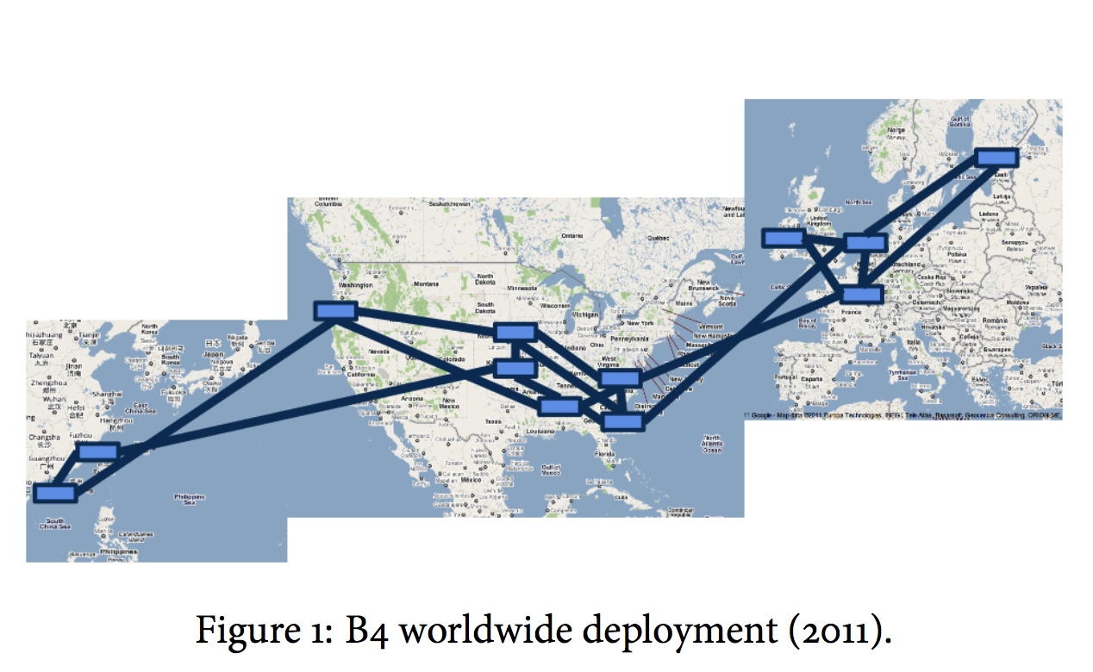
Google’s SD-WAN (B4)

Slide 40
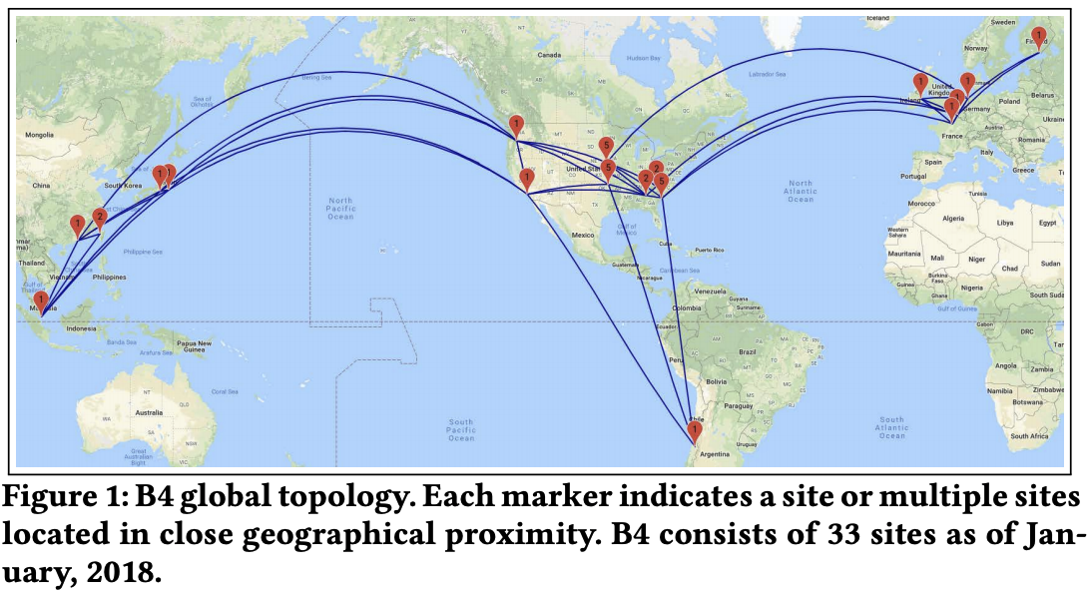
Google’s SD-WAN (B4)

Slide 41
Summary
Abstractions beget modularity
Modularity is (almost always) good
Next lecture: Layer 2

Slide 42
OpenFlow: Controller-to-switch messages
Key controller-to-switch messages
Features: controller queries switch features, switch replies
Configure: controller queries/sets switch configuration parameters
Modify-state: add, delete, modify flow entries in the OpenFlow tables
Packet-out: controller can send this packet out of specific switch port

Slide 43
OpenFlow: Switch-to-controller messages
Key switch-to-controller messages
Packet-in: transfer packet (and its control) to controller. See packet-out message from controller
Flow-removed: flow table entry deleted at switch
Port status: inform controller of a change on a port
Network operators do not “program” switches by creating/sending OpenFlow messages directly.
Instead, they use higher-level abstraction at controller

